Slide 1
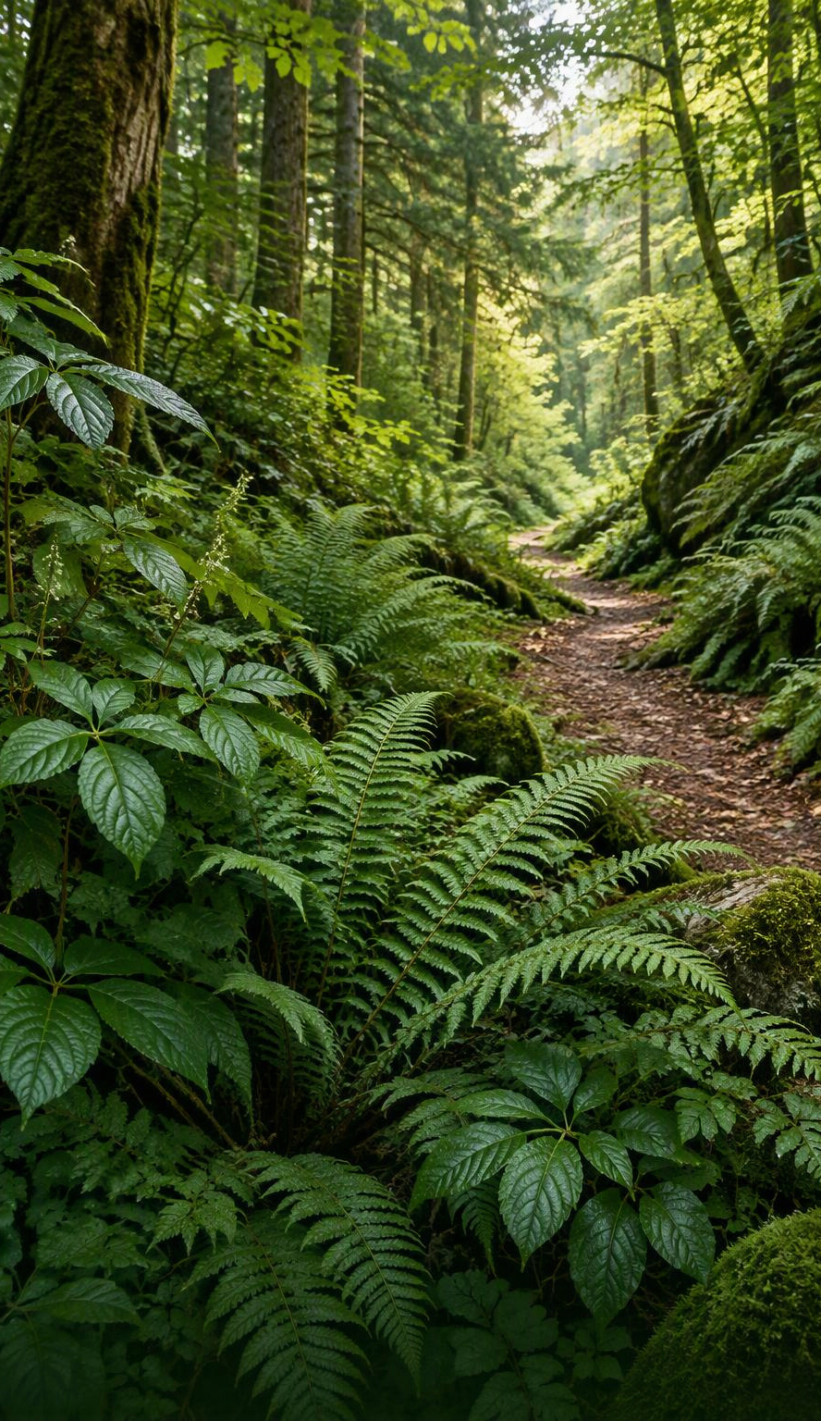
RESEARCH PAPER STUDY
PlantTraitNet
An Uncertainty-Aware Multimodal Framework for Global-Scale Plant Trait Inference from Citizen Science Data
Research paper accepted at the 40th AAAI Conference on Artificial Intelligence (AAAI-26)
https://ojs.aaai.org/index.php/AAAI/article/view/41272
This presentation studies the paper. Unless otherwise noted, all references refer to this paper and the sources cited within it.
Created by: Mayank Dwivedi
Date : 10/16/2026
Notes:
This presentation is a study of the PlantTraitNet paper, not a claim of authorship. Unless otherwise noted, references refer to this paper and the sources cited within it.
[Sources]
https://ojs.aaai.org/index.php/AAAI/article/view/41272
Title, author attribution and AAAI-26 publication verified against the official AAAI article page.
[/Sources]
Cover image: AI-generated conceptual woodland and plant scene. Caption: Explore Nature Together.

Slide 2
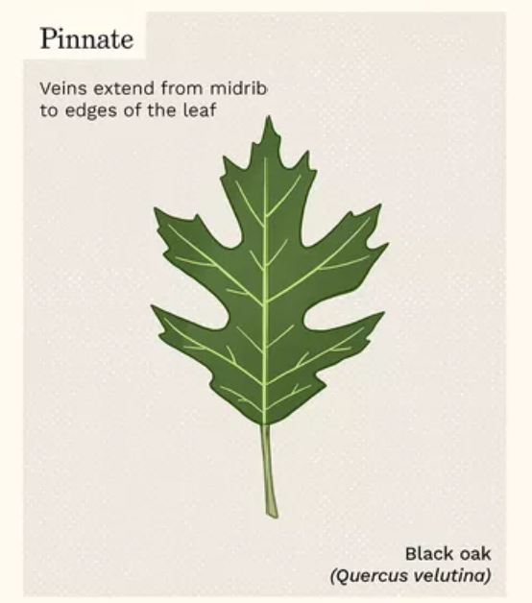
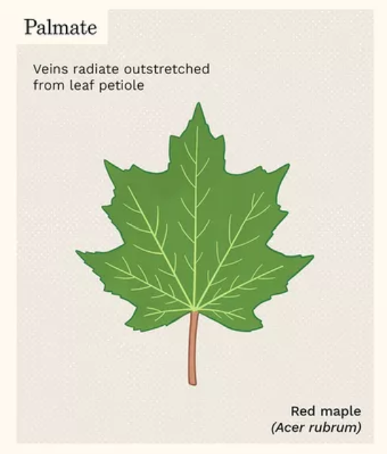
PlantTraitNet: An Uncertainty-Aware Multimodal Framework for Global-Scale
Plant Trait Inference from Citizen Science Data
Plant traits talks about Plant.
What is difference between Oak and Maple Tree
The main difference involve their leaves,
branching patterns, seeds, and bark

Slide 3
PlantTraitNet: An Uncertainty-Aware Multimodal Framework for Global-Scale
Plant Trait Inference from Citizen Science Data
The traits such as plant height, leaf shape-area, nitrogen level are essential for understanding the ecosystem processes.
Challenge – Gathering these traits are cost intensive and sparse geographic coverage is labor intensive and time consuming.
Idea – Citizen Science initiatives offer a largely untapped resources to overcome these limitations. With over 50 million geotagged plant photograph worldwide capturing valuable visual information about plant morphology and physiology.
Paper Introduces PlantTraitNet – A multimodal multitask, uncertainty aware deep learning framework that predicts four key characteristics or traits of plant – plant height, leaf area, specific leaf area, and nitrogen content.

Slide 4
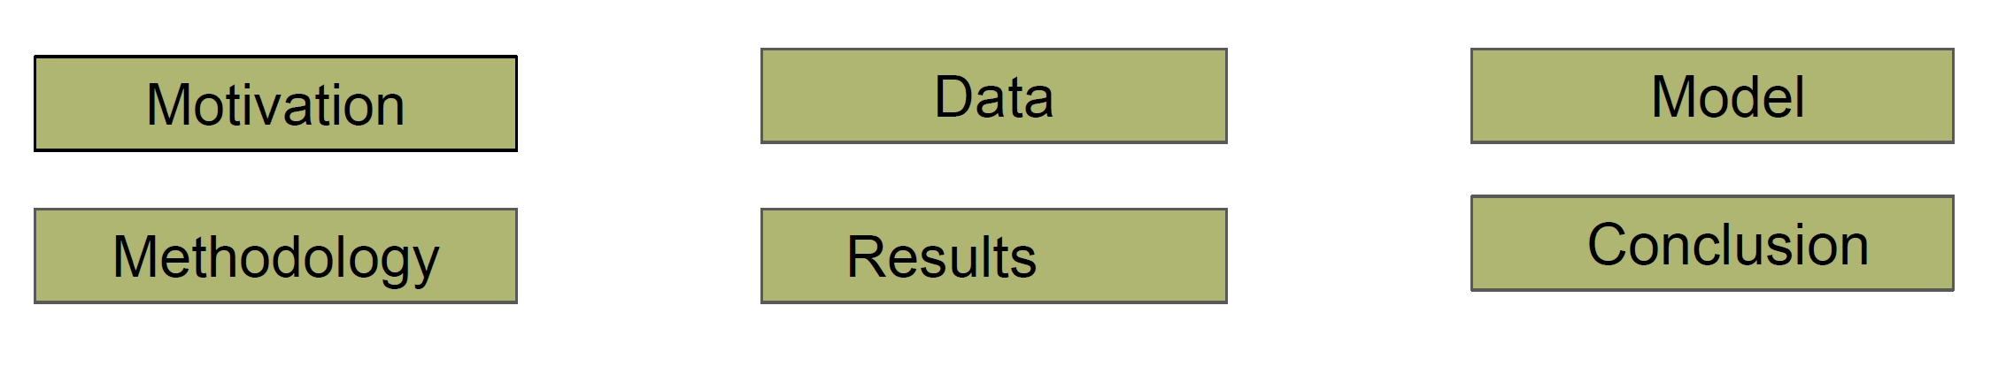
Agenda

Slide 5
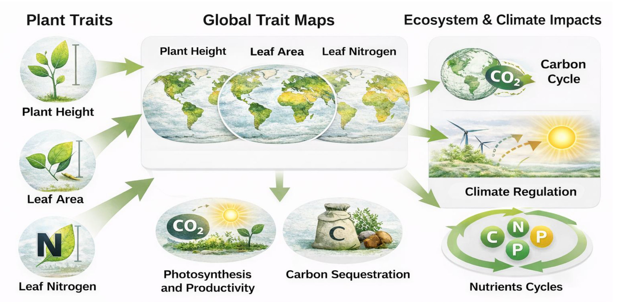
Motivation

Slide 6
PlantTraitNet: An Uncertainty-Aware Multimodal Framework for Global-Scale
Plant Trait Inference from Citizen Science Data
The traits such as plant height, leaf shape-area, nitrogen level are essential for understanding the ecosystem processes.
Challenge – Gathering these traits are cost intensive and sparse geographic coverage is labor intensive and time consuming.
Idea – Citizen Science initiatives offer a largely untapped resources to overcome these limitations. With over 50 million geotagged plant photograph worldwide capturing valuable visual information about plant morphology and physiology.
Paper Introduces PlantTraitNet – A multimodal multitask, uncertainty aware deep learning framework that predicts four key characteristics or traits of plant – plant height, leaf area, specific leaf area, and nitrogen content.

Slide 7
What is PlantTraitNet?
  A multi-modal, multitask uncertainty-aware deep learning framework that predicts four key plant traits (plant height, leaf area, specific leaf area, and nitrogen content) from citizen science photos using weak supervision.
  By aggregating individual traits predictions across space, we generate global map of trait distribution and then validate these maps against independent vegetation survey data (sPlotOpen) and benchmark them against leading global trait products.
  Result showed PlantTraitNet outperforms existing trait map across all evaluation traits, demonstrating that citizen Imagery when integration with computer vision and geospatial AI – Not only the scalable but also more accurate global trait mapping.
  This approach offers a new powerful pathway for ecological research and Earth System Modeling.

Slide 8
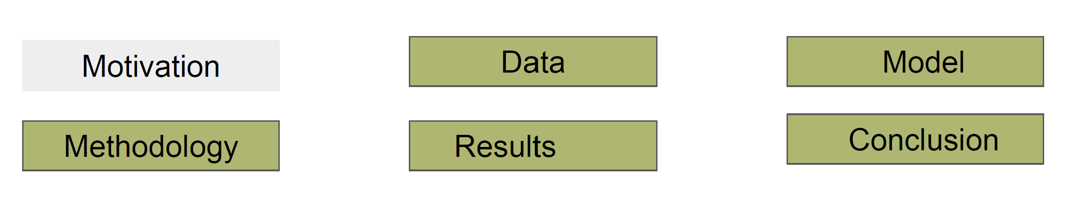
Agenda

Slide 9
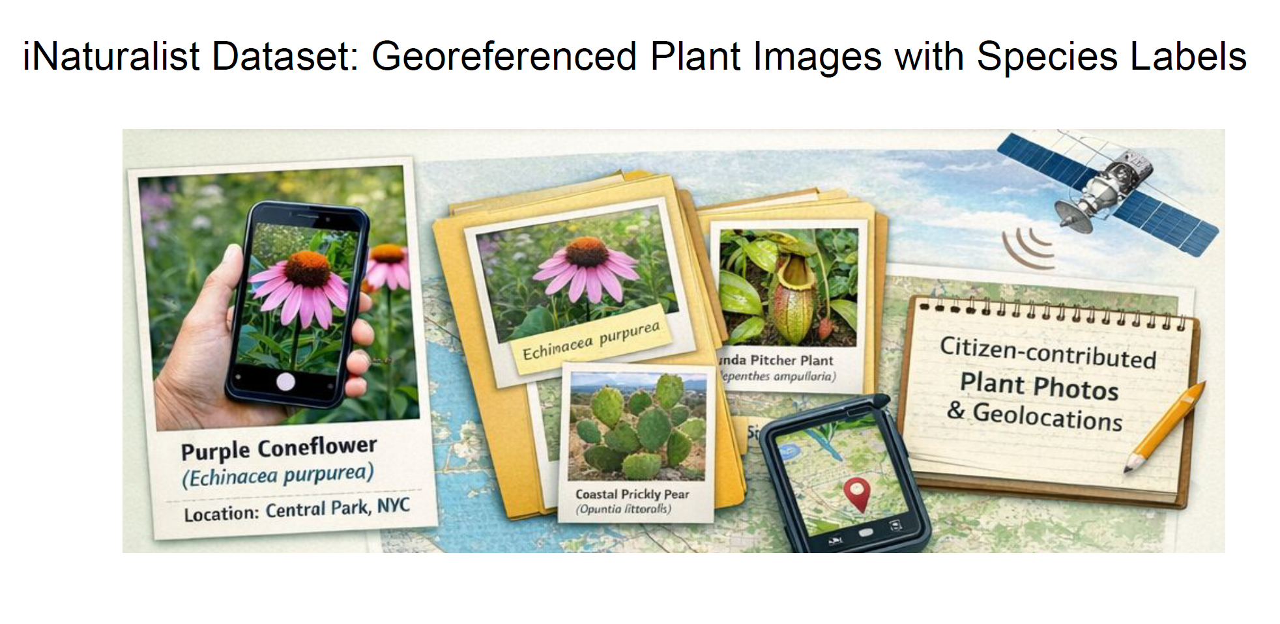
Data Based on Citizen Science Contributions

Slide 10
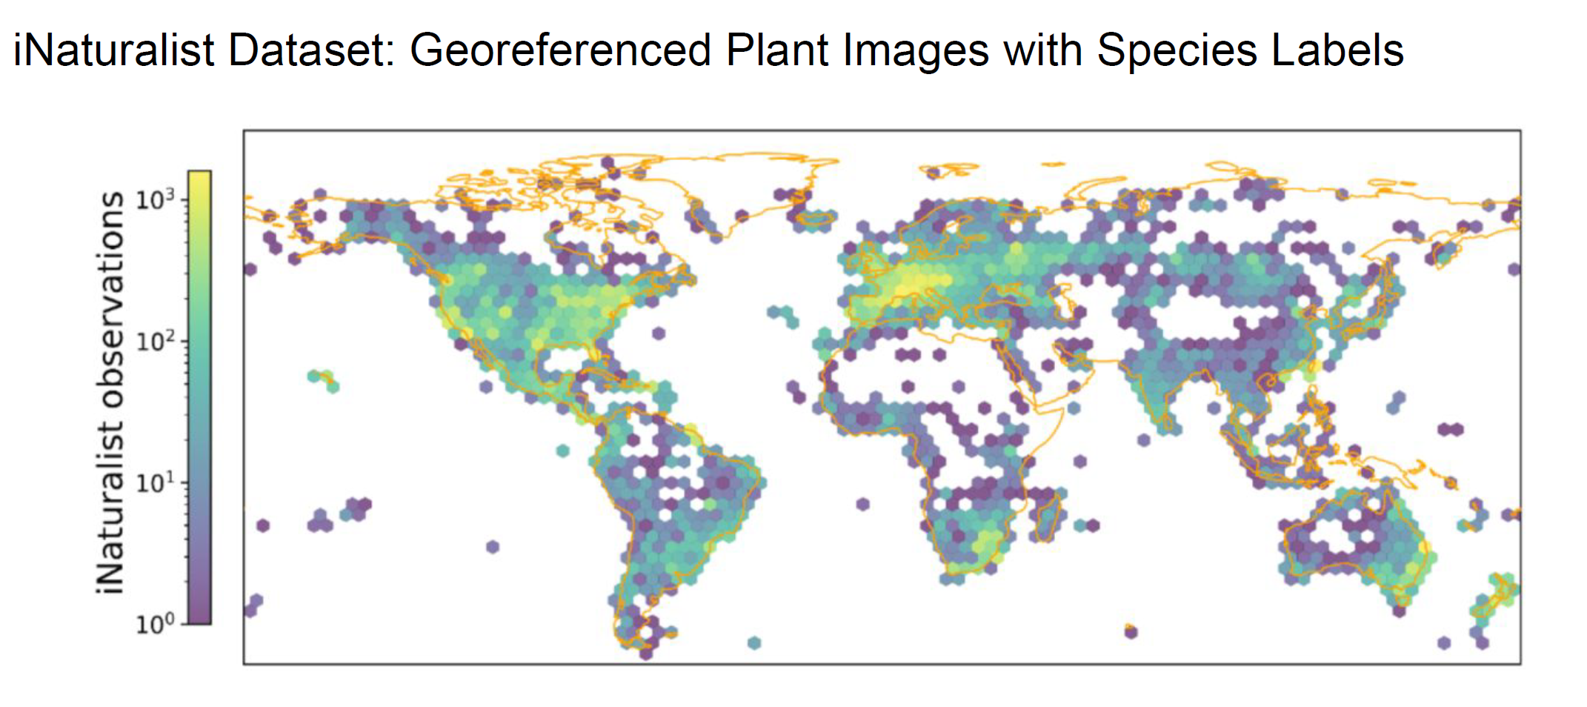
Data Based on Citizen Science Contributions
Reference: GBIF - iNaturalist Research-grade Observations

Slide 11
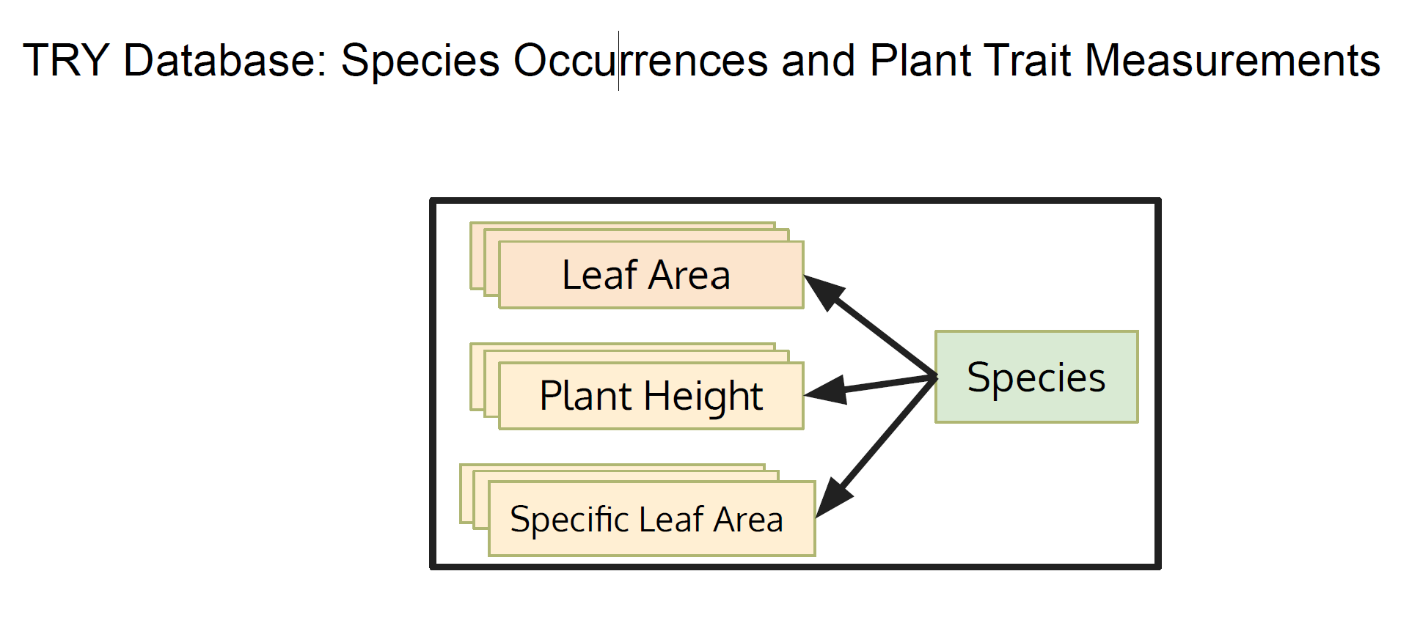
TRY Database : Plant Trait Data
Reference: TRY—A plant trait database of databases

Slide 12
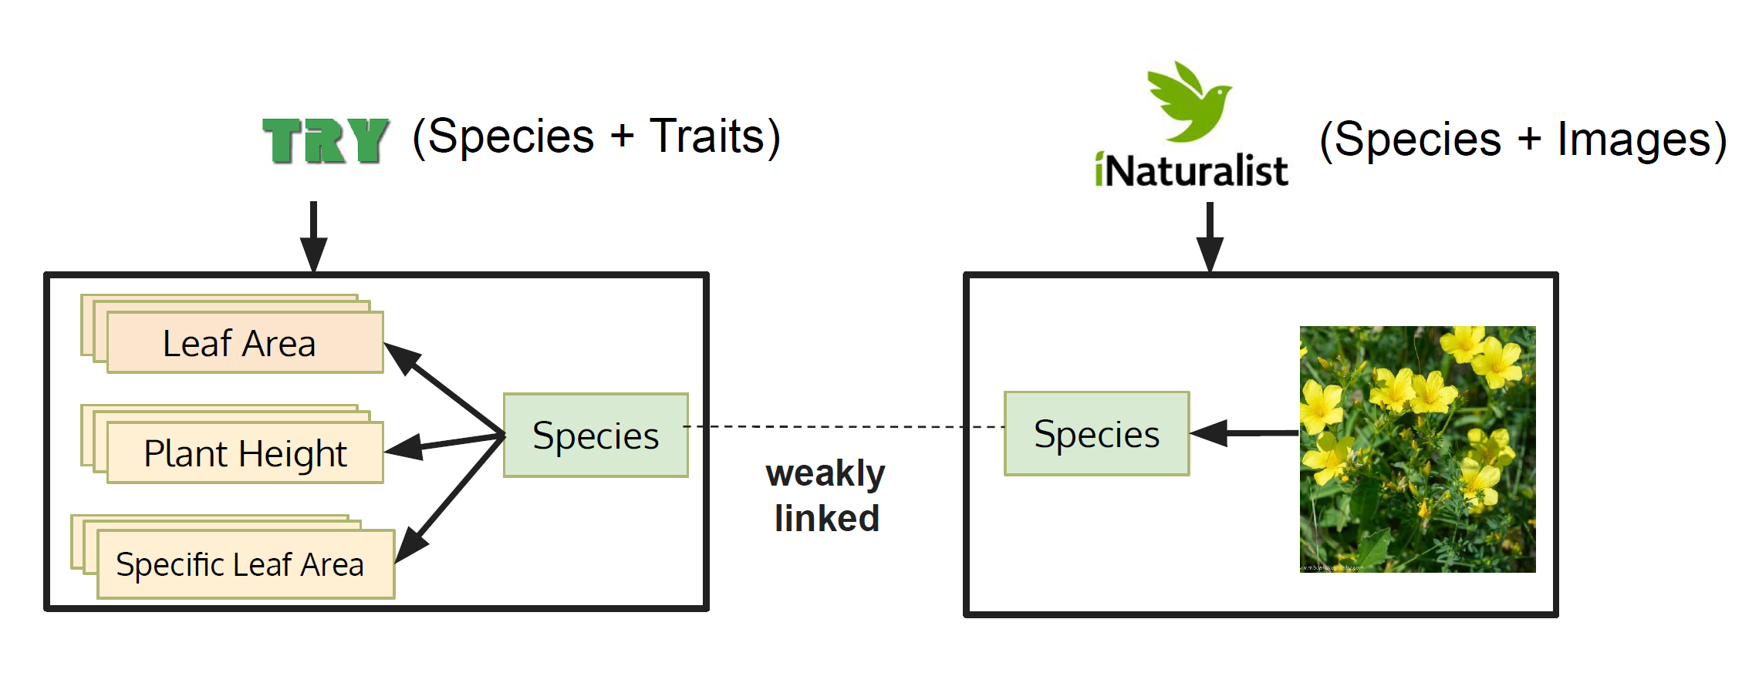
Weak Annotation

Slide 13
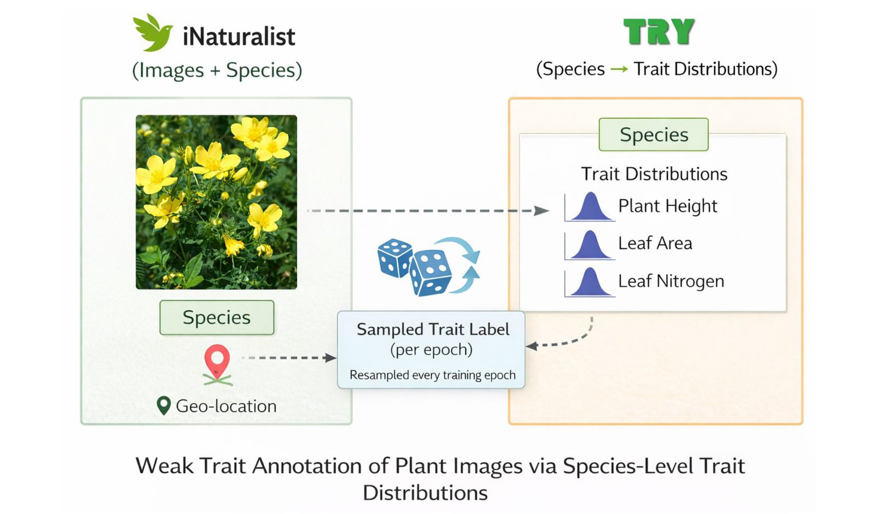
Weak Annotation

Slide 14
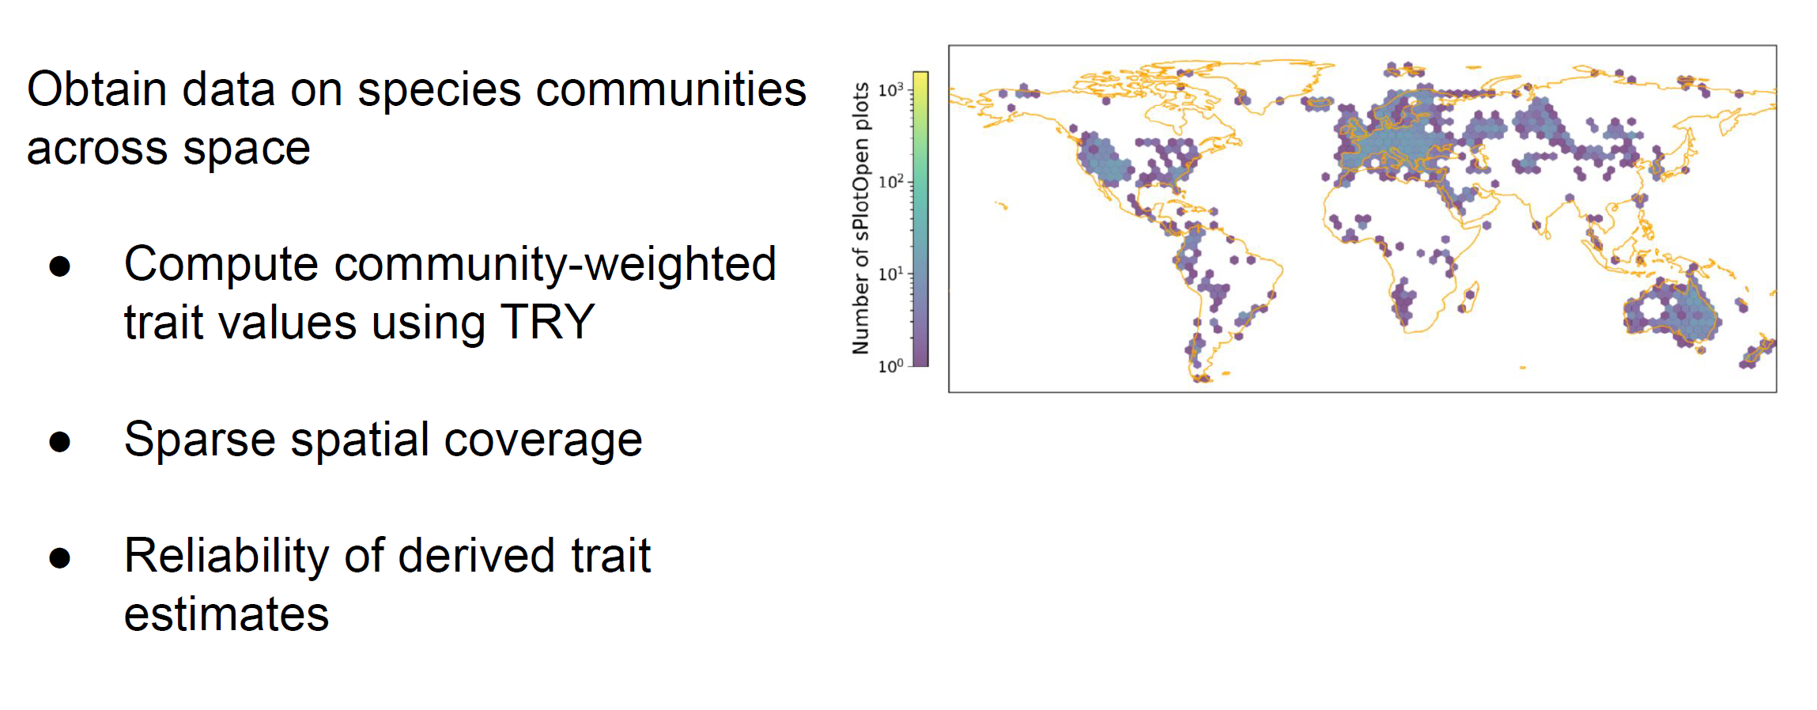
sPlotOpen: A Global Dataset of Vegetation Plot
Reference: sPlotOpen – An environmentally balanced, open-access, global dataset of vegetation plots

Slide 15
Overview of Data
Training Data
  iNaturalist Dataset: Georeferenced Plant Images with Species Labels
  TRY Database: Plant Trait Data
Reference Data
  sPlotOpen (Community weighted trait values)

Slide 16
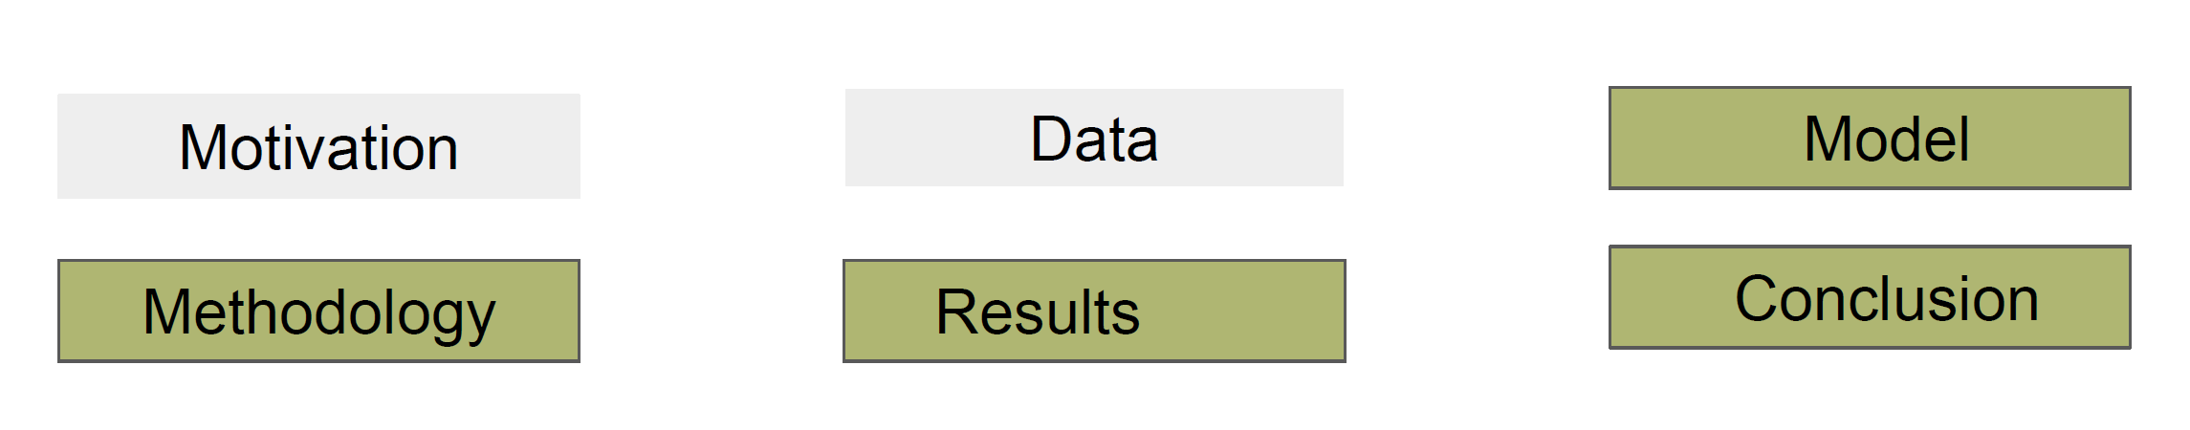
Agenda

Slide 17
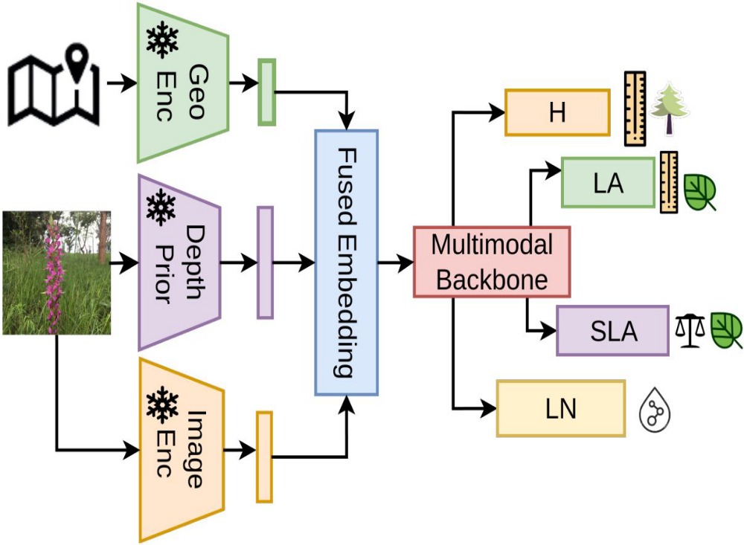
Model
Image
Image Encoder: Vit-b from DINOv2
Depth Encoder: Depth Anything V2 - Vit-b
GeoLocation
Location encoder from Climplicit model
Multimodal Backbone
Resnet blocks
ResNet (Residual Network) blocks serve as a foundational architecture for the vision or "backbone" component.
They are primarily used to extract rich visual features from images before combining them with other modalities
like text or audio.

Slide 18
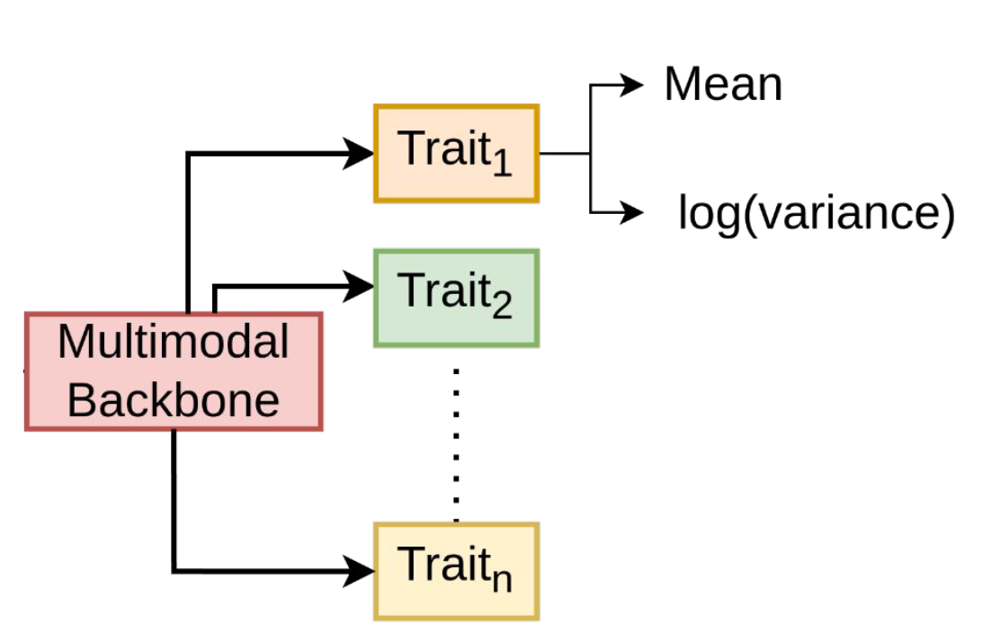
Model Training

Slide 19
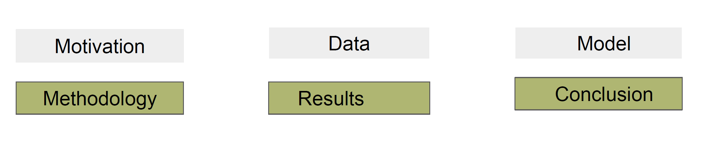
Agenda

Slide 20
How are Plant traits captured?
Collect plant photos. Gather research-grade, geotagged plant photographs from citizen-science platforms such as iNaturalist and Pl@ntNet (over 50 million images). These provide species labels but no trait measurements.
Take trait values from TRY. Use the TRY global plant trait database, which holds species-level trait measurements such as canopy height, leaf area, leaf nitrogen and leaf dry matter content.
Add geospatial context. Use each photo’s location to get climate and satellite-based context from geospatial foundation models: Climplicit (climate) and SatCLIP (satellite Earth observation).
Match by species name. Link each photo’s species name to the TRY database and assign that species’ trait values to the image as weak (indirect) labels.

Slide 21
How are Plant traits captured? Continued …
Build the training dataset. The result is a large trait-annotated image dataset. It is noisy, with feature noise from varied photo quality and label noise from species-level weak labels.
Train the multi-trait model. Train an uncertainty-aware probabilistic deep learning model that predicts several traits at once. It combines visual features from the image with the geospatial embeddings.
Predict traits with uncertainty. For each photo, the model outputs trait predictions along with an estimate of its own uncertainty. Highly uncertain (noisy) samples are down-weighted during training and filtered out as unreliable.
Aggregate into global maps. Group the per-photo predictions by their geotags and aggregate them spatially to produce global, gridded maps of plant trait distributions across ecosystems.

Slide 22
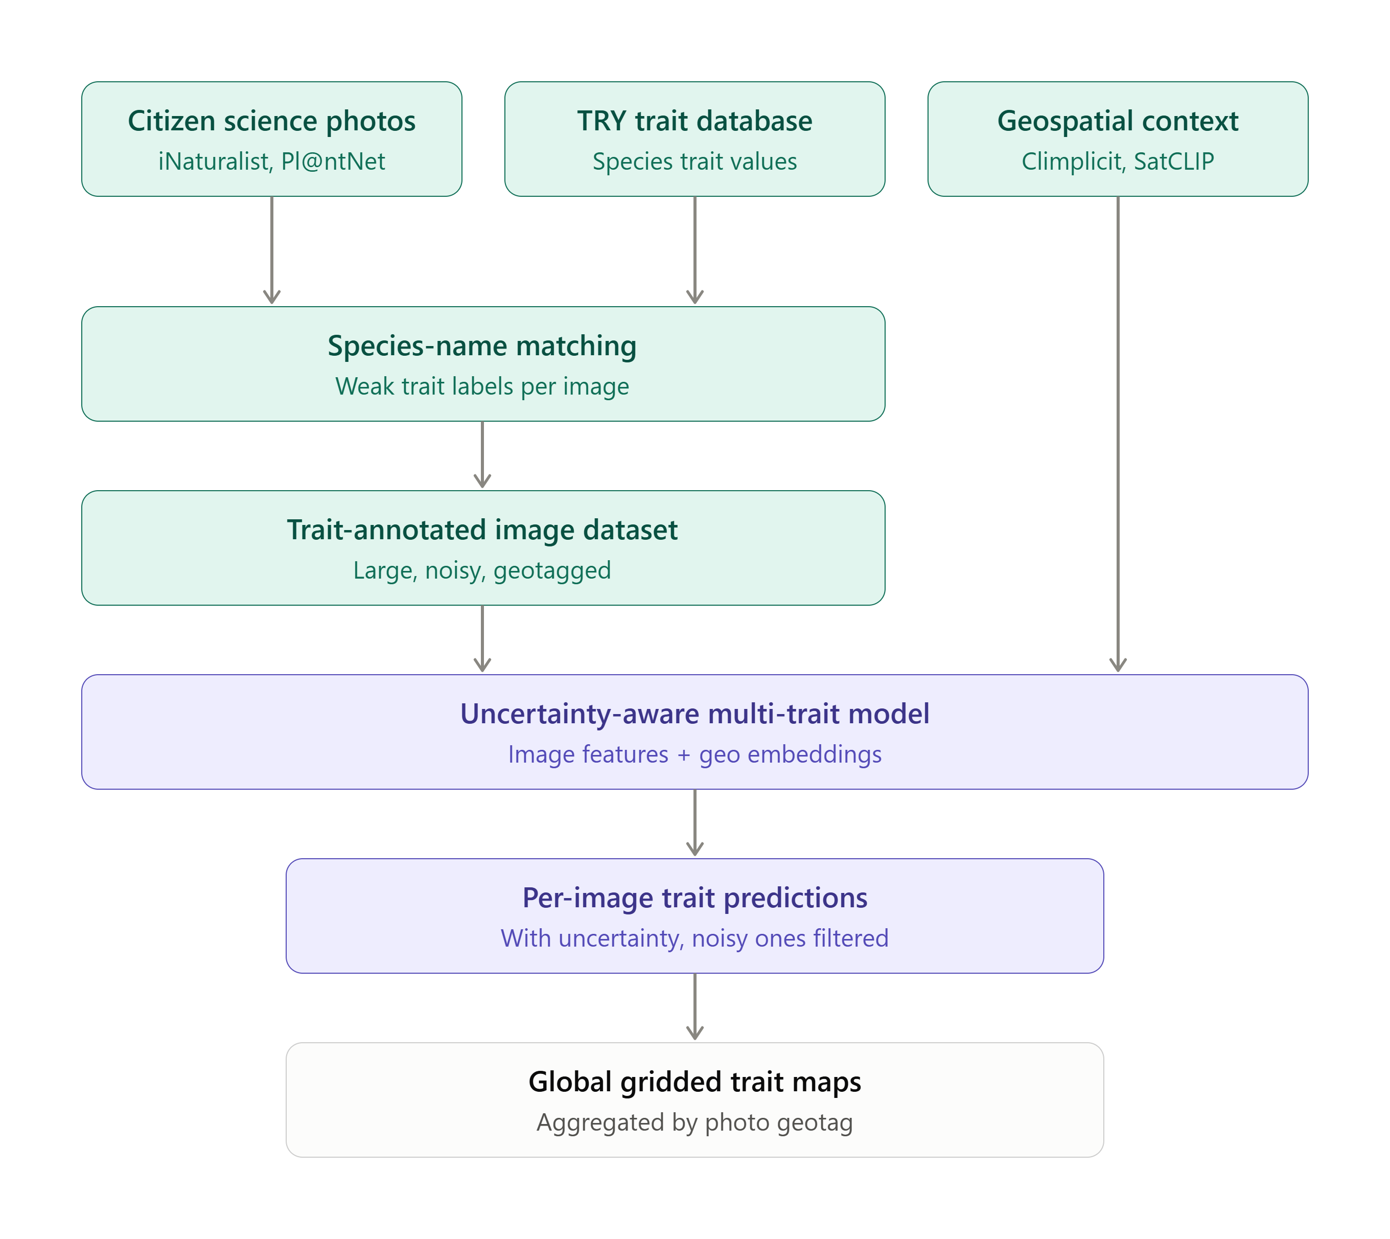
How are Plant traits captured – Flow Diagram

Slide 23
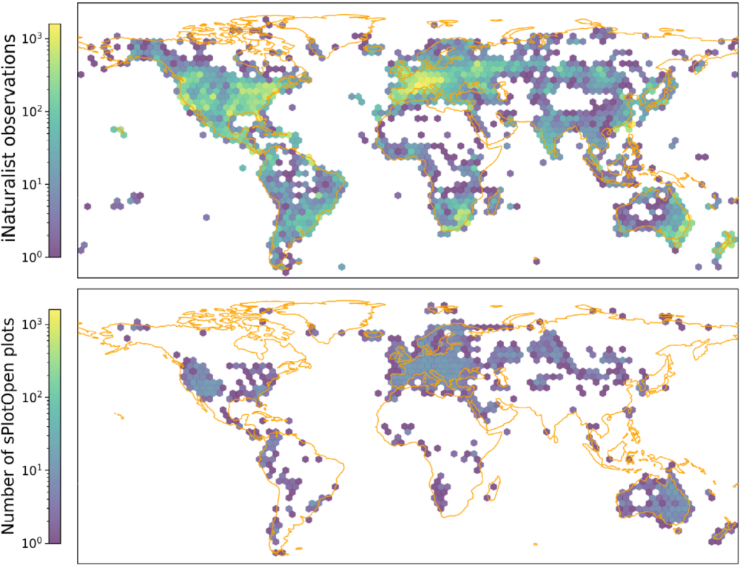
Geographic Coverage of citizen science data (top)
Independent benchmark sPlotOpen Survey(bottom)

Slide 24
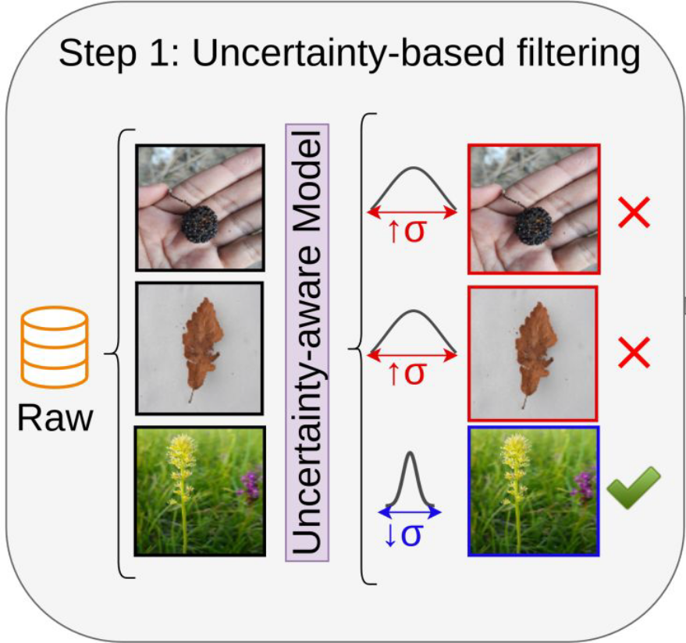
Step 1: Uncertainty aware Filtering
Images with high predictive uncertainty are excluded to
improve label reliability

Slide 25
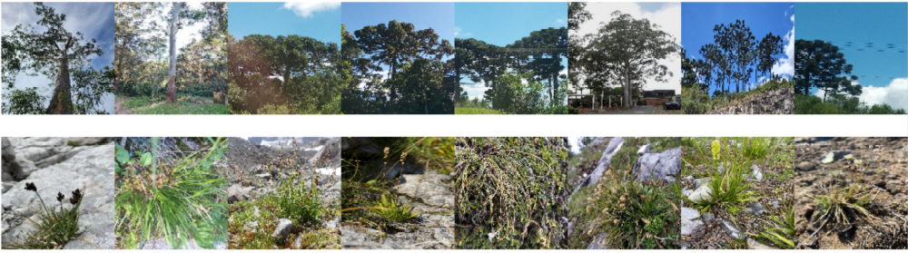
Limitation - Heteroscedasticity
Higher Uncertainty for taller plants.

Slide 26
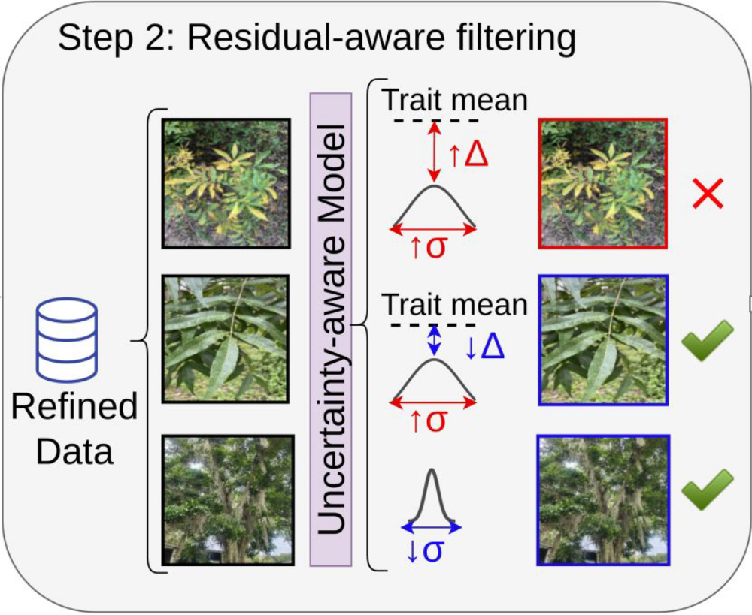
Step 2: Residual aware Filtering
Remove Images with high uncertainty and high residual error
Helps to mitigate extreme noisy label

Slide 27
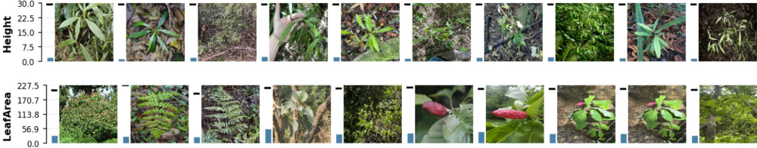
Residual Aware Filtering

Slide 28
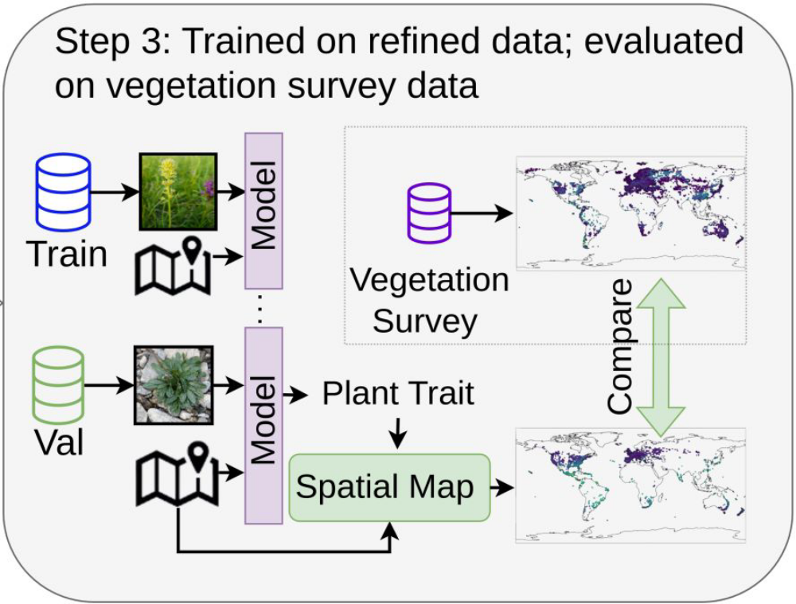
Step 3: Training and Evaluation
Train the model
Aggregate spatial using geolocation.
Evaluate against sPlotOpen

Slide 29
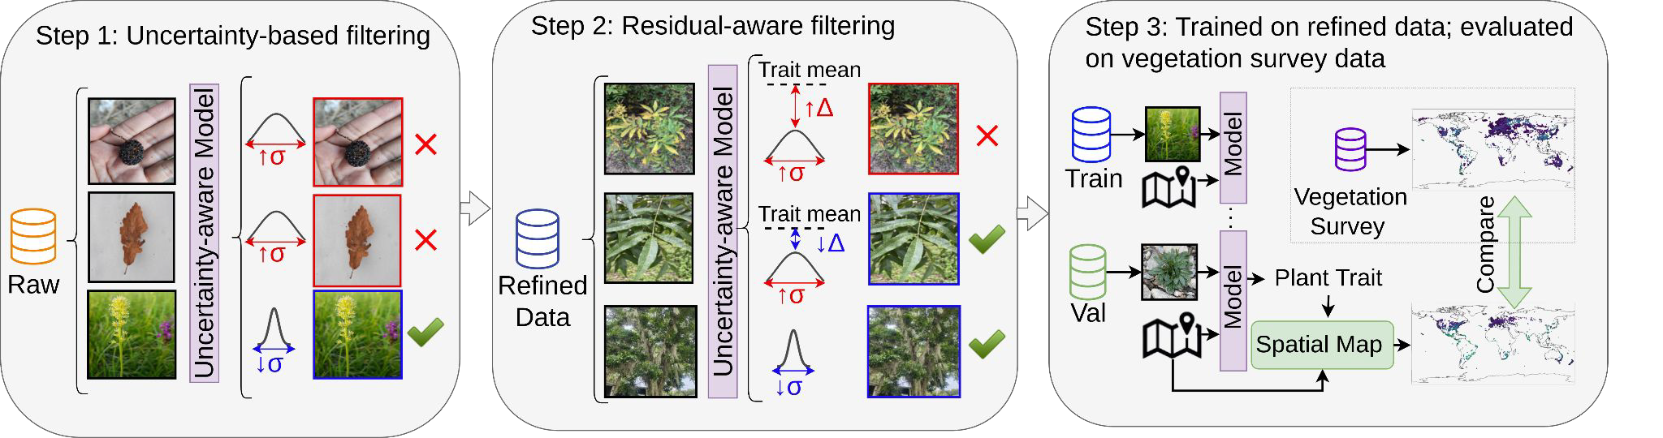
Overview: An uncertainty-aware Framework

Slide 30
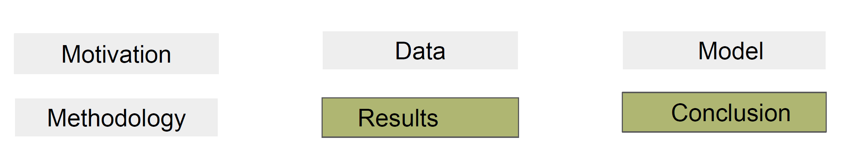
Agenda

Slide 31
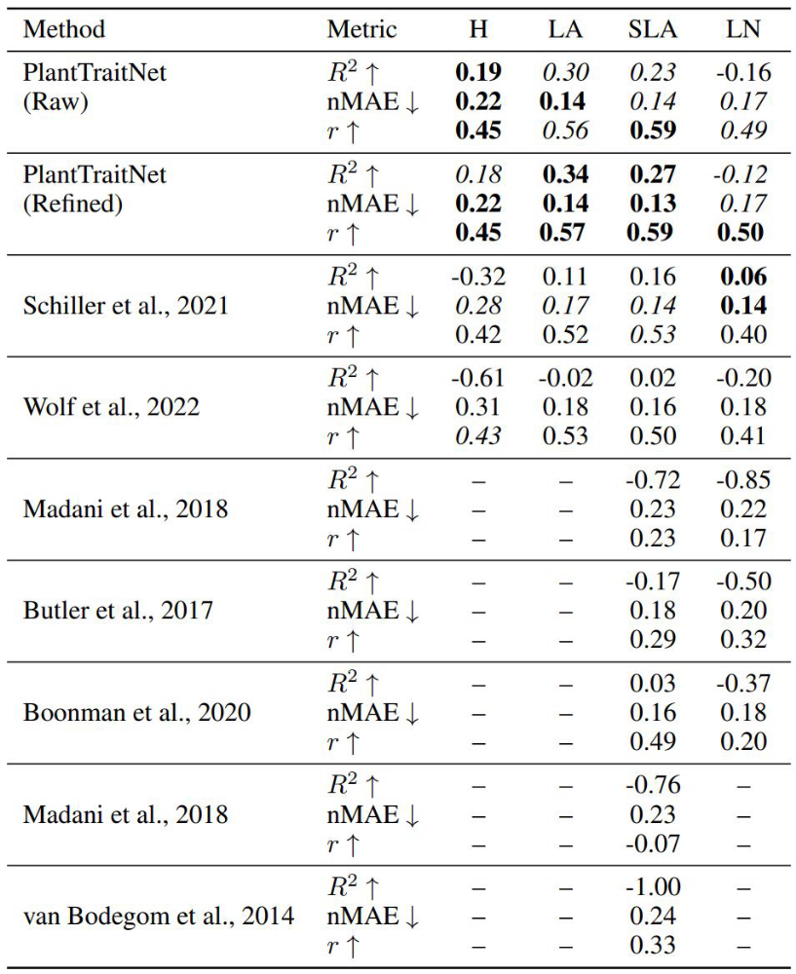
Baseline
Takeaway
Uncertainty-aware filtering helps in performance
improvement for most traits
PlantTraitNet outperforms previous methods for
plant height, leaf area and specific leaf area
The coefficient of determination (R²) : quantifies the proportion of variance in observed
trait values explained by the predictions
The normalized mean absolute error (nMAE) measures: The average deviation normalized
by the observed trait range.
Pearson’s correlation coefficient (r) on log-transformed values quantifies the linear
relationship between predicted and observed data.

Slide 32
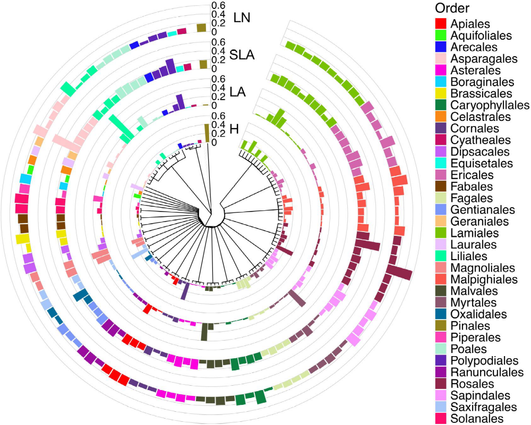
Phylogenetic Correlation
Takeaway
No systematic bias observed.
Mean relative prediction error (MRPE) computed on
validation data at the family level, visualized along
the taxonomic tree, for height (H), leaf area (LA),
specific leaf area (SLA) and leaf nitrogen (LN).

Slide 33
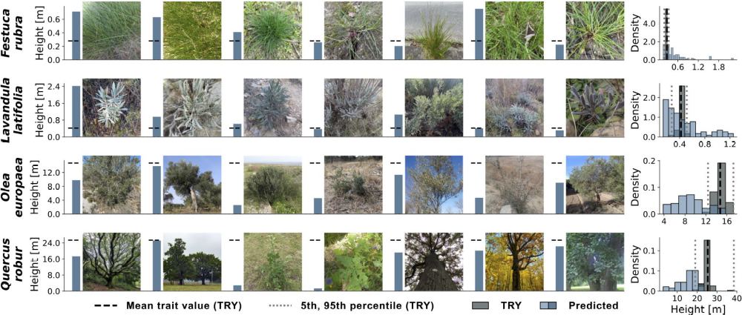
Intra Species Variation
Takeaway
Model Predictions capture trait variability within the species.

Slide 34
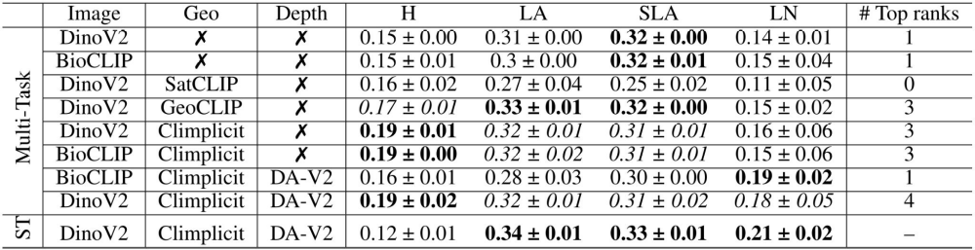
Ablation

Slide 35
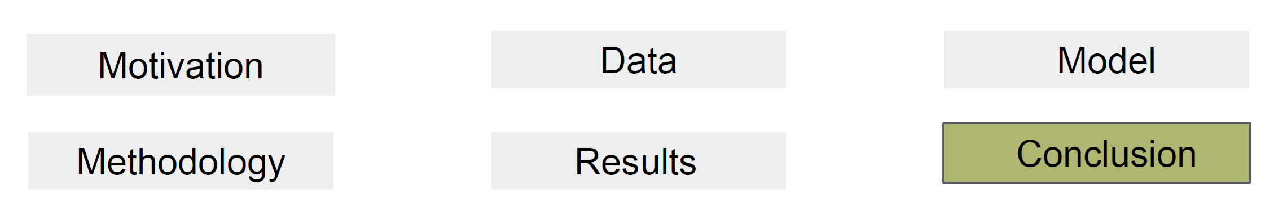
Agenda

Slide 36
Conclusion
Citizen science images paired with labels from scientific databases (TRY) enable inference of functional traits
Uncertainty-aware deep learning improves robustness to noisy citizen science images
Our model generalizes across species and captures intra-species variation.
Our approach outperforms prior work on most traits in a global benchmark

