Slide 1

SQL PROJECT FOR PIZZA SALES DATA

Slide 2

NAME : MAYANK GADIYA
PROJECT : PIZZA SALES ANALYSIS
GITHUB LINK:
DESCRIPTION:
Used SQL to perform analytics on pizza sales. performed a variety of tasks, including as totaling sales, obtaining the best-selling items, allocating pizza orders by category, and analyzing cumulative income over time using simple to complex SQL queries.

Slide 3
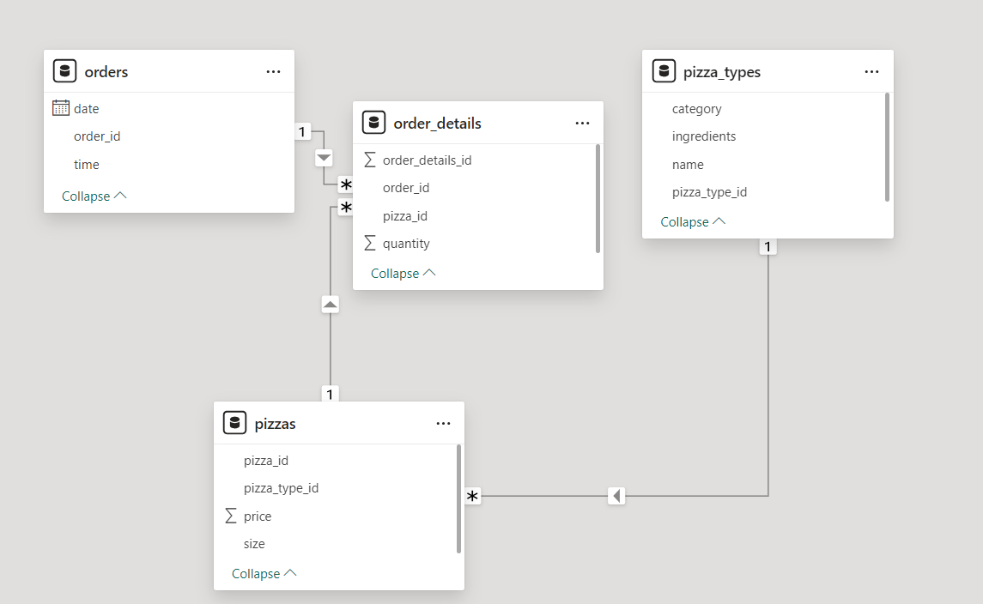
SCHEMA

Slide 4
SQL QUERIES
BASIC
INTERMEDIATE
ADVANCED
Retrieve the total number of orders placed.
Calculate the total revenue generated from pizza sales.
Identify the highest-priced pizza.
Identify the most common pizza size ordered.
List the top 5 most ordered pizza types along with their quantities.
Join the necessary tables to find the total quantity of each pizza category ordered.
Determine the distribution of orders by hour of the day.
Join relevant tables to find the category-wise distribution of pizzas.
Group the orders by date and calculate the average number of pizzas ordered per day.
Determine the top 3 most ordered pizza types based on revenue.
Calculate the percentage contribution of each pizza type to total revenue.
Analyze the cumulative revenue generated over time.
Determine the top 3 most ordered pizza types based on revenue for each pizza category.

Slide 5
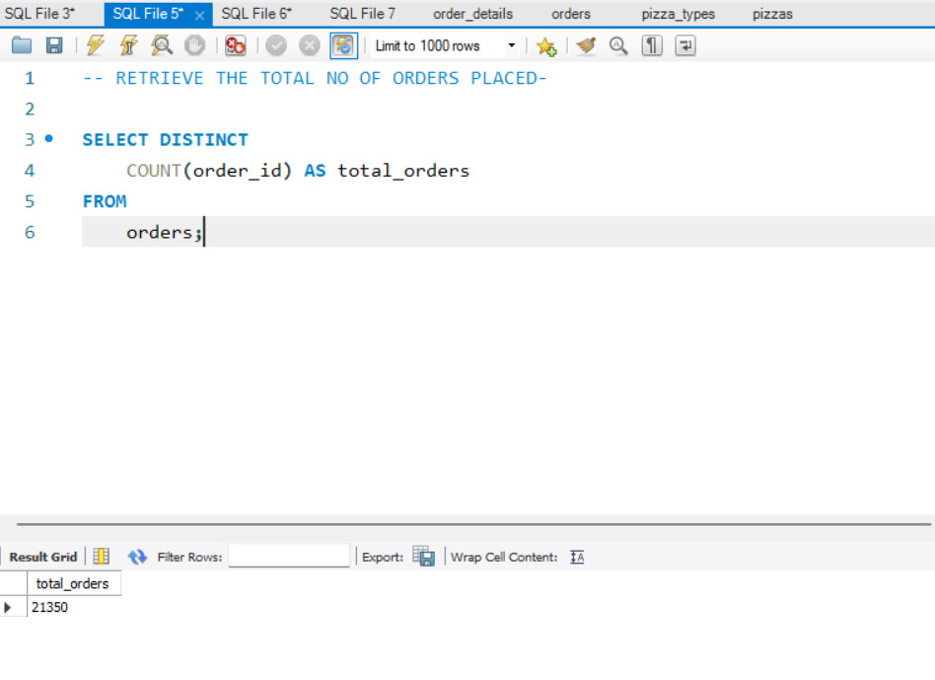
Retrieve the total number of orders placed.

Slide 6
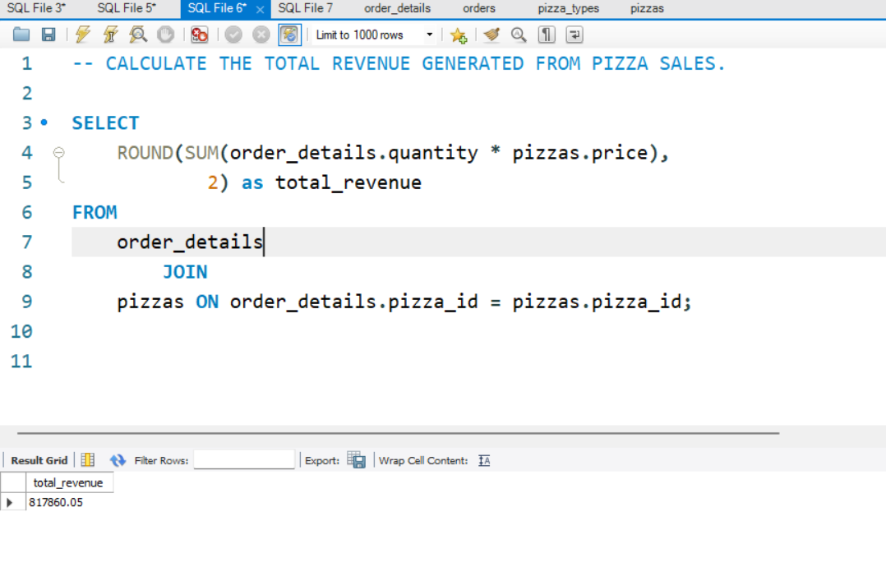
Calculate the total revenue generated from pizza sales.

Slide 7
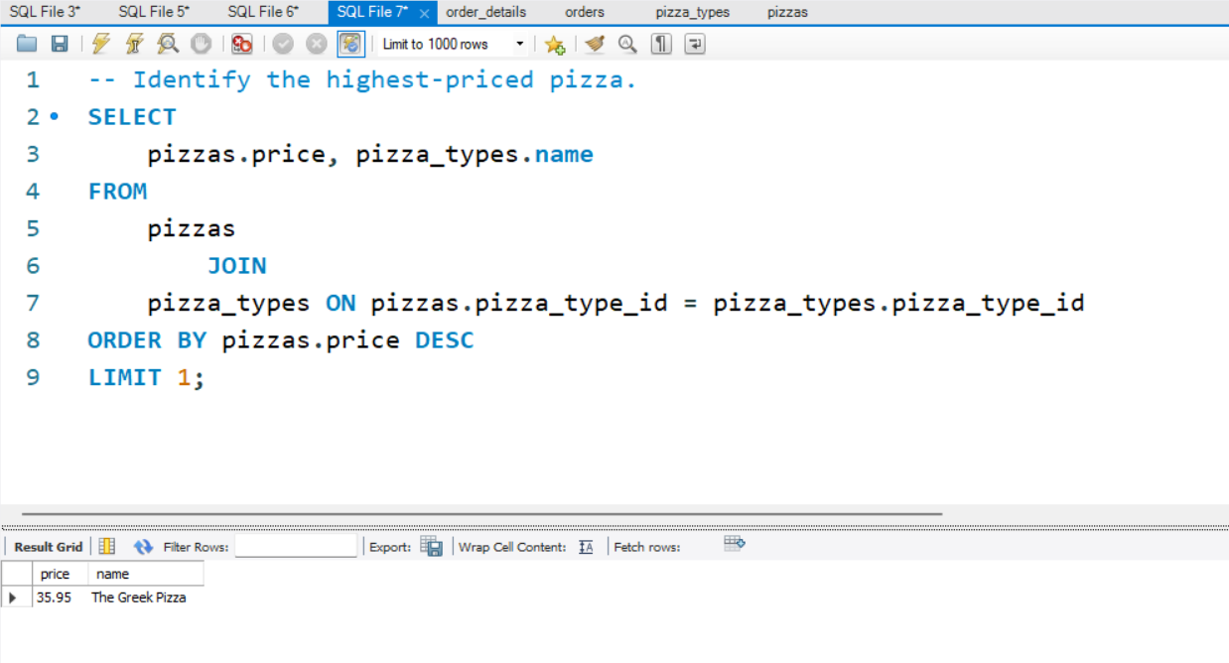
Identify the highest-priced pizza

Slide 8
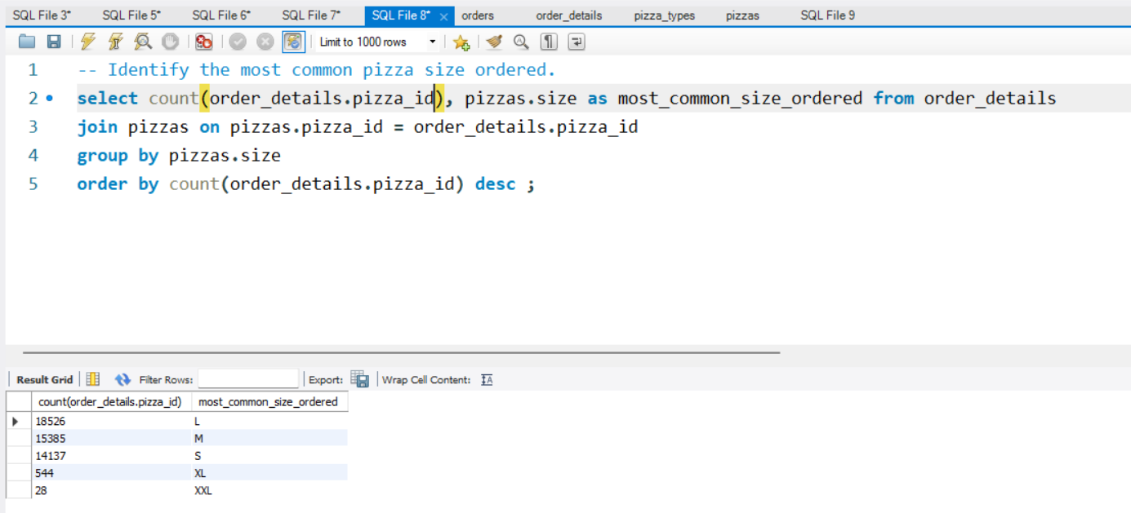
Identify the most common pizza size ordered.

Slide 9
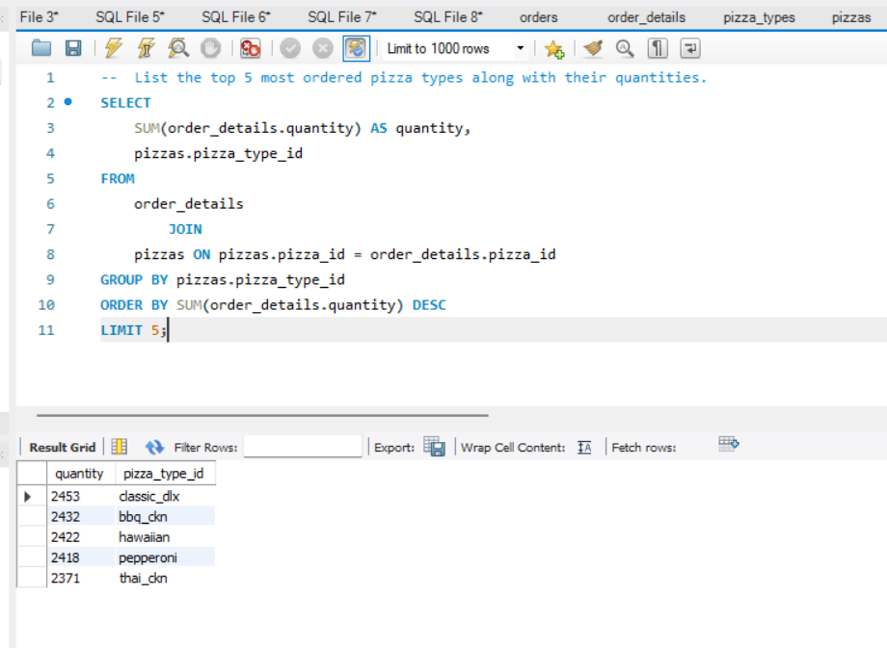
List the top 5 most ordered pizza types along with their quantities.

Slide 10
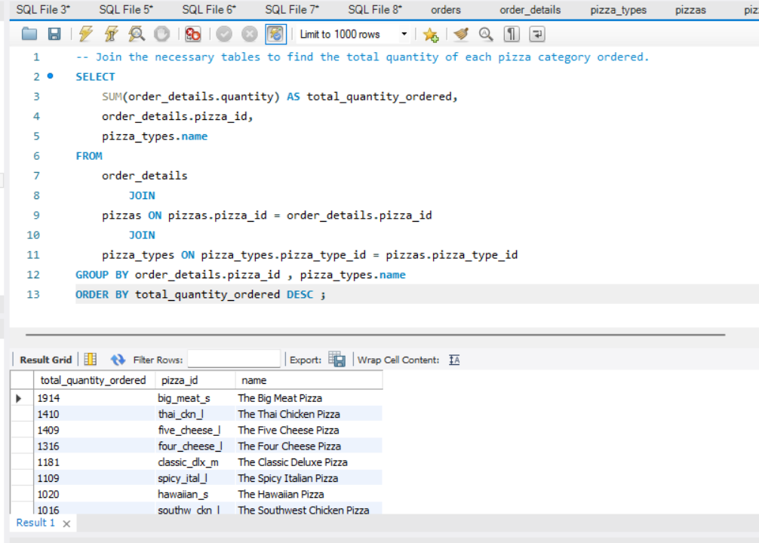
Join the necessary tables to find the total quantity of each pizza category ordered.

Slide 11
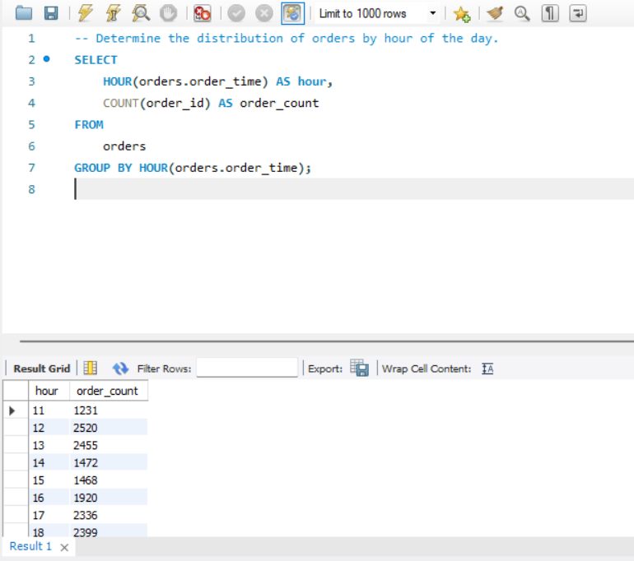
Determine the distribution of orders by hour of the day

Slide 12
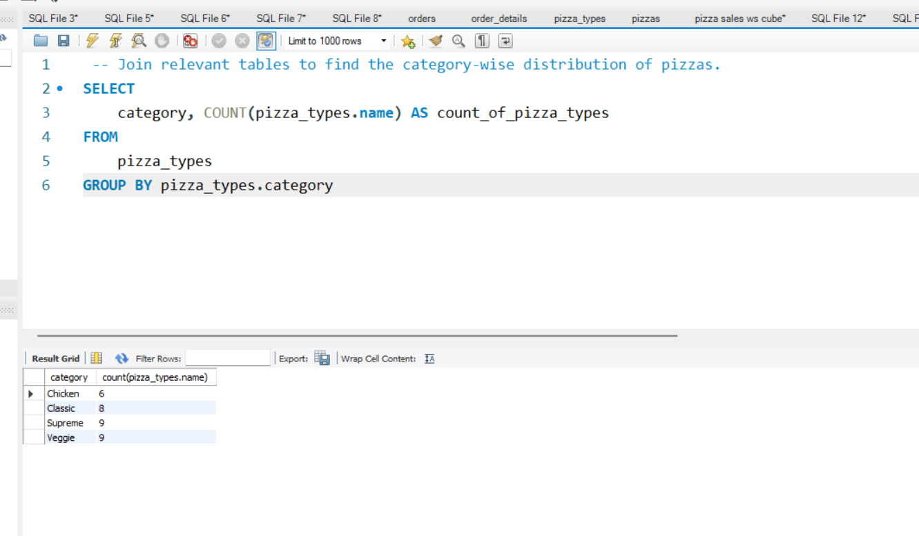
Join relevant tables to find the category-wise distribution of pizzas

Slide 13
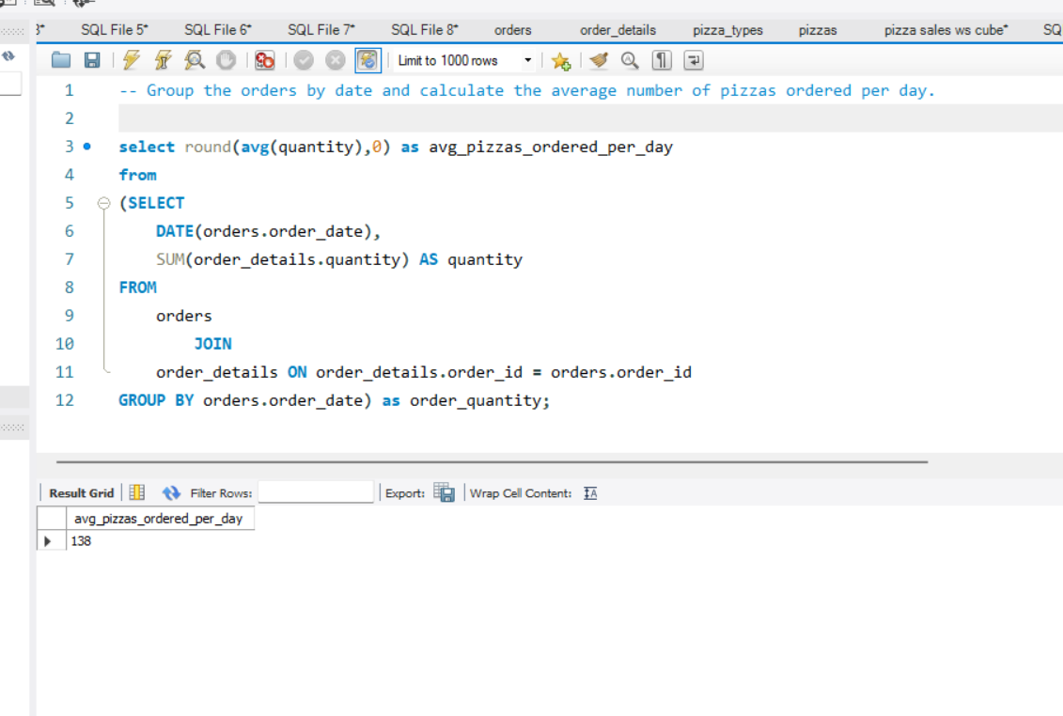
Group the orders by date and calculate the average number of pizzas ordered per day

Slide 14
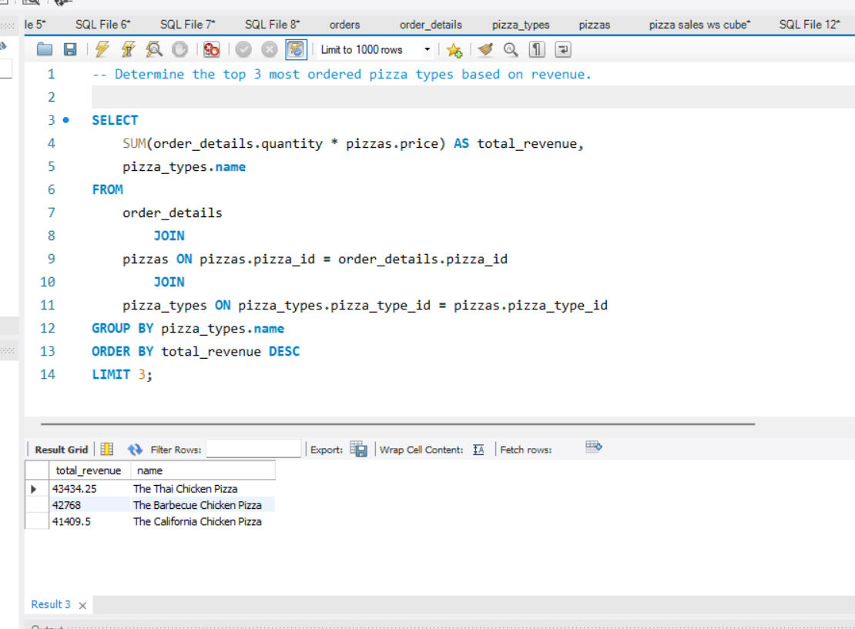
Determine the top 3 most ordered pizza types based on revenue

Slide 15
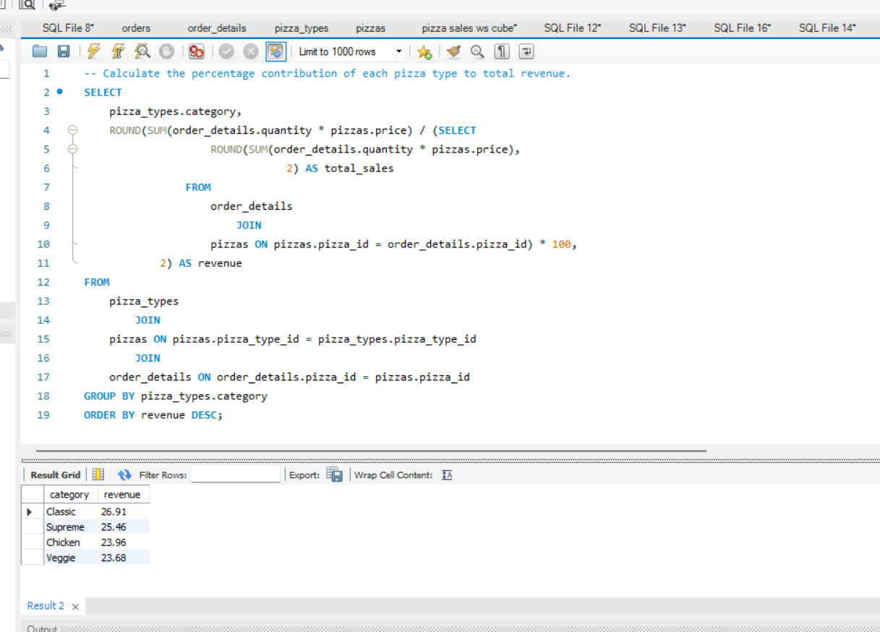
Calculate the percentage contribution of each pizza type to total revenue.

Slide 16
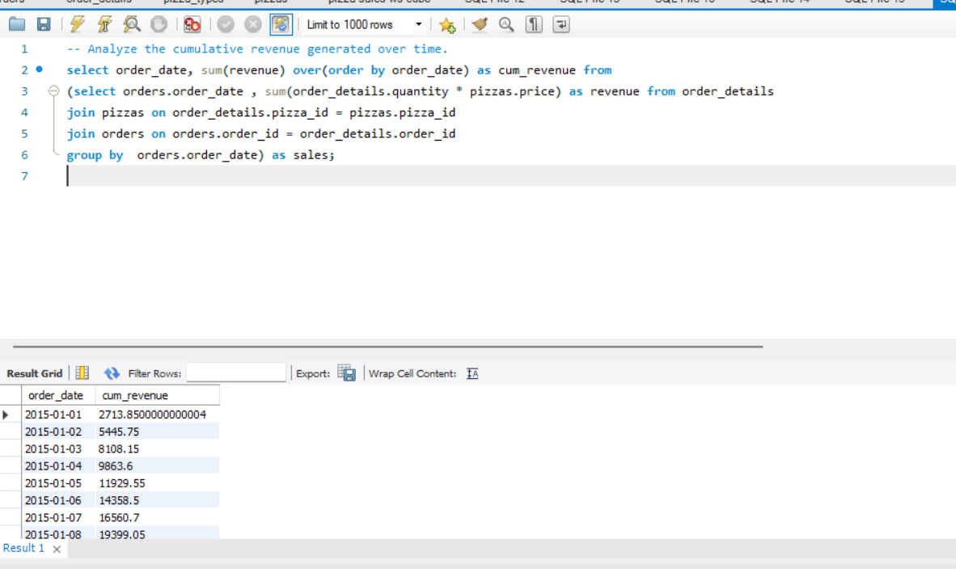
Analyze the cumulative revenue generated over time.

Slide 17
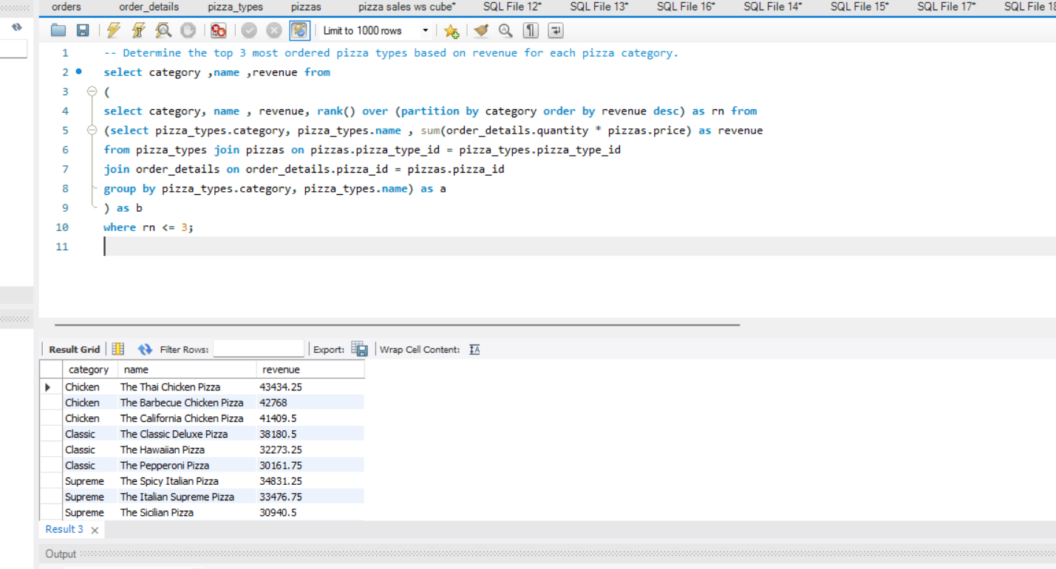
Determine the top 3 most ordered pizza types based on revenue for each pizza category.

Slide 18
THANK YOU

