Slide 1
CREDIT CARD FRAUD DETECTION WITH PREDICTIVE ANALYTICS
PREDICTIVE ANALYTICS PROJECT GROUP 13
MAYANK GOEL (2024H1540832P)

Slide 2


PROBLEM STATEMENT & OBJECTIVES
Problem Statement
Detecting fraudulent transactions from all credit card transactions is challenging due to the dataset's inherent complexities.
Rare Fraud Occurrences: Generally, only 0.1% of transactions are fraudulent.
Reduces fraud detection accuracy.
Objective
Build robust classifier models to detect credit card fraud in an imbalanced dataset effectively
Assess performance using AUPRC, Recall, and confusion matrices to ensure reliable fraud detection.

Slide 3
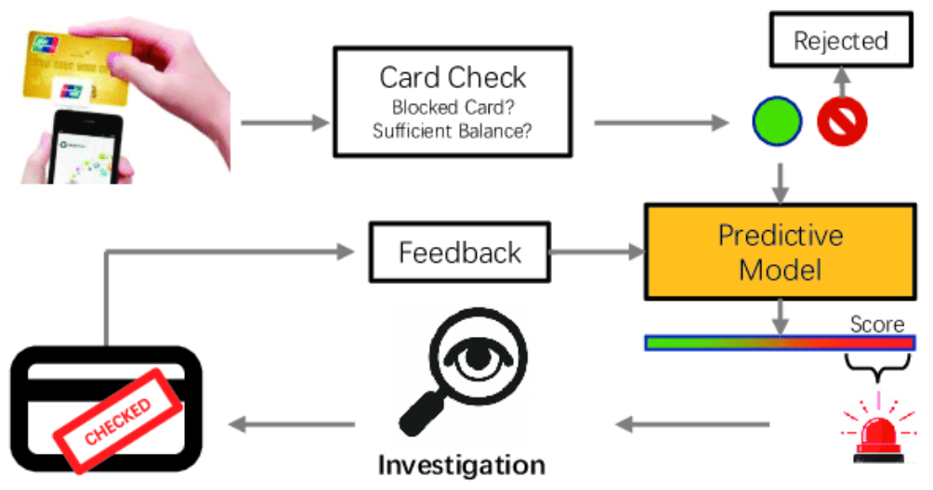
DATASET OVERVIEW
Transactions: 48‐hr window, European cardholders.
Fraud Ratio: 0.172%
Feature breakdown: 28 PCA components + 2 raw (Time, Amount).
Target Variable: Class is 1 for fraud, 0 for legitimate transactions.

Slide 4
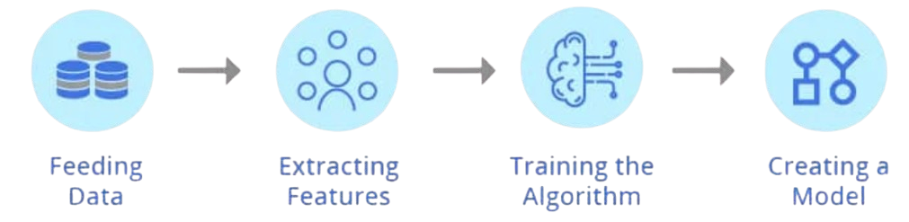
METHODOLOGY OVERVIEW
Modeling
Exploratory Data Analysis
RandomForest (baseline)
LightGBM
LightGBM + Cross - Val
XGBoost
XGBoost + Cross‑Val + SMOTE
Class distribution, temporal & amount patterns, PCA component behavior.
Preprocessing
Evaluation
Standard‑scale Time & Amount
Stratified 60/20/20 split (182,276 / 45,569 / 56,962)
Primary: AUPRC
Secondary: ROC‑AUC, Precision, Recall, Confusion Matrix

Slide 5

DATA PREPROCESSING
Feature Scaling:
PCA features (V1–V28) were already normalized.
Time and Amount were standardized using StandardScaler to align with PCA scales.
Temporary EDA features (e.g., Hour, Log_Amount) were dropped to avoid redundancy.
Data Splitting:
Split: 60% Train, 20% Validation, 20% Test.
Stratified splitting preserved the rare fraud ratio (~0.172%) across all sets.
Ensured representativeness: ~316 frauds (train), 78 (val), 98 (test).
Random state set to 2018 for reproducibility.

Slide 6
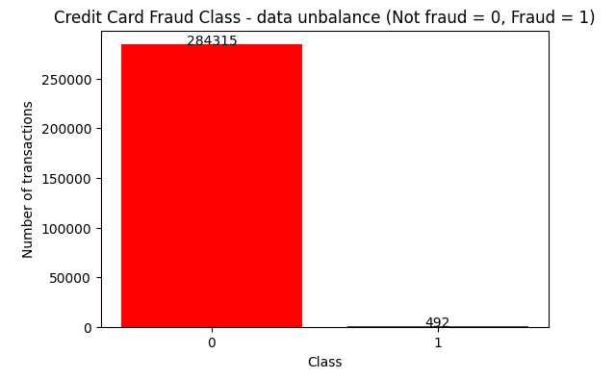
EDA – CLASS IMBALANCE
Count plot of Class distribution
Fraud = 492 / 284,807 ≈ 0.172% → naïve accuracy ≈ 99.8% but 0% recall.
Motivates AUPRC over accuracy.

Slide 7
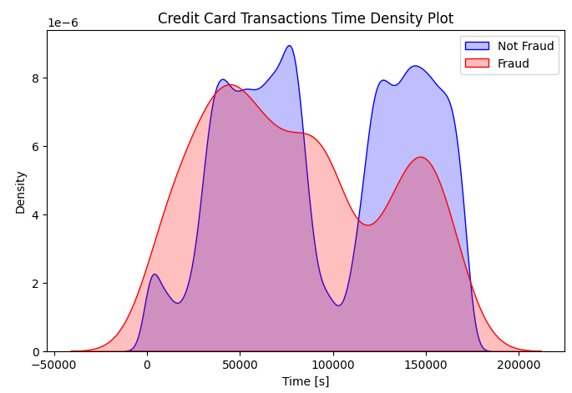


EDA – TRANSACTION TIME ANALYSIS
Non‑fraud
Strong daytime peaks (user activity cycles).
Fraud
Nearly uniform across 0–23 hrs (even low‑activity nighttime) ​
Implies Time carries discriminative signal despite PCA anonymity.
Overlaid histograms of Time by Class

Slide 8
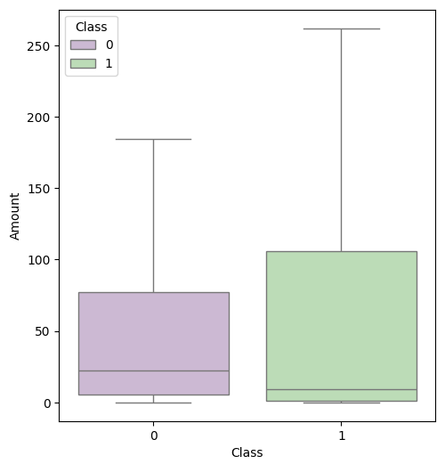
EDA – TRANSACTION AMOUNT ANALYSIS
Non‑fraud:
Higher mean/Q1, more extreme outliers.
Fraud:
Lower mean/Q1 but heavier Q4, fewer extreme outliers
Amount skew is a useful signal for separation.
Boxplots of Amount by Class

Slide 9
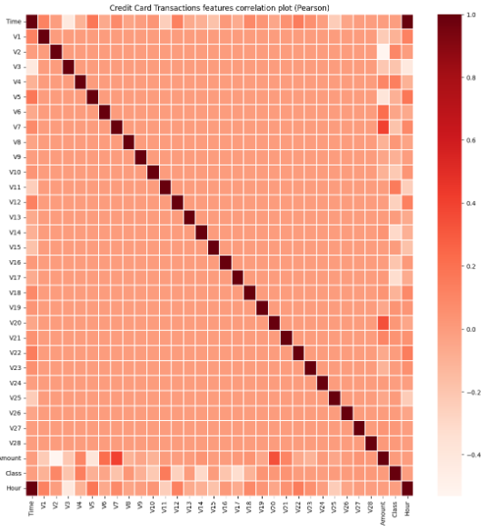
EDA – FEATURE CORRELATIONS
PCA axes (V1–V28) largely orthogonal by design.
Notable: V3 ↔ Time (inverse), V7/V20 ↔ Amount (positive), V1/V5 ↔ Amount (inverse)
Highlights which latent features capture temporal vs. monetary effects.
Feature correlation plot

Slide 10
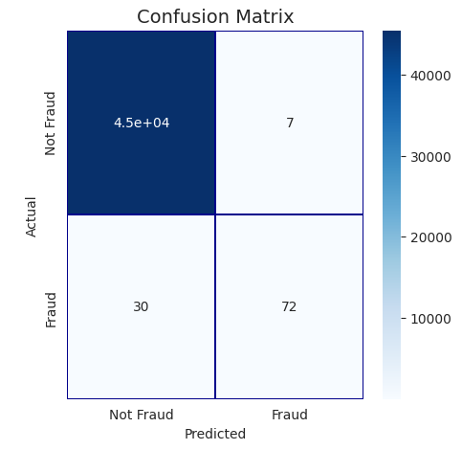
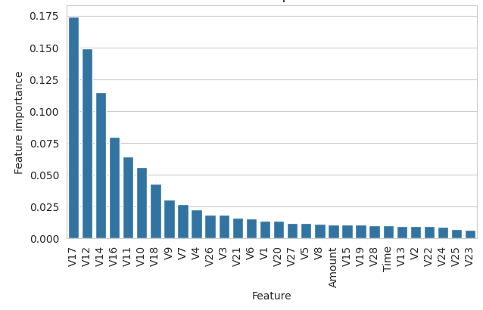
MODEL 1: RANDOMFORESTCLASSIFIER
Config: 100 trees, Gini, random_state=2018, no class_weight.
Test: ROC‑AUC 0.85, AUPRC 0.64; Precision 91.1%, Recall 70.6%
No Imbalance handling
Confusion Matrix
Feature importance bar chart

Slide 11
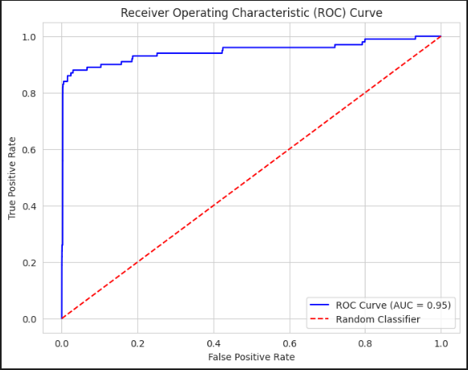
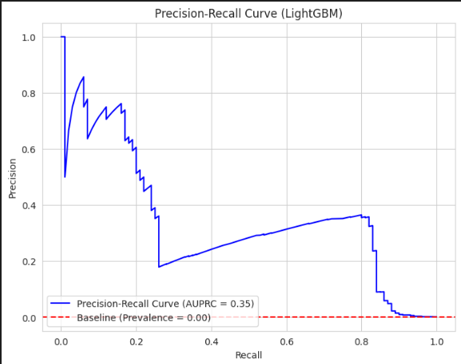
MODEL 2: LIGHTGBM (NO CV)
Config: lr 0.05, max_depth 4, leaves 7, scale_pos_weight 150, early stop 100.
Test: ROC‑AUC 0.9579, AUPRC 0.35
Good separability but very poor precision‑recall

Slide 12
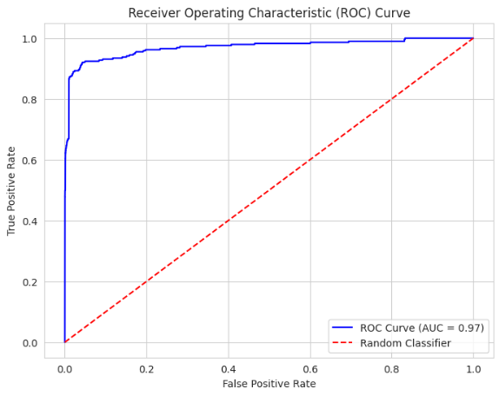
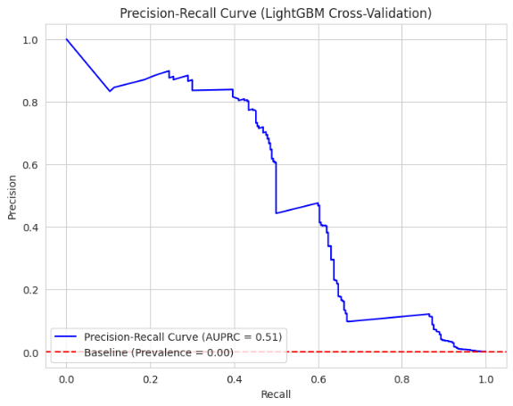
MODEL 3: LIGHTBGM WITH KFOLD CROSS‑VALIDATION
LightGBM 5‑fold CV, Learning Rate: 0.01
Number of Estimators: 2000
AUPRC 0.51 (↑ from 0.35)
Still lacks explicit imbalance handling

Slide 13

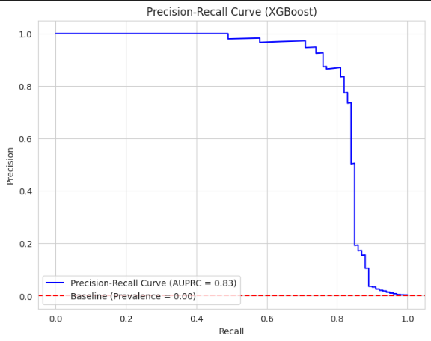
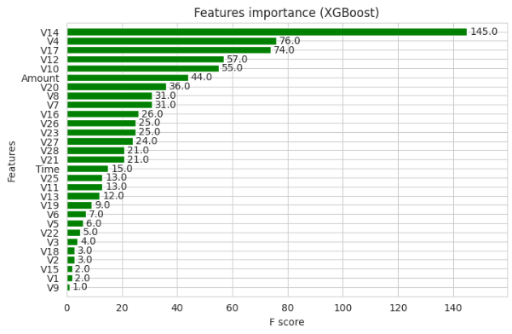
MODEL 4: XGBOOST (NO CV)
Config: Eta 0.039, Max depth 2, subsample 0.8, colsample 0.9, early stop 241.
ROC‑AUC 0.984, AUPRC 0.83; Precision 93.8%, Recall 76.0%
Key features: V4, V12, V10, V2, V7.
Used scale_pos_weight & early stopping
Best performer

Slide 14
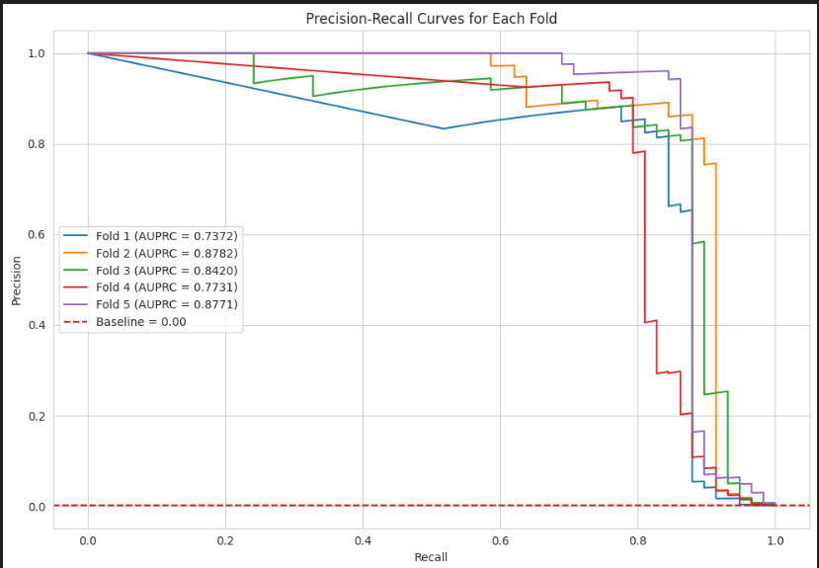
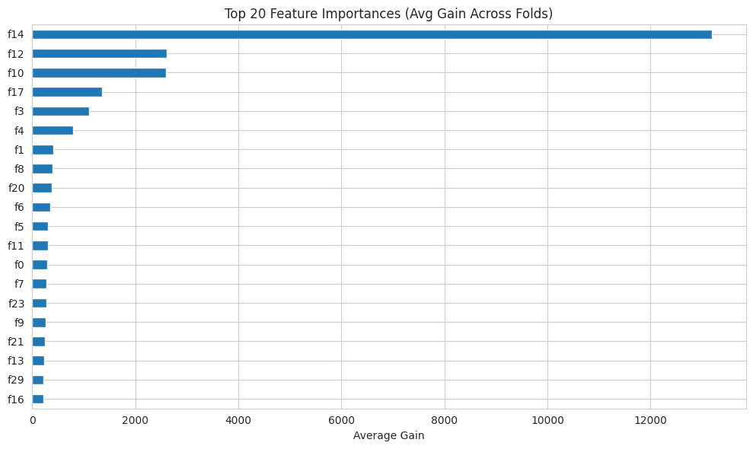
MODEL 4: XGBOOST (WITH SMOTE AND KFOLD CV)
Config: Eta 0.05, Max depth 4, subsample 0.8, colsample 0.8, random state 42. KFold 5
Average AUPRC across folds: 0.8215 ± 0.0569

Slide 15
RESULTS SUMMARY
MODEL | ROC-AUC | AUPRC | HIGHLIGHTS
Random Forest | 0.85 | 0.64 | High precision (91.1%), moderate recall (70.6%); no imbalance handling
LightGBM (No CV) | 0.9579 | 0.35 | High ROC-AUC, but poor fraud detection due to low AUPRC
XGBoost (No CV) | 0.974 | 0.83 | Excellent precision (93.83%) & recall (76.0%); used scale_pos_weight
LightGBM (K-Fold CV) | 0.9703 | 0.51 | CV improved AUPRC (0.35 → 0.51); no class imbalance handling
XGBoost (Stratified K-Fold + SMOTE) | 0.984 | 0.8151 ± 0.0587 | Strong AUC; AUPRC slightly below no-CV; SMOTE & CV added robustness

Slide 16




DISCUSSION & CONCLUSIONS
Best: XGBoost (no CV) for highest AUPRC & ROC‑AUC.
Fallback: Random Forest for interpretability, moderate recall.
LightGBM underperforms on AUPRC despite good ROC‑AUC.
PCA trade‑off: obscures interpretability; consider mapping back to raw features.
SMOTE caution: limited uplift in extreme imbalance.

Slide 17
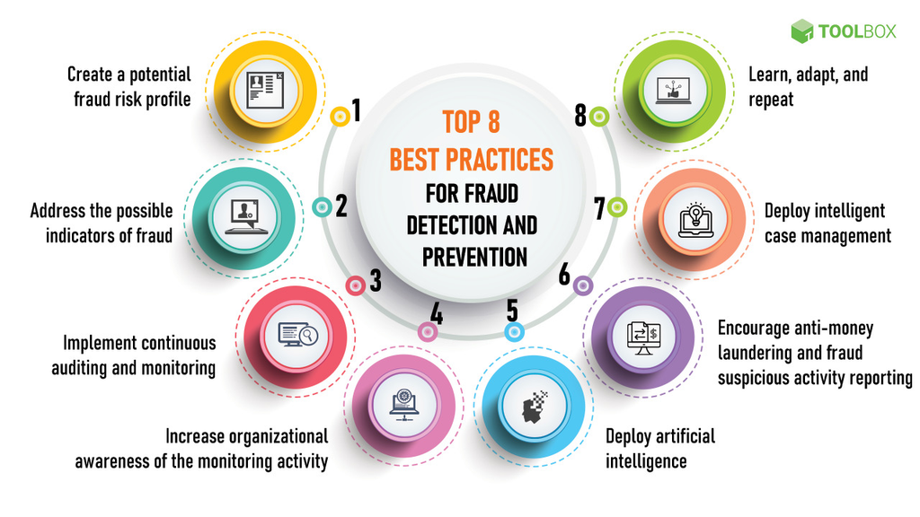
NEXT STEPS & RECOMMENDATIONS
Hyperparameter optimization (Bayesian/grid search).
Advanced sampling: ADASYN, Tomek links.
Multi‑month validation for evolving fraud patterns.
Deployment: real‑time scoring + drift monitoring.

Slide 18
THANK YOU!

