Slide 1
01
GENAI CAPSTONE PROJECT
AI-Powered Document Processing & Business Workflow
From customer complaint documents to validated cases, customer communication, management summaries, and consolidated reports.
A practical, testable GenAI workflow for customer case operations
TXT / PDF / DOCX
LLM + Pydantic
FastAPI + Streamlit

Slide 2
BUSINESS CONTEXT
02
Turning unstructured complaints into operational decisions
!
The challenge
>
The solution
Complaints arrive as unstructured files. Manual review creates slow turnaround, inconsistent classification, repetitive writing, and limited visibility into failed cases.
A modular pipeline parses each document, extracts a validated case, generates two business outputs, and records every result in structured reports.
The result
Faster review • Consistent data • Traceable outcomes
AI Document Processing
GenAI Capstone Project

Slide 3
CAPABILITIES
03
One workflow, multiple business outputs
01
Ingest
02
Extract
03
Communicate
TXT, PDF, and DOCX complaint files.
Convert unstructured text into ComplaintCase.
Draft a grounded customer response email.
04
Summarize
05
Report
06
Deliver
Create an internal management summary.
Persist JSON, TXT, CSV, and processing status.
Expose the flow through API and browser UI.
AI Document Processing
GenAI Capstone Project

Slide 4
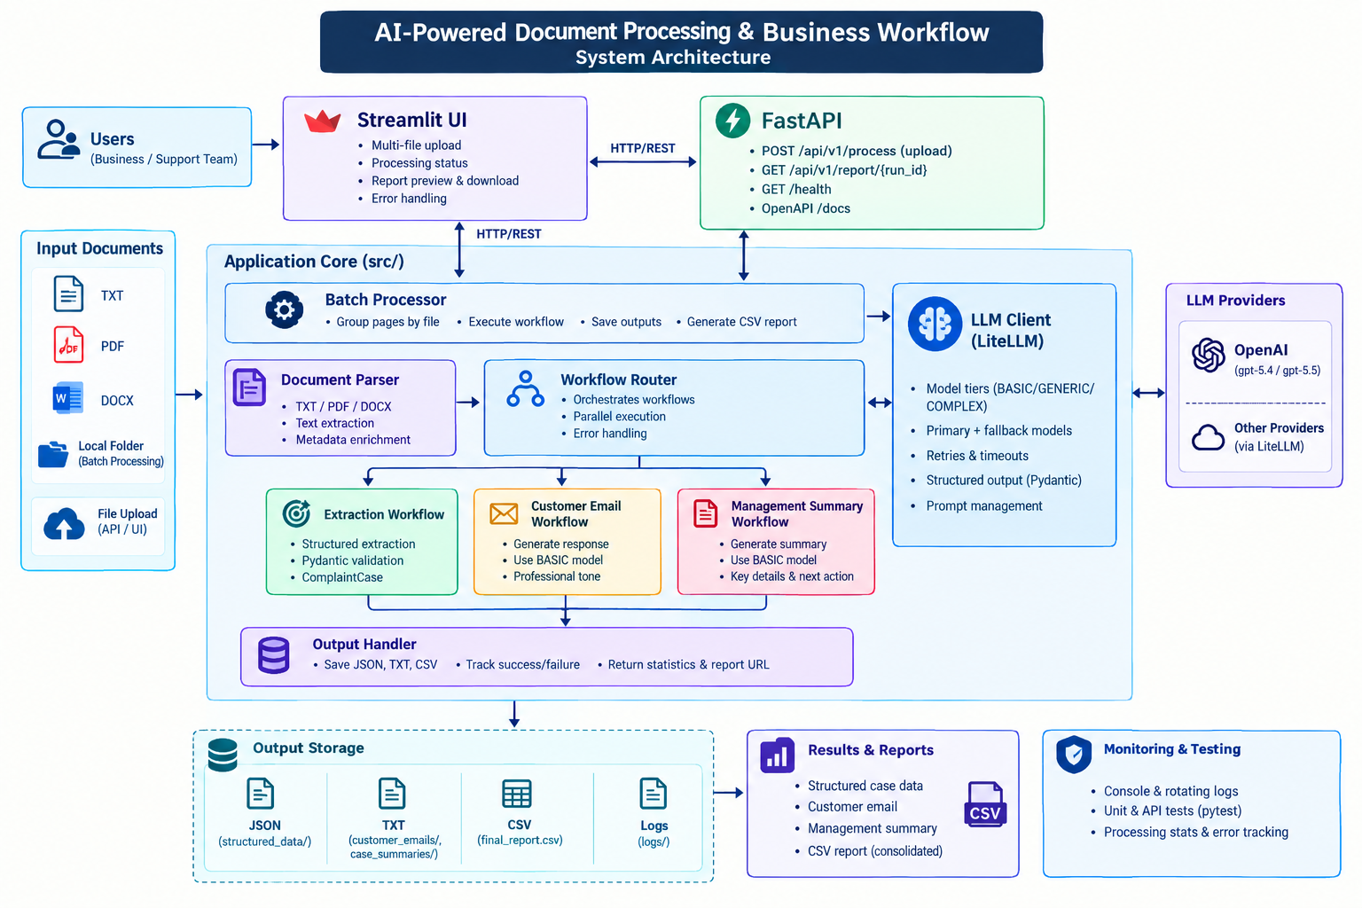
SYSTEM DESIGN
04
A layered architecture built for change
Application layer
Batch processor and workflow router coordinate the business process.
AI layer
LLM client centralizes tiers, retries, fallbacks, and structured responses.
Delivery layer
FastAPI and Streamlit make the workflow usable by systems and people.
AI Document Processing
GenAI Capstone Project

Slide 5
WORKFLOW
05
Sequential extraction, parallel generation
01
02
03
04
05
Parse
>
Extract
>
Validate
>
Generate
>
Persist
Load and group document content
Create ComplaintCase with the LLM
Enforce the Pydantic contract
Email + summary run independently
Save artifacts and report status
Parallel branch: customer email + management summary
AI Document Processing
GenAI Capstone Project

Slide 6
STRUCTURED INTELLIGENCE
06
The LLM is constrained by a business contract
Unstructured complaint
LLM extraction
Validated case
Why it matters
Customer reports issue, action, status, and supporting evidence
Grounded prompts + model tier + fallback
ComplaintCase Pydantic schema strict fields
The downstream workflows receive predictable data instead of an unvalidated raw response.
>
>
AI Document Processing
GenAI Capstone Project

Slide 7
LLM STRATEGY
07
Reliability is designed into the LLM boundary
1
Model tiers
2
Retry + fallback
3
Grounded prompts
BASIC handles email and summary generation. GENERIC handles structured extraction. COMPLEX is available for future workflows.
Each tier has a primary and fallback model. Requests use configured timeout and retry policies before failure is reported.
Prompts require source-only facts and prohibit invented customer details, actions, dates, resolutions, and promises.
Failure is visible: it becomes a logged, document-level result in the final report.
AI Document Processing
GenAI Capstone Project

Slide 8
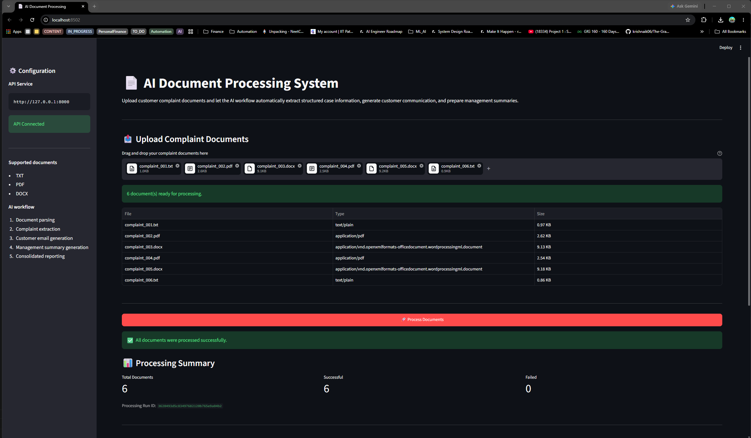
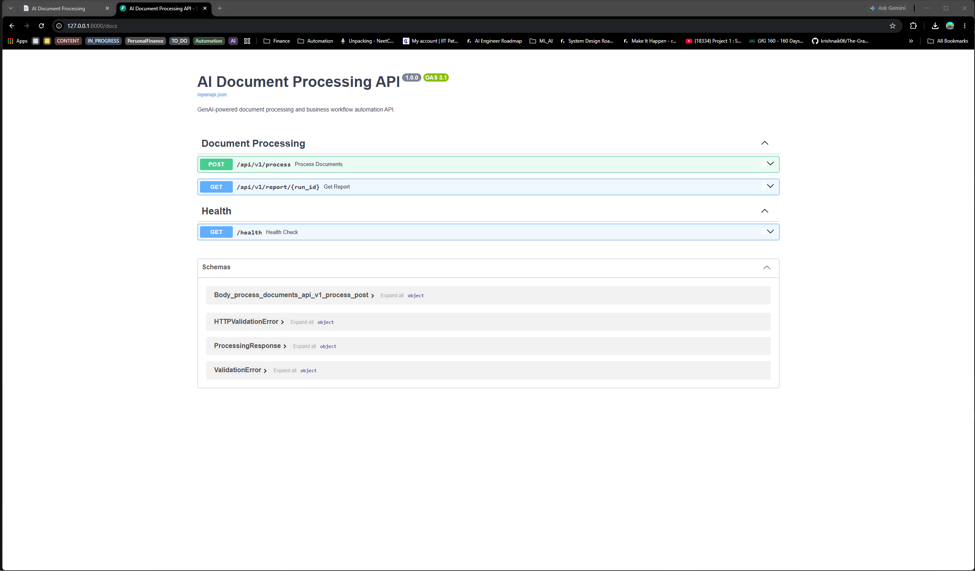
DELIVERY
08
Built for both people and systems
Streamlit UI
FastAPI + Swagger
AI Document Processing
GenAI Capstone Project

Slide 9
OUTPUTS
09
Every run leaves a useful audit trail
JSON
Structured data
TXT
Human-readable outputs
CSV
Batch report
One JSON file per source document with customer details, category, issue, resolution, escalation, evidence, and case status.
A customer-facing email and an internal management summary are saved as separate text artifacts.
The final CSV records source files, success or failure, errors, and paths to generated outputs.
Local batch: output/ API runs: output/runs/<run_id>/
AI Document Processing
GenAI Capstone Project

Slide 10
API
10
A small API surface with a complete workflow behind it
GET
/health
Service health check
POST
/api/v1/process
Upload and process documents
GET
/api/v1/report/{run_id}
Download the final CSV report
Upload → Run ID → Processing statistics → Downloadable report
AI Document Processing
GenAI Capstone Project

Slide 11
QUALITY AND OPERATIONS
11
Designed to be tested without spending on live calls
✓
Automated tests
◇
Mocked LLM calls
≡
Operational visibility
Pytest coverage spans parsing, schemas, LLM behavior, workflows, batch processing, output persistence, and FastAPI endpoints.
Tests remain deterministic and generally do not require an API key or provider calls.
Console and rotating file logs capture document-level outcomes, API run IDs, failures, and model activity.
Run: python -m pytest
AI Document Processing
GenAI Capstone Project

Slide 12
DEMO FLOW
12
A clear path from upload to decision
1
2
3
4
5
>
>
>
>
Upload complaints
Watch processing
Inspect report
Review email
Review summary
One complaint document becomes a validated case and three useful outputs.
AI-assisted processing with validation, traceability, and human review built into the workflow.
AI Document Processing • Thank you
GenAI Capstone Project

