Slide 1
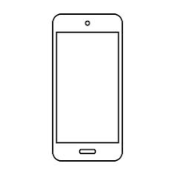
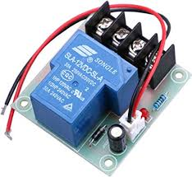
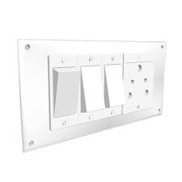

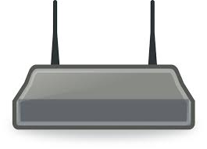
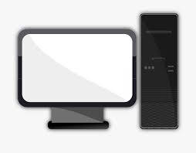
APP
Wireless Communication
Main Power Supply
IOT Device
Wi-Fi
Router
PC
PC
PC
PC
PC
PC
PC
PC
PC
PC
PC
PC
PC
PC
PC
PC

