Slide 1

TWITTER DATA ANALYSIS USING HADOOP ECOSYSTEM
Under the guidance of
Dr. Pardeep Singh
Presented by:
Group No - 6
Prashant Arora (15MI544)
Mayank Kumar Singh (15MI538)
Ashutosh Dubey (15MI537)
Gopal Khatri(15MI520)
Anubhav Markanday (15MI521)
DEPARTMENT OF COMPUTER SCIENCE AND ENGINEERING
National Institute of Technology – Hamirpur
Hamirpur – 177005
May 2019

Slide 2
CONTENTS
Introduction
Why did we choose Twitter for our analysis
Why did we choose Hadoop for our analysis
Tools and Technologies used
Big Data Techniques used
How to build Twitter API
Methodology and System Flow
Spam Detection
Analysis of Tweets using Hive
Challenges and Limitations
Future Scope
Conclusion

Slide 3
Introduction
Every minute opinion, reviews are expressed online and a potential user rely on these reviews, opinions, feedback given by various other users to make decisions with respect to purchasing an item or developing a software when it comes to an organization that provides services.
Social media is popular with marketing teams.
It is an effective tool for promotion because it help companies to know about success of their campaigns.

Slide 4
Introduction
There are firms and organizations that analyze social media data to understand how the public feels about something at a particular moment in time, and also to track how those opinions change over time.
The challenge is to gather all such relevant data from an enormous source of data, analyze and summarize overall patterns on a particular topic.

Slide 5
Why did we choose twitter for our analysis?
Twitter is a networking and microblogging website (currently 307 millions monthly users).
Each tweet can be of maximum 140 characters length.
Different companies and organizations use twitter for branding and promotion.
If an organization send out good information through their tweets continuously, people will get to know their campaigns and brand’s name and share their tweets.
Tweets can help users to know about brands or competition, success of campaign, etc.

Slide 6
Why did we choose Hadoop for our Analysis?
Extracting the tweets without using Hadoop framework, i.e. using traditional machine learning techniques is less scalable
Approaches other than Hadoop are not suitable for large amount of data and more fault tolerance
Traditional method i.e. without using Hadoop is not flexible and efficient to load streaming data.
Then we used Hadoop framework with Apache Flume to load streaming data and were able to load huge number of tweets in less execution time.
Using Hadoop is not very expensive as it runs oncluster of commodity hardware

Slide 7
Tools and Technologies used
System is implemented using following Big Data tools and technologies:
Hadoop Distributed File System (HDFS)
A framework that allows distributed processing of large datasets with minimal programming.
Ability to store, manage and analyze vast amounts of structured and unstructured data quickly and reliably.

Slide 8
Tools and Technologies used (contind…)
Apache Flume
It is a reliable service used across developers for streaming data provided by server’s API and transferring that raw data into Hadoop Distributed File Systems.
Apache Hive
It is a data warehouse software which facilitates reading, writing and managing large datasets using HiveQL (SQL like interface).
Can be used for querying and analyzing large datasets that are stored in HDFS.

Slide 9
Big Data Techniques used
MapReduce
Enables the development of application in very easy and efficient way.
Processing of datasets is done in parallel.
Uses two functions: Map and Reduce.
Map:
Data is captured and divided into pairs of data. This data is further divided into tuples to form a key/value pair that can be processed in parallel by different machines as a cluster.

Slide 10
Big Data Techniques used
MapReduce
Reduce:
Input to the Reduce function is the output of Map function.
All the divided tuples from map are combined to form smaller set of tuples.

Slide 11
Big Data Techniques used
SerDe is a short form of Serializer/Deserializer.
Used as an interface for Input/Output that handles both serialization and deserialization.
Instructs Hive how a record should be processed.
SerDe

Slide 12
Big Data Techniques used
SerDe
Serializer converts an object to a byte stream so that the byte stream can be reverted back into a copy of the object.
Deserializer interface takes a string of binary representation of a record and translate it into a Java object that Hive can manipulate.

Slide 13
How to build Twitter API?
Creating Twitter App
Twitter API requires creation of Twitter app and generation of consumer keys and access tokens.
Visit developer portal with an approved developer account to create a Twitter app and generate authentication keys.
These include :
‘consumer’ tokens – for app authentication
‘access’ tokens – for user/account authentication

Slide 14
Proposed System Architecture
Popular Hashtags
Twitter
Recent Trend Detection
Response to query
Table
Apache Hive
(API)
Tweets
Query
Load Data in a tables
Apache Flume
Tokenization
Channel
HDFS
Unstructured data
Sentiment Word Detection
Dictionary
Classification

Slide 15
Methodology and System Flow
Twitter Data
(API)
Data gathering
Apache Flume
Store Tweets
(HDFS)
Load data into Hive and store in tables
Query table and analyze data in Hive
Result of Analysis

Slide 16
Methodology and System Flow
[1] In first step, we have gathered tweets around a particular context using Twitter Streaming API.
[2] Before doing analysis, data is stored on to a local HDFS using Flume. The tweets retrieved from Flume are in unstructured JSON format.
[3] This semi-structured data is given to the HIVE module which will convert the nested JSON into a suitable structured form that is suitable for analysis.

Slide 17
Methodology and System Flow
[4] For sentiment analysis
Tweets are split into words where each word within the same tweet has same tweet_id.
Table is created to store every word of every tweet where individual words are stored in subsequent rows of tables.
Tables are joined with a dictionary where each word is given polarity based on the severity of each word.

Slide 18
Methodology and System Flow
Average rating for every tweet is calculated.
Based on the rating of tweets, its polarity is calculated, i.e. positive, negative or neutral.

Slide 19
Methodology and System Flow
[5] For finding top hashtags that are used in twitter:
The tweets are loaded into Hive module, wherein these tweets are passed through a series of Hive scripts for finding popular hashtags.
To find top hashtags, we have extracted tweet id and entities fields from tweets where the entity field has a member hashtag. This member is used for further analysis along with tweet id.

Slide 20
Methodology and System Flow
[5] For finding top hashtags that are used in twitter:
We have extracted text field of the hashtag object. The output of this phase is hashtag followed by the tweet id.
Now we group the relation of tweet with respect to hashtag and count the number of times the hashtag appeared.
Hashtags, which have appeared highest number of times, are categorized as famous hashtags or recent trends.

Slide 21
Spam Detection
Process of filtering the content relevant to use case, and to remove spam.
Recently created User : Not including accounts that are created very recently.
Users with few followers : Not including users with very low numbers of followers.
Users with short description : Not including users with short descriptions.
Large numbers of Hashtags : Excluding tweets with large number of hashtags.
Short content length : Excluding tweets with very short content.

Slide 22
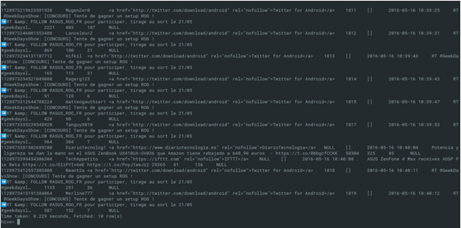
Query used for detecting and removing spam.
CREATE VIEW remove_spam AS SELECT * FROM simple_tweets WHERE statuses_count > 50 AND friends_count/followers_count > 0.01 AND length(text) > 10 AND size(hashtags) < 10
Spam Detection

Slide 23
Analysis of Tweets using Hive
[1] Twitter data table creation.
CREATE EXTERNAL TABLE raw_f (id BIGINT,created_at STRING,source STRING,favorited BOOLEAN,
retweeted_status STRUCT<text:STRING,`user`:STRUCT<screen_name:STRING,name:STRING>, retweet_count:INT>,entities STRUCT<
urls:ARRAY<STRUCT<expanded_url:STRING>>,user_mentions:ARRAY<STRUCT<screen_name:STRING,name:STRING>>,
hashtags:ARRAY<STRUCT<text:STRING>>>,text STRING,’user’STRUCT<screen_name:STRING,name:STRING,friends_count:INT,
followers_count:INT,statuses_count:INT,verified:BOOLEAN,utc_offset:INT,time_zone:STRING>,in_reply_to_screen_name STRING
)
ROW FORMAT SERDE 'org.openx.data.jsonserde.JsonSerDe'
WITH SERDEPROPERTIES ("ignore.malformed.json" = "true")
LOCATION 'hdfs://localhost:9000/major';

Slide 24
Analysis of Tweets using Hive
[2] Cleaning and removal of stopwords from table of tweets.
CREATE VIEW tweets_simple AS
SELECT
id,
`user`.screen_name,
source,
retweeted_status.retweet_count,
entities.hashtags,
cast ( from_unixtime( unix_timestamp(concat( '2016 ', substring(created_at,5,15)), 'yyyy MMM dd hh:mm:ss')) as timestamp) ts,
text,
`user`.statuses_count,
`user`.friends_count,
`user`.followers_count,
`user`.time_zone
FROM raw;

Slide 25
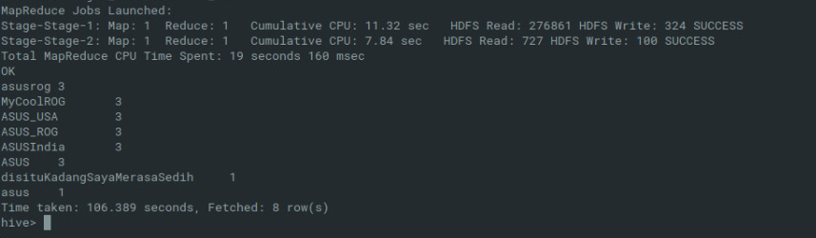
Analysis of Tweets using Hive
[3] Query for recent trends and popular hashtags.
create view l5 as select ht,count(ht) as countht from raw lateral view explode(entities.hashtags.text) dummy as ht group by ht order by countht desc limit 10;

Slide 26
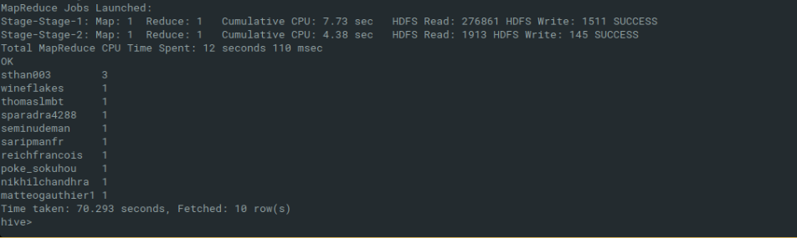
Analysis of Tweets using Hive
[4] Users with most Number of Tweets on Chosen aspect.
create view l7 as select screen_name,count(id) as cnt from tweets_simple group by screen_name having screen_name IS NOT NULL order by cnt desc limit 10;

Slide 27
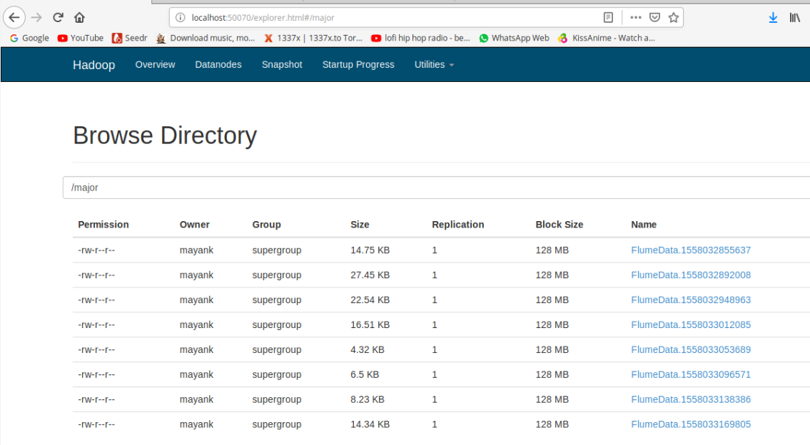
Analysis of Tweets using Hive
[5] Sentiment analysis on the tweets using HIVE
Loading the tweets and feature extraction.

Slide 28
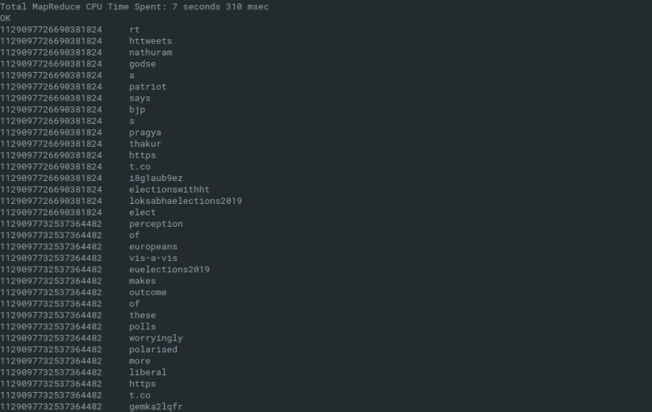
Analysis of Tweets using Hive
Tokenizing the tweets.
Create view l1 as select id, words from raw lateral viewexplode(sentences(lower(text))) dummy as words;
create view l2 as select id, word from l1 lateral view explode( words ) dummy as word;

Slide 29
Analysis of Tweets using Hive
Sentiment word detection.
Done using dictionary based method.
Table is created to store the content of dictionary.
Tokenized words are mapped with the loaded dictionary.
Tweets are matched with the sentiment words in the dictionary.
Appropriate rating is assigned if a word matches with the sentiment.
Null rating is assigned if word does not match with any sentiment word.
A hive table is created to store the data after analysis for later use.

Slide 30
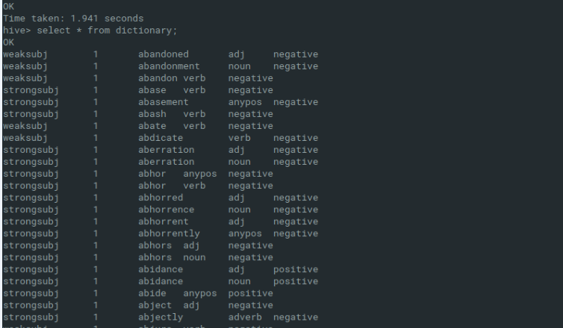
Analysis of Tweets using Hive
Creating table for dictionary.
CREATE EXTERNAL TABLE dictionary (type string,length int,word string,pos string,
polarity string,)
ROW FORMAT DELIMITED FIELDS TERMINATED BY '\t' STORED AS TEXTFILE;

Slide 31
Analysis of Tweets using Hive
Loading dictionary into HDFS.
hadoop fs -put /home/mayank/AFINN.txt hdfs://localhost:9000/
Loading dictionary from hdfs into table
load data inpath '/AFINN.txt' INTO TABLE dictionary;
Converting polarity into numerical value.
create view l3 as select
id,
l2.word,
case d.polarity
when 'negative' then 0
when 'positive' then 5
else 2.5 end as polarity
from l2 left outer join dictionary d on l2.word = d.word;

Slide 32
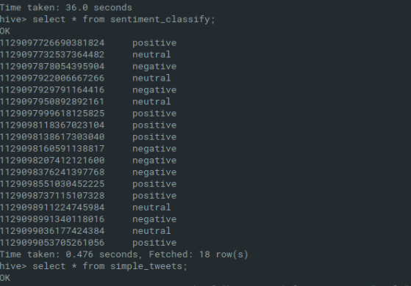
Analysis of Tweets using Hive
Classification into positive, negative and neutral
create table tweets_sentiment as select id,case when avg( polarity ) > 2.5 then 'positive' when avg( polarity ) < 2.5 then 'negative' else 'neutral' end as sentiment from l3 group by id;

Slide 33
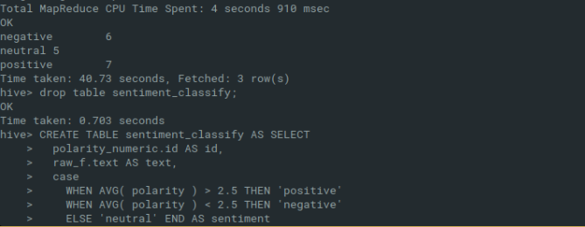
Analysis of Tweets using Hive
Classification of tweets
create view l8 as select sentiment, count(id) from tweets_sentiment ts group by sentiment;

Slide 34
Challenges and Limitations
Retrieving the twitter data was difficult as twitter have not made their data public. Data is provided only to twitter apps.
Flume setup needed a lot of complex classpath JARs and configurations.
Creating a customized JSON SerDe for conversion of unstructured JSON data to structured Hive tables.

Slide 35
Future Scope
Negation Handling - Words like ‘no’, ‘not’, and ‘never’ are difficult to handle properly. This can be handled by using n-grams which is an inbuilt function in HIVE which can analyze two or three words together and then look up in the dictionary look up.

Slide 36
Future Scope
Sarcasm Detection – Sarcasm is tough to detect in written form unless you know the context. When speaking, the tone usually gives away the Sarcasm. That's not the case in written text though. This can be handled to almost the accuracy of 80% by machine learning techniques and by NLP by analyzing the emoticons and words like ‘lol’, ’wow’, ’!!!’.

Slide 37
Conclusion
With this system, one can:
collect and analyze streaming data, and monitor public opinions around any given topic in real-time, allowing the user to take advantage of real-time Twitter sentiments for insights on a particular topic.
perform different operations by using queries in collected data sets.
The problem arises when dealing with unstructured data. So it must be converted to query-able structured format.

Slide 38
Conclusion (contd….)
Since analysis were done on large number of tweets by using Hadoop and its packages, it can be concluded that:
processing time and retrieving capabilities are can be very easy when compared to other traditional processing systems and analysis techniques for large amounts of data.

