Slide 1

KNIME AP Session 2 – Read and Transform
Notes:
Now we will discuss ETL, a crucial process in the world of data analytics that prepares data for analysis. Understanding ETL will provide a foundation for using KNIME effectively.

Slide 2

Session Outline
1 | Recap
2 | Session Goals
3 | Step 1 – Read/Access Data
4 | Understanding Nodes and Configuration
5 6
Step 2 – Data Tranformation
Use-case and Conclusion
Notes:
We'll start with an ice-breaking session to get to know each other. Then, we'll dive into the concept of ETL and its importance in data analytics. Following that, we'll introduce KNIME, examining its features and applications. Finally, we will explore KNIME's interface, workflow design, and reporting capabilities.

Slide 3
Recap
Introduction to KNIME: KNIME is a powerful data analytics platform that simplifies data access and manipulation. It offers low code/no code capabilities, is open-source, and provides comprehensive data analysis features without license issues
Core Features of KNIME: KNIME supports various data sources, powerful nodes for data cleaning and transformation, algorithms for classification and regression, and tools for creating interactive charts and plots
Navigating the Interface: The KNIME interface includes sections such as the Application Tab, Toolbar, Side Panel Navigation, Workflow Editor, and Node Monitor. Each section has specific functionalities to aid in data processing
Steps Involved in Data Processing: The data processing workflow includes steps like Data Access, Data Cleaning, Transformation, Data Merging, Data Aggregation, and Export and Visualization
Introduction to Nodes and Workflows: The stages of a data processing workflow are divided into Read, Analyze, Transform, Visualize, and Deploy. Each stage involves specific tools and actions
Creating and Executing Workflows: The process of creating and executing workflows involves steps like Data Access, Data Transformation, and Deployment
Use Cases and Industry Applications: KNIME is applied in various industries such as Finance, Healthcare, and Marketing. It is used for risk analysis, fraud detection, portfolio optimization, patient data analysis, predictive modeling, operational efficiency, customer behavior analysis, market segmentation, and trend forecasting
Notes:
Welcome everyone to the session. I'll start by introducing myself and sharing a bit about my background in data analytics. This will help us understand each other's perspectives.

Slide 4

Overview of Session Goals
Read/
Access
Data
Transform
Data
Notes:
Finally, I'll outline the goals for today's session. Our aim is to provide you with a solid understanding of KNIME and its capabilities in data analytics, and to leave you feeling empowered to use the tool effectively.

Slide 5
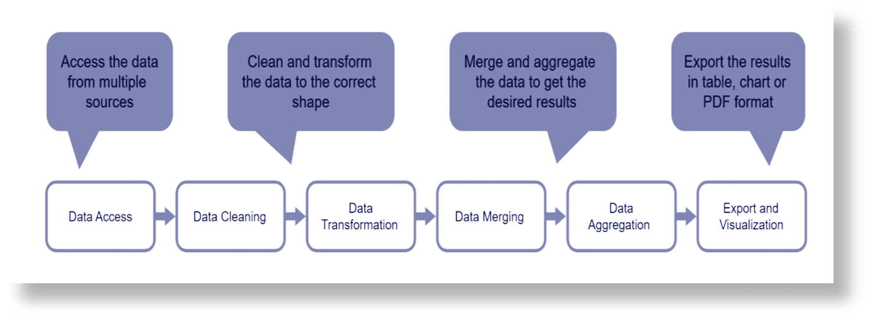
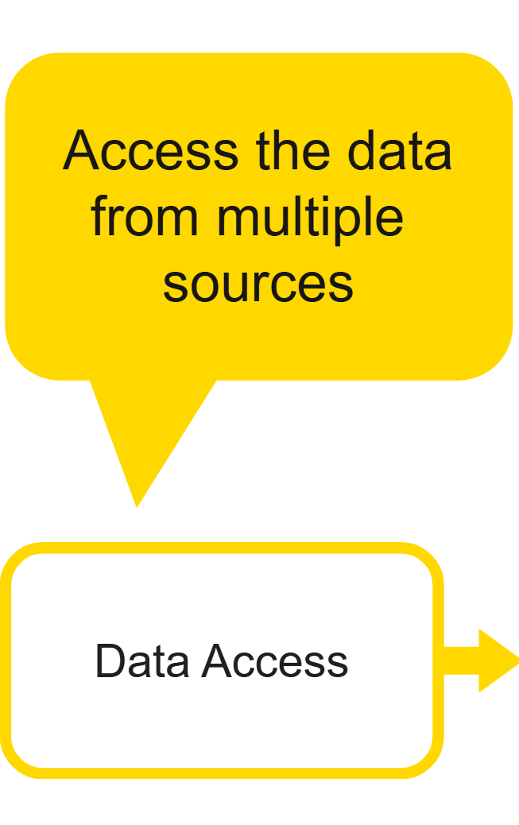
STEP 1
Data Access/Read
Notes:
ETL processes are essential for gathering data from various sources, transforming it into a suitable format, and loading it into data warehouses for analysis. This ensures data integrity and enables informed decision-making.

Slide 6
Data Access represents the beginning of every data process. Data can be stored in many ways, including:
Locally
In different data formats (.csv, .xls…)
On the cloud
In a database
Data Access/Read Definition and Use Case
Notes:
ETL processes are essential for gathering data from various sources, transforming it into a suitable format, and loading it into data warehouses for analysis. This ensures data integrity and enables informed decision-making.

Slide 7
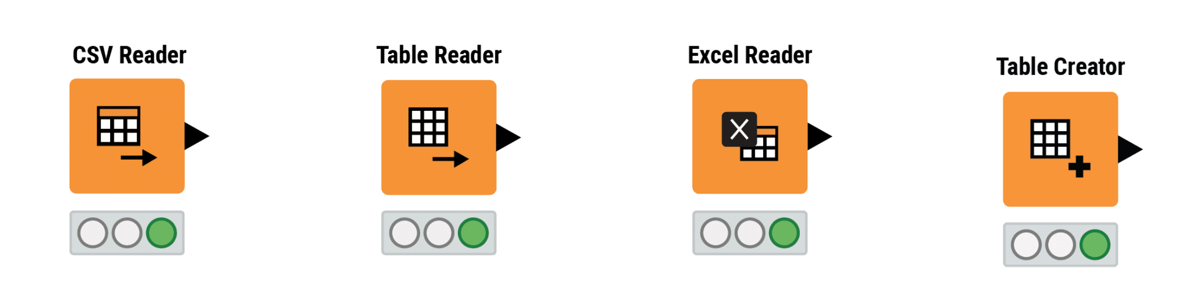
Data Access/Read Nodes Files\Tables
Notes:
ETL processes are essential for gathering data from various sources, transforming it into a suitable format, and loading it into data warehouses for analysis. This ensures data integrity and enables informed decision-making.

Slide 8
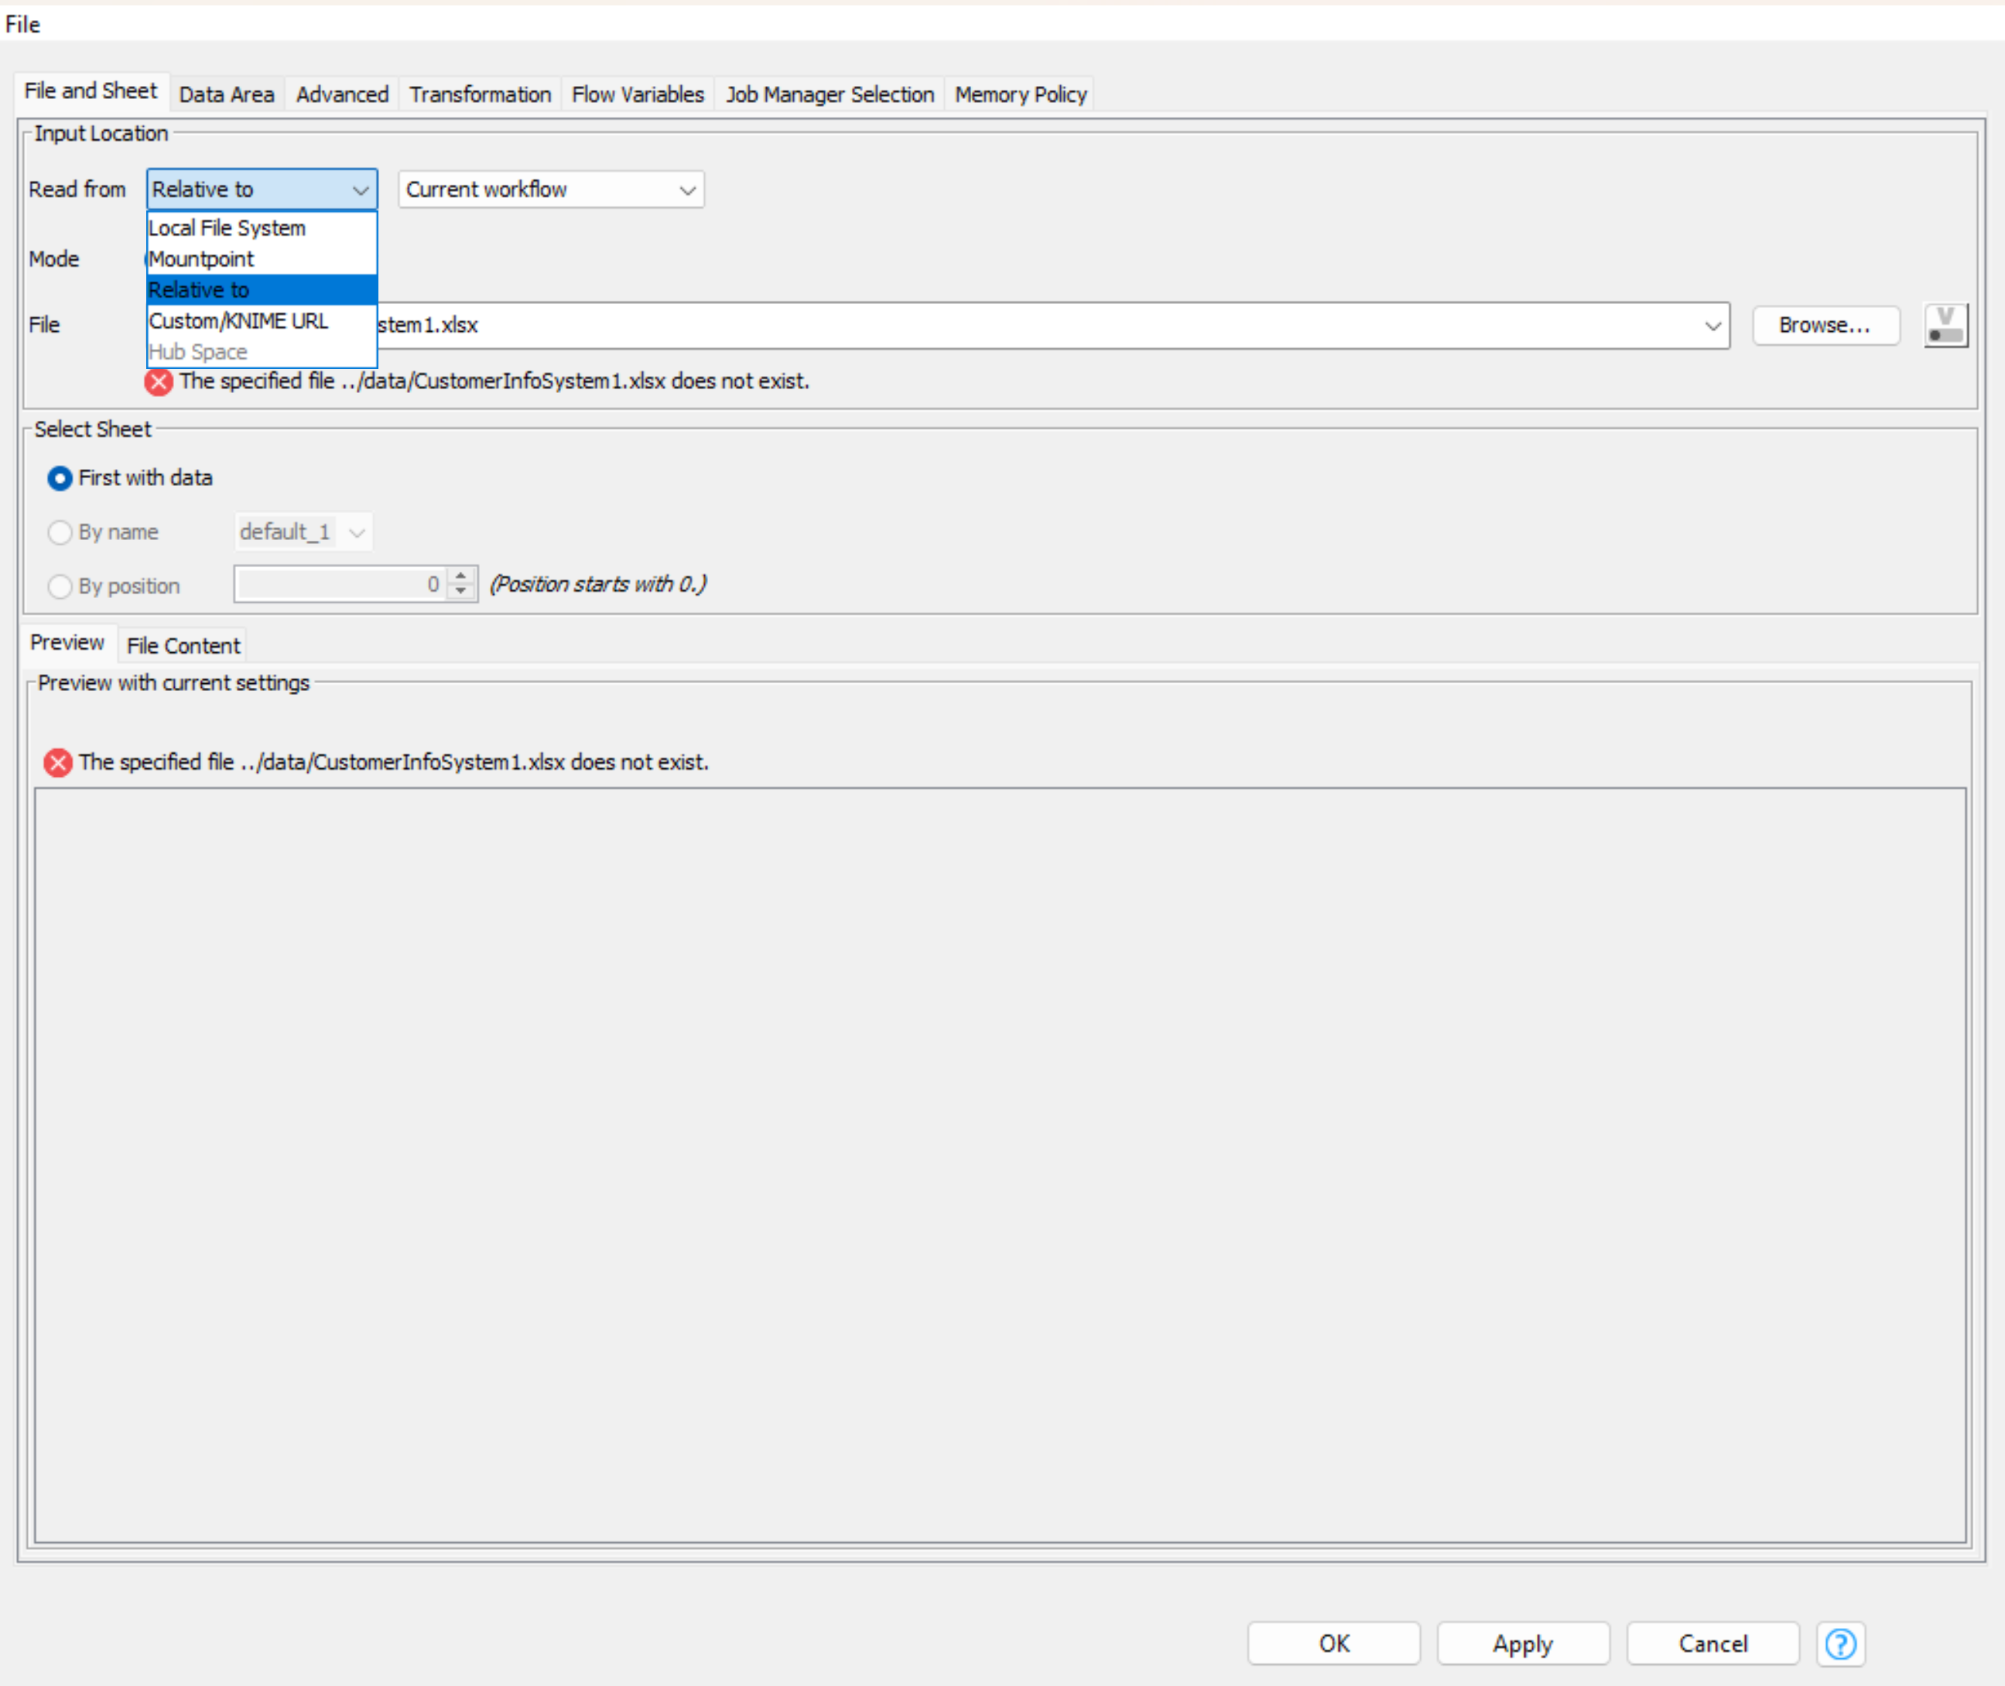
Configuration Reading Files
Local File System
Indicates a file on the local machine (for instance, the computer or laptop you are working on) with an absolute path. The syntax of the path depends on the file system.
Examples:
C:\Users\username\file.txt for Windows
/folder1/folder2/file.txt on Linux
Relative to
Indicates a location relative to the currently active workflow or mountpoint.
Example:
Relative to + Current workflow + “../data/file.txt” points to the file.txt inside a folder data which is one level above “..” the current workflow
Mountpoint
Indicates a location relative to the selected mountpoint (for example, the local workspace).
Example:
Mountpoint LOCAL + /Example Workflows/TheData/Basics/Rooms.xlsx points to a file inside the Example Workflow folder in the local workspace
Custom/KNIME URL
A pseudo-file system that allows you to access single files via a URL.
Example:
knime://knime.workflow/file.txt uses the KNIME protocol (knime://) to access a file stored in the workflow folder (knime.workflow).

Slide 9
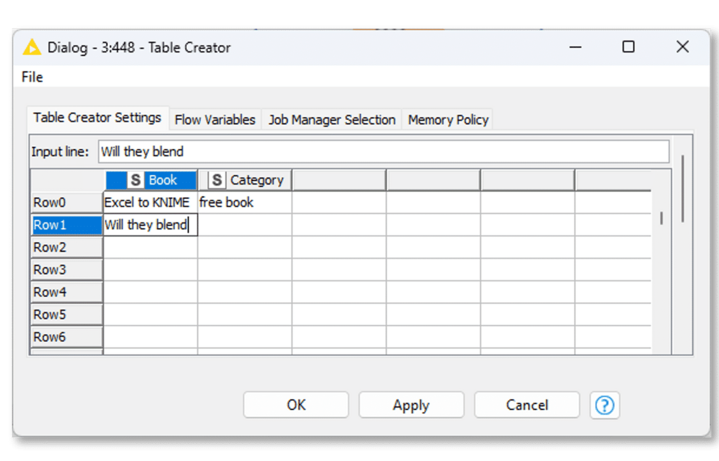
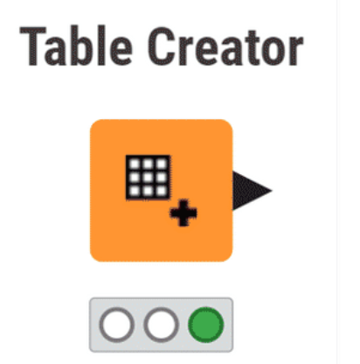
Table Creator

Slide 10
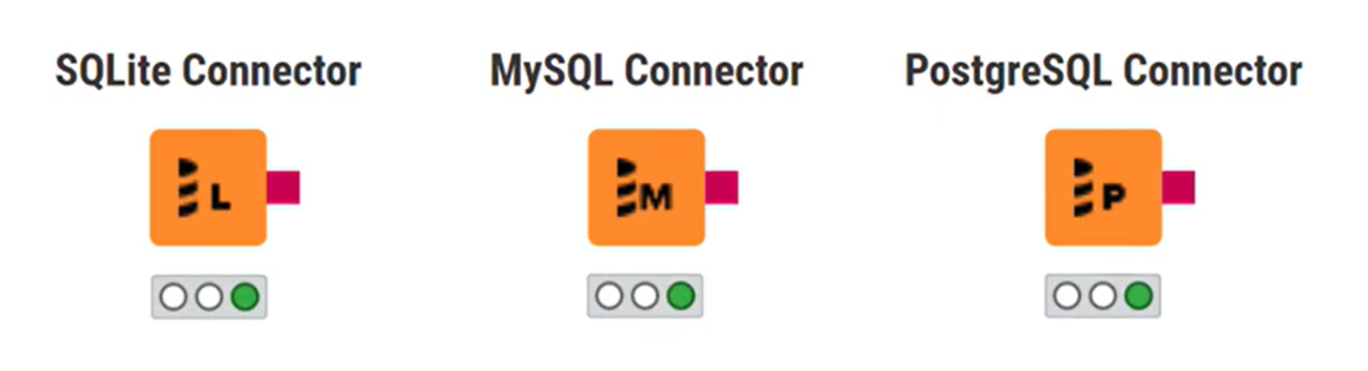
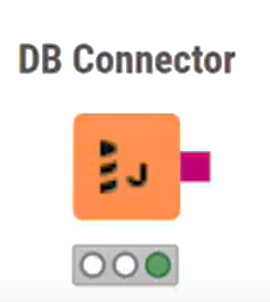
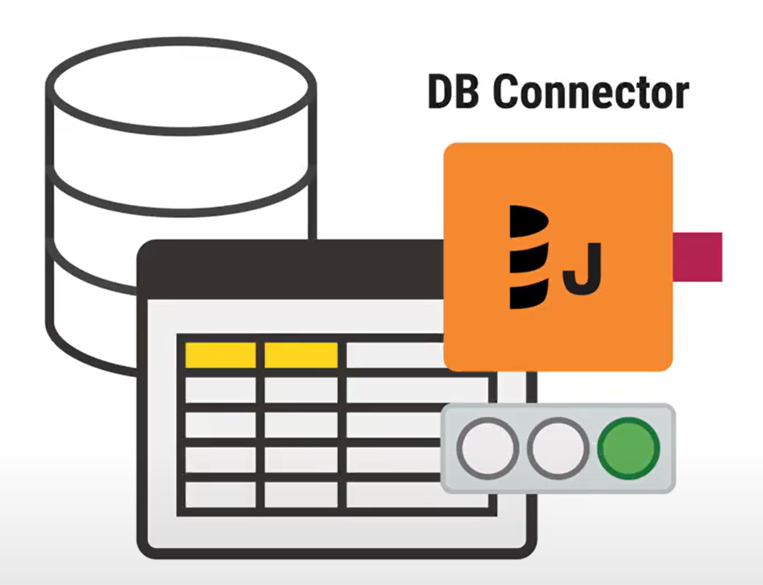
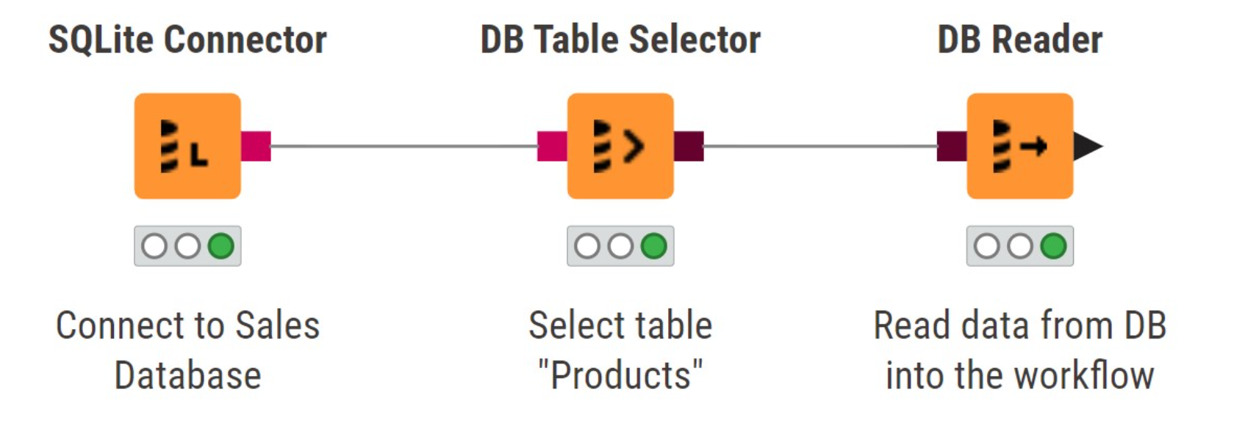
Accessing Databases
Installed
In a KNIME workflow, you can connect to any JDBC-compliant database and access and manipulate data directly on the database.
If no dedicated connector node available
Once you are connected to a database, you can build the query with the other available DB nodes. The most basic operation that you can perform is adding a DB Table Selector node to select the database schema and the table you want to read from. Then, you can import the data into the workflow by appending a DB Reader node.

Slide 11
Other Data sources
Google Sheets
Google Sheets is a popular online spreadsheet editor. A set of KNIME nodes let you create, read, and edit Google Sheets from a workflow.
REST Requests
REST standardizes communications between resources on the web. You can use various HTTP methods to perform requests to an API, such as GET, POST, PUT and DELETE requests. Each method has its own node in KNIME Analytics Platform. Typically, the response of a REST request is a JSON or XML document, that can be further analyzed with the JSON Path or XPath nodes.
JSON
JSON is a commonly used format for data interchange and for data storage, in attribute-value pairs fashion. You can read JSON files with the JSON Reader node and extract values with the JSON Path node.
XML
XML is another common data format based on markup. Values are stored with tags (e.g. <title>Page Title<title>). Similarly to JSON, you can read XML files with the XML Reader node and extract values with the XPath node.

Slide 12
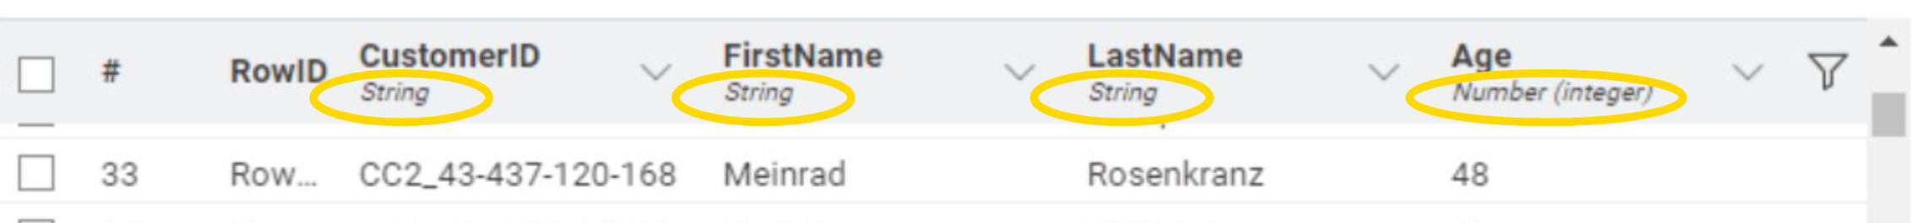
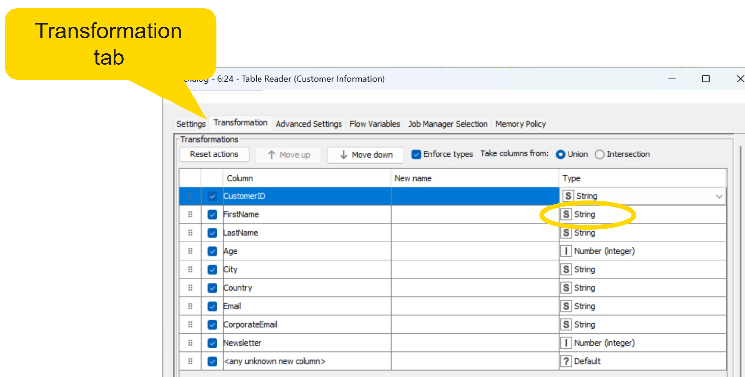
Data Types
Number
A numeric value. Can be integer, long or double (decimal)
String
A sequence of characters
Boolean
A truth value, either true or false
Date&Time
A temporal value with date, time or both
Collection
Multiple values of the same type
Other Data Types
KNIME supports more specialized data types, such as Document, JSON, XML, Bit vector, Image and so on
Dealing with structured data means classifying them into types. In KNIME, each column has a specific data type that describes the kind of data that the column stores. The data type of a column is indicated in the table monitor below the column name.

Slide 13
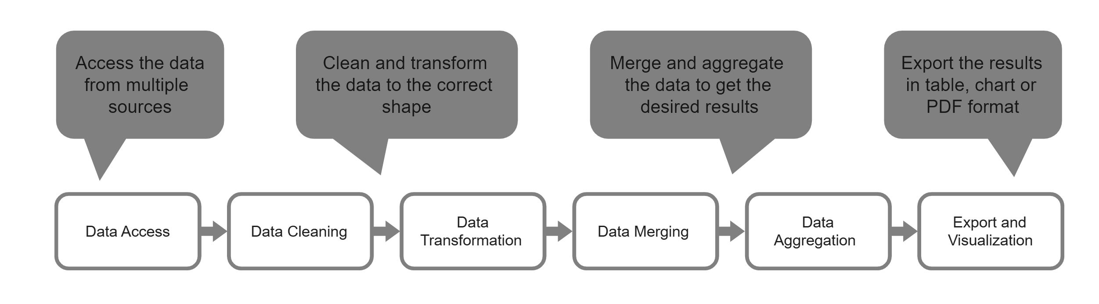
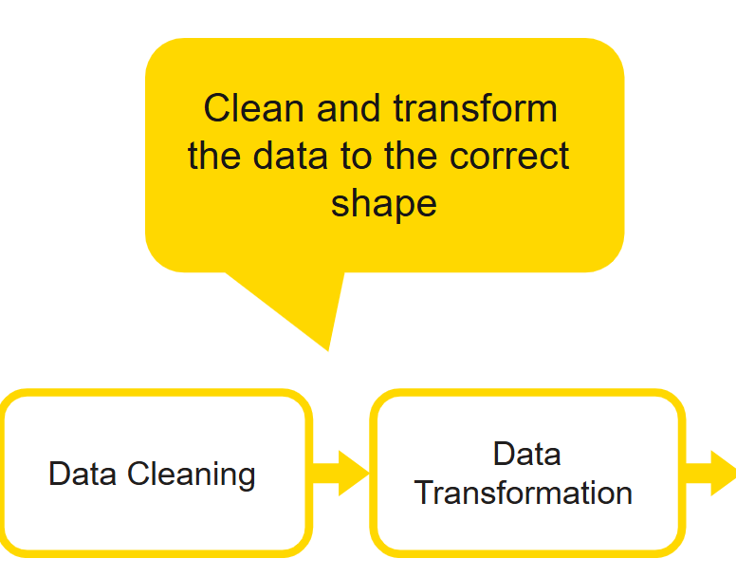
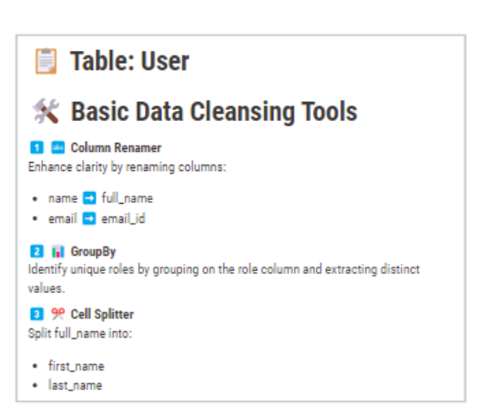
STEP 2 Data Transform
(Cleaning & Transformation)

Slide 14
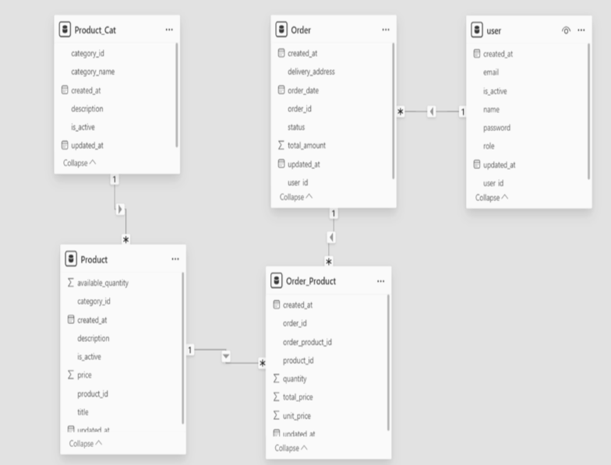
Database Schema (Case Study)

Slide 15
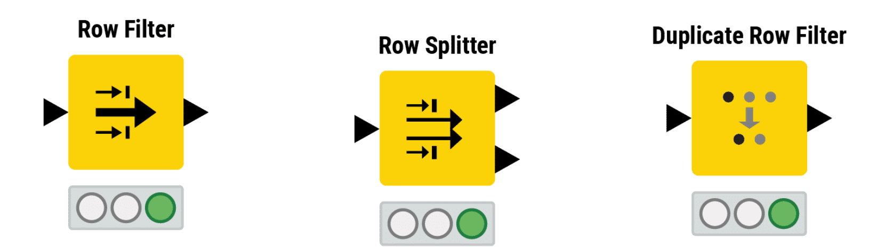
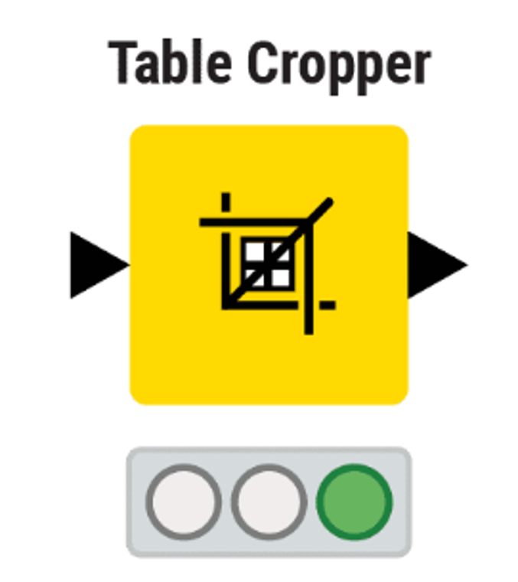
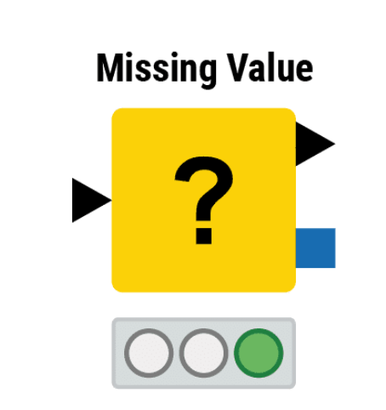
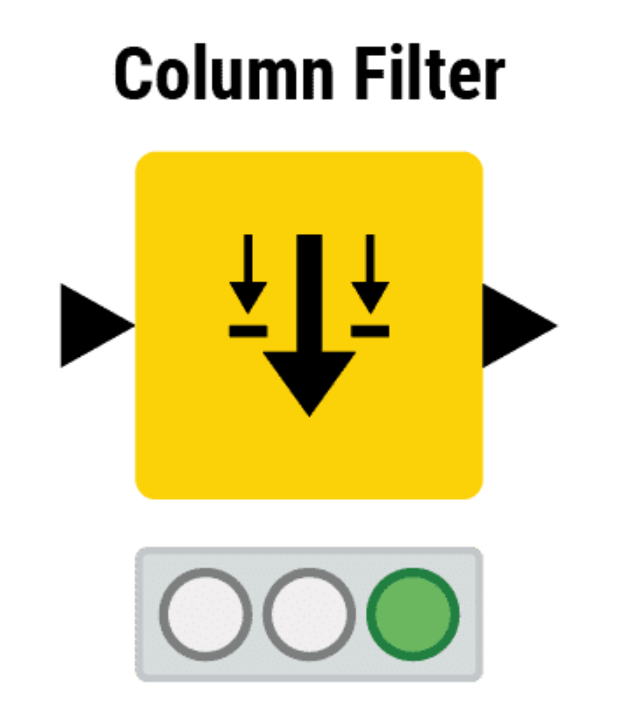
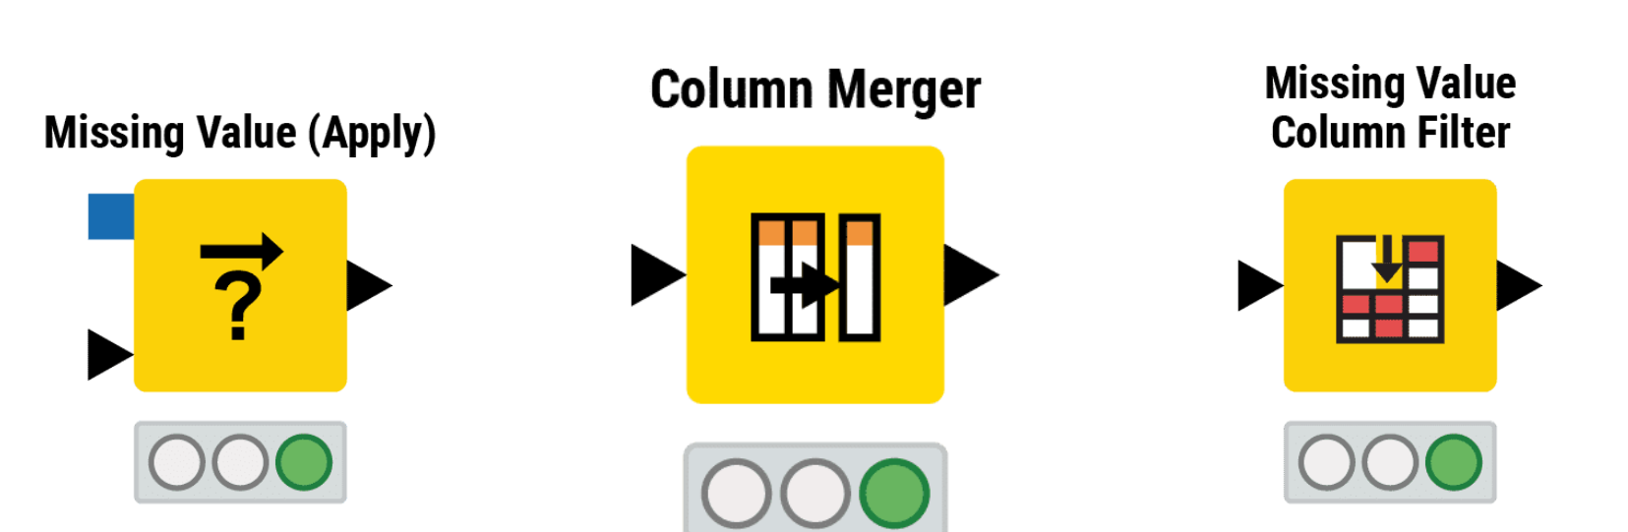
Data Cleaning
The purpose of data cleaning is to reduce the irrelevant and retain or generate the essential information. Possible operations include
Removing irrelevant data by filtering entire rows or columns
Removing duplicate data
Handling missing values

Slide 16
Q&A Thank you

