Slide 1

KNIME AP Session 3 –Transform
Notes:
Now we will discuss ETL, a crucial process in the world of data analytics that prepares data for analysis. Understanding ETL will provide a foundation for using KNIME effectively.

Slide 2

Session Outline
1 | Recap
2 | Session Goals
3 | Step 3 – Transformation of Data
4 | Understanding Use Case
5 6
Built the Workflow
Conclusion & Q&A
Notes:
We'll start with an ice-breaking session to get to know each other. Then, we'll dive into the concept of ETL and its importance in data analytics. Following that, we'll introduce KNIME, examining its features and applications. Finally, we will explore KNIME's interface, workflow design, and reporting capabilities.

Slide 3
Recap
Read the input files using the I/O nodes
Connect to a database and read data using corresponding nodes
Manually import data by using the Table creator node
Data type supported in KNIME
How to configure nodes
Notes:
Welcome everyone to the session. I'll start by introducing myself and sharing a bit about my background in data analytics. This will help us understand each other's perspectives.

Slide 4

Overview of Session Goals
Transform
Data
Notes:
Finally, I'll outline the goals for today's session. Our aim is to provide you with a solid understanding of KNIME and its capabilities in data analytics, and to leave you feeling empowered to use the tool effectively.

Slide 5
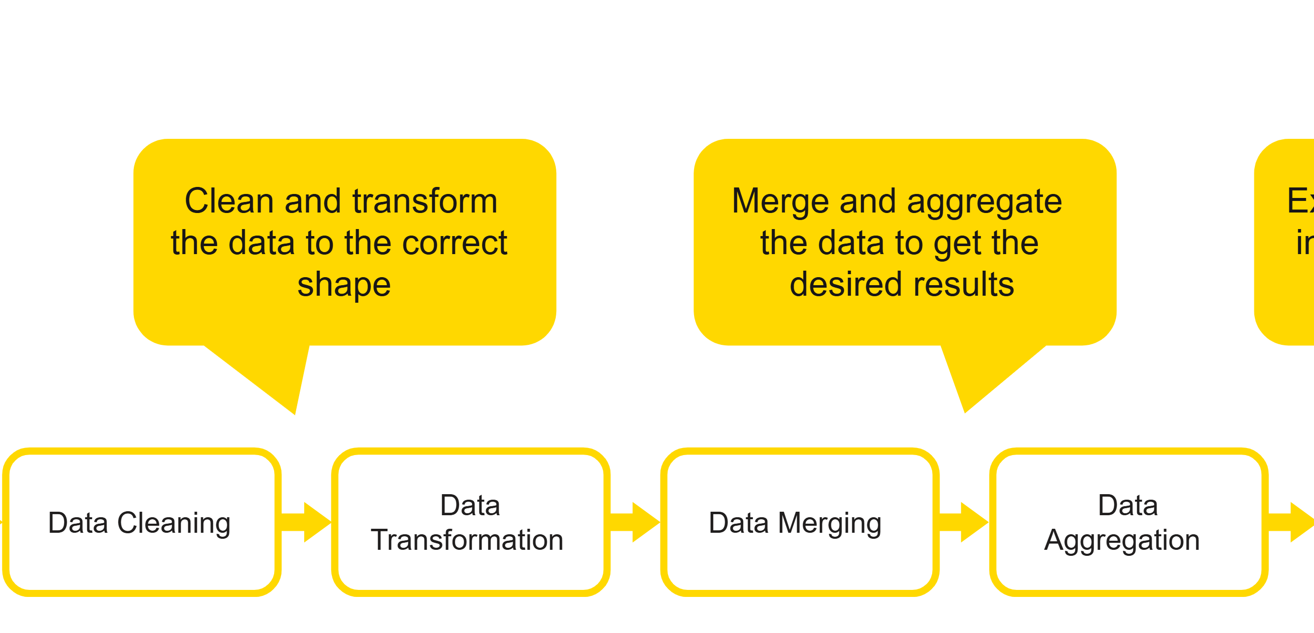
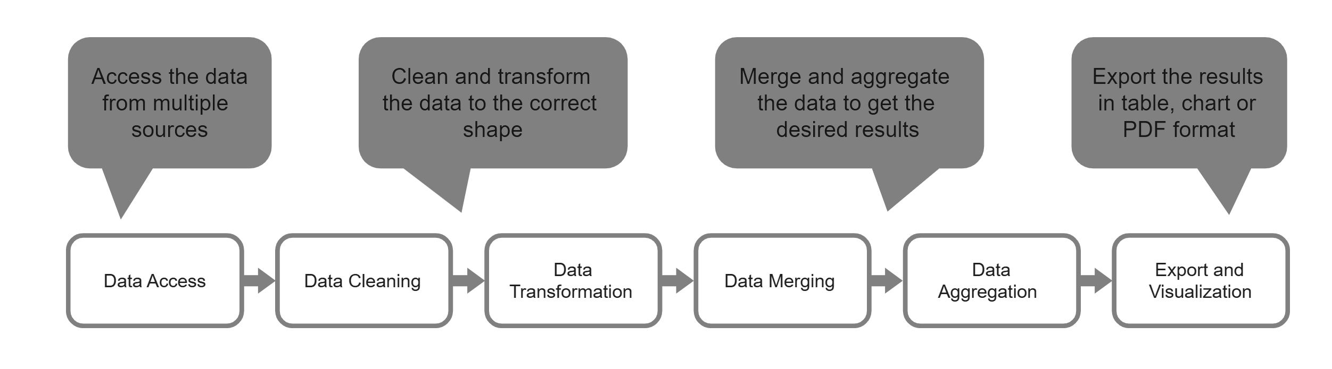
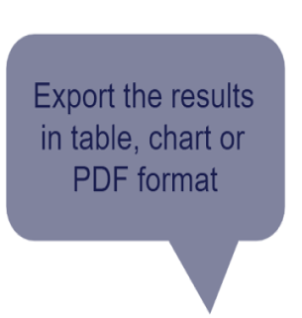
STEP 3

Slide 6
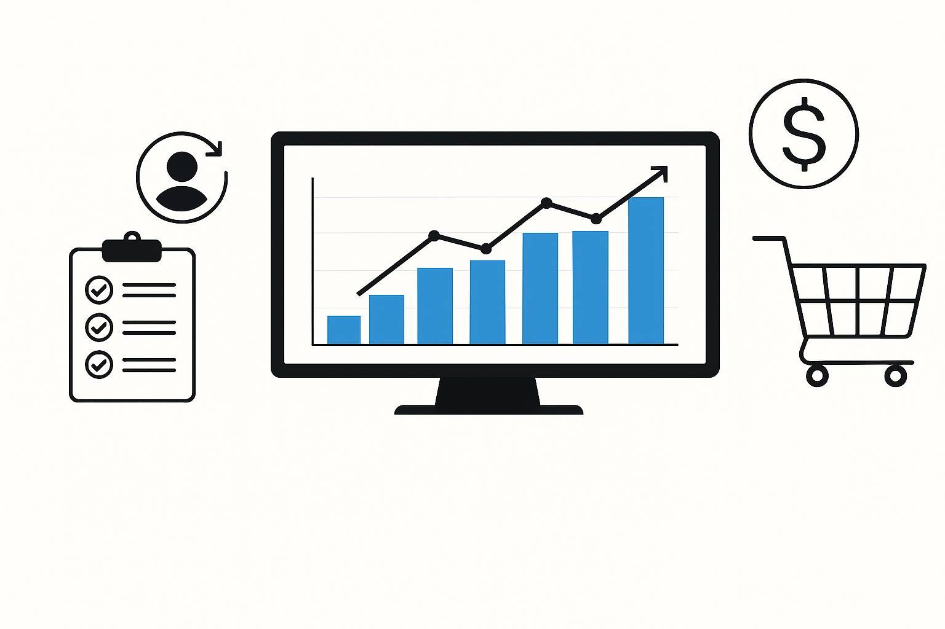
Use Case: E-Commerce Data
Objectives of Data Analysis
Identify top-selling products
Understand customer purchasing behavior
Optimize inventory and supply chain
Increase revenue through targeted marketing
This use case focuses on analyzing e-commerce data to understand customer behavior, transaction patterns, and sales trends to optimize operation and boost revenue.

Slide 7
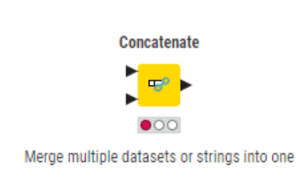
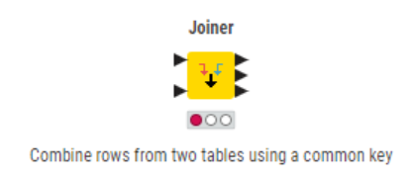
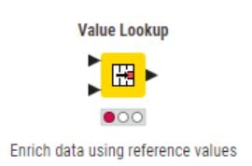
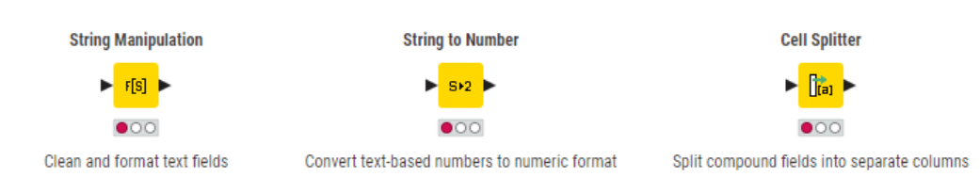
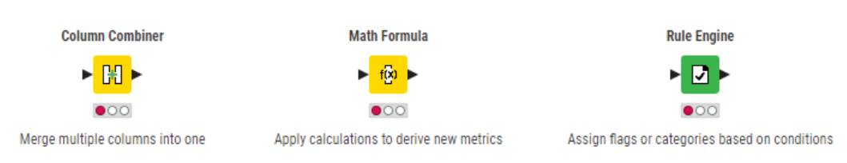
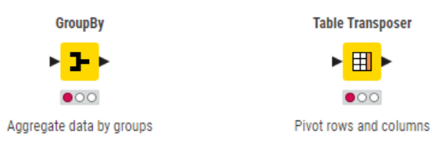
Transformation Nodes
Data Ingestion
Data Cleaning
Transformation & Calculation
Aggregation & Reshaping

Slide 8
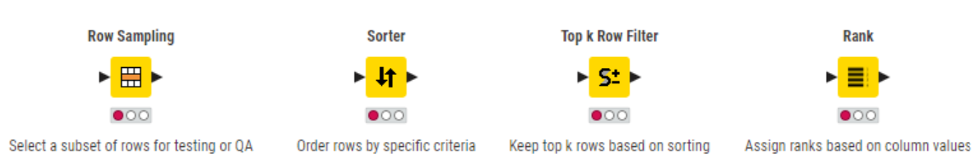
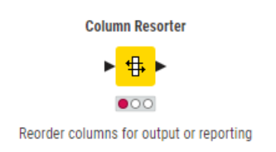
Filtering & Sampling
Final Structuring

Slide 9
Q&A Thank you

