Slide 1
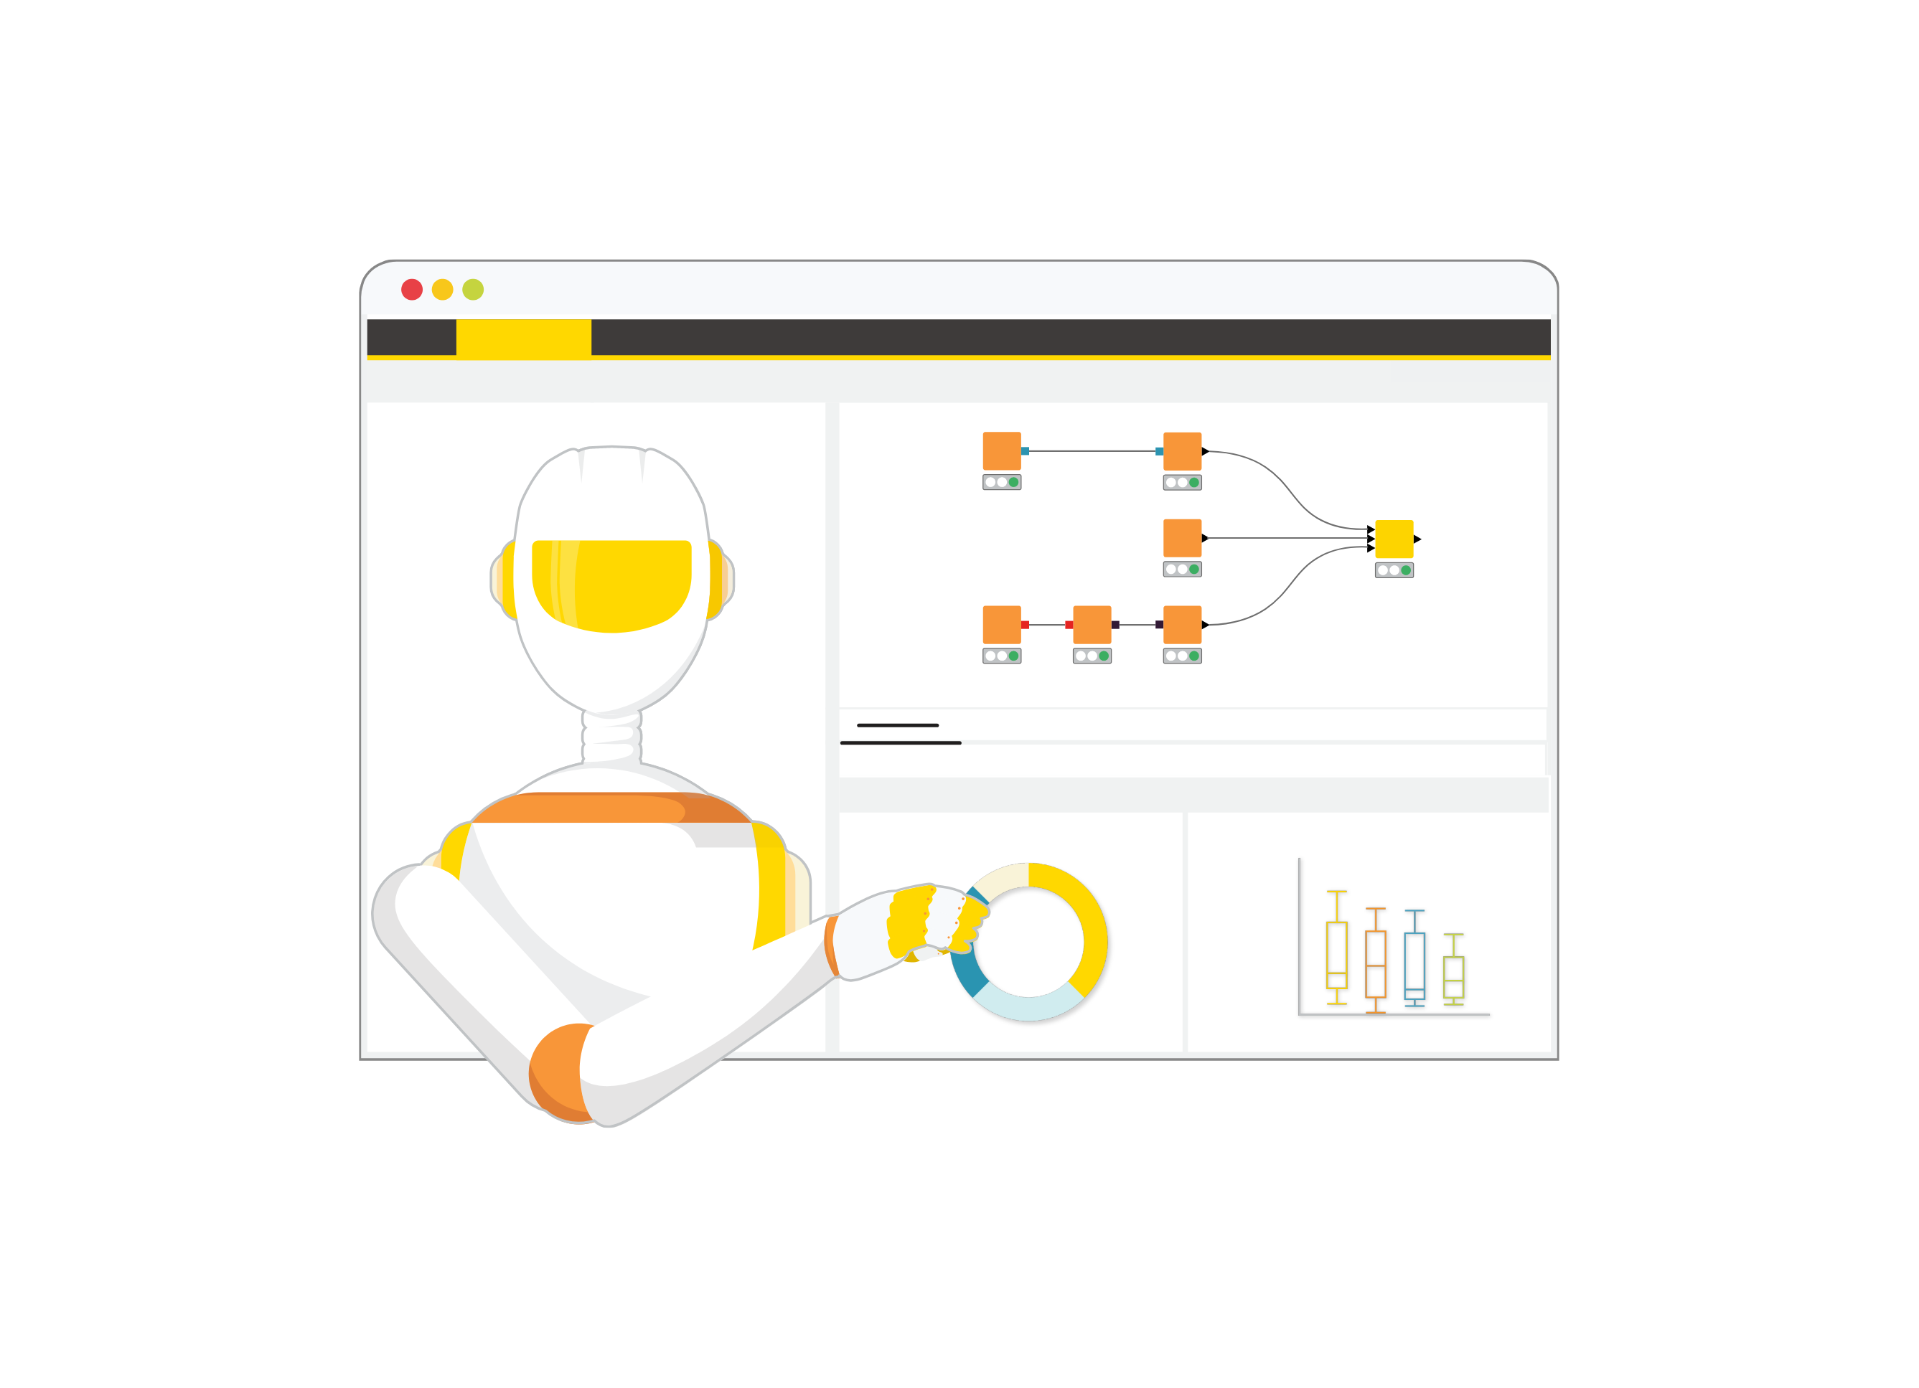
KNIME AP Session 4 –Visualise
Notes:
Now we will discuss ETL, a crucial process in the world of data analytics that prepares data for analysis. Understanding ETL will provide a foundation for using KNIME effectively.

Slide 2

Session Outline
1 | Recap
2 | Step 4 – Visualisation of Data
3 | Understanding Nodes
4 | Built the Workflow
5 | Conclusion & Q&A
Notes:
We'll start with an ice-breaking session to get to know each other. Then, we'll dive into the concept of ETL and its importance in data analytics. Following that, we'll introduce KNIME, examining its features and applications. Finally, we will explore KNIME's interface, workflow design, and reporting capabilities.

Slide 3
Recap
Session goals emphasized transforming raw data into actionable insights.
Detailed exploration of e-commerce use case highlighting customer behavior analysis.
Extensive use of transformation nodes for ingestion, cleaning, and calculation tasks.
Filtering and sampling techniques applied to refine data sets for accuracy.
Final data structuring essential for reliable sales trend analysis and reporting.
Notes:
Welcome everyone to the session. I'll start by introducing myself and sharing a bit about my background in data analytics. This will help us understand each other's perspectives.

Slide 4
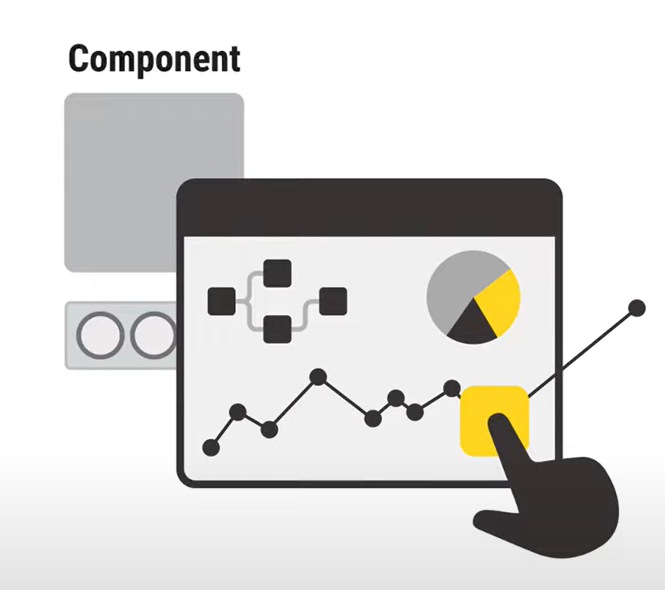
Overview of Session Goals
Visualize
Data
Data visualization consists of representing the information of data tables in a visual way. It helps to understand the data and get more insights. By plotting your data, it is possible to identify patterns, relationships, and trends that are hidden in tabular format.
Notes:
Finally, I'll outline the goals for today's session. Our aim is to provide you with a solid understanding of KNIME and its capabilities in data analytics, and to leave you feeling empowered to use the tool effectively.

Slide 5
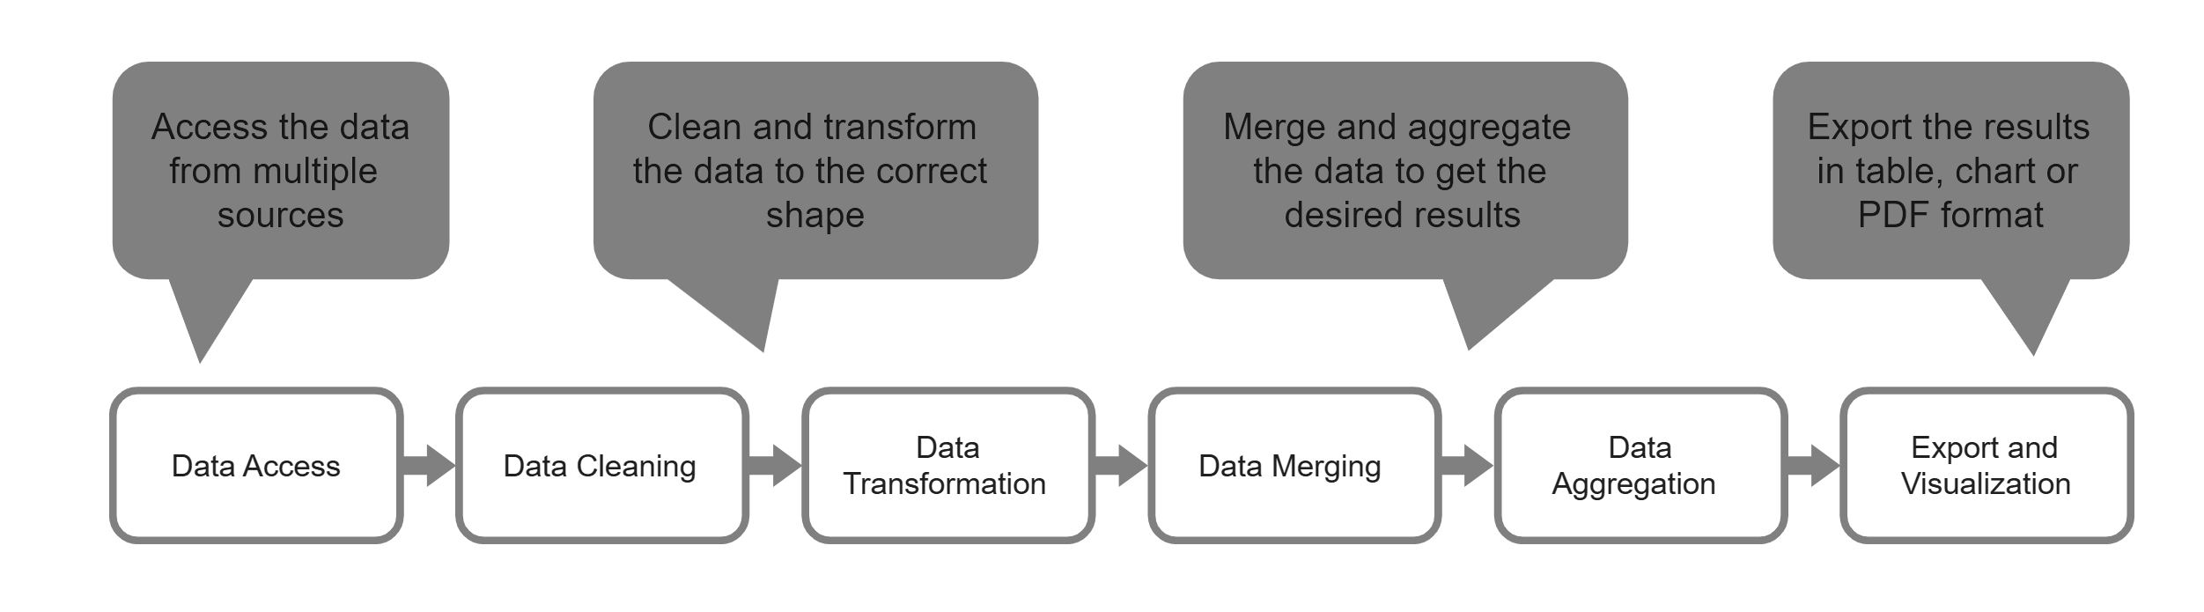
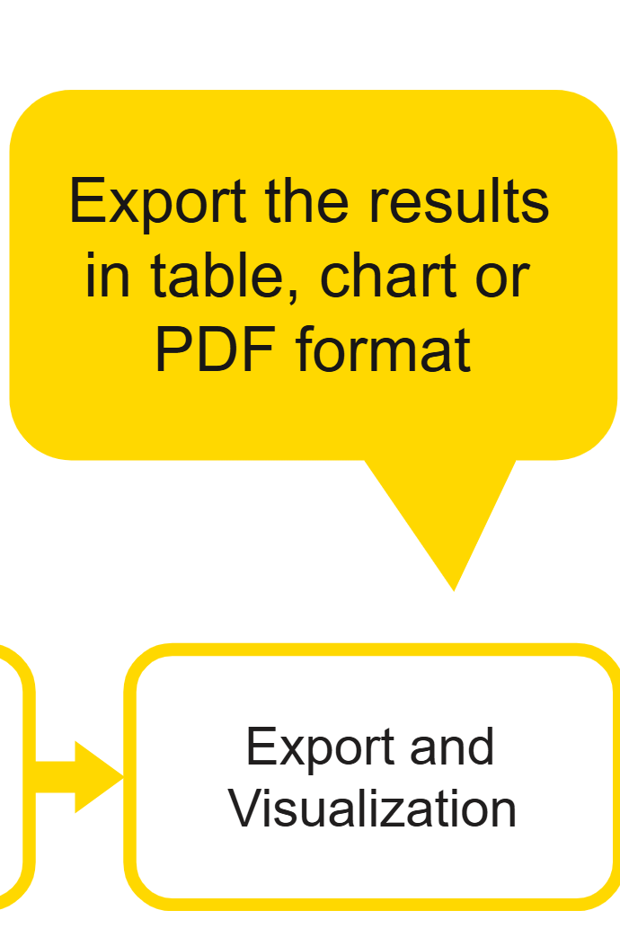
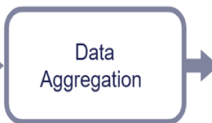
STEP 4
Knime Hub- Visualization

Slide 6
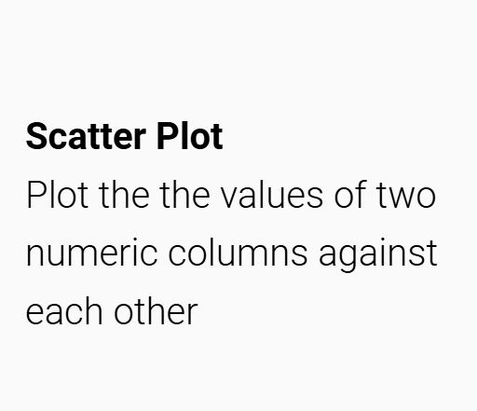
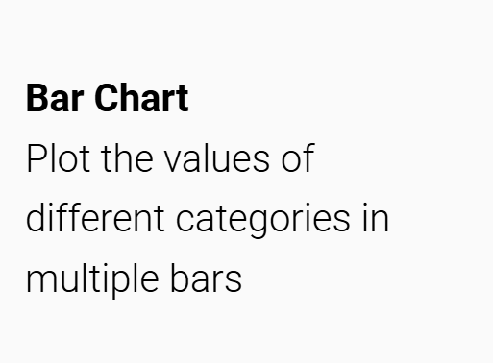
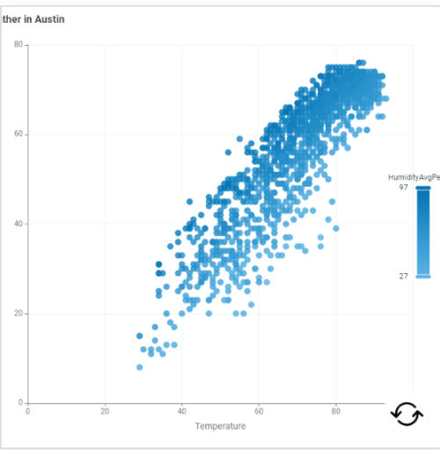
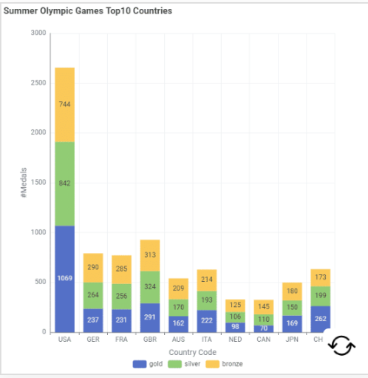
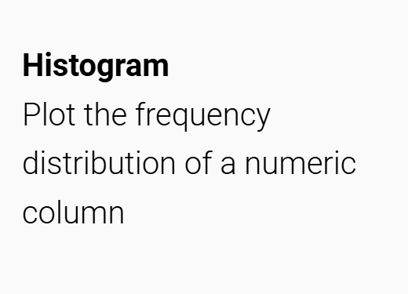
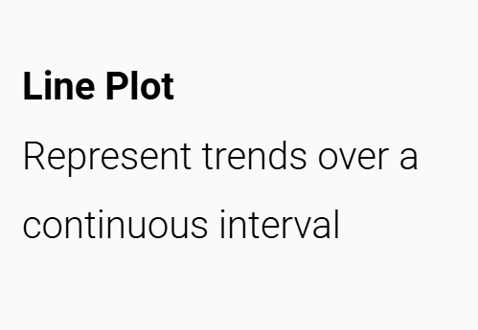
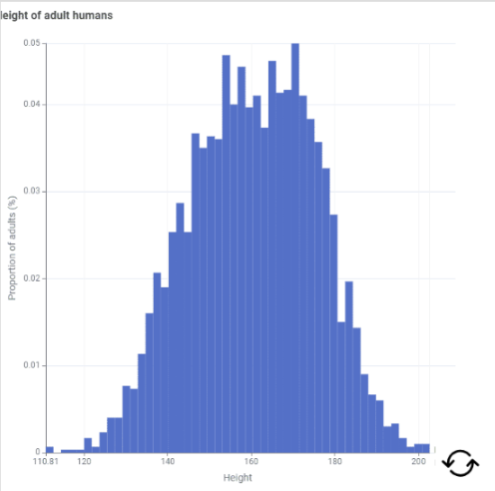
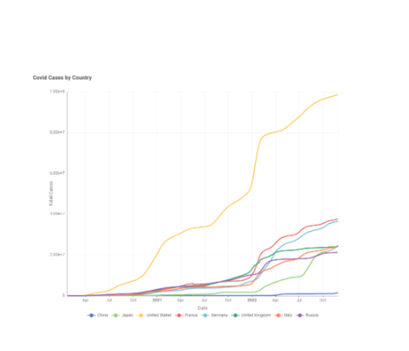
Different Charts

Slide 7
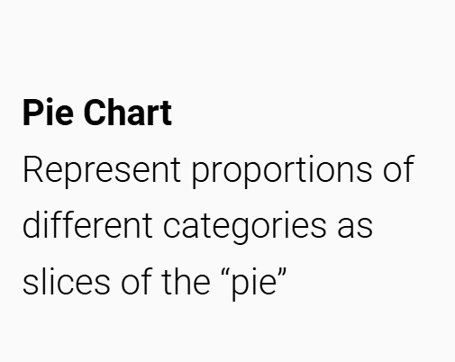
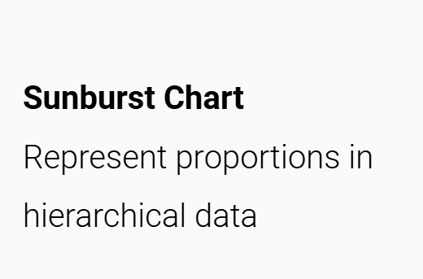
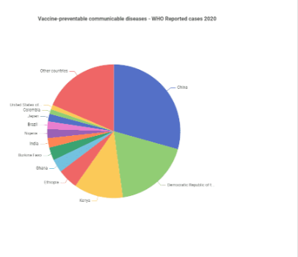
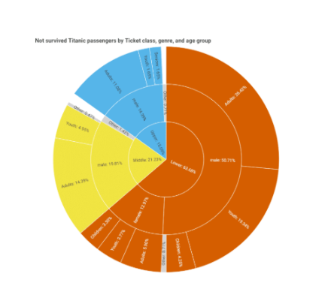
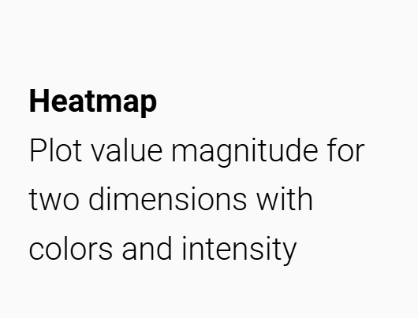
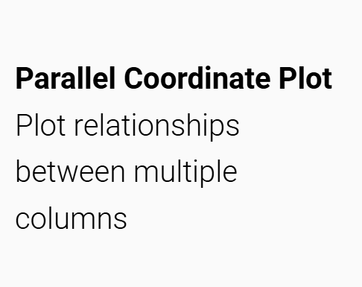
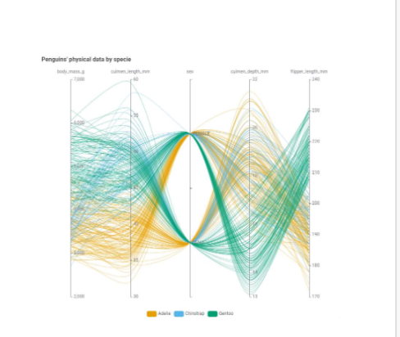
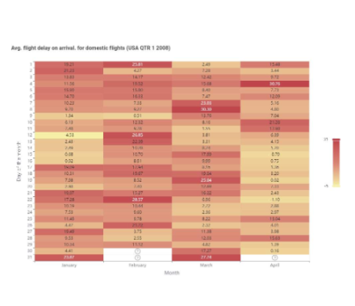

Slide 8
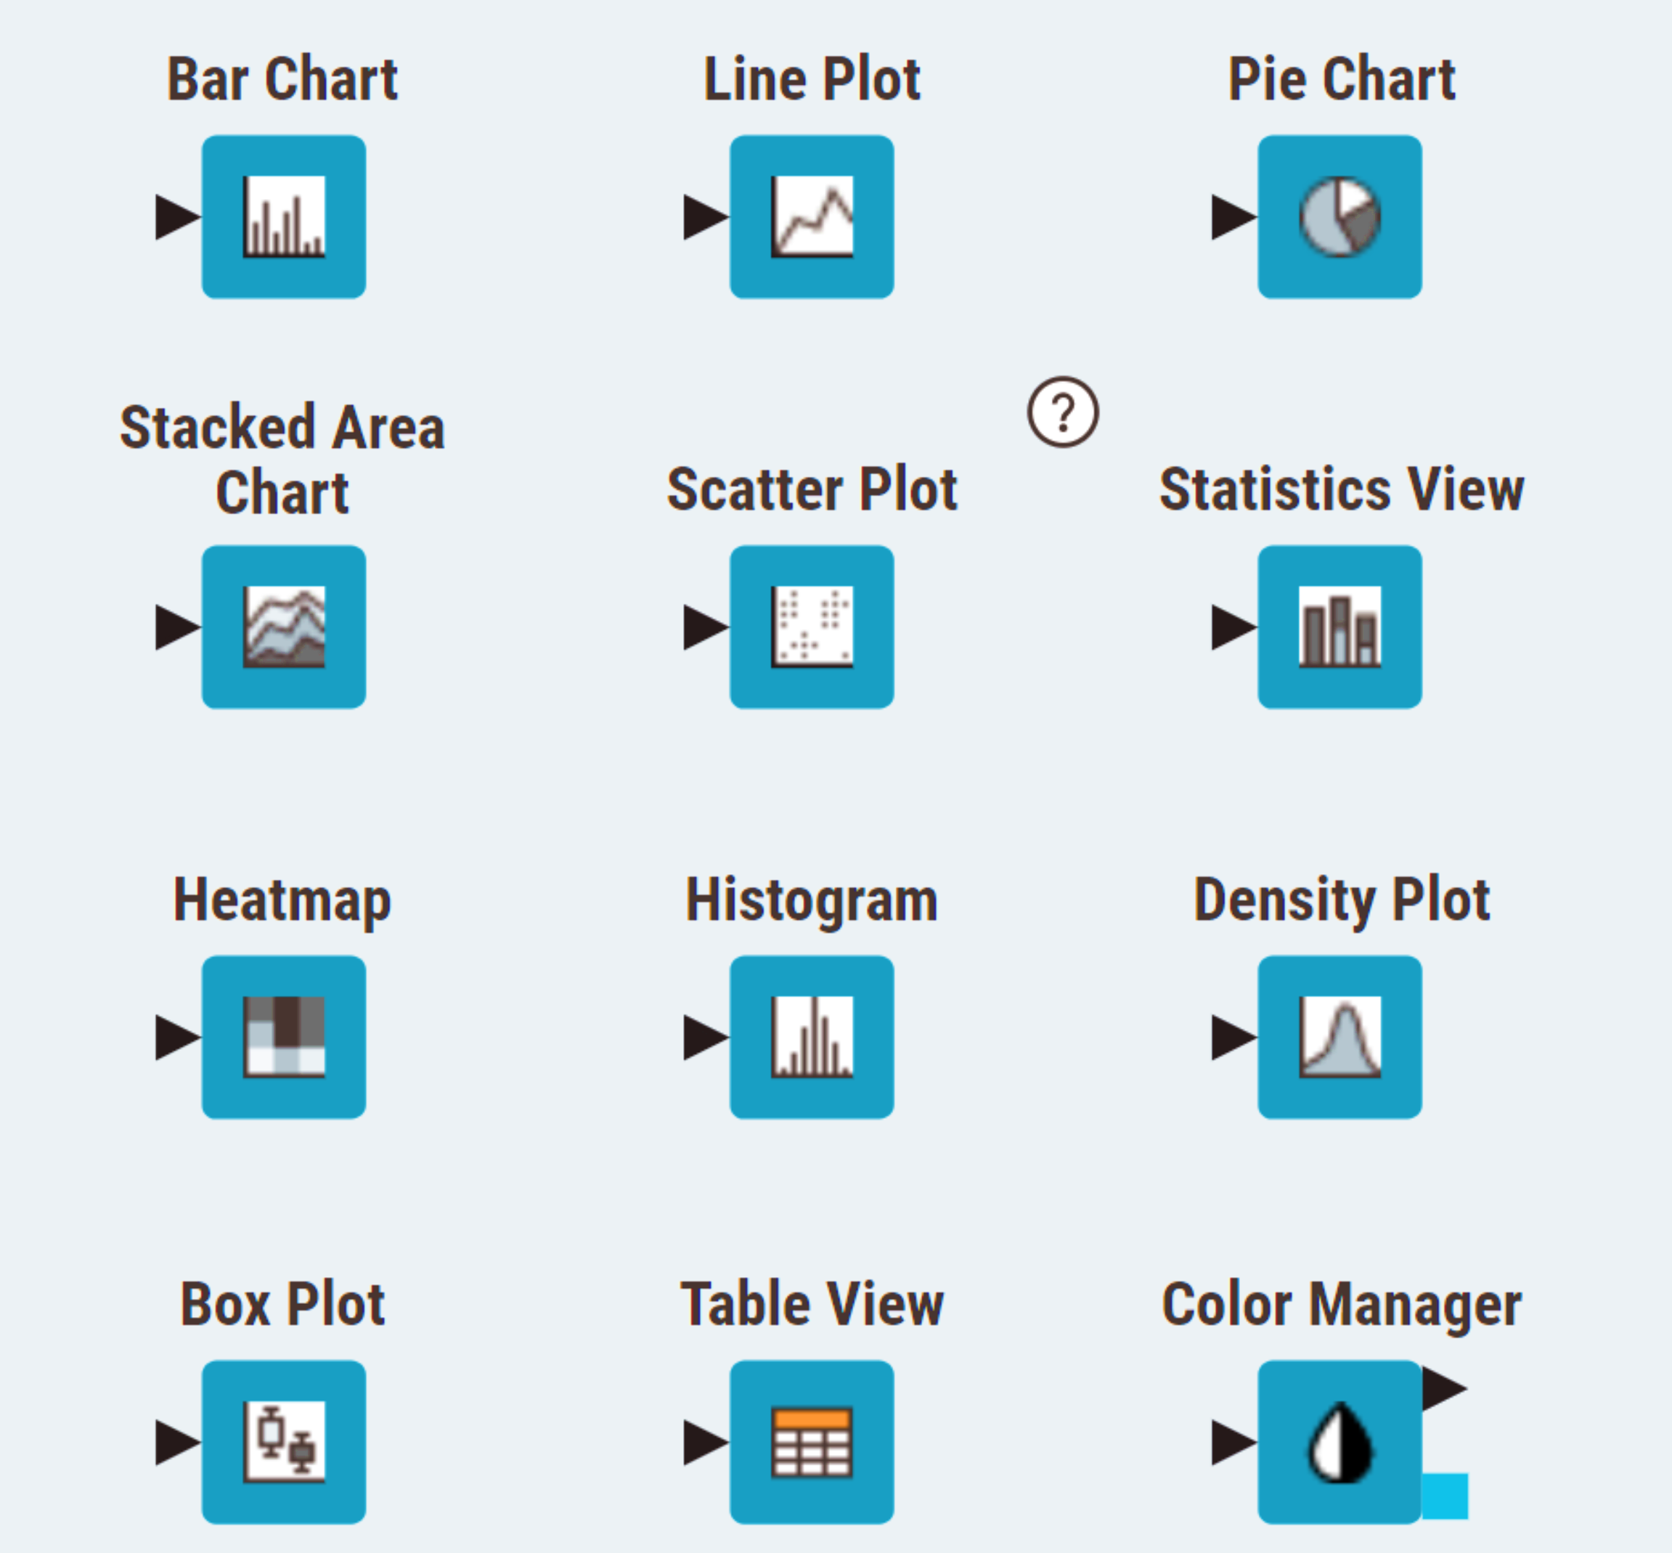
Visualisation/ Views Nodes

Slide 9
Q&A Thank you

