Slide 1

KNIME AP Session 5 – Write/Deploy
Notes:
Now we will discuss ETL, a crucial process in the world of data analytics that prepares data for analysis. Understanding ETL will provide a foundation for using KNIME effectively.

Slide 2

Session Outline
1 | Recap
2 | Write Data (Nodes and Configuration)
3 | Deploy Workflow
4 | Schedule & Trigger
5
Hands On / Q & A
Notes:
We'll start with an ice-breaking session to get to know each other. Then, we'll dive into the concept of ETL and its importance in data analytics. Following that, we'll introduce KNIME, examining its features and applications. Finally, we will explore KNIME's interface, workflow design, and reporting capabilities.

Slide 3
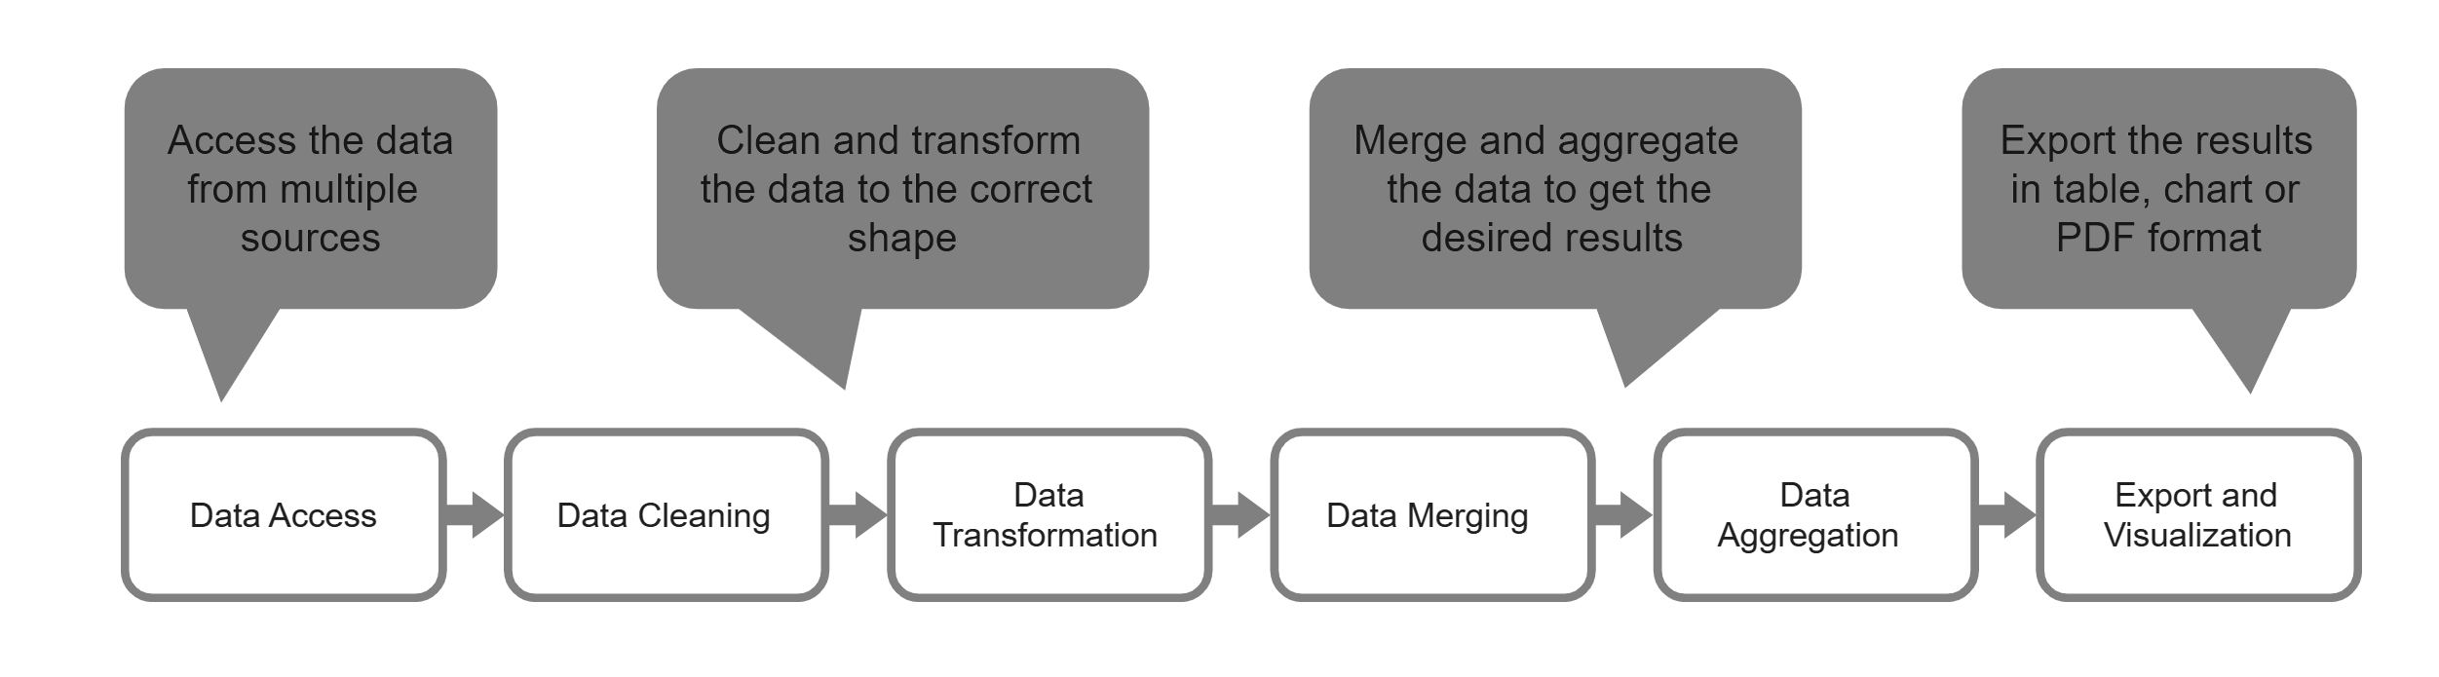
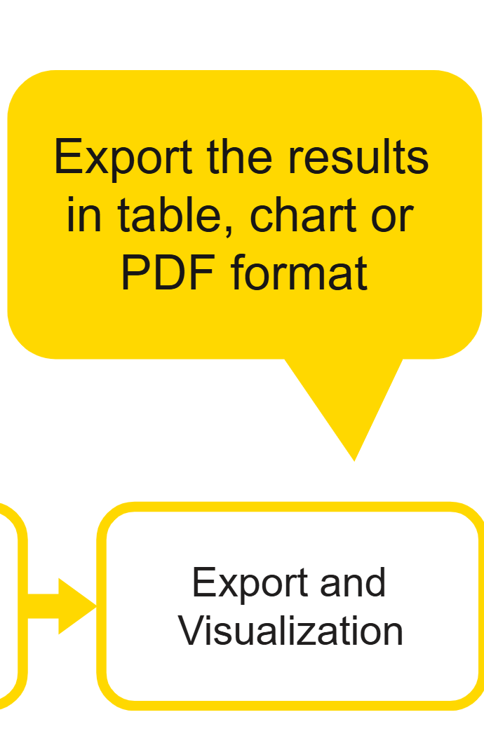
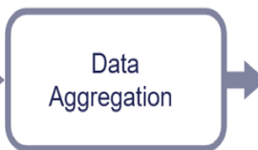
STEP 5
Write Data

Slide 4
1. CSV Writer Node
Writes data to .csv format.
Supports custom delimiters, quote characters, and missing value patterns.
Ideal for exporting tabular data for downstream use in Excel or other tools.
2. Excel Writer Node
Exports data to .xls or .xlsx formats.
Allows writing to specific sheets and appending data.
Advanced options include formatting and overwriting control.
3. JSON Writer Node
Outputs structured data in .json format.
Supports compression and formatting options.
Useful for APIs, web applications, or configuration files.
4. XML Writer Node
Writes XML-type table cells to .xml files.
Often used in data exchange or configuration scenarios
5. Image Writer (Port) Node
Exports images generated by visualization or graphic nodes.
Commonly used in reporting workflows.
6. Table to PDF Node
Converts a KNIME table into a formatted .pdf document.
Useful for generating static reports or summaries
Writing to Local Files
Notes:
ETL processes are essential for gathering data from various sources, transforming it into a suitable format, and loading it into data warehouses for analysis. This ensures data integrity and enables informed decision-making.

Slide 5
1. DB Connector Node
This node stores the database connection information (e.g., credentials, server details).
It acts as the source for both reading and writing operations.
You can easily switch environments (e.g., dev to prod) by swapping the connector configuration
2. DB Writer Node
This node is used to write data into a database table.
You specify the target table name and the columns to be written.
It accepts two inputs: one from the DB Connector and one from the data source (e.g., File Reader or Table Creator node).
3. DB Merge Node
Found in your chat with Oshin Mishra, this node is ideal for upsert operations—merging data into a table and inserting new rows if no match is found.
It simplifies workflows where data needs to be updated or appended conditionally.
4. Remote Connections
KNIME supports writing to remote databases using the “Add File System Connection port” feature.
This allows seamless integration with external systems and cloud-based databases
.
Writing to Databases
Notes:
ETL processes are essential for gathering data from various sources, transforming it into a suitable format, and loading it into data warehouses for analysis. This ensures data integrity and enables informed decision-making.

Slide 6
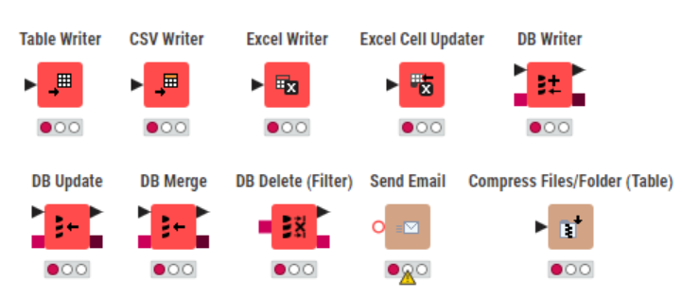
Most used Nodes
Notes:
ETL processes are essential for gathering data from various sources, transforming it into a suitable format, and loading it into data warehouses for analysis. This ensures data integrity and enables informed decision-making.

Slide 7
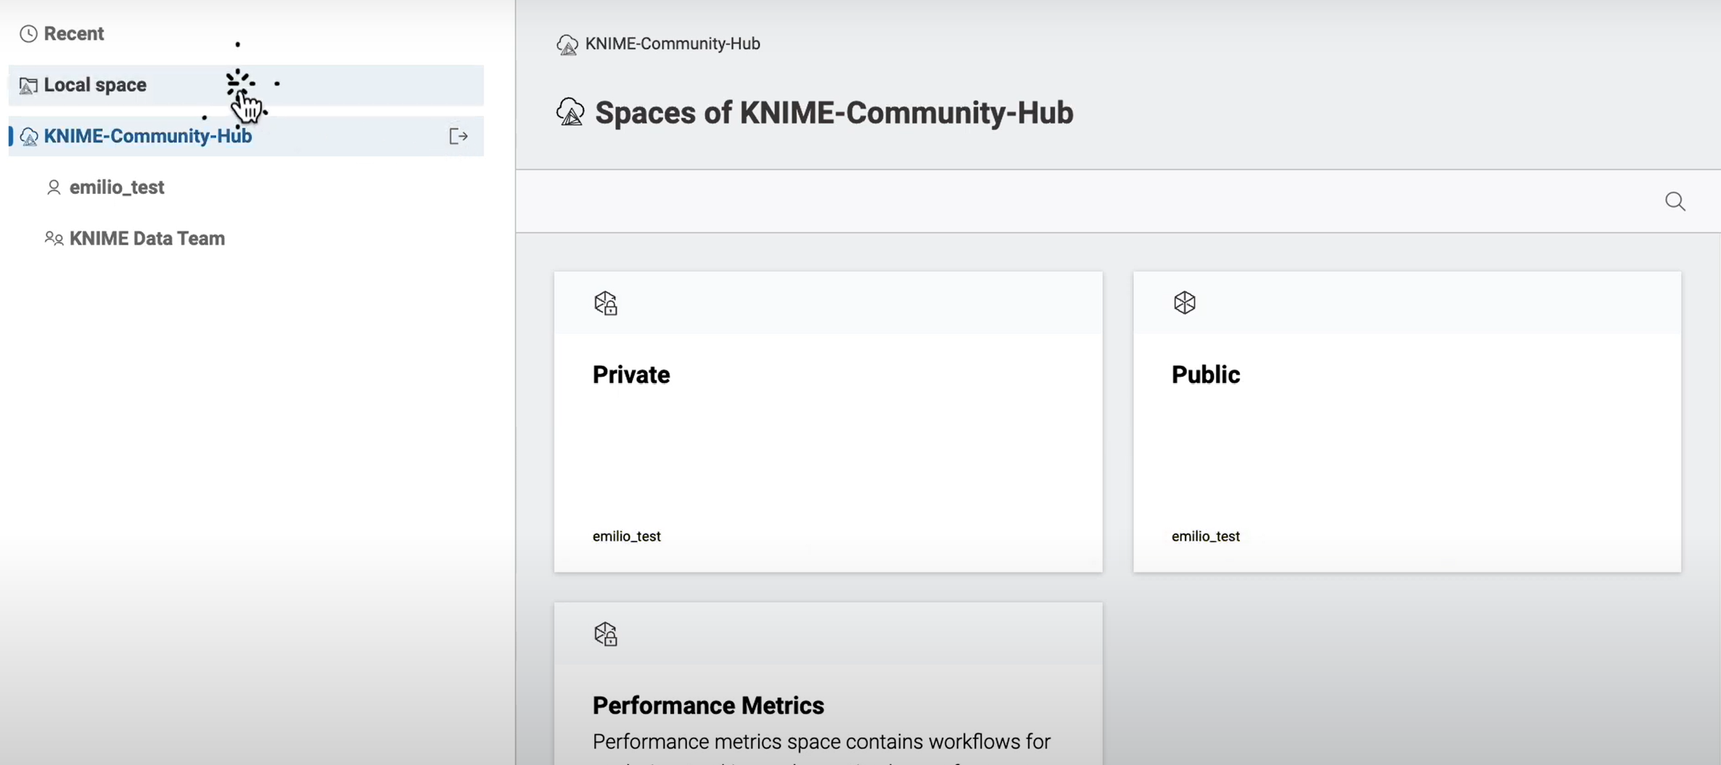
Collaborate in Server
KNIME Server is the enterprise-grade extension of the KNIME Analytics Platform. It enables teams to:
Automate workflows for repetitive tasks.
Schedule jobs to run at specific times or intervals.
Monitor workflow execution and performance.
Collaborate across teams using shared repositories and version control.
Upload
Ad hoc run
Schedule
Trigger

Slide 8
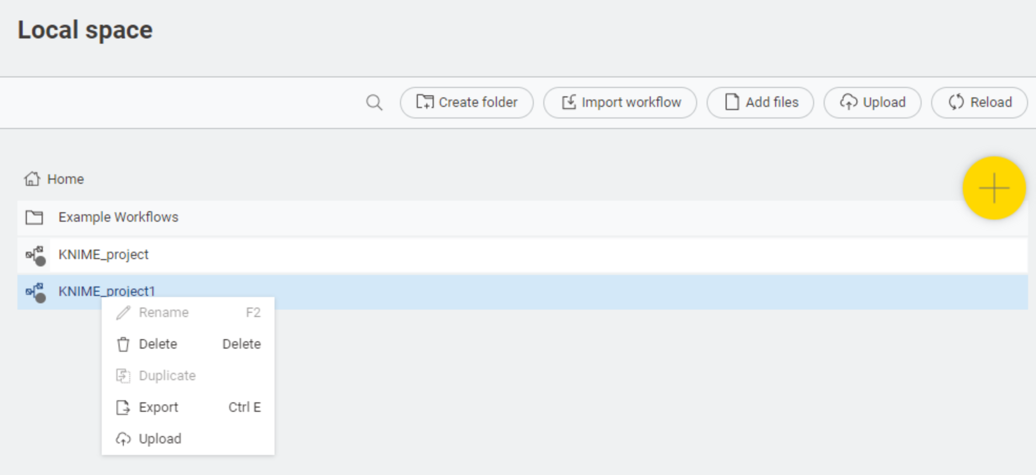
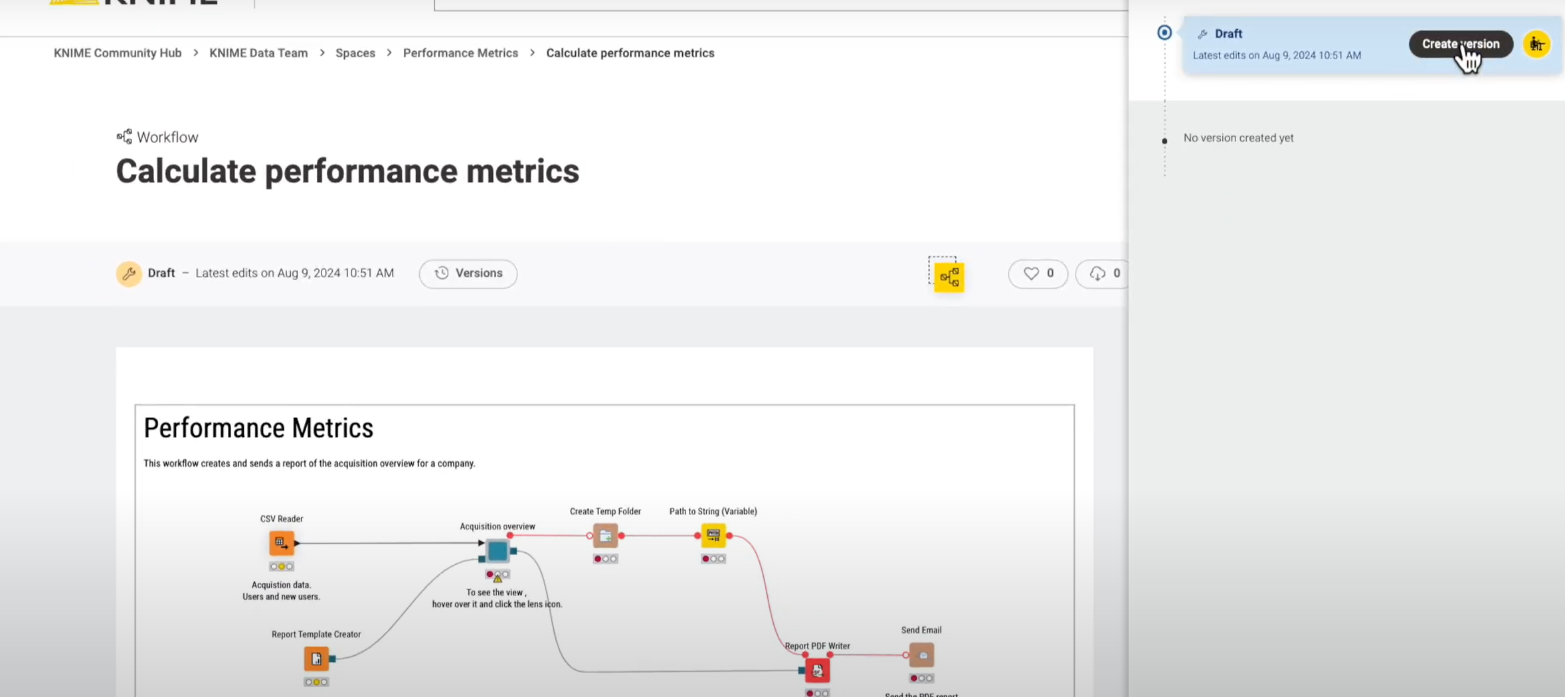
Deploy
The workflow will be a draft until version is created

Slide 9
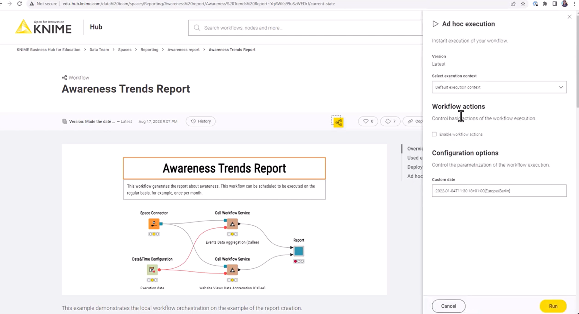
Opt 1 – Ad hoc run

Slide 10
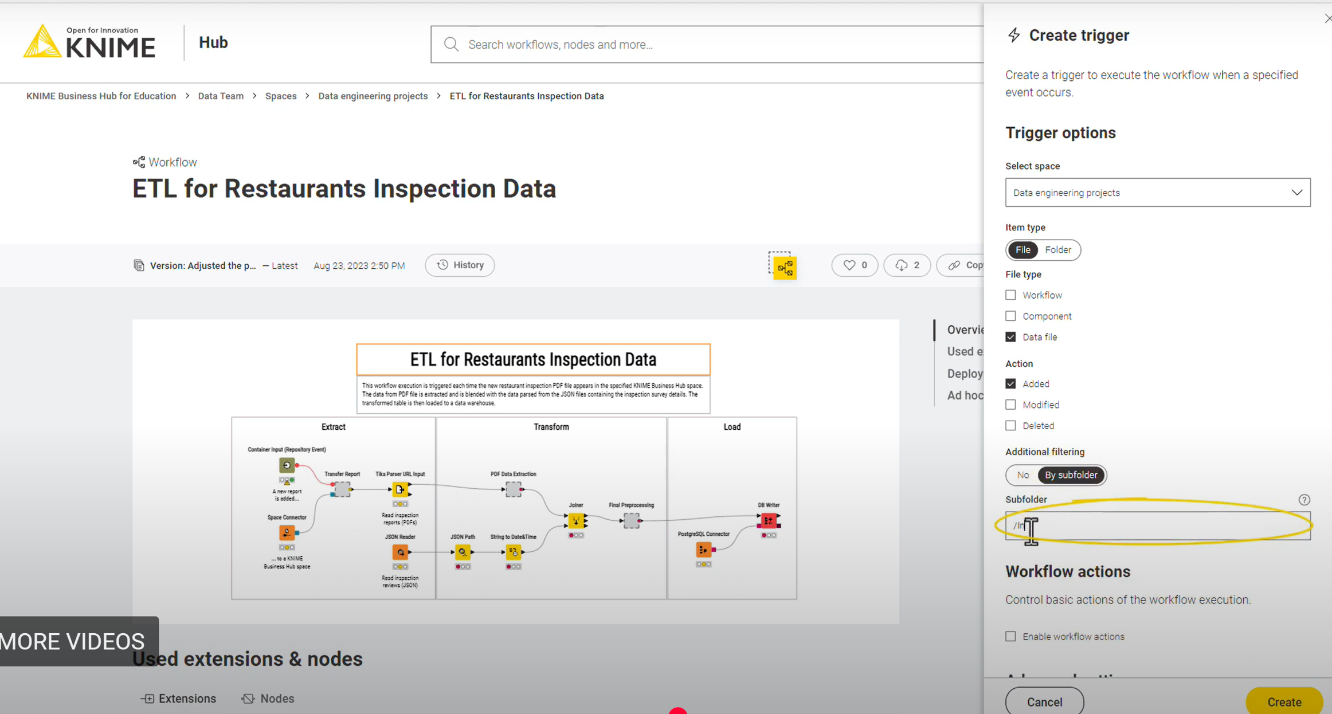
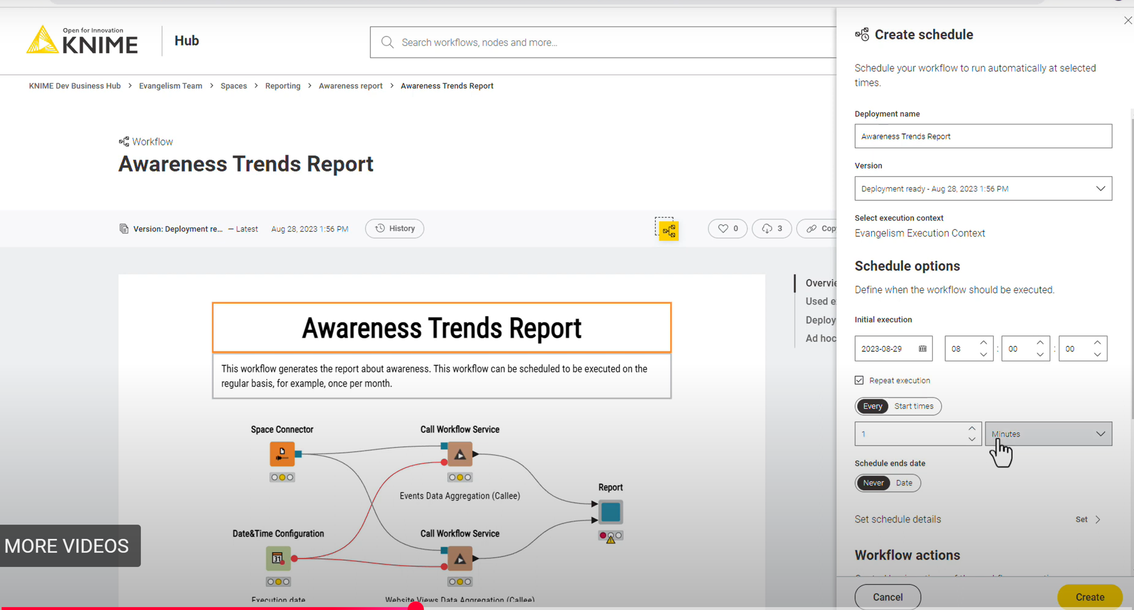
Opt 2 - Schedule

Slide 11
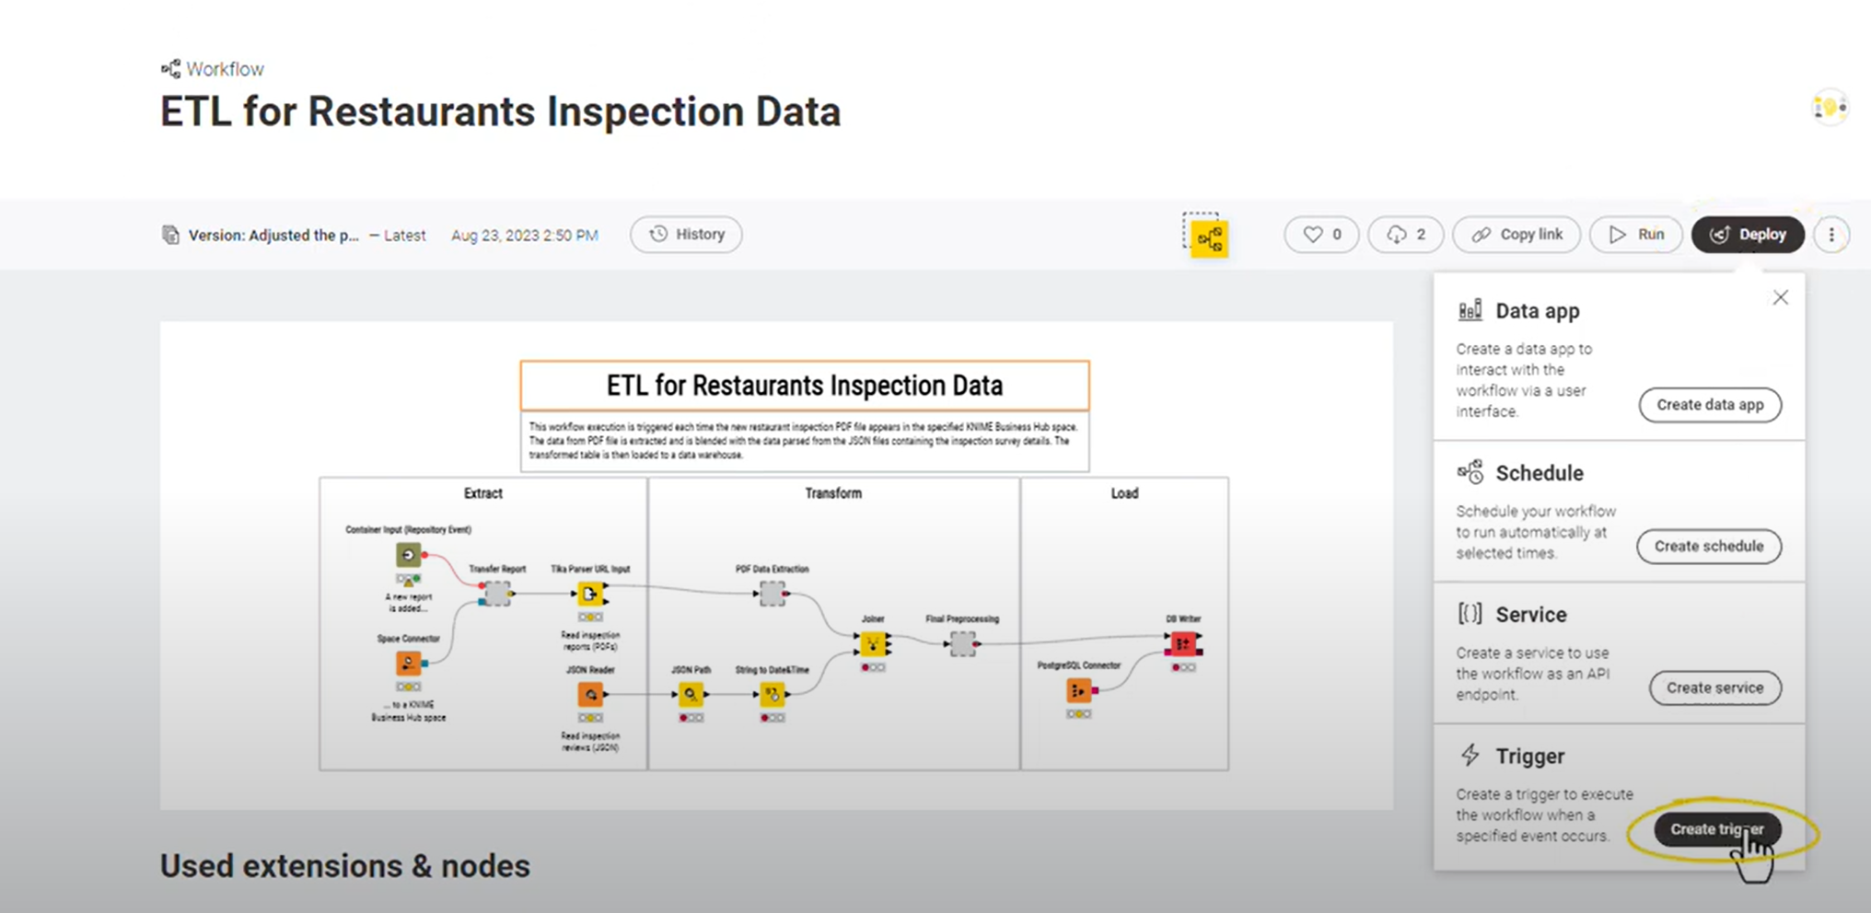
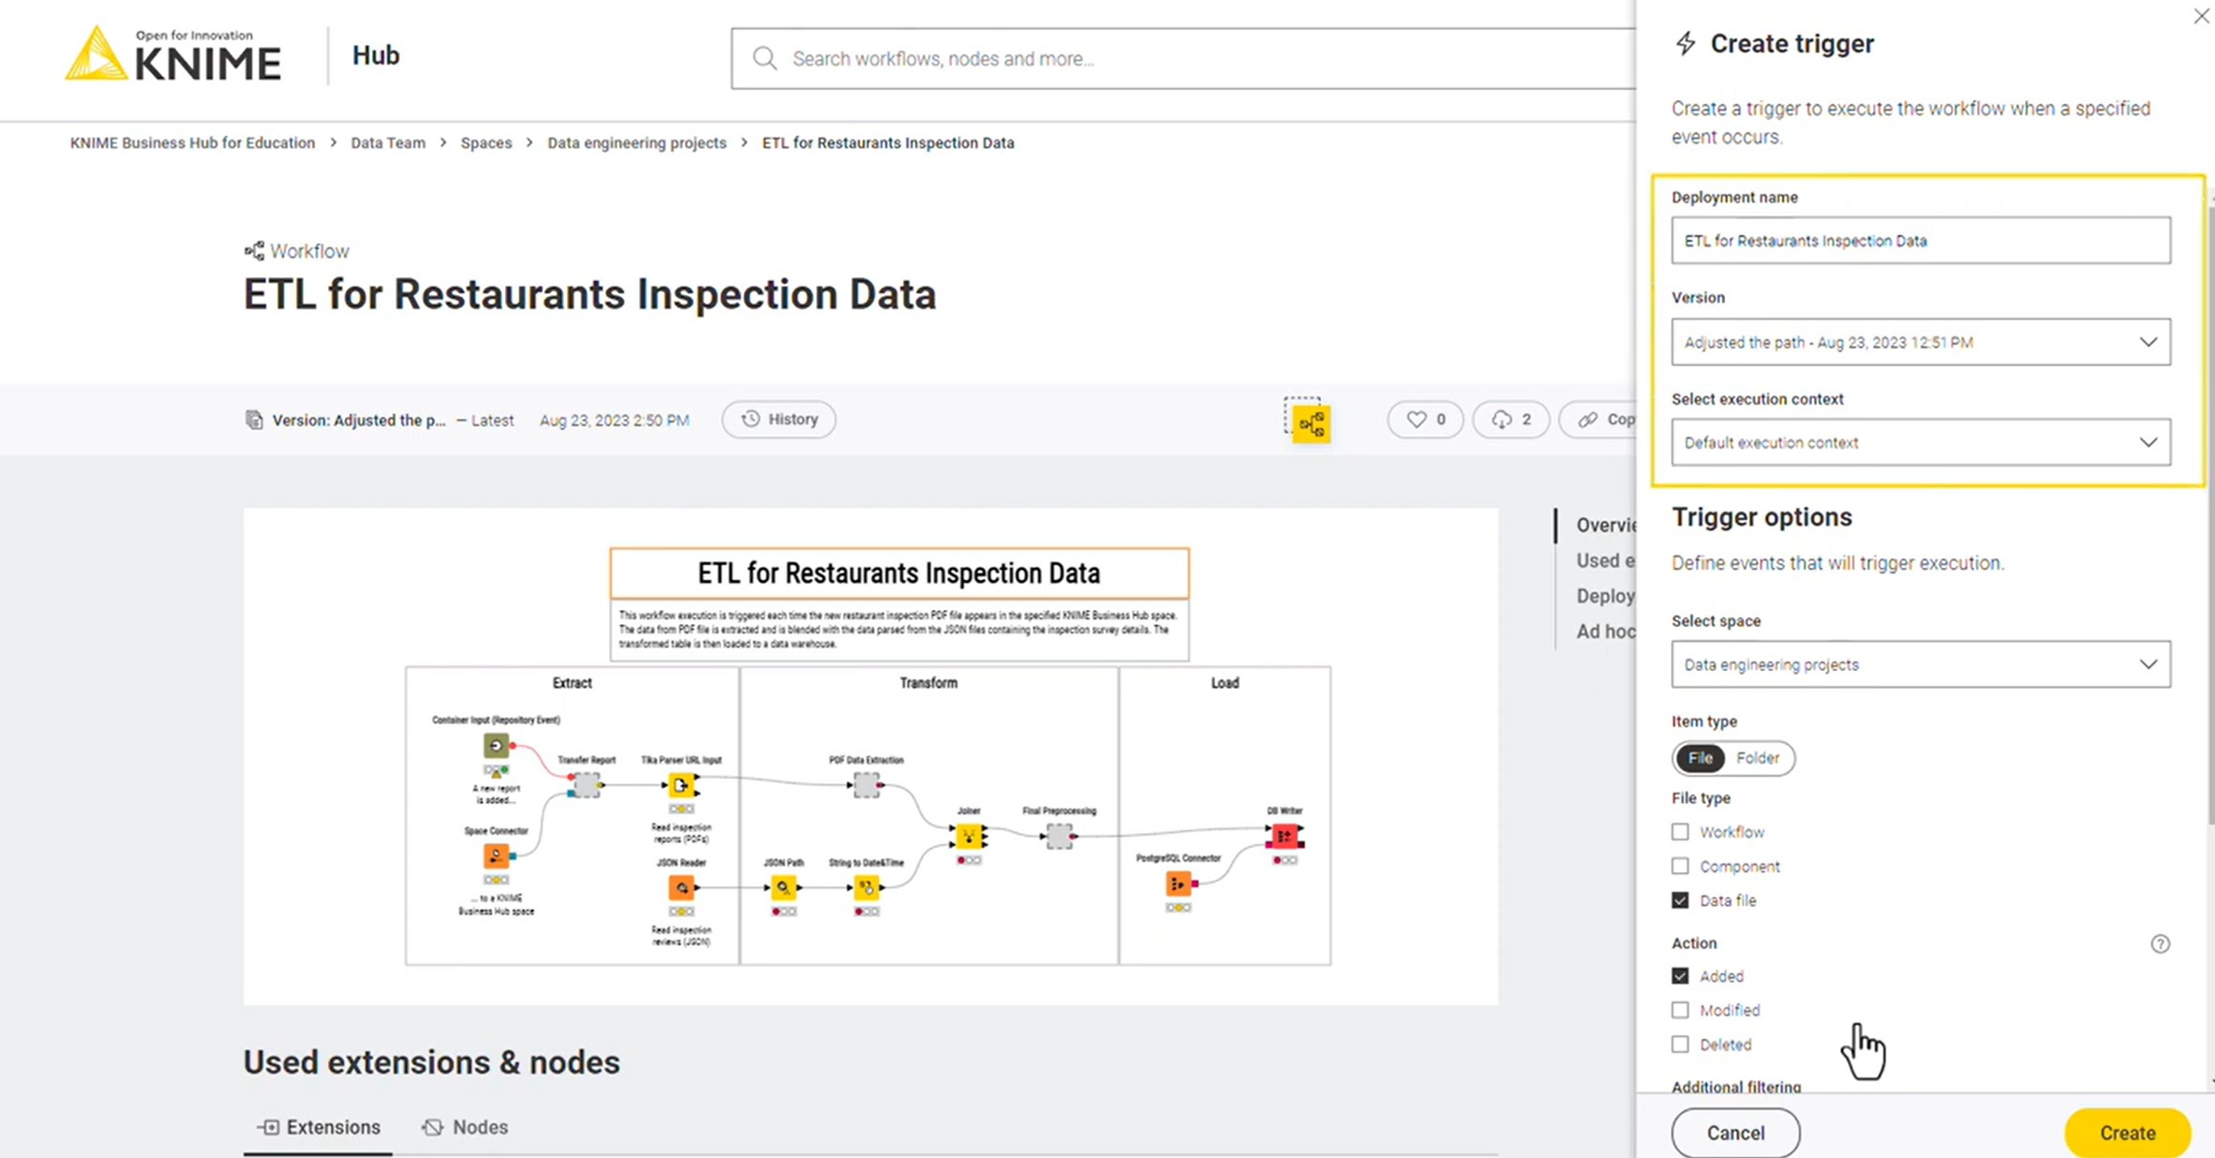
Opt 3 – Trigger

Slide 12
Q&A Thank you

