Slide 1
Sales Forecasting for Big Mart
Prepared by – Mayank Lalwani
Date – 31/07/2025

Slide 2
Project Goal & Business Importance
Objective: Predict monthly product sales at each store using historical, product, and outlet data.
Business Value:
Optimize inventory to reduce stockouts/overstock.
Inform marketing and pricing strategies.
Support strategic outlet planning and resource allocation.

Slide 3
Dataset Overview
Source: Big Mart Sales dataset with ~8,523 records.
Features: Product attributes (weight, fat content, category, price), outlet info (type, size, location), sales figures.
Target: Monthly sales revenue (Item_Outlet_Sales) — variable and real historical data.

Slide 4
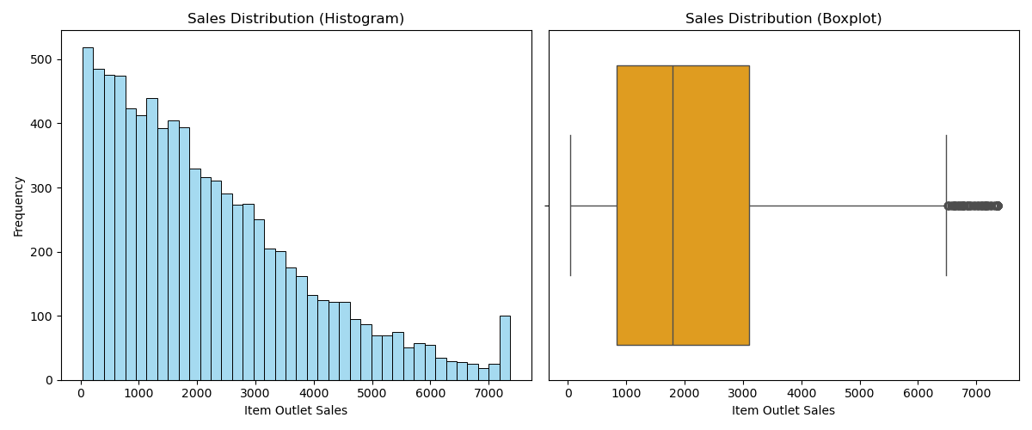
Sales Distribution Histogram and box plot

Slide 5
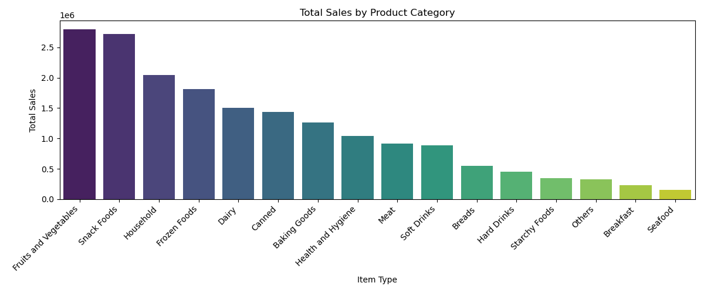
Revenue by product category

Slide 6
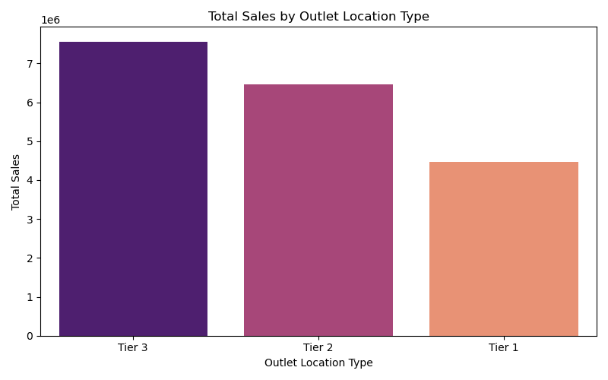
Revenue by outlet location type

Slide 7
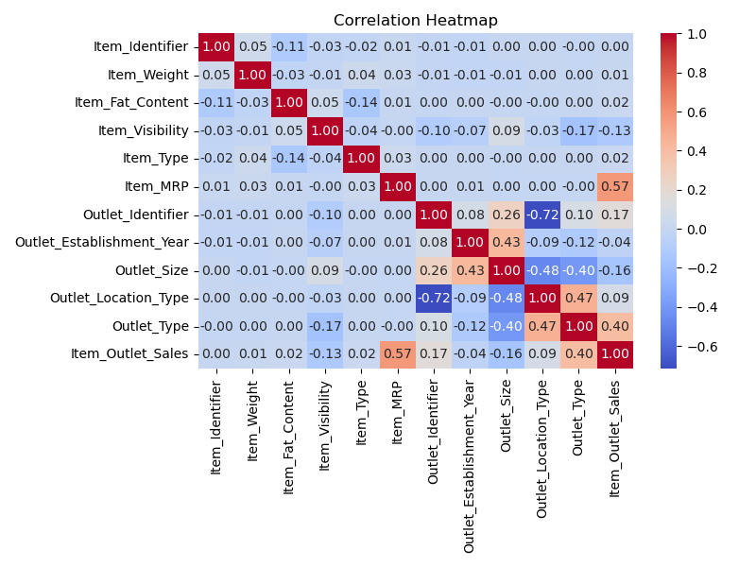
Feature Relationships and Correlation
Item price (MRP) positively correlates with sales.
Outlet characteristics significantly influence sales performance.

Slide 8
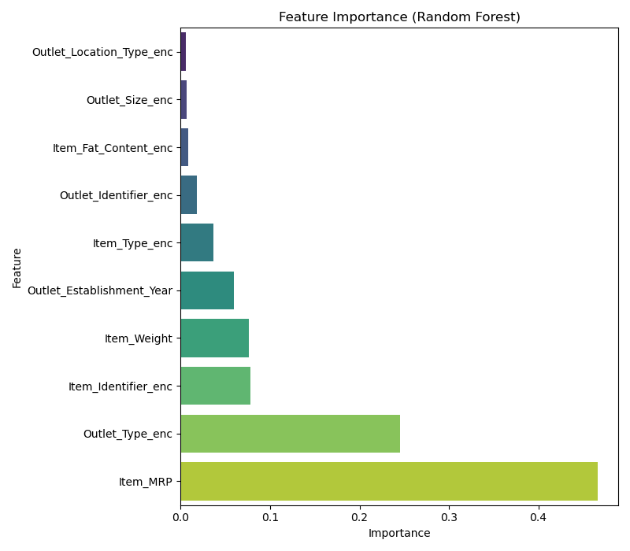
Feature Importance Visuals

Slide 9
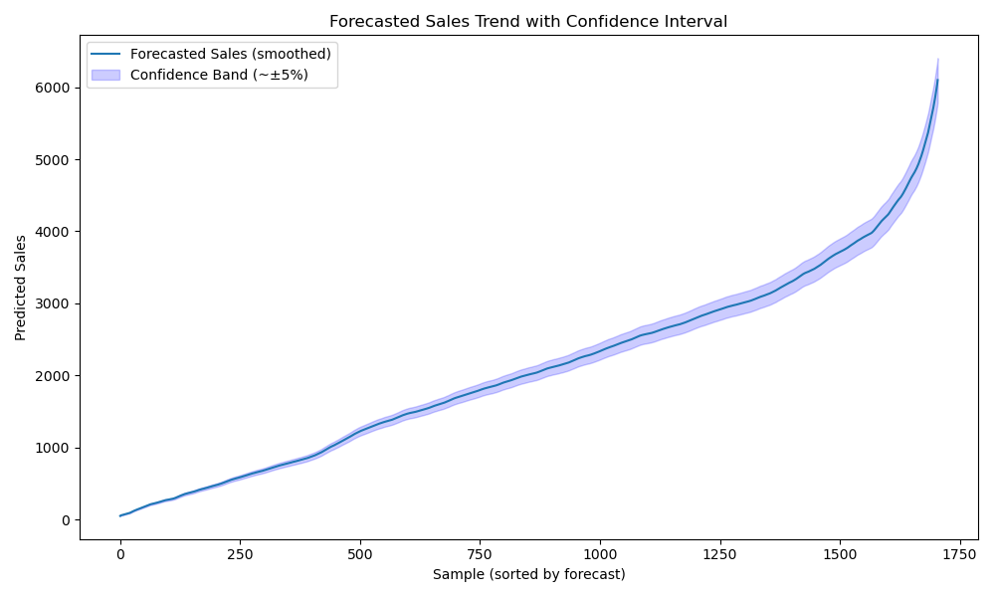
Forecasted sales values

Slide 10
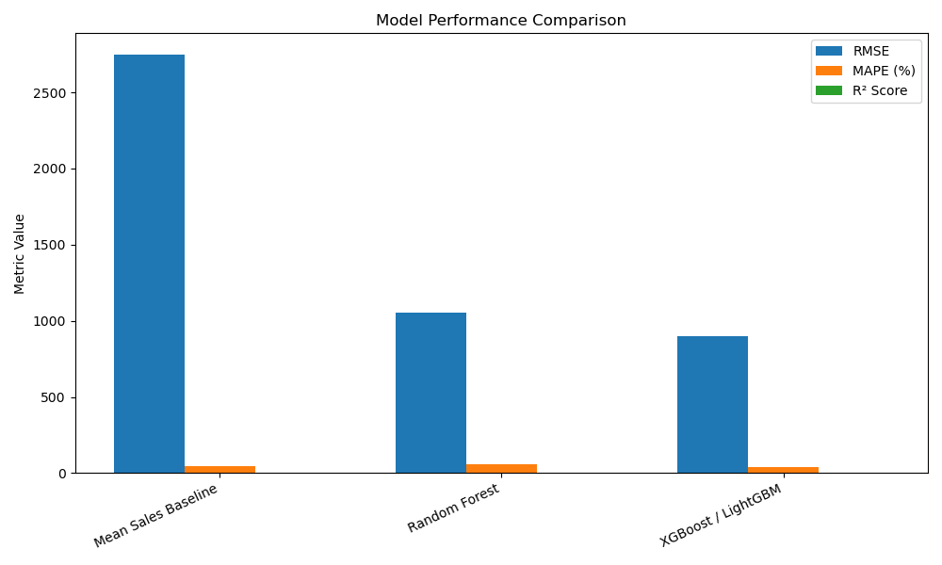
Model Performance Comparison

Slide 11
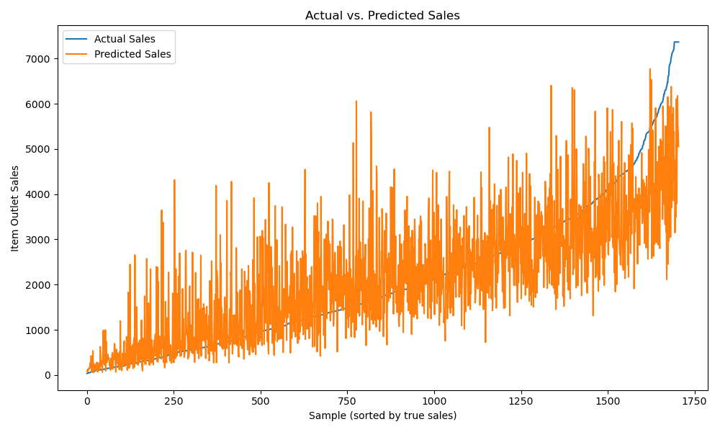
Actual vs. Predicted Sales line chart

Slide 12
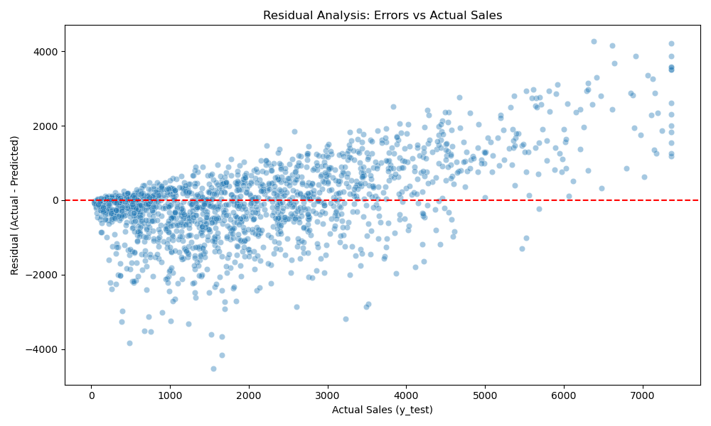
Residual Analysis

Slide 13
Key Business Insights & Recommendations
Sales Trends: Seasonal and category-driven fluctuations require proactive planning.
Inventory: Stock up before expected demand surges, focus on Food and Tier 1 outlets.
Pricing: Leverage price-sales correlation for dynamic pricing strategies.
Marketing: Target promotions during low sales periods to boost volume.
Expansion: Prioritize investments in high-performing regions and product segments.

Slide 14
Challenges & Future Directions
Limitations: Absence of transaction-level timestamp limits advanced time-series modeling.
Suggestions: Incorporate promotion data, external economic indicators, and marketing calendars.
Advanced Techniques: Explore hybrid models combining feature-based and sequential modeling.
Automation: Implement model retraining and online learning pipelines for sustained accuracy

Slide 15
Thank You

