Slide 1
Suicide Prediction Model
MIS 6357.002
Mayank Mohan Yadav
mmy190000

Slide 2
Problem Statement
80000 people commit suicide every year!
Suicide is a serious public health problem that can have lasting harmful effects on individuals, families, and communities.
AIM:
Building a prediction model to estimate likelihood of suicide based on available predictors

Slide 3
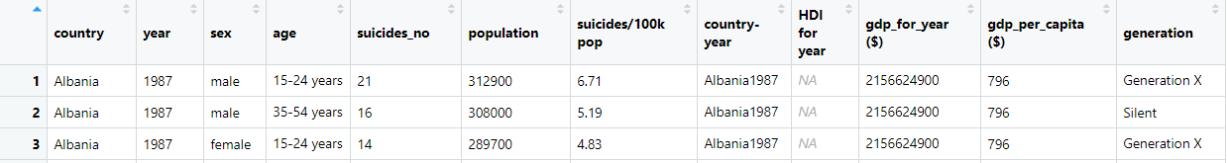
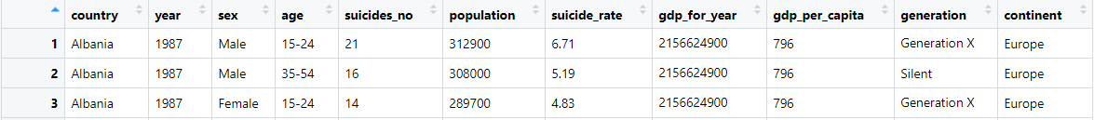
The Dataset
Source:
World Bank
WHO
27821 x 12
Timeline: 1985-2015
countrycode( sourcevar, origin, destination,…)

Slide 4
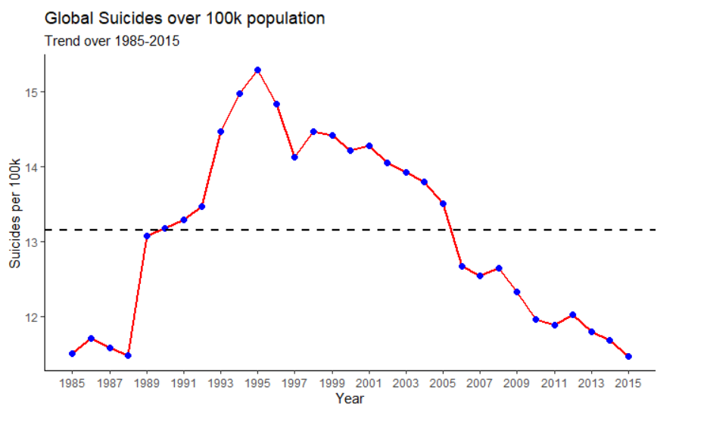
The Big Picture

Slide 5
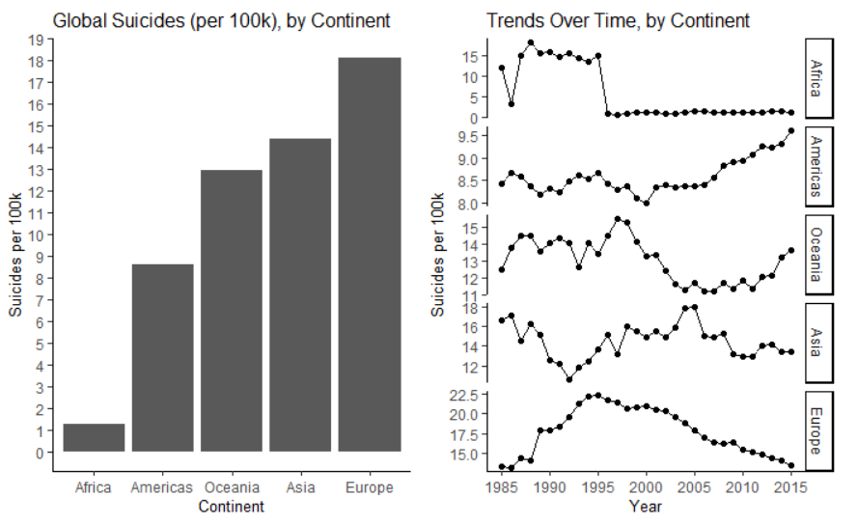
Trends with Continent
Conclusion: European countries have most the concerning numbers
Notes:
#countries in the continent of Africa report a suicide rate of 0 after 1995 which may actually not be the case and it might be that the governments hava not properly collected and reported the data to the World Bank and WHO. Trends of continents Americas and Oceania are on the rise which is concerning but even more concerning is the suicide rate of European countries through the years. They are literally on a different scale. No seriously, take a look at the difference in scales.

Slide 6
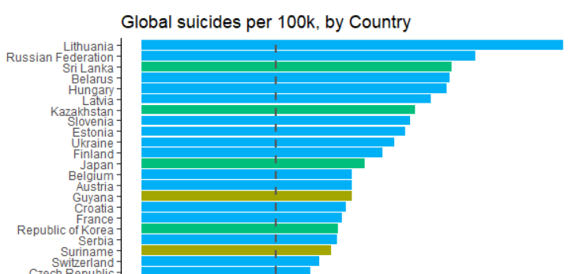
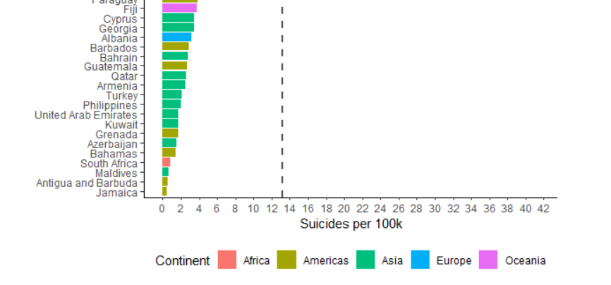
Notes:
Over-representation of European countries is concerning.

Slide 7
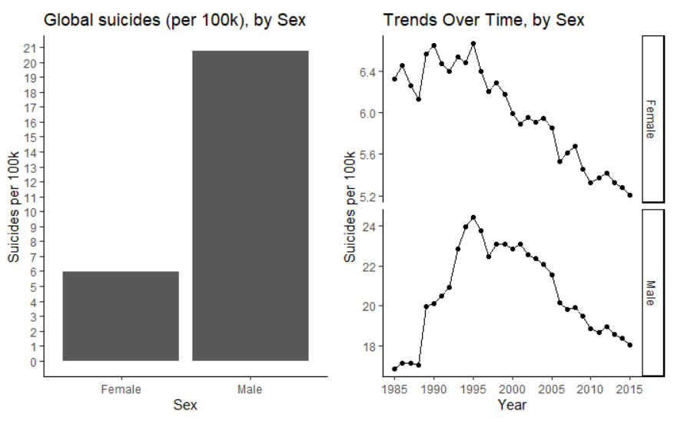
Trends with Gender
3x
Conclusion: Men commit more suicides than women
Notes:
#

Slide 8
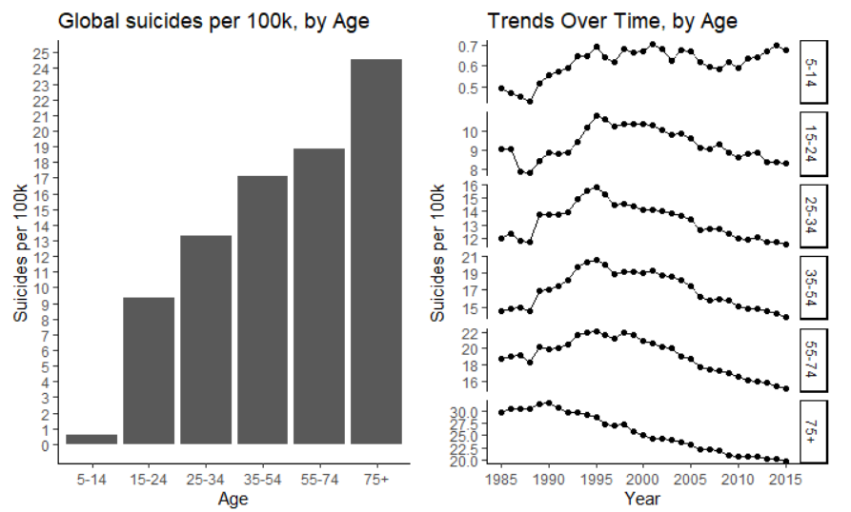
Trends with Age
Conclusion: Tendency increases with age
Notes:
#Through the years we are seeing a decrease in suicidal patterns across all age groups but one thing can be established-as age of a person increases the suicidal tendencies increase

Slide 9
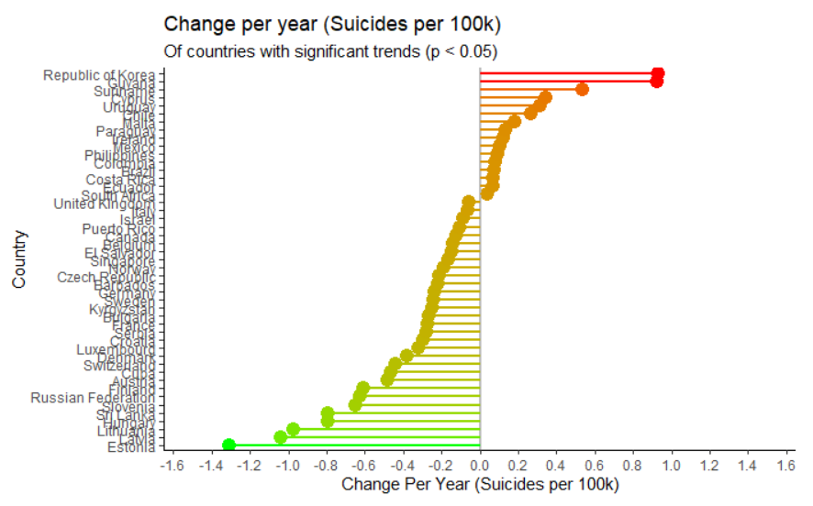
Rate of change among countries
Conclusion: 16 countries have increasing rate of suicide!

Slide 10
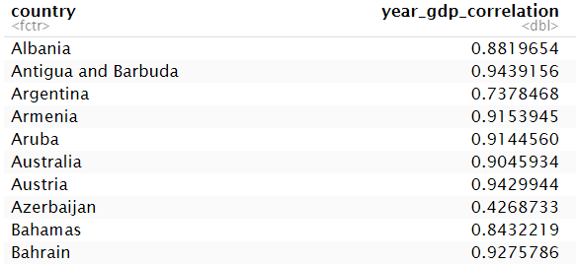
Establishing GDP-Year correlation using p-value
Interpretation: GDP for every country increases with year
Notes:
#In order to find a any kind of relationship between GDP and suicide_rate we must be certain that GDP is indeed increasing with years

Slide 11
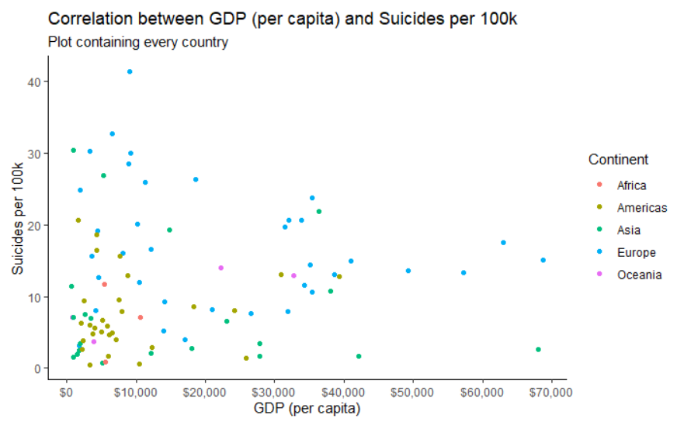
Does money really make you happy?

Slide 12

Prediction model building and comparison
dataframe
Random Forest chosen because:
No feature scaling required
Automatically handles missing values
Less impacted by noise
train
test
Linear model
Random forest model
tune()
predict()
predict()
calculate rmse

Slide 13
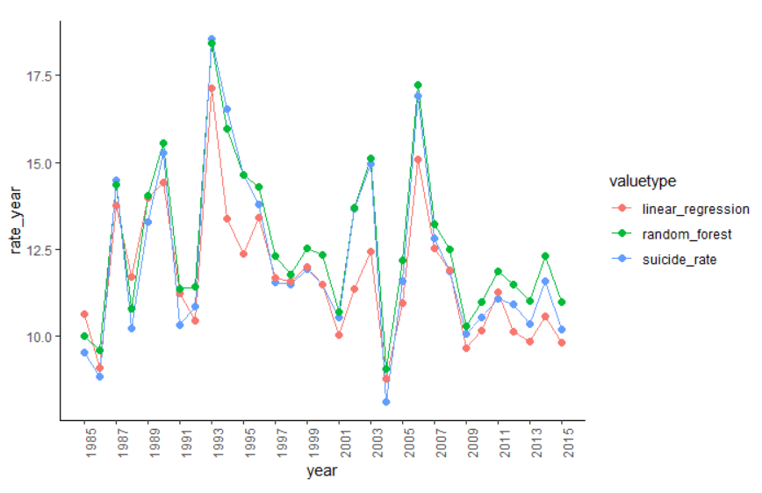
Comparison of predicted suicide values grouped by year for both models with the test values

Slide 14
Thank you!

