Slide 1
Prediction of Accident Severity
Capstone Project

Slide 2
Introduction
Motivation
Traffic accidents are severe concern for most of the countries
Approx. 1.25 million people deaths caused because of road accident injuries in a year [1]
Objective
To help traffic control authorities predict the accident severity
Effectively able to predict “Serious” accidents

Slide 3
Dataset
Size of Dataset: ~70 MB
Number of records: 194673
Number of columns: 38 Columns
Source : Seattle city car accident data from 2004-2020

Slide 4
Data Pre-processing
Data missing values are imputed by the most frequent value of the column
Categorical data labelled with numerical values
Merged similar categorical values
SelectKBest: provides the k best features by performing various statistical tests i.e., chi squared computation between two non-negative features
RFE(Recursive Feature Elimination): Recursively eliminates the features which does not in target variable values
Merged Serious and Fatal classes as Serious class

Slide 5
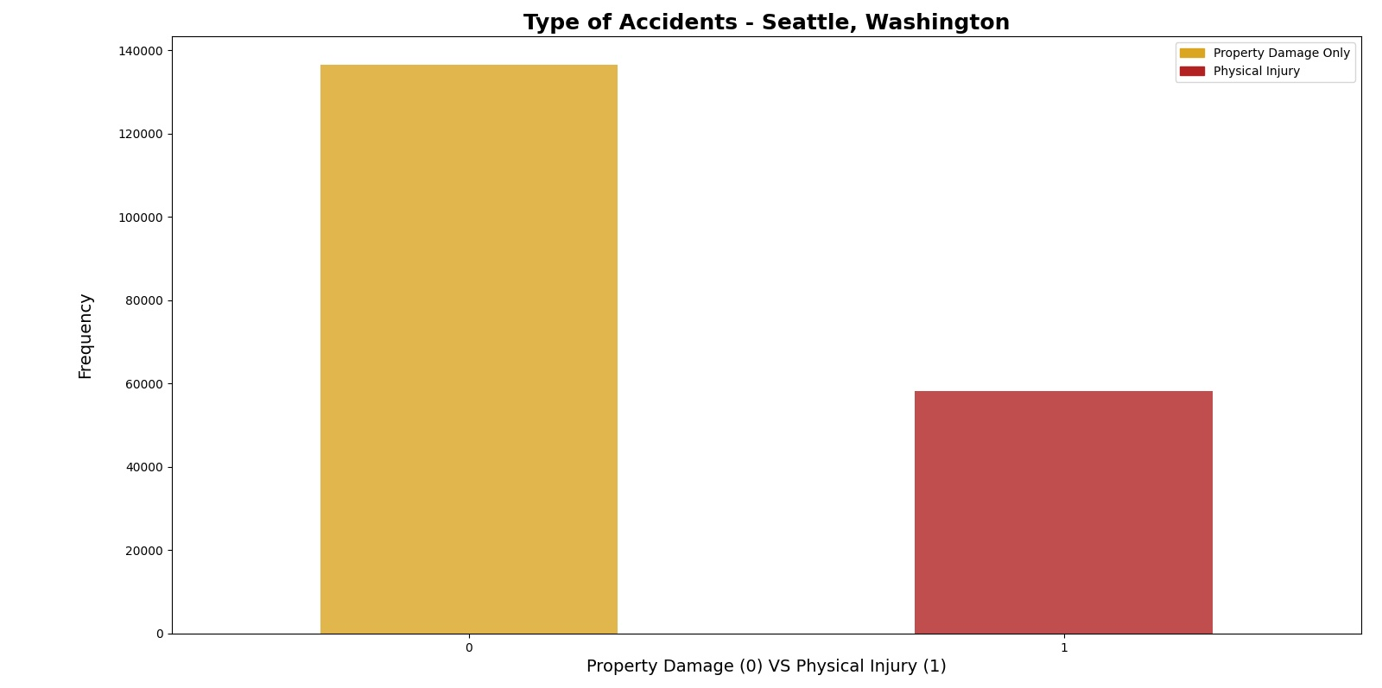
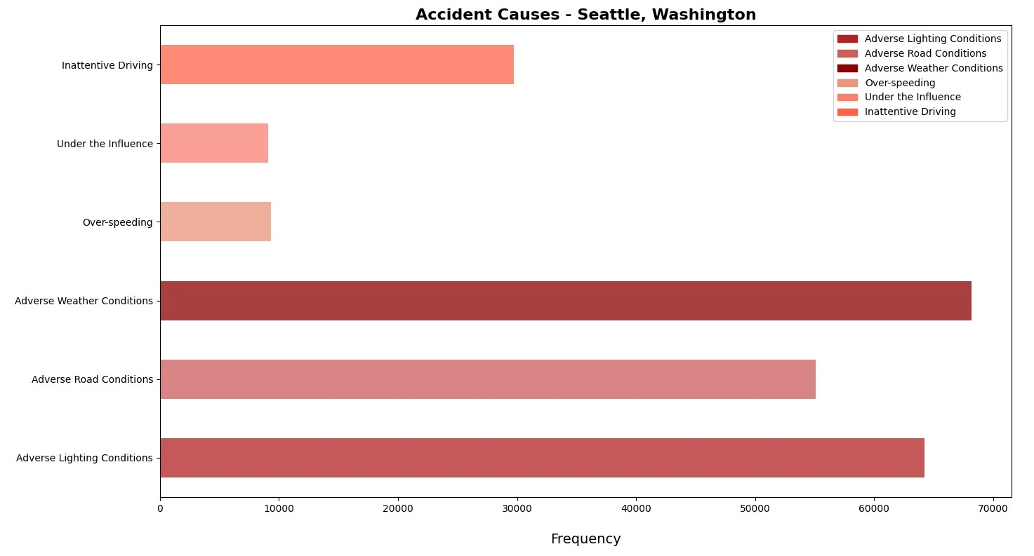
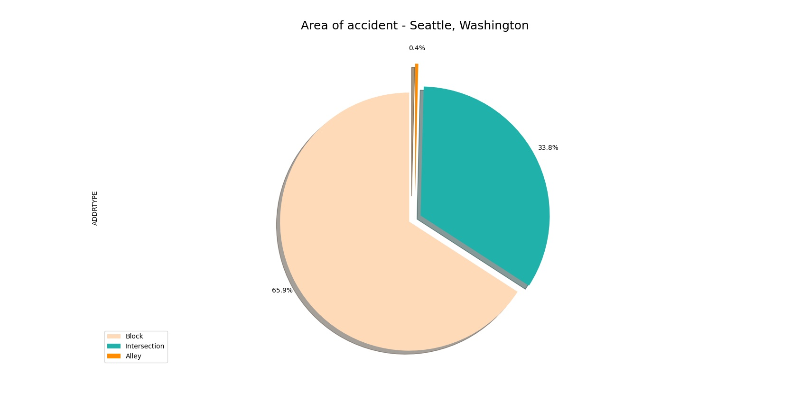
Data Visualization

Slide 6
Algorithms Used
K- Nearest Neighbor
Decision Tree Analysis
Logistic Regression

Slide 7
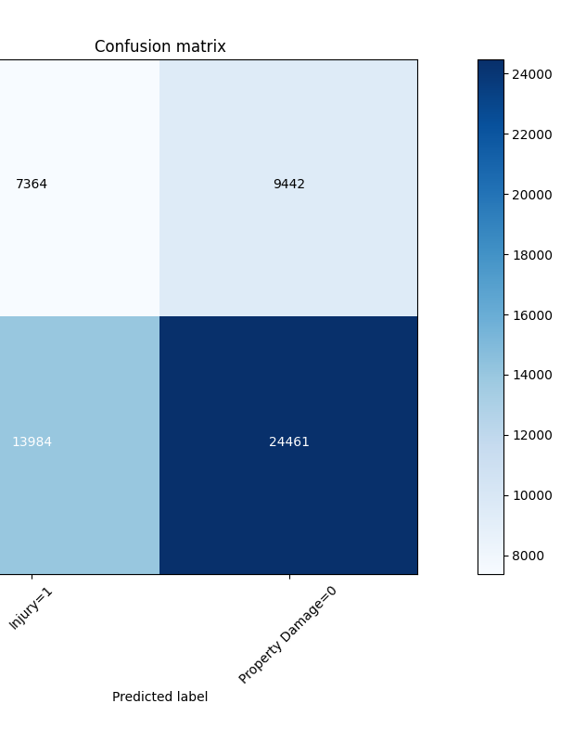
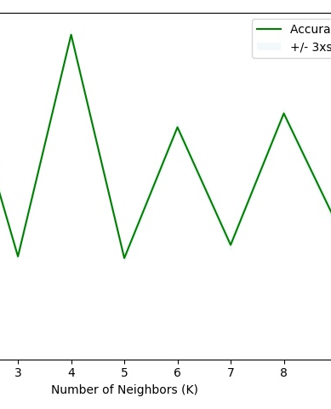
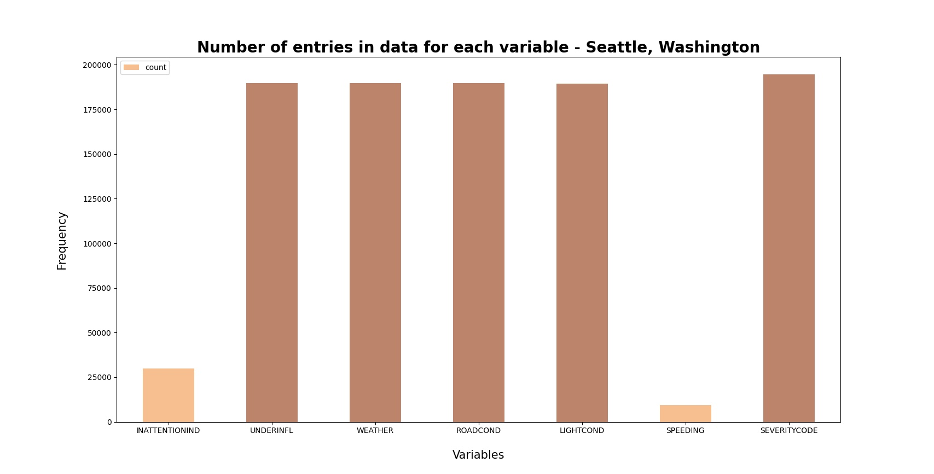
Comparative Analysis

Slide 8
Handling Imbalanced Data
Over Sampling
Under Sampling
Mis-classification penalty
Ensemble methods

Slide 9
Challenges
Cannot run most of the algorithms on local machines
Not able to test over sampling
Highly imbalanced classes

Slide 10
What worked What not worked
Under Sampling
Fine tuning the parameters
Data Preprocessing
Over Sampling
Certain popular ensemble methods did not work well

Slide 11
Conclusion
In conclusion, most of the algorithms are biased towards most frequent class. However, efficient pre-processing and corresponding imbalanced data techniques should give optimal results.

