Slide 1


Slide 2



Slide 3


Slide 4


Slide 5



Slide 6


Slide 7


Slide 8


Slide 9
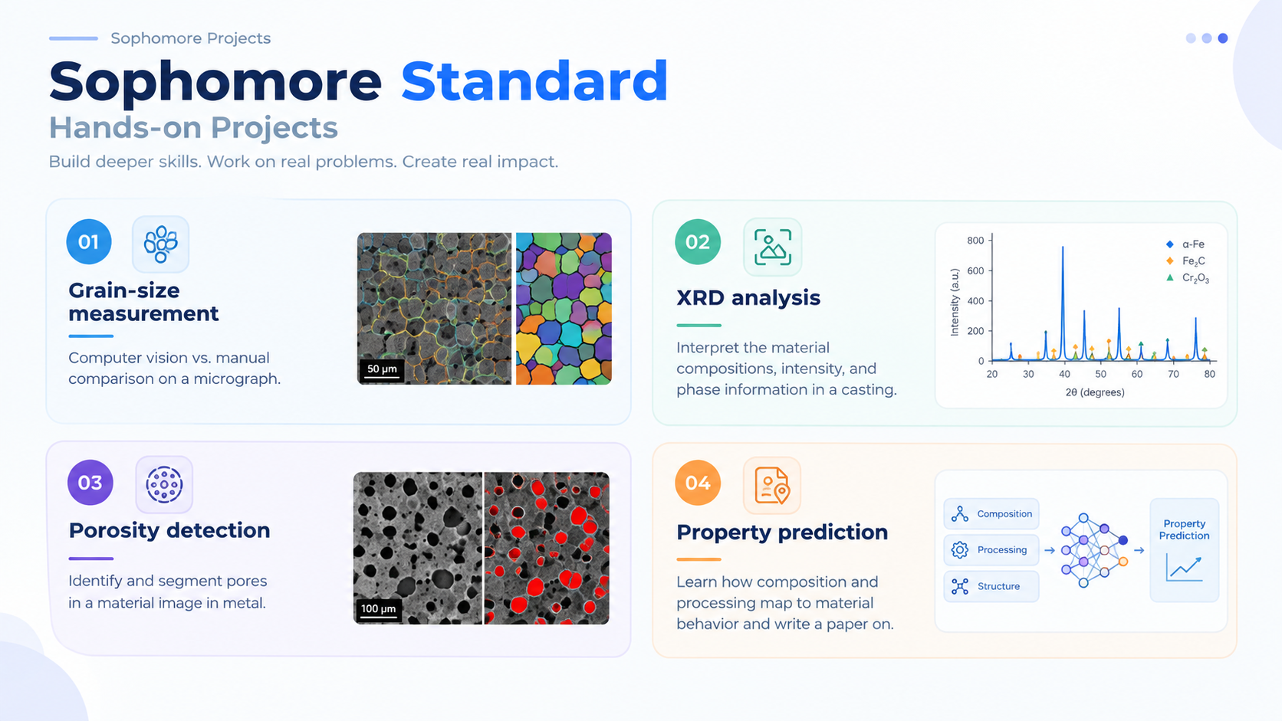

Slide 10


Slide 11

UPPER COUNCIL
Multimedia head
Outreach Head
Management head

