Slide 1

Bridging Ideas Through Computation

Slide 2
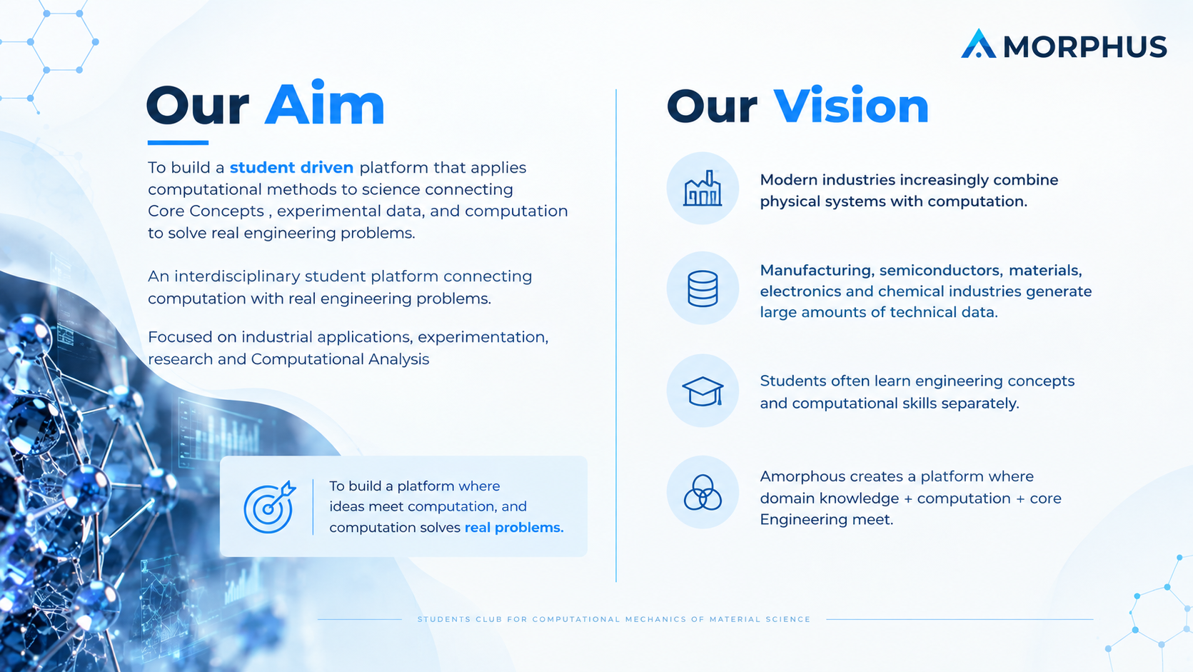


Slide 3


Slide 4
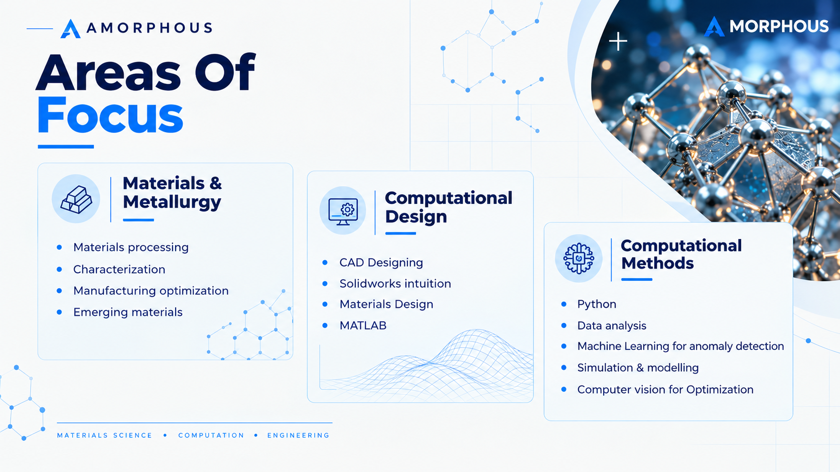
Core Engineering

Slide 5


Slide 6


Slide 7
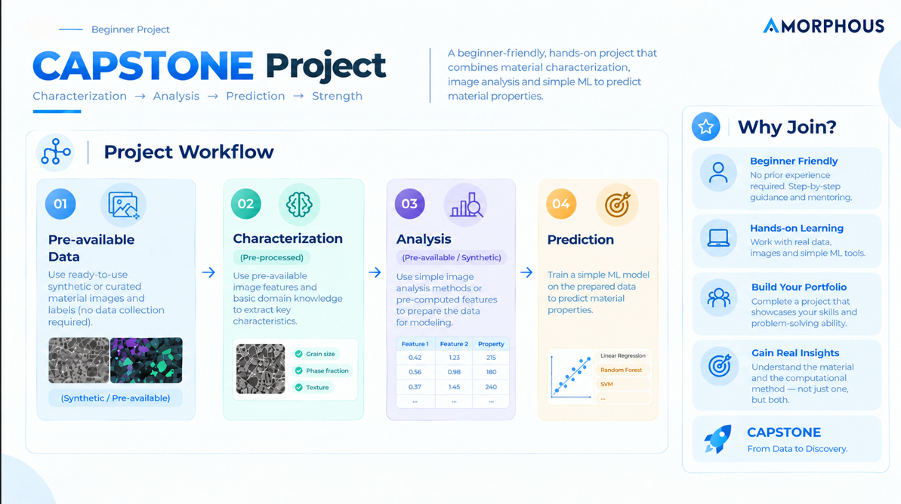


Slide 8
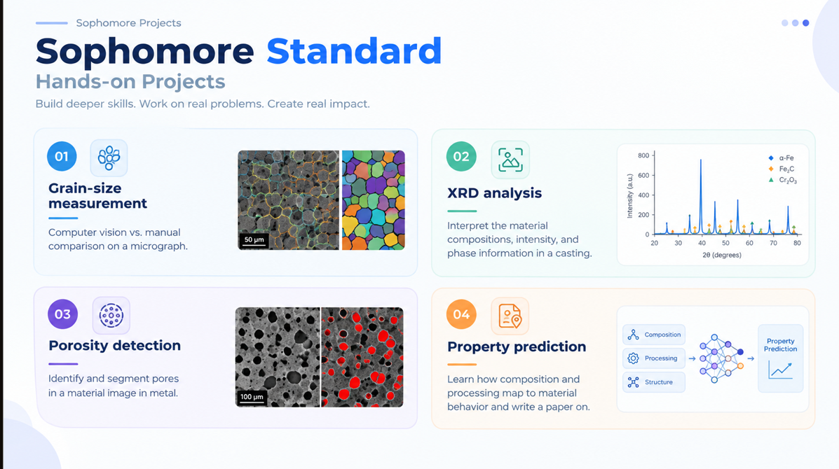

Slide 9


Slide 10


