Slide 1

INFOSYS SPRINGBOARD INTERNSHIP 2025
Project Name:- Wastezero -A modern way to clean the country

Slide 2
INTERNS INVOLVED IN THE INTERNSHIP
Lavesh Karthik
Karampudi Riteesh
Mourya Vardhan Rathod
Siddharth Kumar Maurya
Chandrasekharraju
Rupa Shrees
Sanjana
Subisha
GUIDED MENTOR:-RAMKUMAR SIR

Slide 3

WasteZero is a comprehensive environmental impact management platform that connects volunteers with NGOs and waste management organizations to facilitate environmental cleanup initiatives and recycling programs. Built with React 19, Node.js/Express, and MongoDB, the platform features role-based dashboards for admins, NGOs, and volunteers, enabling efficient coordination of waste collection and sustainability initiatives. The application includes real-time messaging with Socket.IO, advanced event management with volunteer application workflows, and secure JWT authentication with OTP-based password recovery. WasteZero empowers communities to engage in environmental action through a modern, responsive web interface designed to build a sustainable future.
Key features include:-
● User authentication.
● Personalized dashboard.
●Event tracking, and more. ●Role based Dashboards
INTRODUCTION TO WASTEZERO
" Every Click Counts - Platform for Planetary Change.”

Slide 4
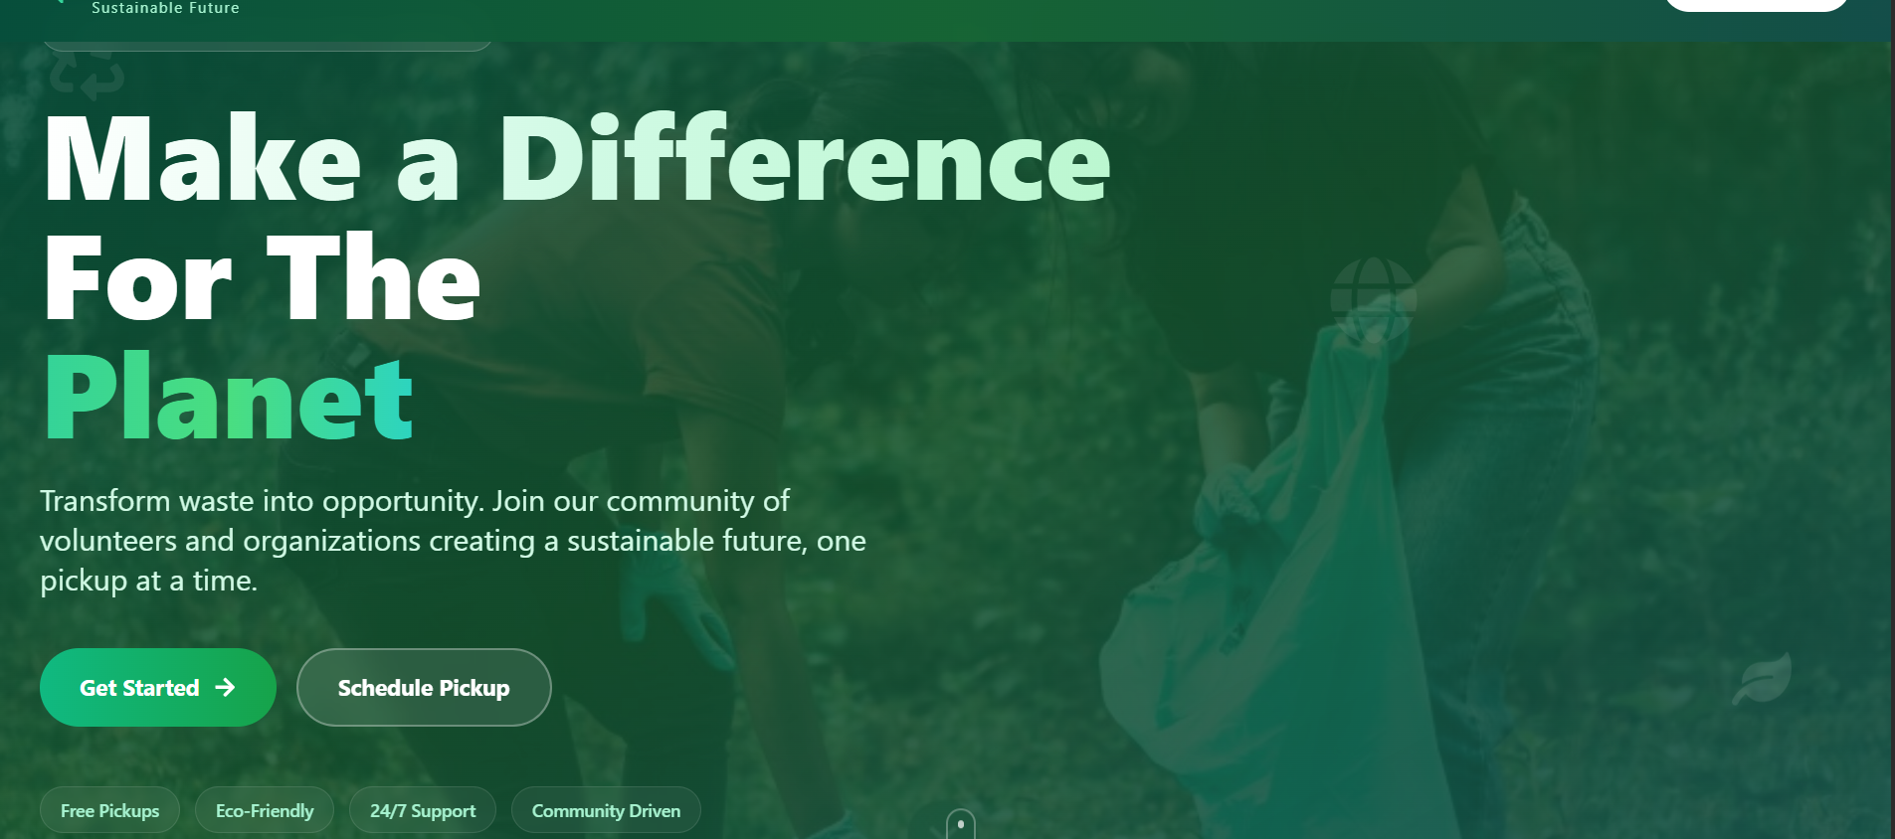
LANDING PAGE
Contains the Waste Zero –sustainable Future and navigation links to Home, Signup, Login, and Contact Us pages.
Home:- Returns to the landing page.
Signup:- Takes the user to the signup page to create a new account.
Login:- Takes the user to the login page to access their existing account.
Contact Us:- Provides information on how to reach the Waste Zero team for support or inquiries.

Slide 5
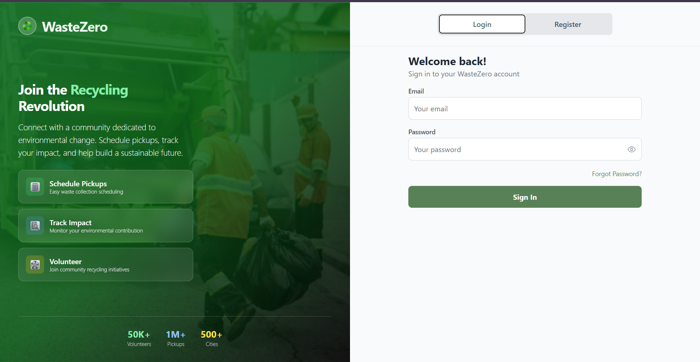
LOGIN PAGE
The login page includes fields for Email and Password.
User can directly redirect to Login page
Including Password Recovery function

Slide 6
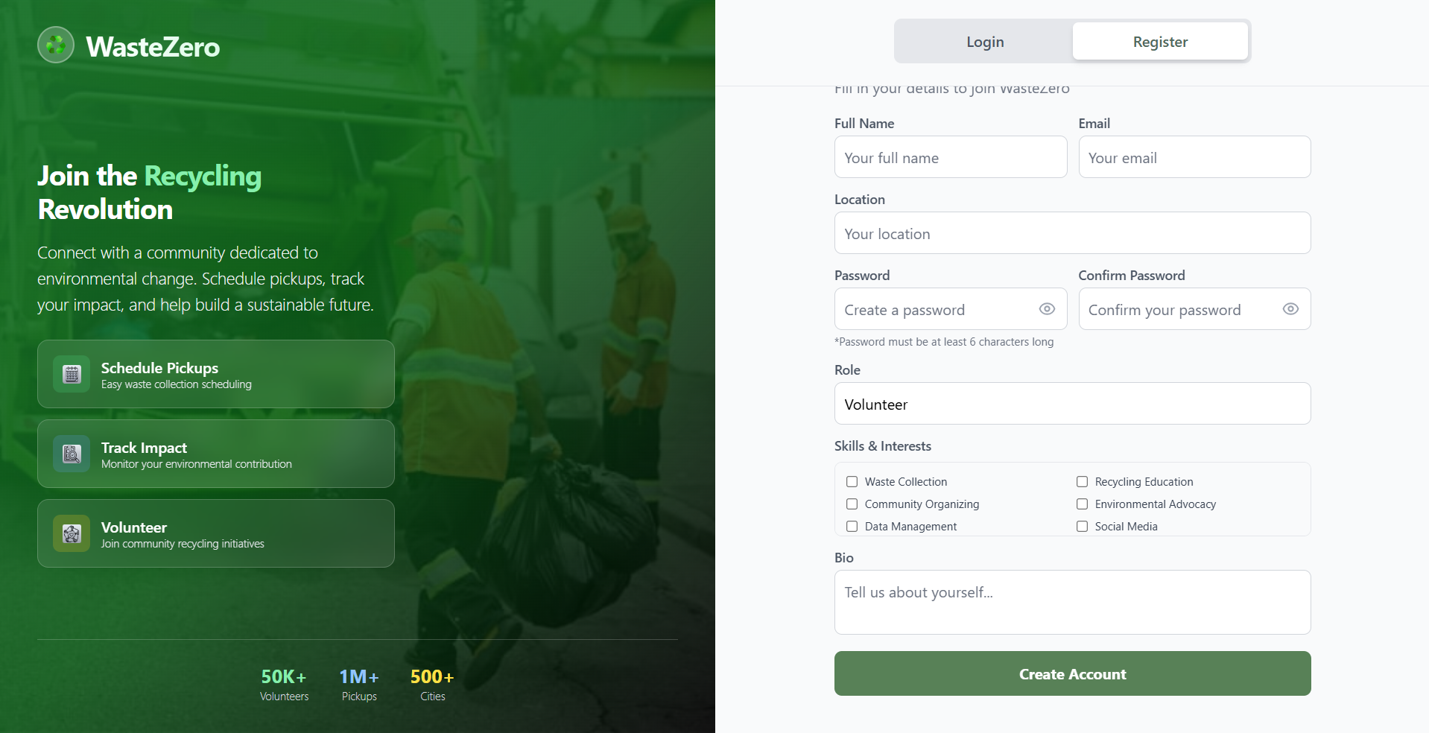
Registration PAGE
The Register page includes a form where users can enter their details (name, email, password,location,Role,Skills,Bio) to create an account.
User can redirect to Login page

Slide 7
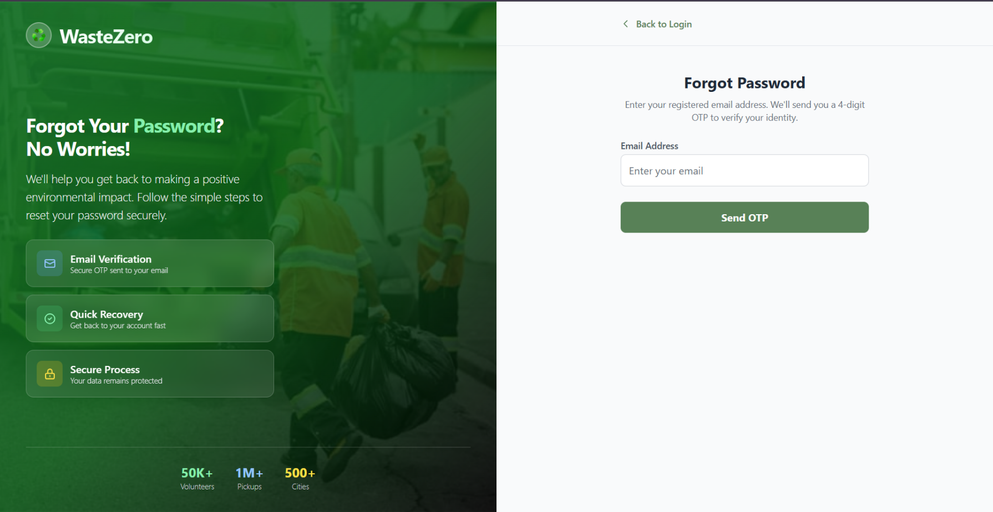
FORGOT PASSWORD PAGE
Helps to recover the forgotten Password
Uses a OTP verification
Contains a Email field

Slide 8
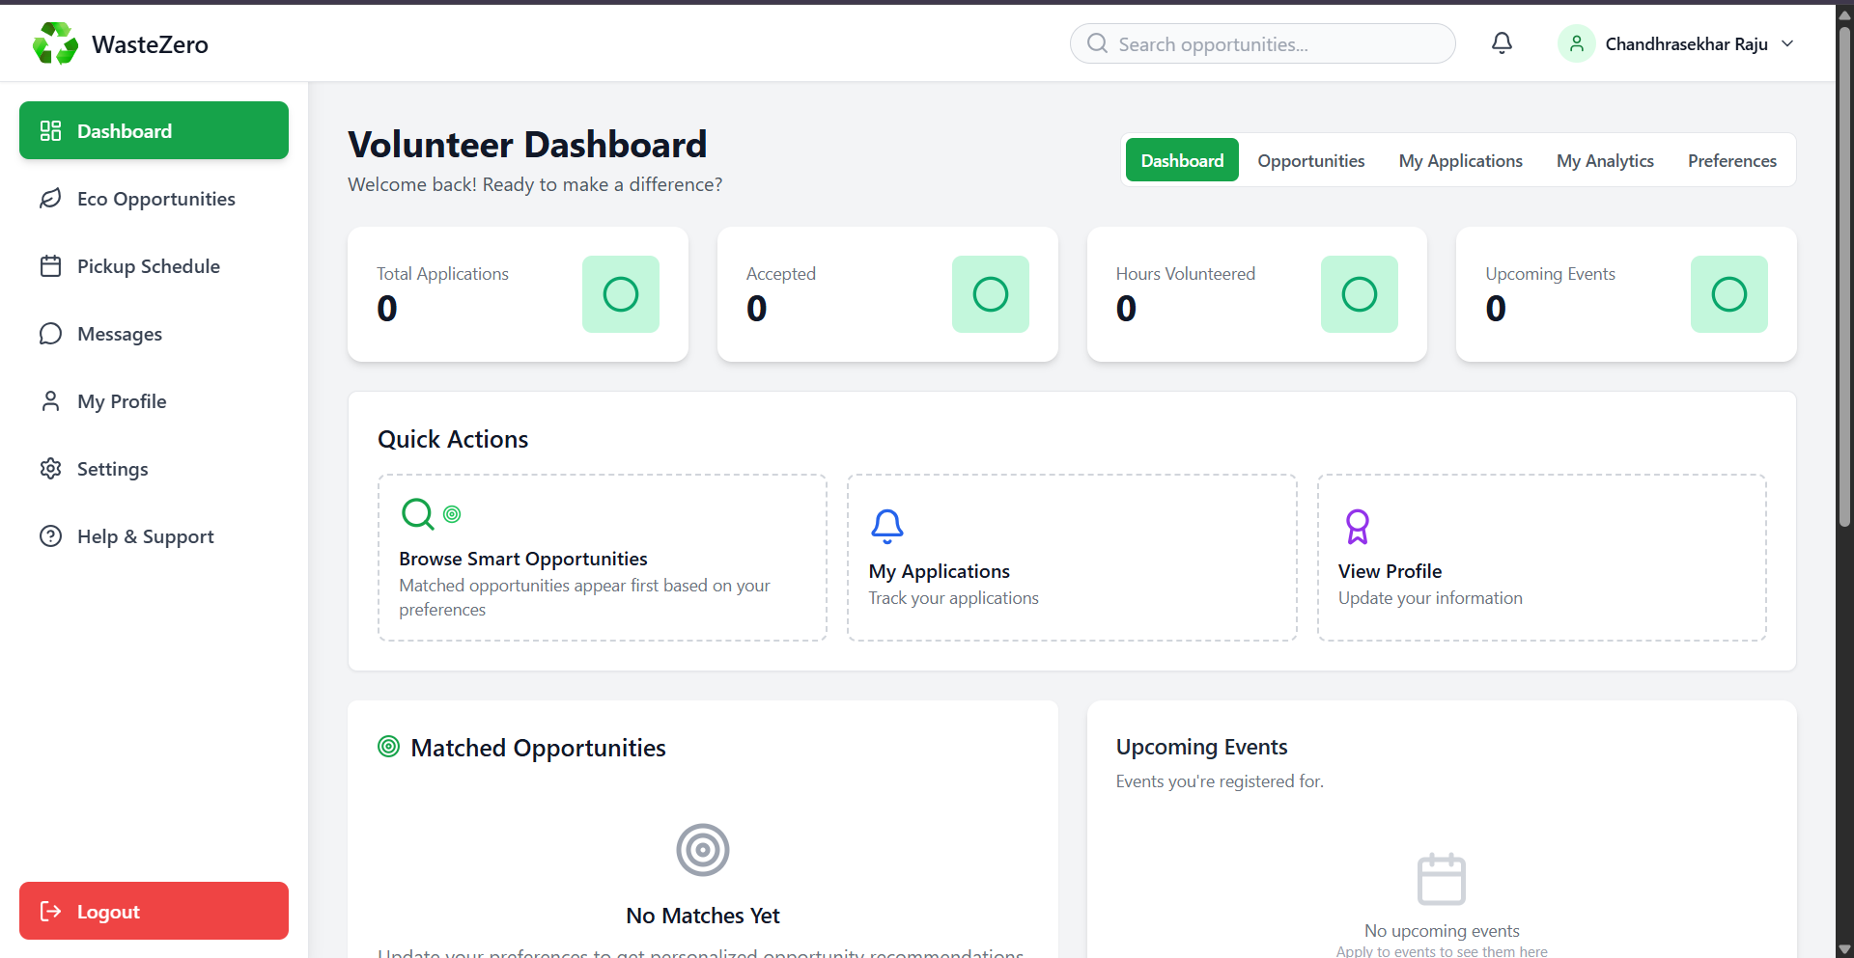
DASHBOARD
There are three different types of dashboards for volunteer,NGO,and Admin each contains different features.
Display the daily activities
Uses the numbers
EVENT-Completion percentage

Slide 9
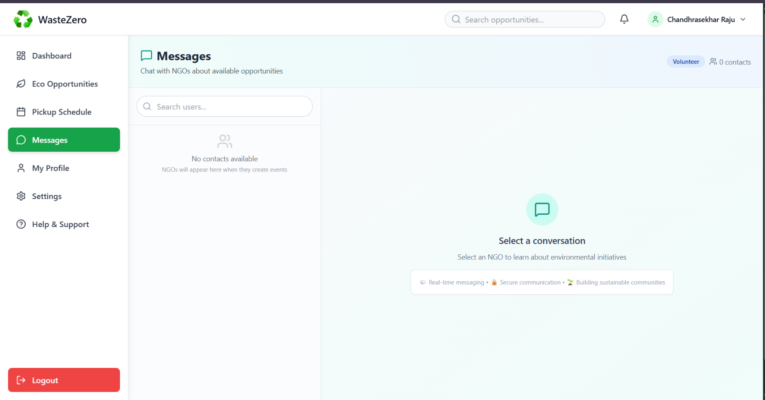
MESSAGING
This Messaging page can connect with the NGO’s ,Admin’s and can clarify volunteers doubts

Slide 10
WORK FLOW
USER
VOLUNTEER
Can apply for events according to preferences
Track his/her application
Message with admin and NGO
NGO
Can create,edit,delete events
Approve volunteers based on applications
ADMIN
Manage whole user base
Can block or unblock user
Website manage ment

Slide 11
WORK FLOW
NGO creates events
Volunteer applys for event
NGO receives application
Approval
Rejects
Approves

Slide 12
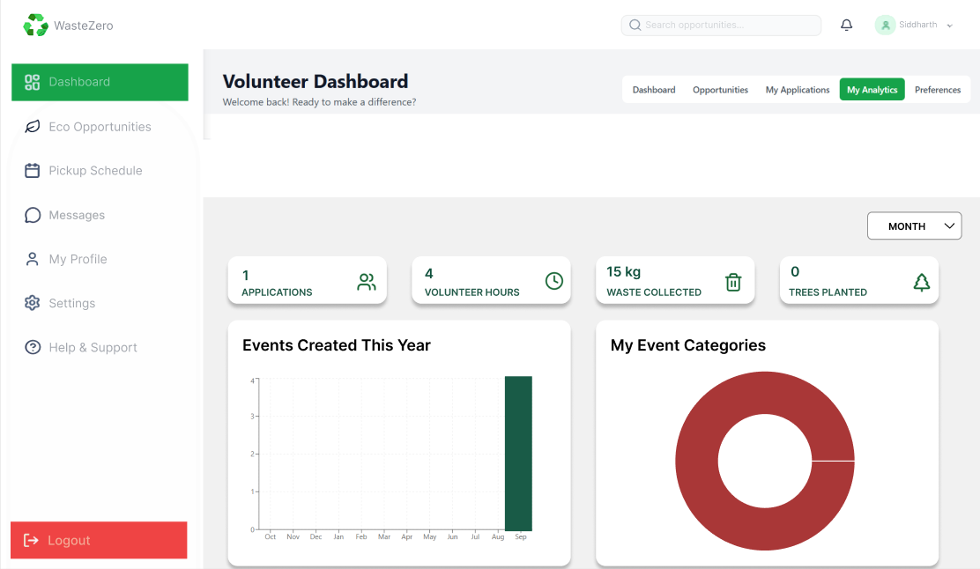
Volunteer Analytics

Slide 13
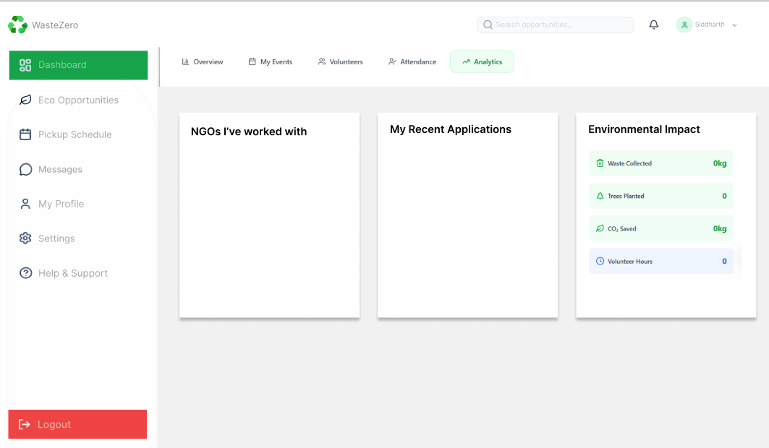
Volunteer Analytics

Slide 14
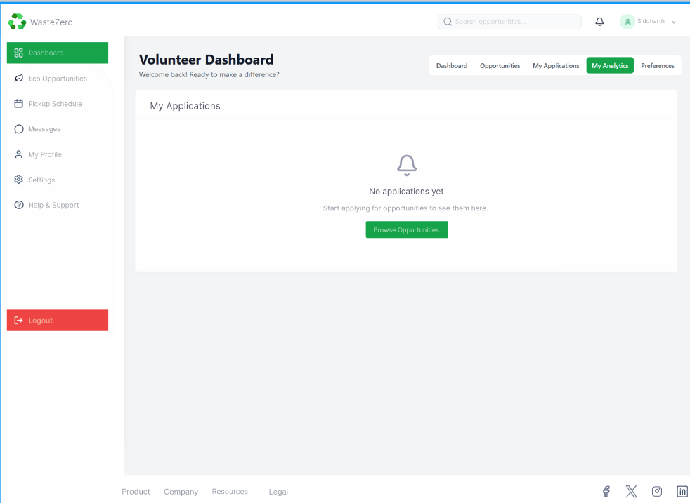
Volunteer Dashboard

Slide 15
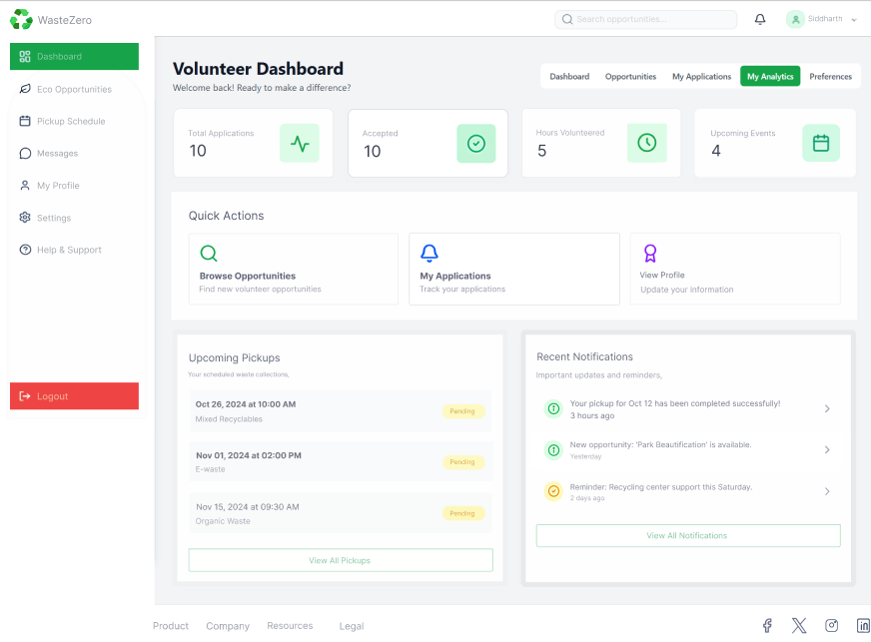
Volunteer Dashboard

Slide 16
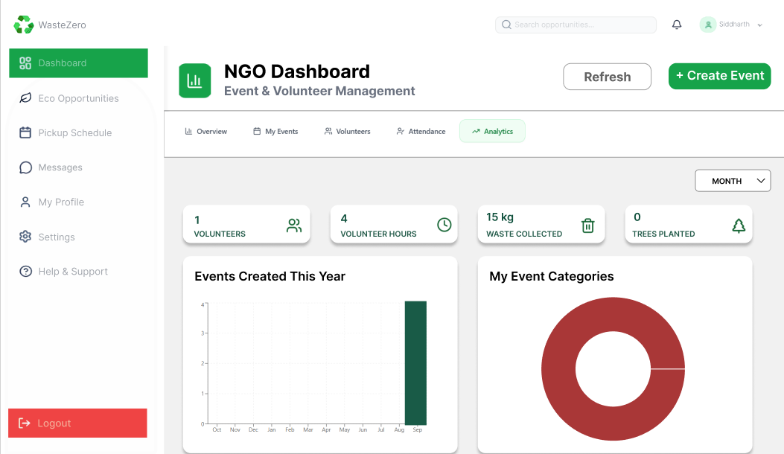
NGO
NGO Analytics

Slide 17
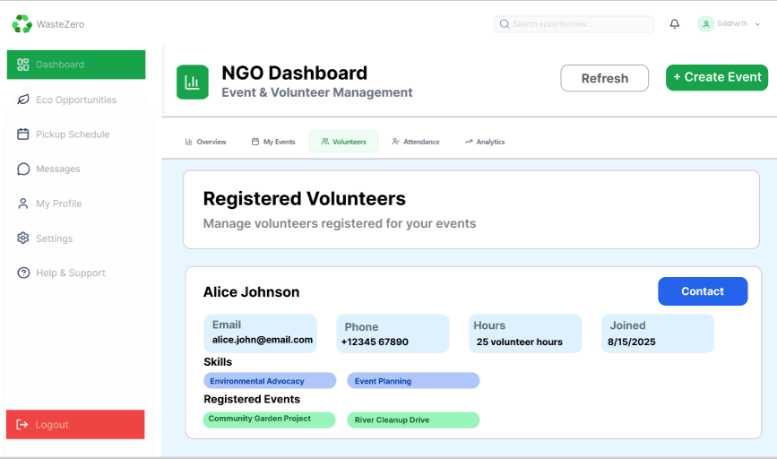
NGO
NGO Volunteers

Slide 18
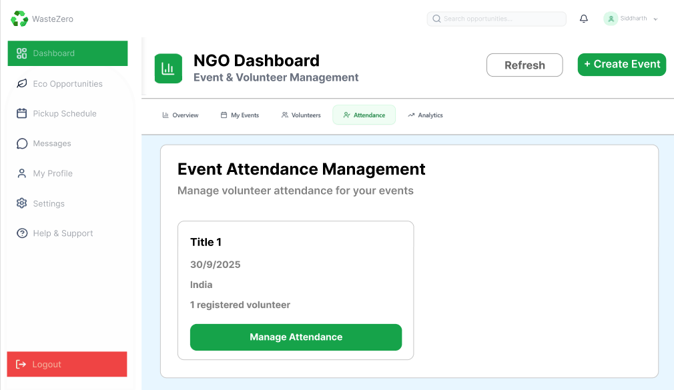
NGO
NGO-Attendance

Slide 19
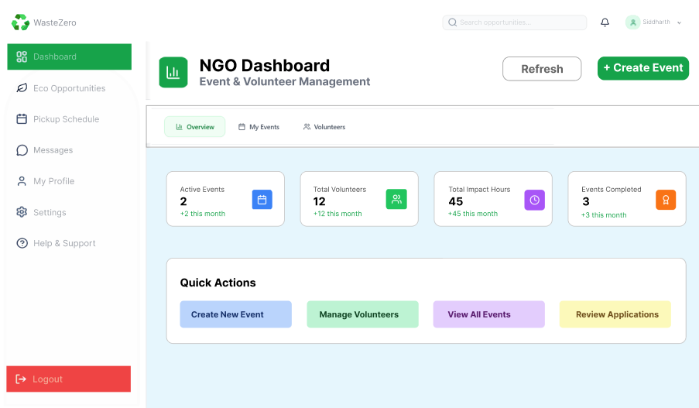
NGO
NGO DASHBOARD

Slide 20
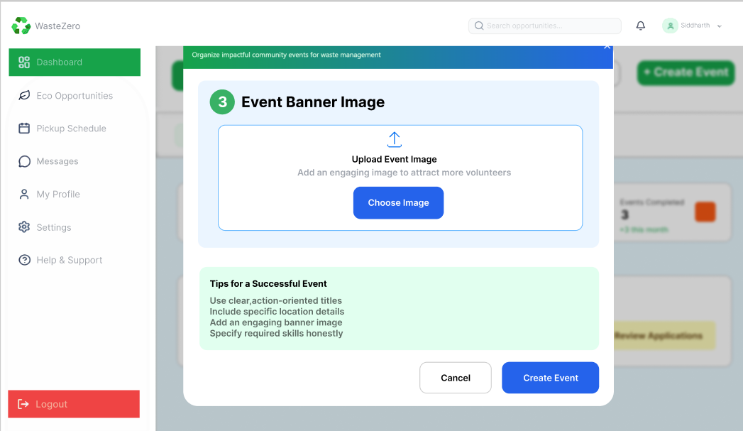
NGO
NGO DASHBOARD- CREATE EVENT

Slide 21
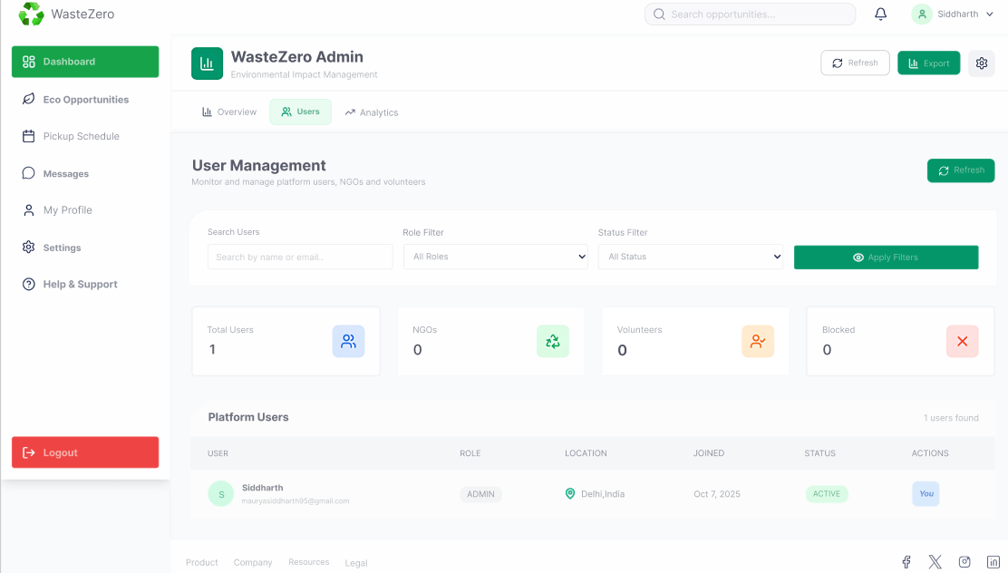
ADMIN PANEL

Slide 22
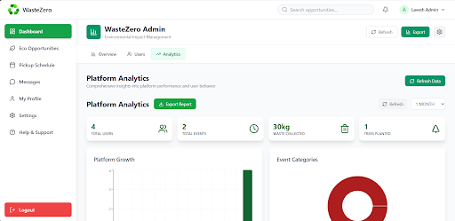
Admin Anlytics

Slide 23
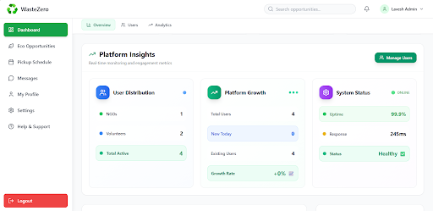
Admin Dashboard

Slide 24
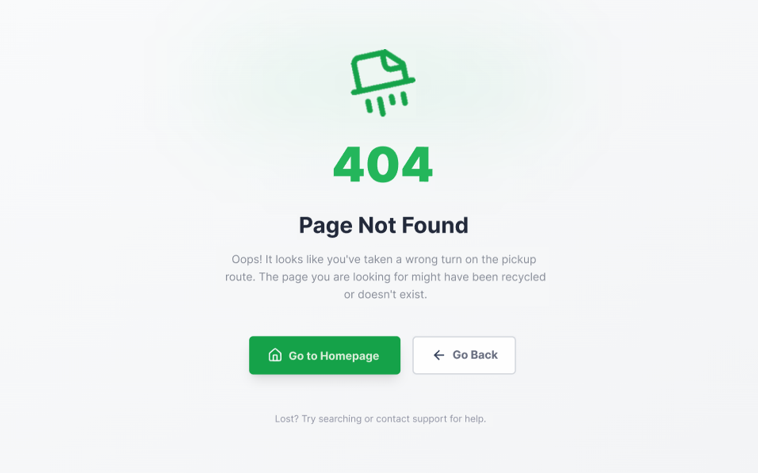
PAGE NOT FOUND

Slide 25
FUTURE IMPLEMENTATION
Multilingual and Accessibility Support.
Add reward systems, multilingual support, and mobile app for better user engagement.
Moving forward, volunteers will be empowered to organize events within their own community.
AI Integrations.

Slide 26
CONCLUSION
WasteZero is a comprehensive digital platform designed to revolutionize urban waste management by connecting residents with waste collection services intelligently and efficiently. Its core purpose is to make recycling and responsible waste disposal seamless and accessible.
The platform is structured around four key pillars.
First, it provides a user-friendly interface where residents can register, schedule on-demand waste pickups, and correctly categorize their recyclables (such as plastic, organic, and e-waste).
Second, it operates on an intelligent backend system that dynamically assigns the nearest available pickup agent (NGOs/Volunteers) based on the user's location and waste type, ensuring operational efficiency.
Third, it fosters communication and engagement through integrated real-time messaging and notifications, keeping both users and agents informed about pickup status and new matches.
Finally, it offers robust administrative oversight with a dedicated dashboard for monitoring platform activity, generating analytical reports, and managing content, ensuring the platform runs smoothly and effectively.
By digitizing the entire process, WasteZero aims to increase recycling rates, optimize collection routes, and promote a culture of environmental responsibility among communities.

