Slide 1

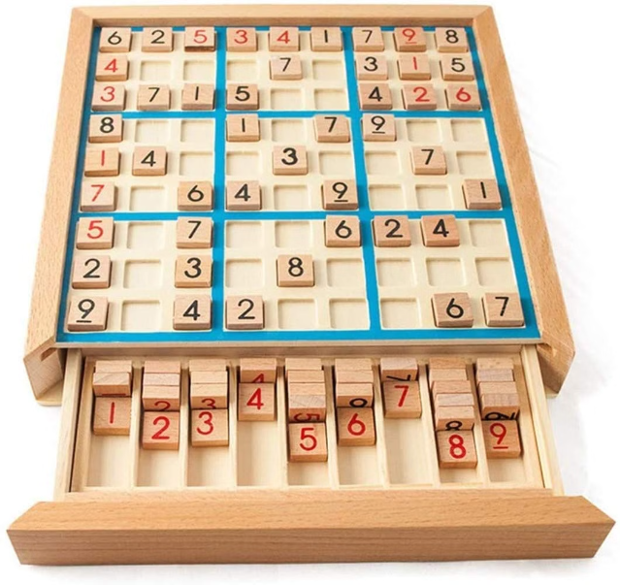

Introduction to Sudoku Solver Visualizer
Explore the captivating world of Sudoku solving with an interactive visualizer that guides you through the process step-by-step.
by Mayank Singh Bora REG. NO. 12218769
Roll No. 32

Slide 2

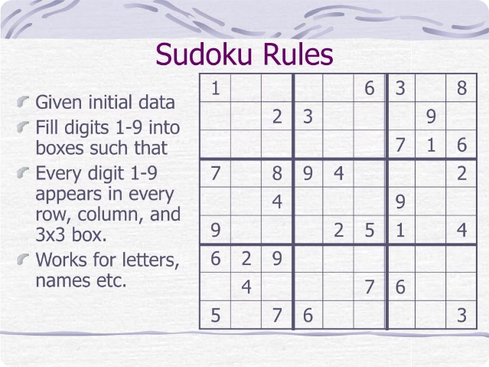
How Sudoku Works
1
Complete the Grid
Fill in empty cells with digits 1-9 without repeating in any row, column, or 3x3 box.
2
Use Logic
Apply strategic thinking to deduce the correct placements.
3
Eliminate Possibilities
Rule out numbers that cannot fit in a cell based on the given clues.

Slide 3
Solving Sudoku Puzzles
Beginner Techniques
Intermediate Strategies
Expert-Level Solving
Spot easy patterns, use process of elimination.
Identify hidden singles, naked pairs, and other advanced logic.
Master techniques like X-wings, swordfish, and unique rectangles.

Slide 4

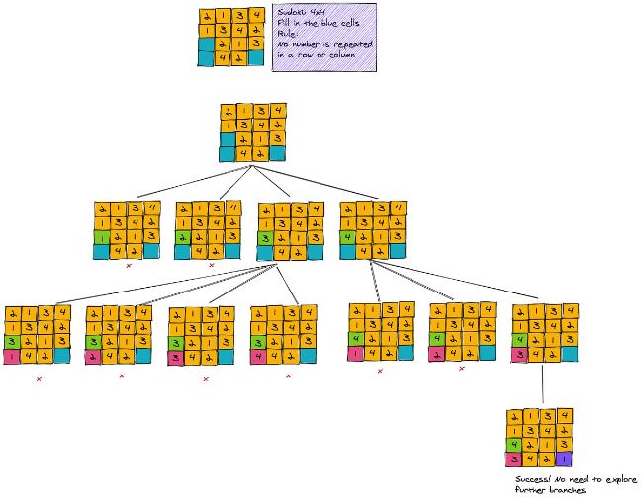
Backtracking Algorithm Explained
1
Recursive Approach
Systematically try all possible numbers in each empty cell.
2
Constraint Checking
Ensure the placement doesn't violate row, column, or box rules.
3
Backtracking
Undo invalid placements and explore alternative solutions.

Slide 5


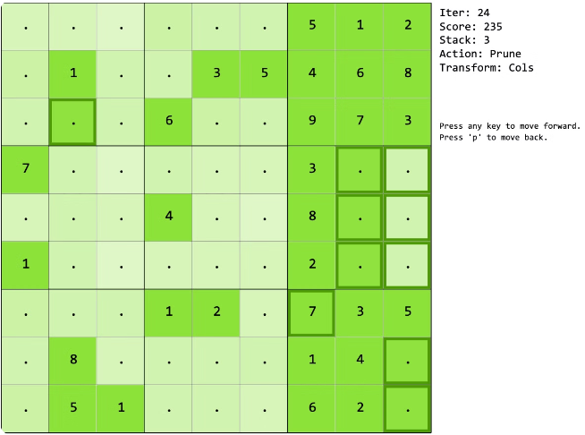


Visualizing the Solving Process
Observe
Watch the algorithm in action, step-by-step.
Analyze
See how the grid is filled using logical reasoning.
Time
Measure the speed of the solving process.

Slide 6
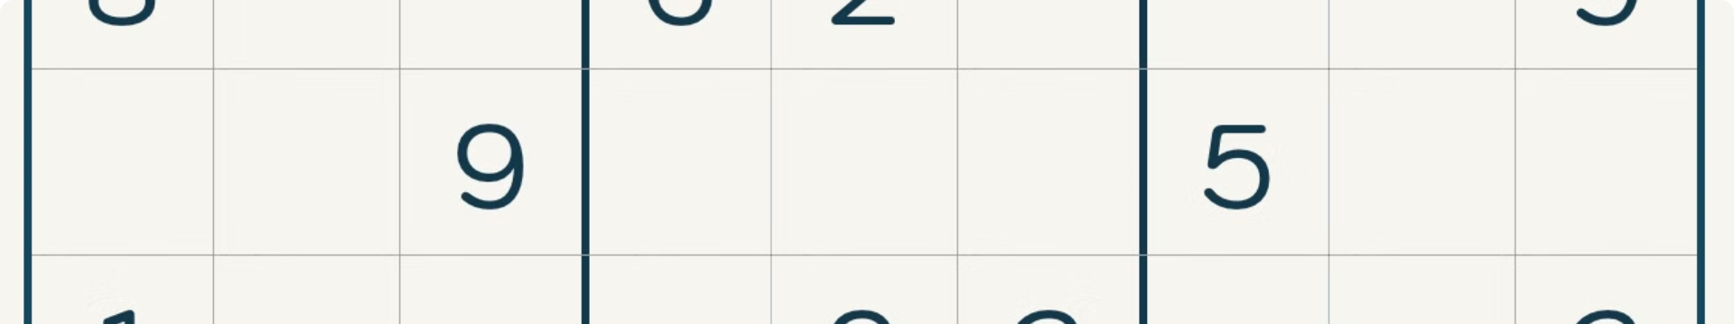




Step-by-Step Walkthrough
Identify Empty Cells
Try Possible Values
Propagate Constraints
Backtrack if Needed
Locate the next unfilled position to work on.
Test each valid number in the current cell.
Undo placements and explore alternative solutions.
Update the board and eliminate conflicting options.

Slide 7
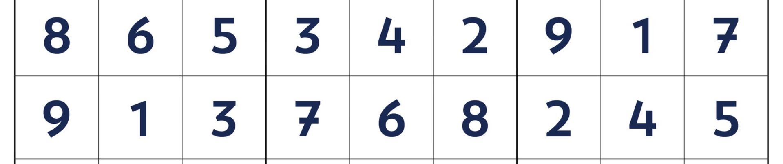
Conclusion and Next Steps
Master Sudoku Solving
Unlock More Puzzles
Explore Variations
Hone your skills with the interactive visualizer.
Challenge yourself with increasingly difficult Sudoku boards.
Try different Sudoku variants like Killer and X-Sudoku.

