Slide 1

CUSTOMER BEHAVIOR READOUT
Customer shopping behavior is repeat-heavy, but subscription adoption lags
A customer behavior readout for growth, margin, and retention.

Slide 2
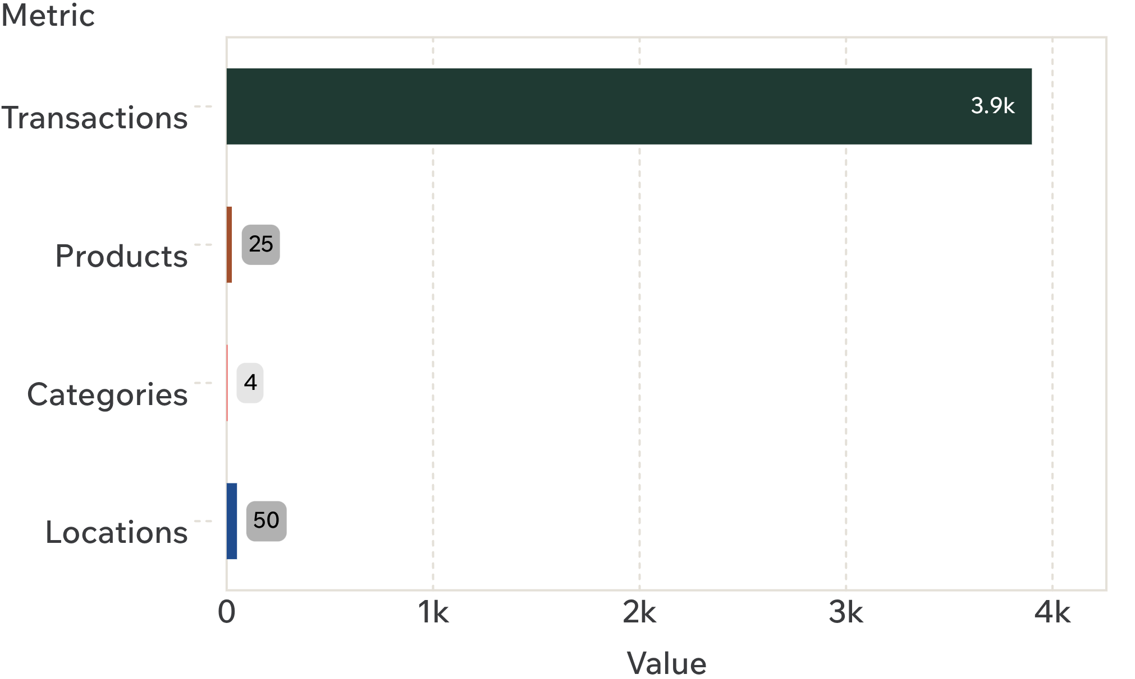
01 · DATASET SNAPSHOT
A 3,900-purchase dataset reveals a practical growth agenda
What the data can answer
3,900 transactions. Across 25 products, 4 categories, 50 locations, and 18 tracked fields.
$59.76 average purchase. Average review rating: 3.75.
One practical agenda. Connect customer value, product demand, promotions, and retention.
Source: Customer Shopping Behavior Analysis.

Slide 3
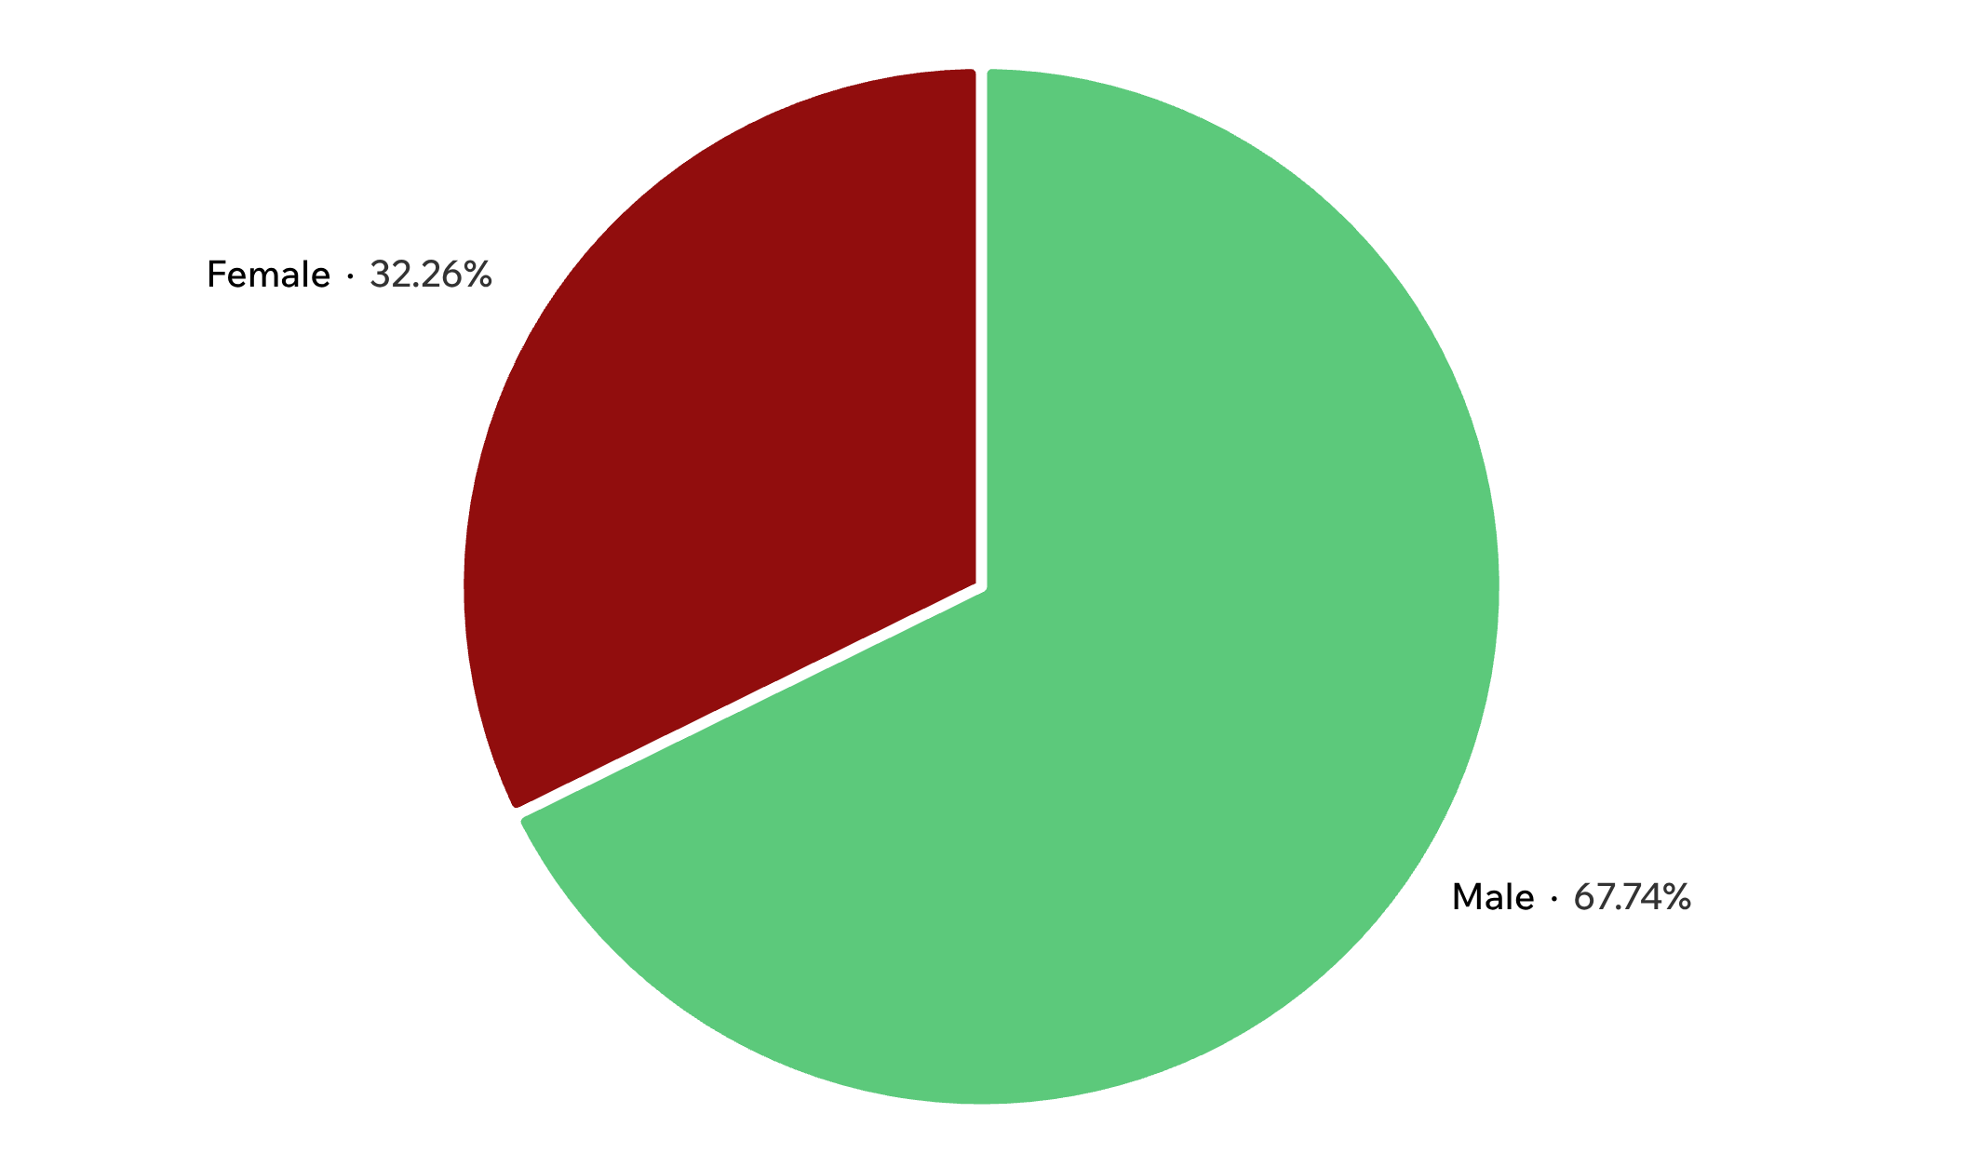
02 · AUDIENCE SIGNAL
Male customers generated more than twice the revenue of female customers
Read before reallocating
Male-customer revenue: $157,890.
Female-customer revenue: $75,191.
Descriptive, not causal. Prioritize audience and assortment analysis before reallocating spend.
Source: Customer Shopping Behavior Analysis.

Slide 4
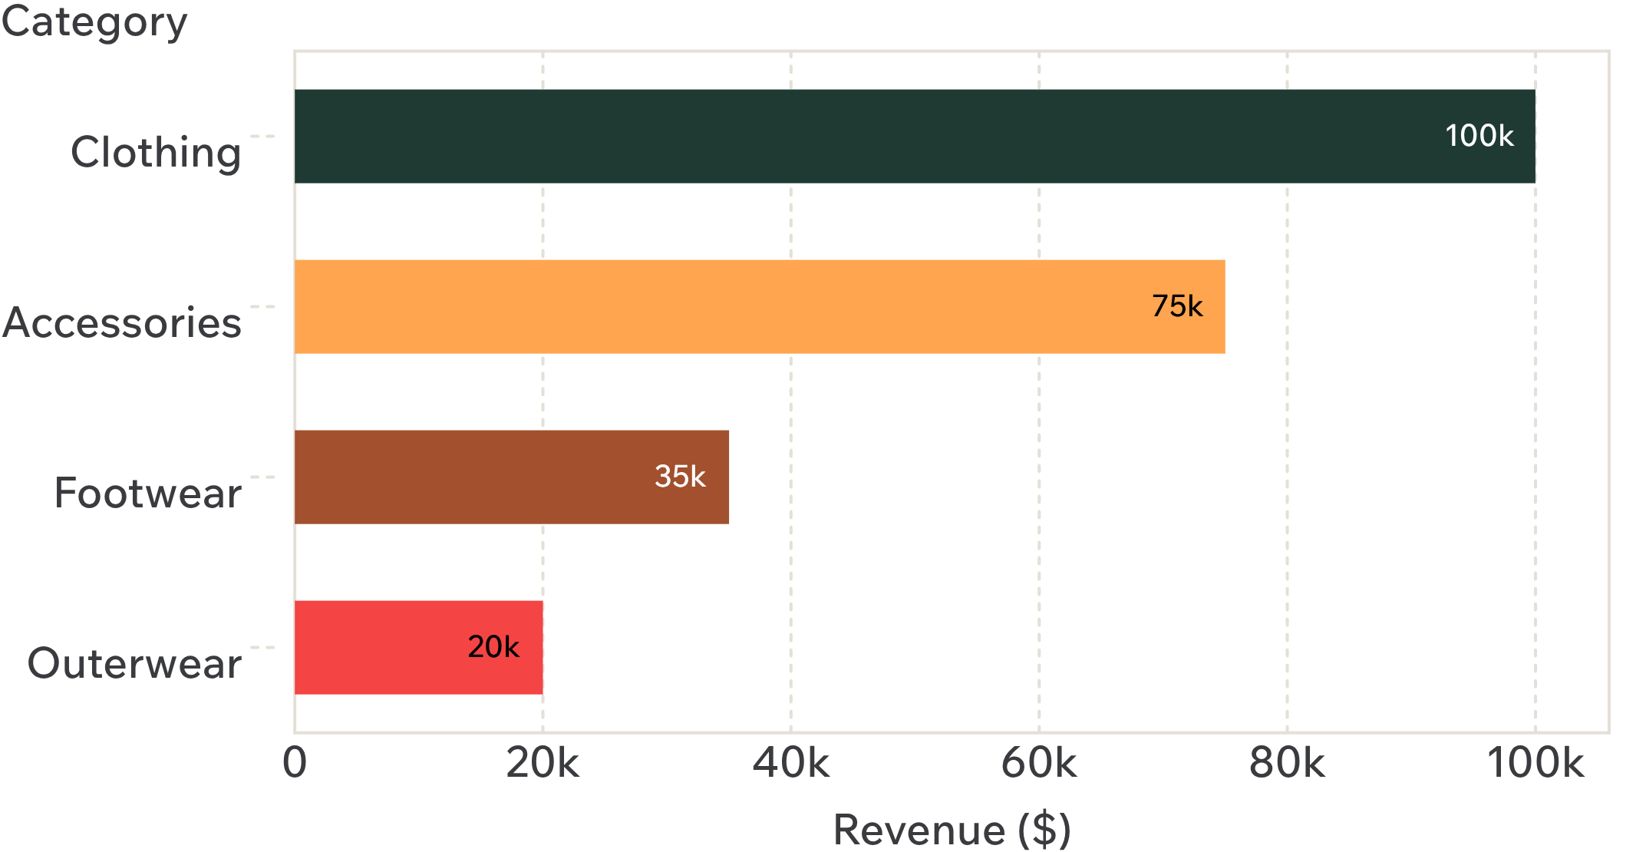
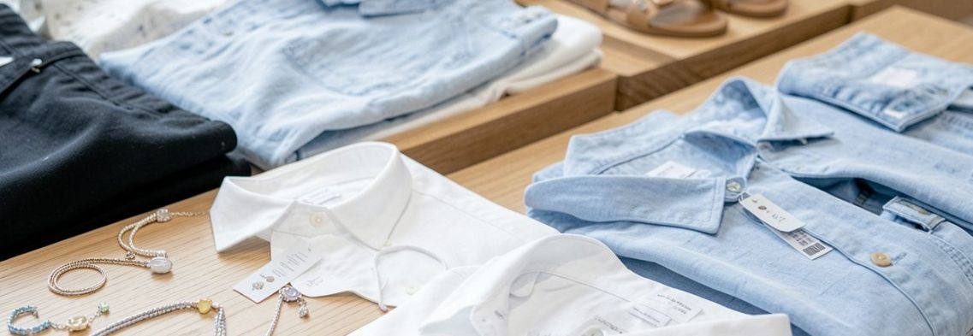
03 · ASSORTMENT SIGNAL
Clothing is the commercial engine; accessories are the next growth pool
Assortment signal · Clothing leads; Accessories is the next sizeable pool.
Source: Customer Shopping Behavior Analysis.

Slide 5
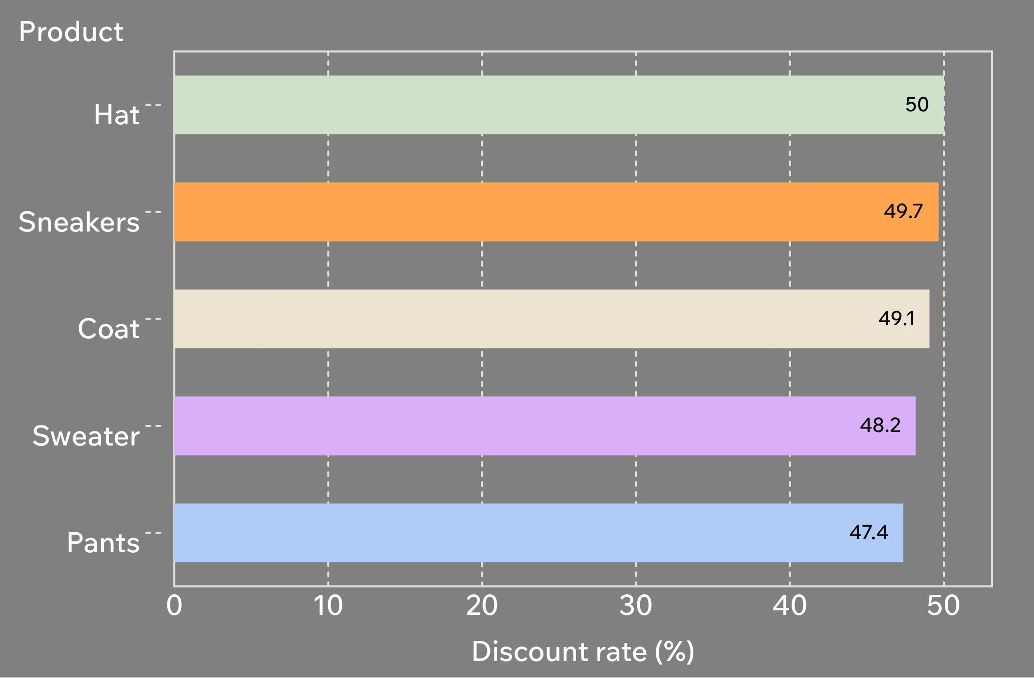
04 · PROMOTION SIGNAL
Discounts are concentrated in products that may need margin discipline
Margin discipline
Highest discount rates. Hat 50.00%, Sneakers 49.66%, Coat 49.07%, Sweater 48.17%, Pants 47.37%.
839 customers. They used discounts and still spent above the average purchase amount.
Shift the offer. Replace blanket promotions with targeted offers and product-level margin checks.
Source: Customer Shopping Behavior Analysis.

Slide 6
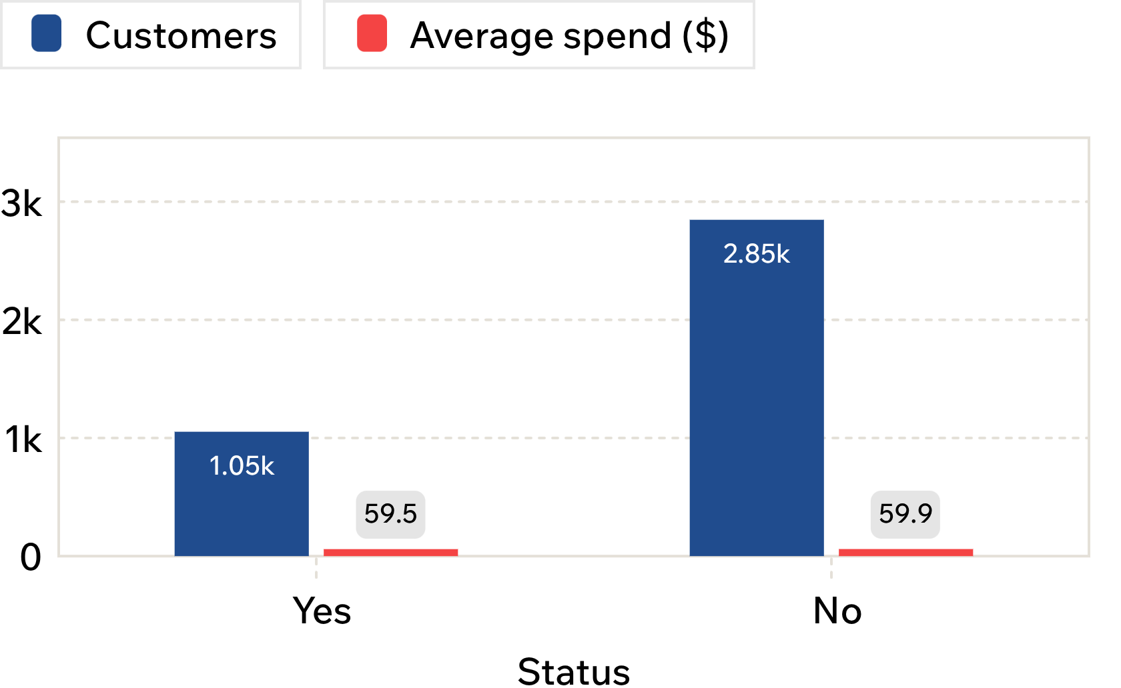
05 · SUBSCRIPTION SIGNAL
The subscription program reaches 27% of customers, but subscribers spend about the same
The gap is penetration
Subscribers: 1,053 customers. $62,645 total revenue and $59.49 average spend.
Non-subscribers: 2,847 customers. $170,436 total revenue and $59.87 average spend.
Source: Customer Shopping Behavior Analysis. Average spend is shown alongside customer count.
Opportunity: penetration and retention, not simply higher order value.

Slide 7
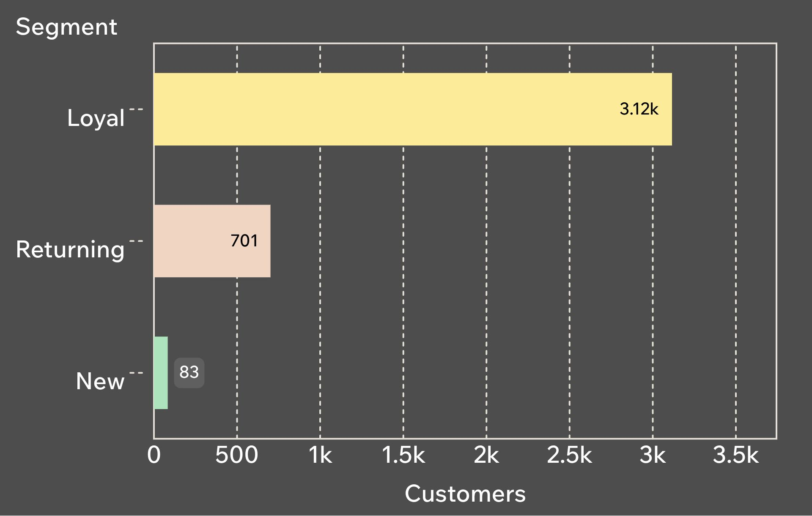
06 · RETENTION SIGNAL
Loyal customers dominate the base, creating a retention advantage
Retention is the base case
Loyal: 3,116 customers. Returning: 701. New: 83.
Repeat buyers are under-subscribed. 958 were subscribers; 2,518 were not.
Use the moment. Build loyalty benefits around repeat behavior, then convert non-subscribers.
Source: Customer Shopping Behavior Analysis.

Slide 8
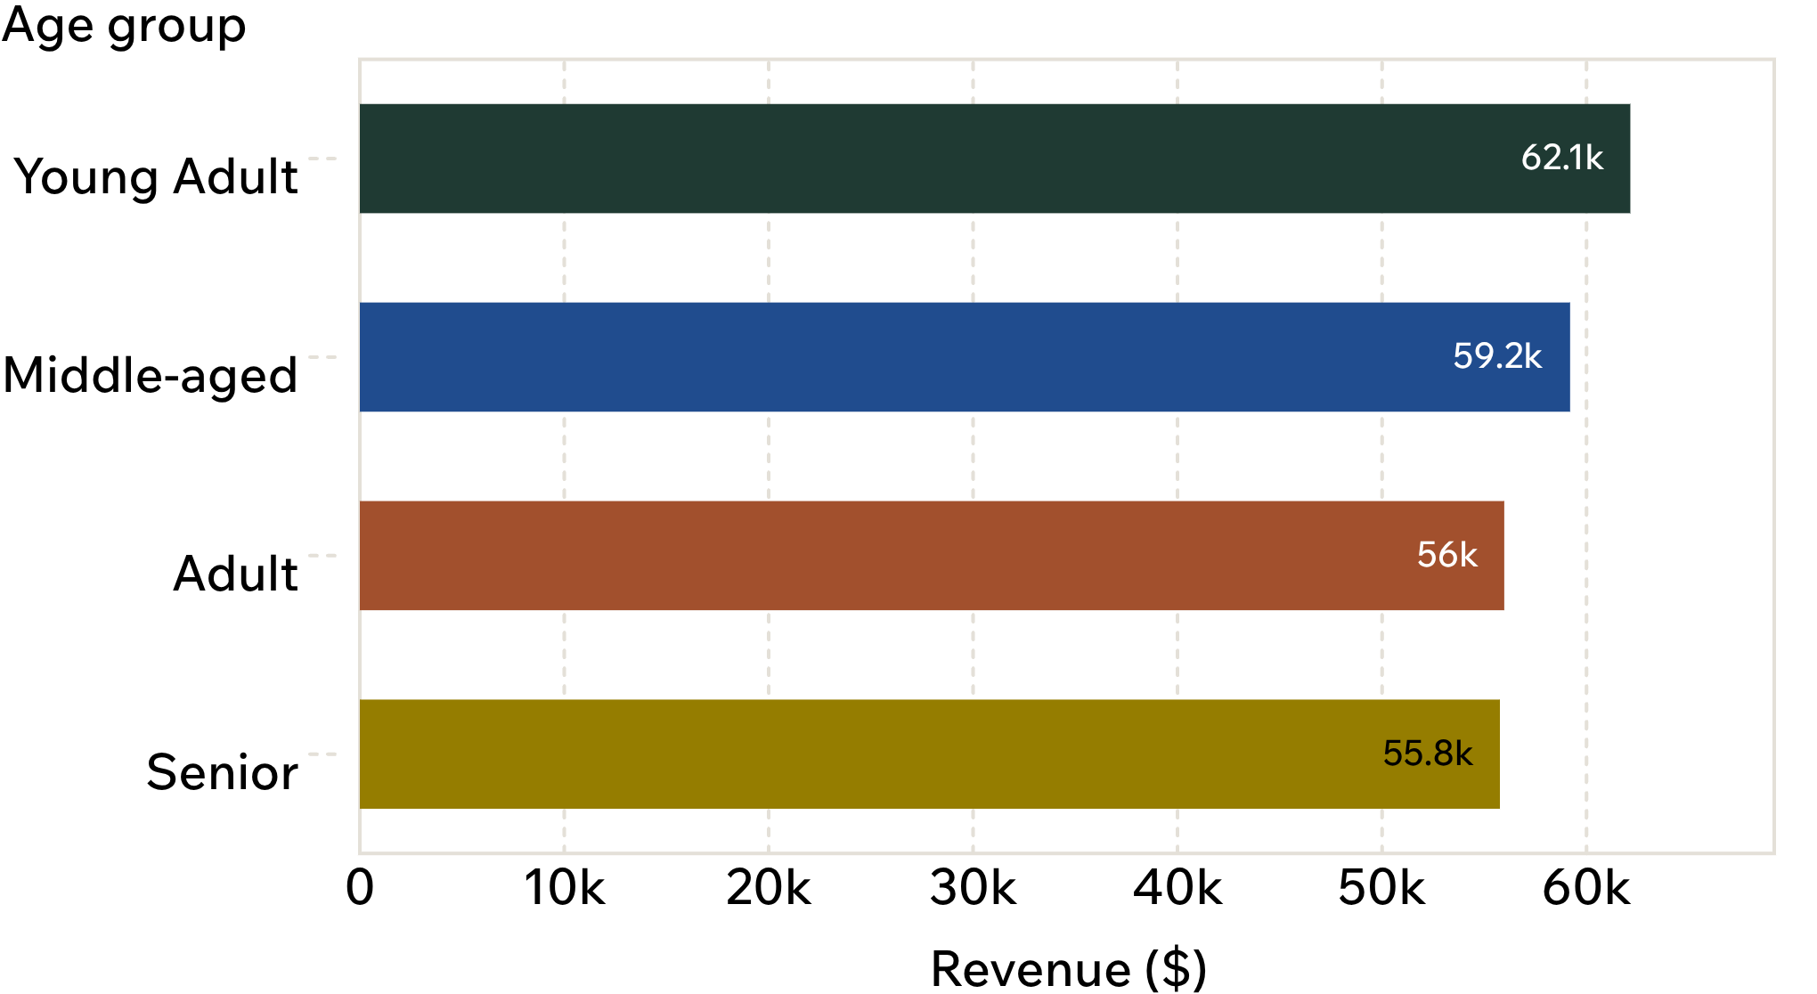
07 · TARGETING SIGNAL
Young adults contribute the most revenue, while shipping speed carries a modest premium
Target, then test
Young Adult: $62,143. Middle-aged: $59,197. Adult: $55,978. Senior: $55,763.
Express shipping: $60.48. Standard shipping: $58.46.
Decision use: target high-revenue age groups and test whether delivery speed improves conversion or basket size.
Source: Customer Shopping Behavior Analysis.

Slide 9

30-DAY PLAYBOOK
Five moves can turn the analysis into action
01
Grow subscriptions. Tie exclusive benefits to repeat purchase moments.
02
Reward loyal and returning customers. Deepen retention where repeat behavior is already visible.
03
Make offers margin-aware. Replace blanket discounts with targeted promotions.
04
Feature the products that win. Put top-rated and best-selling products into campaigns.
05
Target and test. Focus on high-revenue age groups and test express-shipping messaging.
Retention moment · make repeat behavior feel recognized.

