Slide 1
Building a Local Image-to-Caption App
Using BLIP Model + HuggingFace Transformers + Streamlit Mayank Singh | ReSENSE Lab | June 2025

Slide 2
What Are We Building?
Goal: Upload an image → AI generates a caption
Running locally:
BLIP model (Salesforce/blip-image-captioning-base)
HuggingFace Transformers + PyTorch
Streamlit app for UI

Slide 3
Why Local Instead of API?
HuggingFace API for BLIP caused errors:
404 Not Found
StopIteration
JSONDecodeError
Local BLIP model works fully:
No API limits
No token needed
No latency
Runs 100% offline

Slide 4

Architecture
User
→
→ Local HuggingFace BLIP Model (PyTorch) → Caption Output

Slide 5
Project Folder Structure
GEN_AI/image-text/
app.py ← main app code
requirements.txt ← dependencies
Install Required Libraries
pip install streamlit transformers pillow torch torchvision torchaudio --index-url https://download.pytorch.org/whl/cpu

Slide 6
BLIP MODEL USED
Model: Salesforce/blip-image-captioning-base
Supports Image-to-Text
Runs on PyTorch
Available in HuggingFace Transformers library
No special API key needed

Slide 7
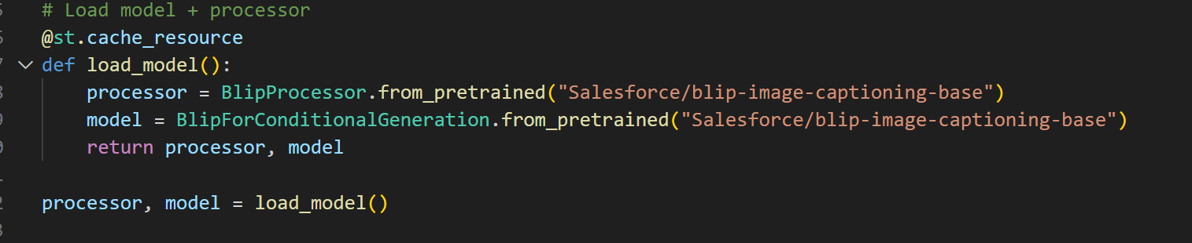
Loading the model

Slide 8
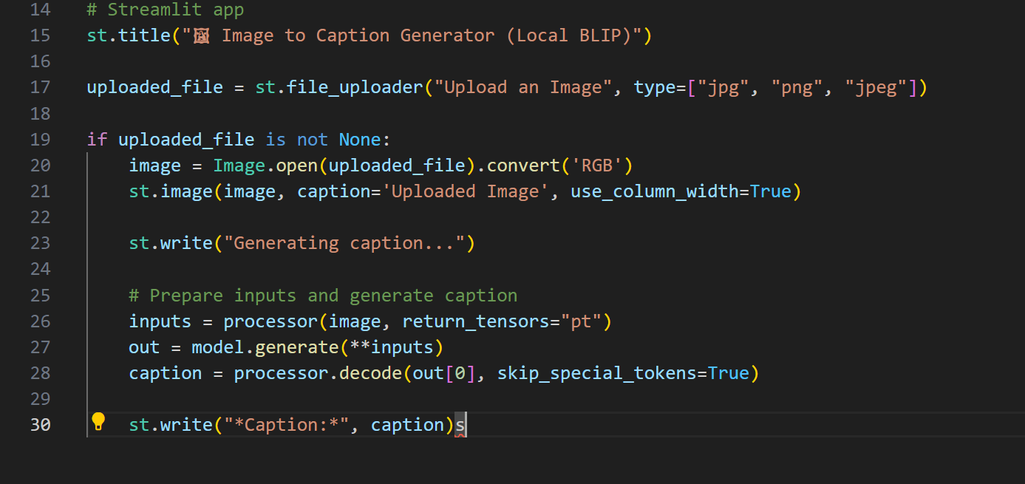
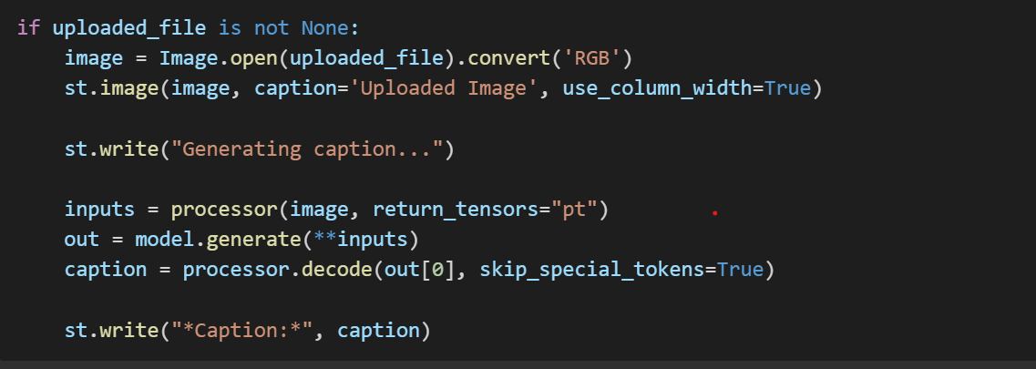
Loading the streamlit app

Slide 9
Common issues/fixes
ImportError: No module named torch | Install PyTorch
Slow first load | BLIP model downloads first time (~500 MB)
Streamlit errors | Ensure correct Python version (3.9/3.10)
CUDA errors | Use CPU version of PyTorch

Slide 10
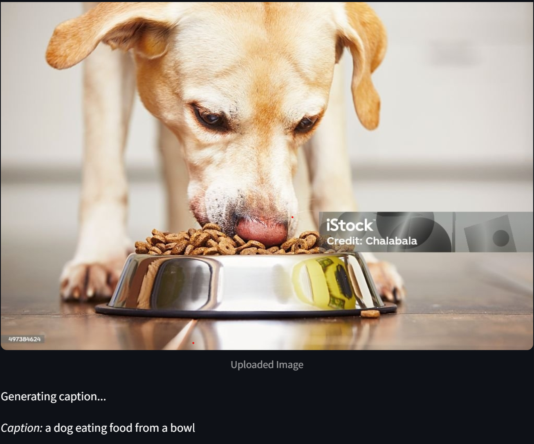
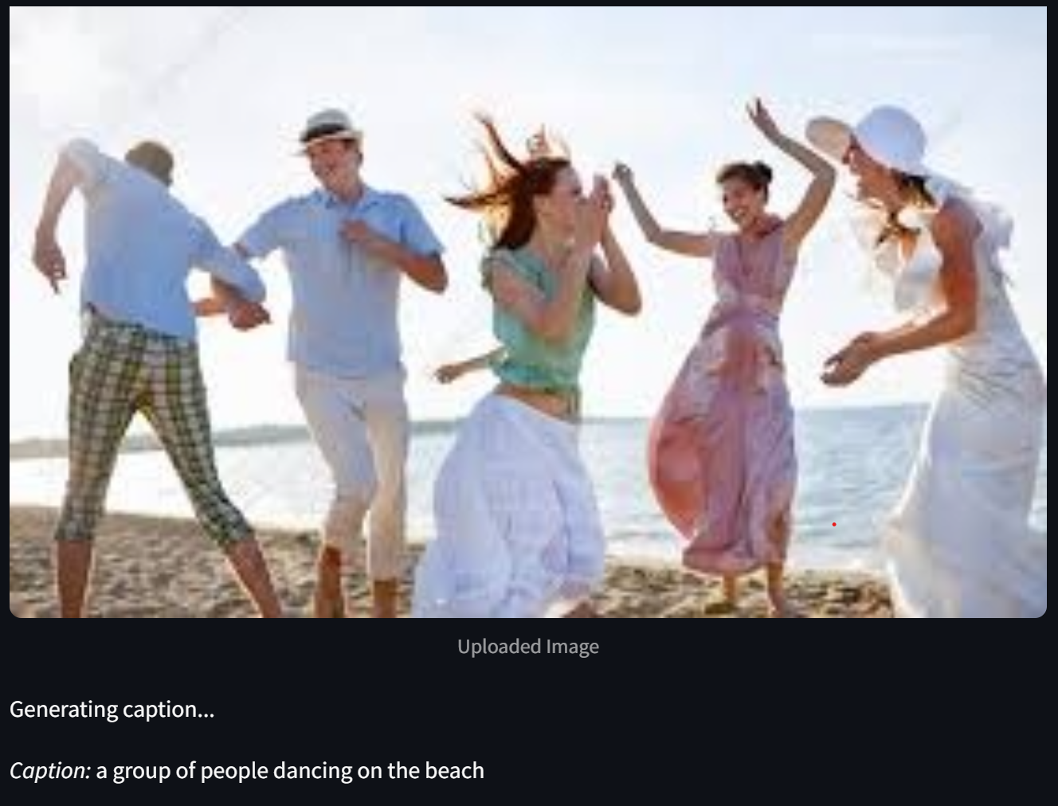
outputs

Slide 11
summary
Built local Image-to-Caption app
Tools used:
Streamlit
HuggingFace Transformers
PyTorch
BLIP model
No API required
Fast, reliable, runs offline!

