Slide 1
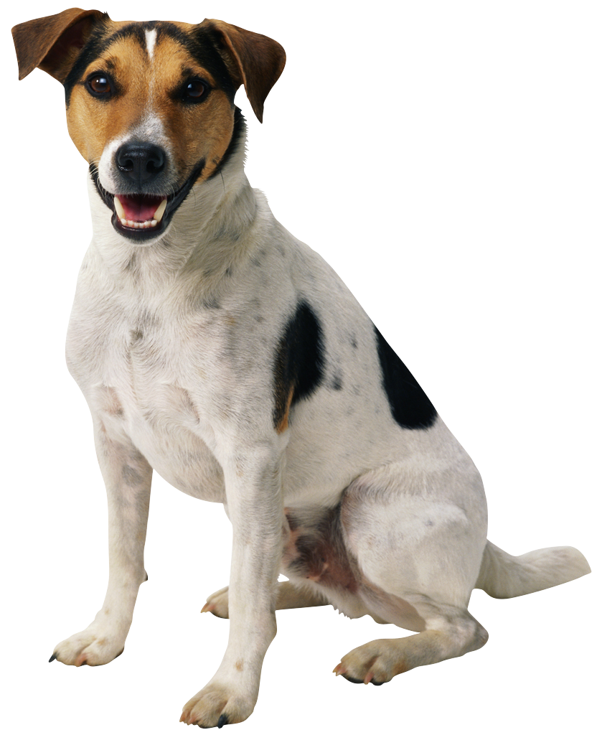
autoshape with inherited fill
autoshape with solid RGB fill
autoshape with blip fill

