Slide 1

Botler AI
Connecting
Human Capital
With
Global opportunities

Slide 2

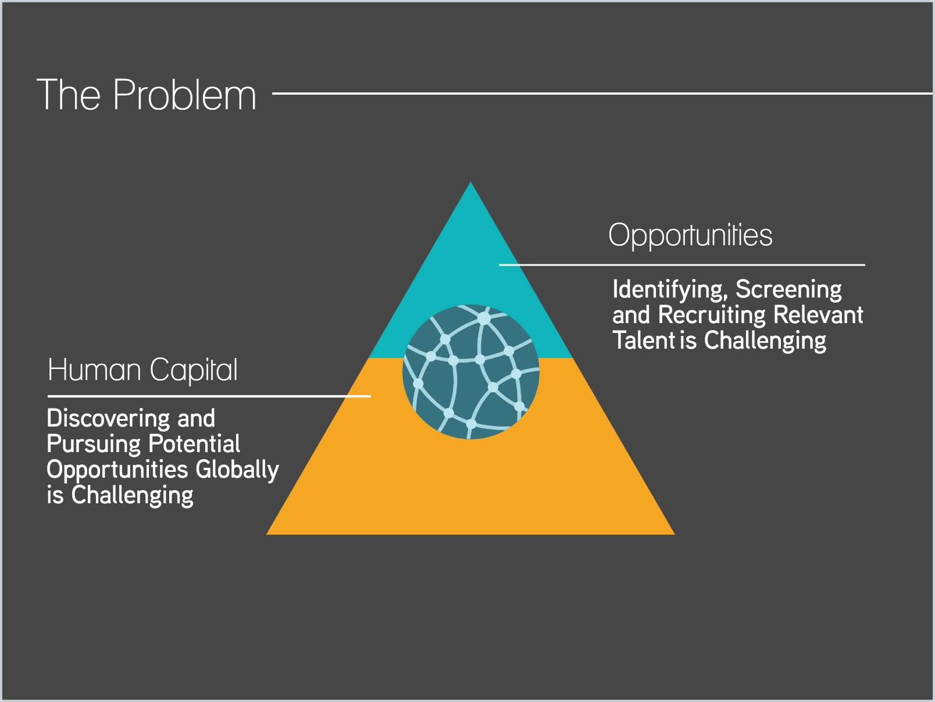
The Problem

Slide 3


Human Capital
Discovering global opportunities requires researching individual countries and positions one by one.
Discovery, is the easy part!
Navigating through the policies of the opportunity , laws and the immigration process of the foreign country is the real challenge.

Slide 4


Opportunities
Sourcing and screening the right international talent requires significant investment.
The recruitment process involves dealing with complicated legal nuances, in both the source and destination countries.

Slide 5

The Solution
Harnessing the power of Artificial Intelligence to connect human capital with global opportunities

Slide 6




Processing
Using Machine Learning from plain text, Botler AI constructs decision making procedures, in order to:
Automate scanning and processing

Slide 7
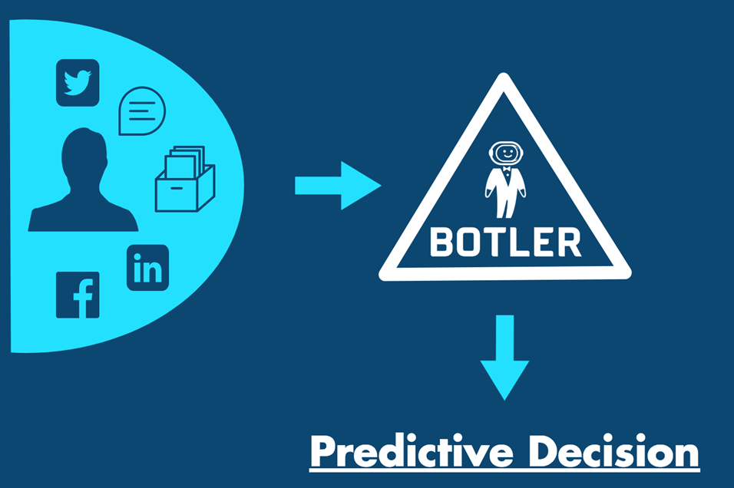
Screening & Discovery

Slide 8
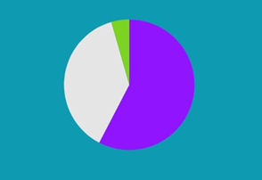
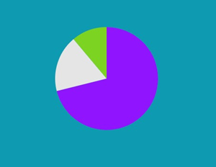
The Market
$479.08B Global HR Industry
(2017)*
$901.8B Global Migrant Workforce
(150.3M Migrants)*
Staffing($276.12B)(57.64%)
Services Sectors(106.8M)(71.11%)
Professionals(181.72B(37.93%)
Manufacturing and Constru..(17.78%)
Executive Search($21.24B)(4.43%)
Agriculture(16.7M)(11.12%)
https://www.ir.randstaf.com/-/media/Files/R/Randstad-IR-V2/annual-reports/annual%20report%202017.pdf
http://www.ilo.org/global/topics/labour-migration/news-statement/WCMS_436140/lang-en/index.htm
Based on a conservative estimation of ~$6000 = government application + legal fees.

Slide 9

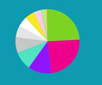


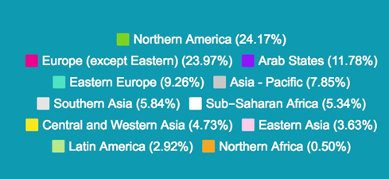
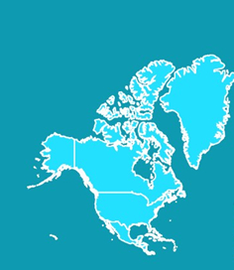
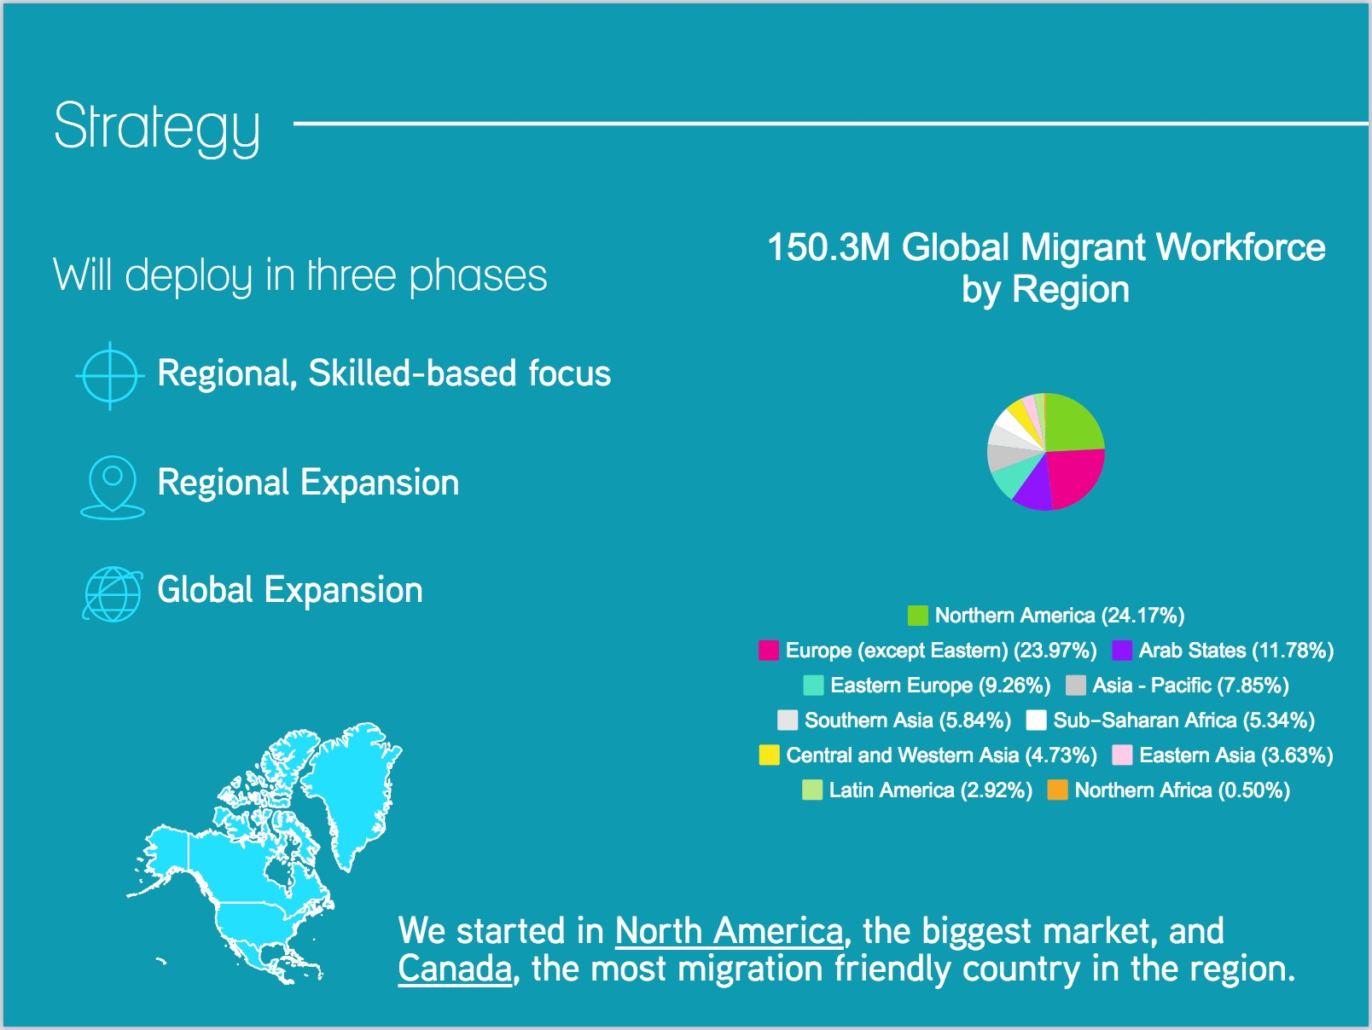
Strategy
Will deploy in three phases
150.3M Global Migrant Workforce
by Region
Regional , Skilled-based focus
Regional Expansion
Global Expansion
We started in North America, the biggest market, and Canada, the most migration friendly country in the region.

Slide 10
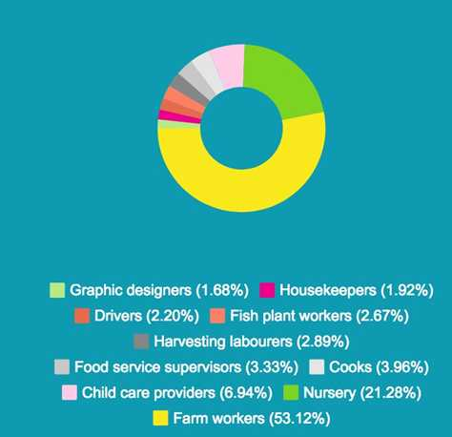
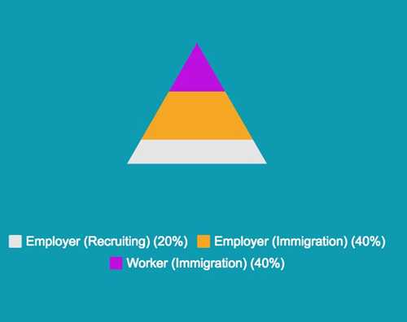
Phase 1 Region: Canada
98,135 Temporary Foreign Workers
(2017)
$1.23 B Spent on Recruiting & Immigration Process(2017)*
* Based on the estimation of ~$2500 recruitment price per recruit, ~$5000 legal immigration fees for employers, and ~$5000 legal immigration fees for workers.

Slide 11




Phase 1 Skill Focus: Food industry
Currently, we have over 100 Opportunities for Temporary Foreign Workers from more than six employers, including giant global food chains.

Slide 12




Business Model
$2500 CAD
Placing + Legal
$5000 CAD
Recruitment + Legal
Giving us
$4000 CAD in net profits

Slide 13



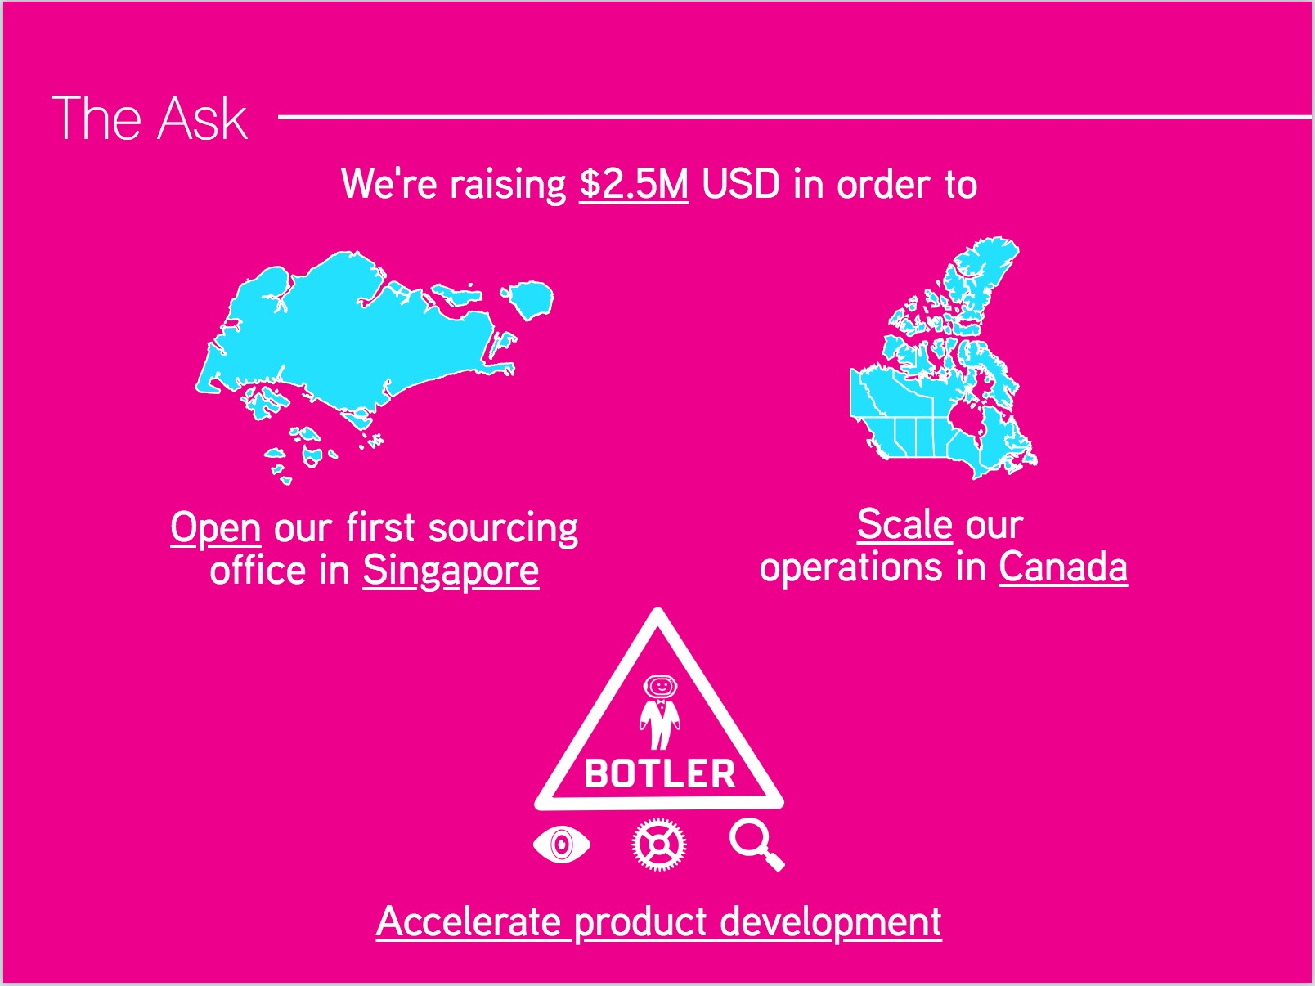
The Ask
We’re raising $2.5M USD in order to
Open our first sourcing office in Singapore
Scale our operations in Canada
Accelerate product development

