Slide 1
Working With JavaScript

Slide 2
JavaScript Single Threaded Architecture

Slide 3
Single Threaded Architecture
Javascript is Single Threaded Execution Model
The Main Thread can Only Execute a Single Function at a Time
Execution, in case of Asynchronous Functions like “setTimeout”:
As soon as asynchronous request is received, it goes to Web APIs
Web APIs process the request for timeout
Once the timeout is complete, callback waits in the Callback Queue for Execution
Once the main execution thread is available, it start processing callbacks

Slide 4


Slide 5
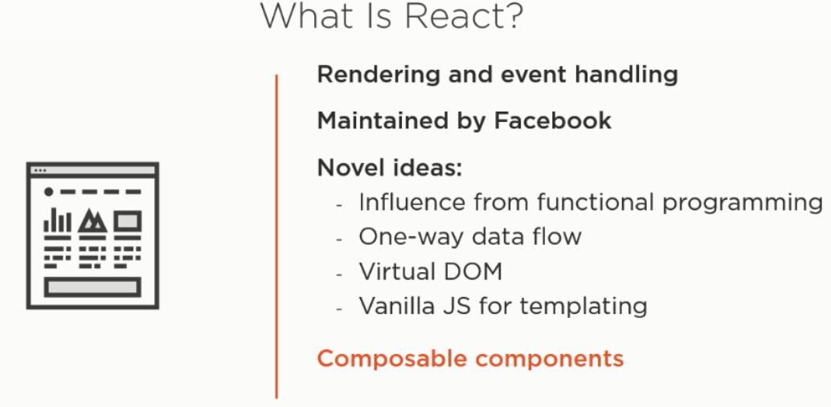

Slide 6
Introduction to React
Major Feature of React which make it distinct are:
Concept of Virtual DOM
Component based Structure
Lightweight Library
Updates are Patched
Can Manage Component Updates
Concept of Pure Functions
Synthetic Events
One Way Binding

Slide 7
Concept of Virtual DOM
In case of update in React Component state:
Updation to real DOM is an Expensive Operation
React creates a Virtual DOM
React do not re-renders the UI every time when State Changes
Re-rendering cause Repaint and Layout stages on Browser
Updates are first made to Virtual DOM
React looks for the Difference between the previous and new DOM
Only differences are re-rendered, not entire component

Slide 8
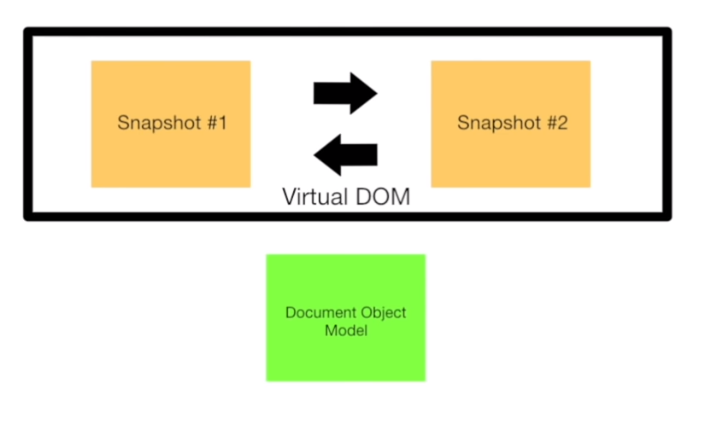
Virtual DOM Model..

Slide 9
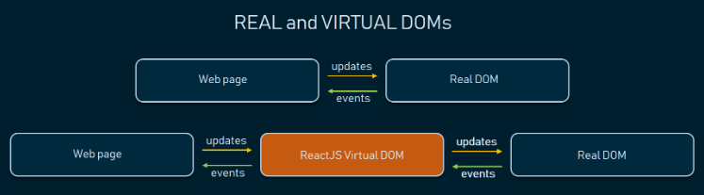

Slide 10
Component Based Structure
Separation of Concern is on the basis of Components
React separates application into multiple components
The application is not segregated on the basis of:
Scripts
Styling
Templates
The Approach given above is more of Separation of Technologies
Each component contains it own styling, Scripts and Templates

Slide 11
Lightweight Library
React is a lightweight library which can support multiple other libraries:
Being a library, less overhead of Setup is there
Developer can pull multiple libraries
Example, the following libraries, can be used:
Form Validation: “react-forms”
Routing: “react-router”
Http Requests and Response: Axios

Slide 12
Getting Started with React

Slide 13
Getting Started with React
Install Node
Run “npm install -g create-react-app”
Run “create-react-app employee-management”
Run “cd employee-management”
Run “npm start”

Slide 14

Rendering First React Element
Controls the contents of the container node which is passed as the second argument
DOM elements inside are replaced when first called.
Later calls use React DOM Diffing algorithm for efficient updates.

Slide 15

Working with JSX
React embraces the fact that rendering logic is inherently coupled with other UI logic
Templates are not segregated into different files
The syntax stated in neither String not HTML
It is called JSX, and it is a Syntax Extension to JavaScript.
JSX may remind you of a template language, but it comes with the full power of JavaScript.

Slide 16
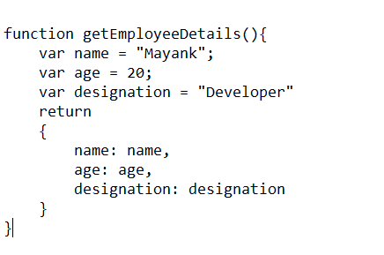
Automatic Semicolon Insertion

Slide 17
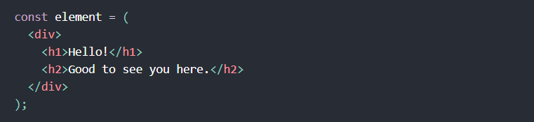
JSX in Multi Line
If the JSX Template Extends to multiple Lines it is enclosed within “Brackets”
JavaScript has got Automatic Semicolon Insertion by default.

Slide 18
Stateless Components
Components created using “functions” are stateless
These components extracts the state from the parent Elements
The parent Component passes data to the Child Component
The Child component can access the Parent Component data using “props”
“Props” are read only properties.
Any attempt to update them will lead to an Error Condition

Slide 19
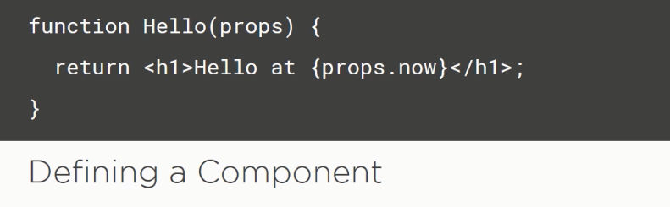

Slide 20
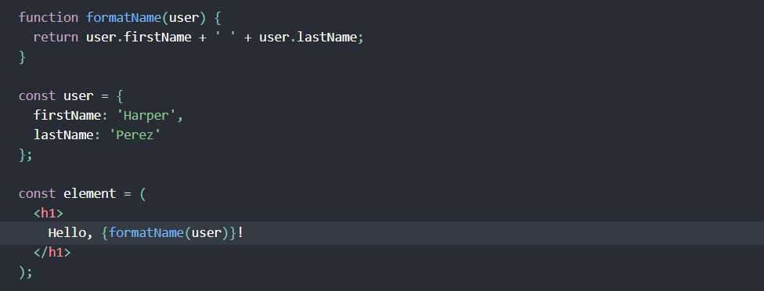
Separation of Concerns in React
Instead of artificially separating technologies by putting markup and logic in separate files
React separates concerns with loosely coupled units called “components” that contain both

Slide 21
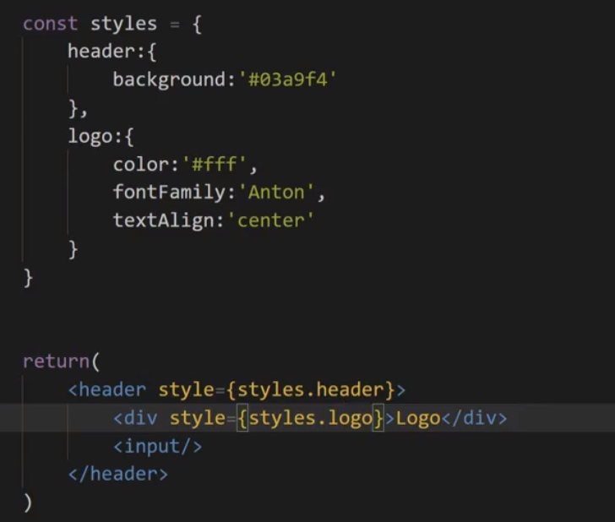
Adding Styles to Elements

Slide 22

Adding Inline Css to the Element
In order to add style to the element, it is enclosed within “{{styling}}”

Slide 23
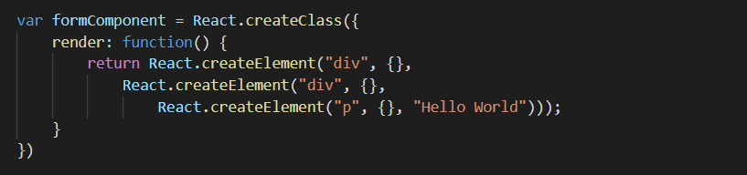
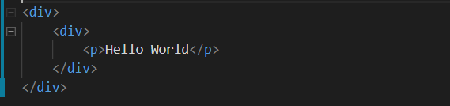
Working without JSX

Slide 24
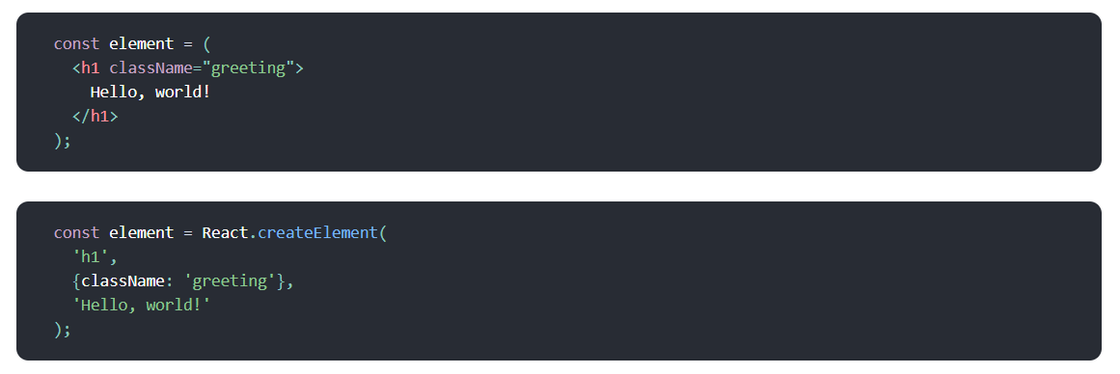
JSX to JavaScript Compilation

Slide 25
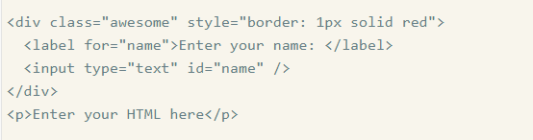
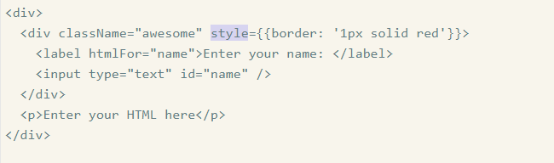
JSX to HTML

Slide 26
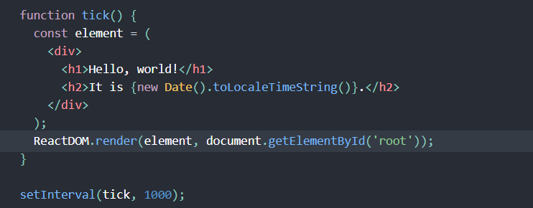
Updating Rendered Element
When a component need to be updated:
DOM difference is evaluated
Once the difference is calculated, the changes are batched.
All the batched changes are updated at once.

Slide 27
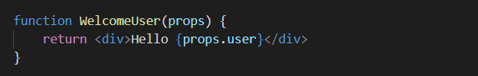

Child Components within Parent
Enhance the reusability of the component.

Slide 28
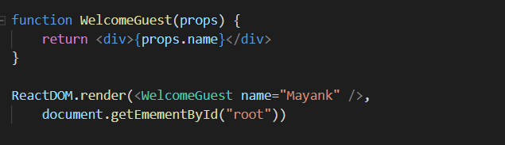
Passing props to Component
“Name” variable will be passed to the “props” argument

Slide 29


Slide 30
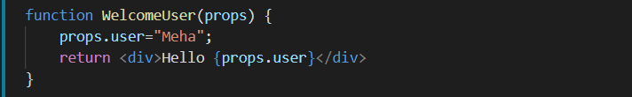
“Props” cannot be Modified
We can never modify the props value
Props should be considered as Read Only Value
Any Modification in the value shall result in Error

Slide 31
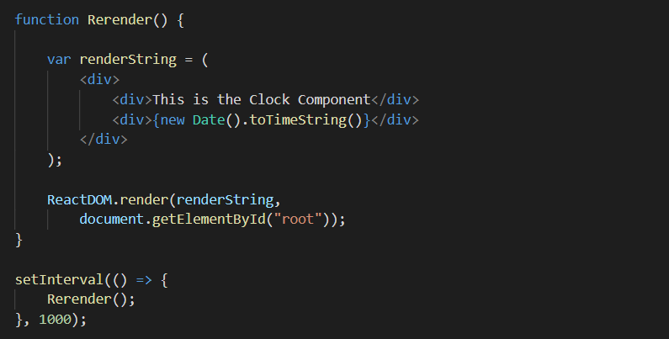
Re-rendering Parent Element

Slide 32
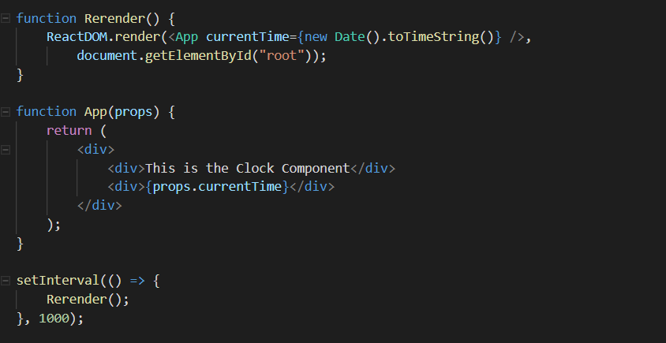
Passing Props to Update Time

Slide 33
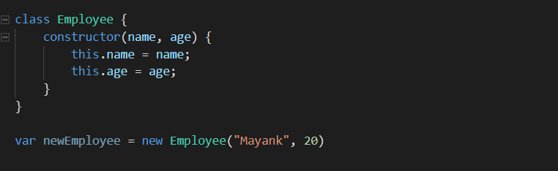
Creating Simple ES6 Classes

Slide 34
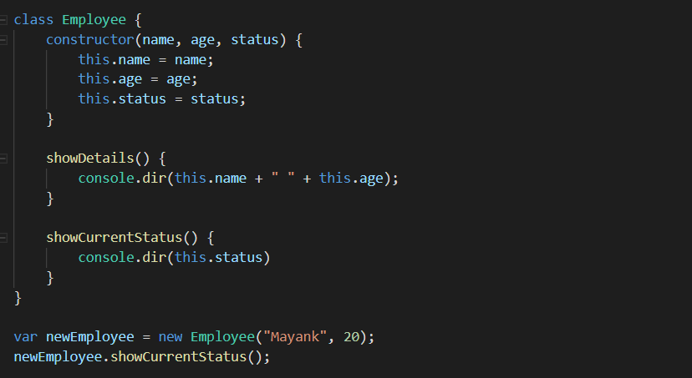
Adding Functions to Classes

Slide 35
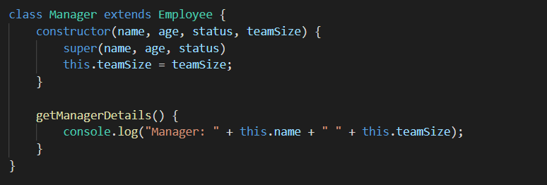
Adding Super Keyword in Constructor

Slide 36
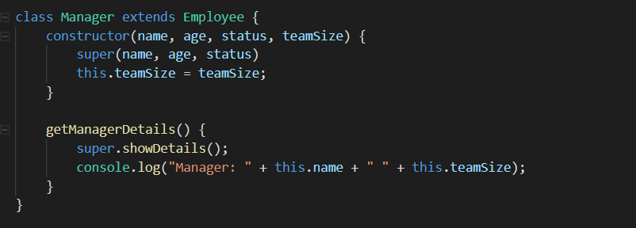
Extending Subclass Function

Slide 37

Adding Static Methods and Properties
Static Properties can only be accessed inside Static Methods.

Slide 38
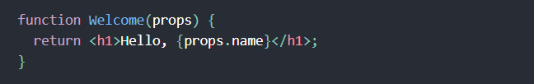

Working with ES6 Classes
Instead of function we can use ES6 Classes
In order to create React Class, it must extend from “React.Component”

Slide 39
Updates are Patched
React component do not updates for every state and property changes
React looks for all the updates that need to be done in the UI
Updates are patched together and are updated all at once.
It reduces the overhead of updating the Component on every state change
React promotes higher performance using the same approach.

Slide 40
Avoiding Reflow and Repaints
Reflow
The process used by the browser for positioning elements on the screen is called Reflow. This process is executed always a DOM element is manipulated, any CSS rule about position or geometry is changed or when the browser is resized. The reflow process is executed for each element's children, ancestors and elements that appear after it in the DOM, once it needs to re-calculate the styles based on the target element.
Repaint
Also known as redraw, repaint is the name of the process used by the browser when it needs to update some style that is not about layout. In other words styles not related with position, width or height. An example would be a manipulation of the background color.

Slide 41
Can Manage Component Updates
On state changes, React component can control the Re-Rendering
On conditional basis, the Rendering for the current change can be disabled
In order to stop component from updation
“shouldComponentUpdate” should return “false”
On returning “false”, Component will not be updated

Slide 42

Pure Stateless Functions Components
React contains Stateless Components
In case of Stateless components, the Component is rendered according to the “props”
It behaves as a pure function, where for each specific state, same output is rendered

Slide 43
Synthetic Events
Synthetic events are the wrapper over plain JavaScript Events
Cross Browser Compatibility for Synthetic Events
Events are not directly attached to the elements
When we have multiple clickable divs inside a parent div:
React wont attach click event to each div
React will automatically attach the event to parent div
On the basis on input parameters, React decide which event to Call
Optimises the performance of the Application

Slide 44
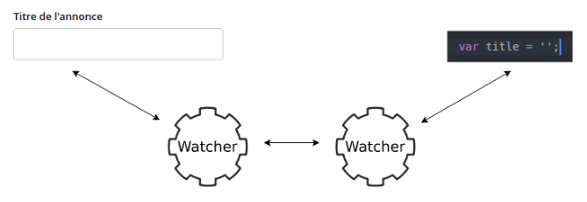
One Way vs Two Way Binding
Two Way Data Binding

Slide 45
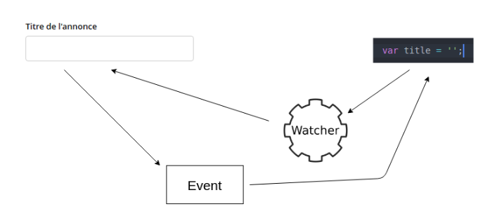
One Way vs Two Way Binding
One Way Data Binding

Slide 46
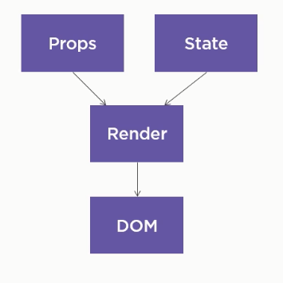
One Way Data Flow
Application Data is defined at Parent Level
This Parent Level Data(state) Flows from Parent To Children
Child Components takes this data in form of “props”
“Props” are read only and cannot be modified by Child
State can change consistently. Any state Changes, propagates down
Encourage to create Application State at Single Point
Data flow from Top to Bottom
“Props” + “State” combines to form data model to render

Slide 47
Propagating Event From Child to Parent

Slide 48
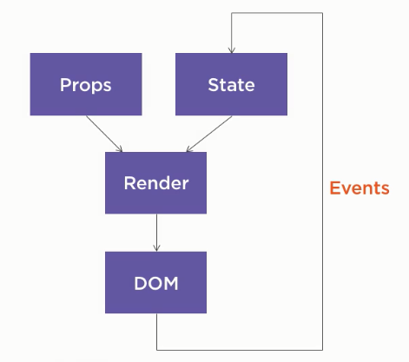
Handling Events
Events are raised to bring changes to State
Once the State Data changes, render Cycle is called
Updates are propagated to the Components
Not Entire Component is re-rendered.
Brings the Concept of Virtual DOM in the picture

Slide 49
Problems With React..
Working with JSX (JavaScript Expressions)
React Applications may vary in Composition
Multiple Tools to Ecomplish same tasks.
Need to Import Multiple Packages to Create Full Fledged Application
Focusses on the View Layer Only.
Working with Third Party State Management Libraries
Additional SEO Hassles
React Library is Still Developing.
Bootstrapping is slower for the React Application.

