Slide 1

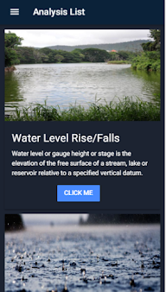

WaterLoo
By Team CypherOps
Team ID : JH2018017

Slide 2
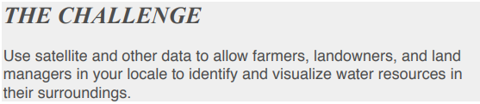
Problem Statement
Planetary Blues : Where is the water ?

Slide 3
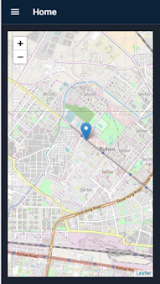
Our Solution
Hybrid app interface i.e availability for Android, Web,Windows and IOS.
Geolocation of person or searchable location
Visualisation via graphs data representation for levels, precipitation and many more...
Prediction of data for water levels, precipitation, population density etc. upto 10 years.

Slide 4
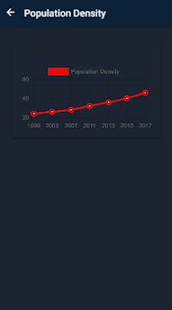
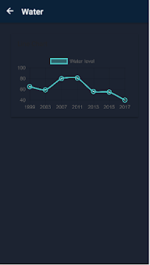
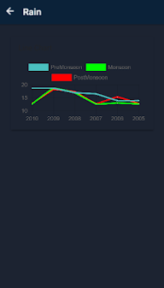
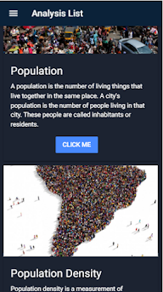
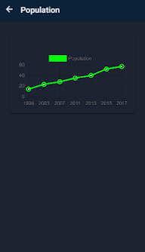
Graph Visualization

Slide 5
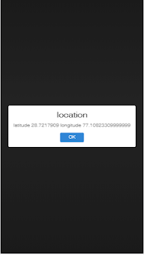

Future Scope
We plan to expand our app and make it more detailed. Add maps which shows the ground-water ,precipitation etc. level over the next 10 years to make it more interactive and easy to use. Add a compare feature so that landowners and farmers can easily determine where to buy the land.
Research and development purposes.
Spotting flood prone areas.
Forest covers.
Tracking Glacier and polar cap melting

Slide 6

Tech Stack
Ionic For multi-platform availability of the app.
Django for backend framework.
Python for Data analysis.
Machine Learning for future predictions prediction.
NASA & other Web Api’s for data .
Chart.js for data visualization.
Angular as the frontend framework.
Notes:
hackathonjims@gmail.com

Slide 7
Resources Used
Nasa Data : https://earthobservatory.nasa.gov/
https://water.usgs.gov/ogw/times-sq
https://www.un-igrac.org/global-groundwater-inform...
http://databank.worldbank.org/data/reports.aspx?so...
Population Api : http://api.population.io/1.0/population/India{{CountryName}}/19{{Age}}
Water Level Api : https://waterlevel.ie/page/api/ Api for Water Level(Delhi) : http://api.sehavniva.no/tideapi.php?lat=58.974339&lon=5.730121&fromtime=2018-08-30T00%3A00&totime=2018-08-31T00%3A00&datatype=all&refcode=cd&place=Delhi&file=&lang=en&interval=10&dst=0&tzone=&tide_request=locationdata
Geolocation : https://ionicframework.com/docs/native/geolocation/
https://www.tutorialspoint.com/android/android_google_maps.htm
https://www.pubnub.com/tutorials/android/mapping-geolocation-tracking/
## Google
https://github.com/ionic-team/ionic-native-google-maps/blob/master/documents/README.md
## Google Map Alternative
http://geoawesomeness.com/looking-for-google-maps-api-alternatives-here-are-the-best-picks/
free api : https://leafletjs.com/index.html

Slide 8
Thank You
Efforts By :
Mayank Jha
Pranjal Rastogi
Mayank Sharma
Govind Singh

