Slide 1

MALIGNANT COMMENTS CLASSIFICATION
This Photo by Unknown Author is licensed under CC BY-NC

Slide 2
Use Case
The proliferation of social media enables people to express their opinions widely online. However, at the same time, this has resulted in the emergence of conflict and hate, making online environments uninviting for users. Although researchers have found that hate is a problem across multiple platforms, there is a lack of models for online hate detection.
Online hate, described as abusive language, aggression, cyberbullying, hatefulness and many others has been identified as a major threat on online social media platforms. Social media platforms are the most prominent grounds for such toxic behaviour.
Our goal is to build a prototype of online hate and abuse comment classifier which can used to classify hate and offensive comments so that it can be controlled and restricted from spreading hatred and cyberbullying.

Slide 3

Approach and Life Cycle

Slide 4
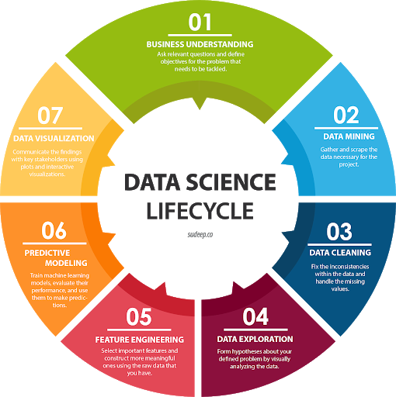

Slide 5

Data Description
Project contain train and test dataset.
In train data set there are 159,571 rows and 8 columns.
In test data set it is like 153,164 rows and 2 columns.
There are no null values in the dataset
Most of the data are numeric in nature which are binary.
Comments is object in nature and consist of text.
Overall memory usage for train and test is around 15MB.

Slide 6
Data Pre-processing
As there are no null values in the dataset, but as the comment column in text format so there require lot of text pre-processing.
Percentage of unlabelled comments or good comments is 89.832.
Percentage of all bad comments 0.0194.
As, number of offensive comments are in very less in number

Slide 7
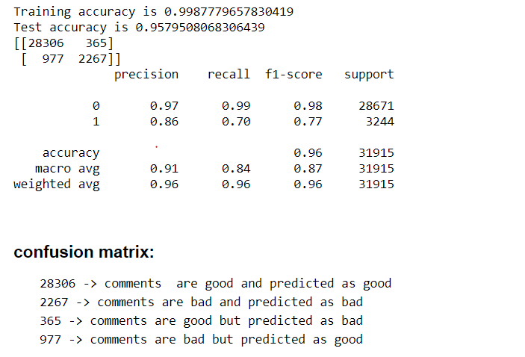
Metrics : Accuracy, Confusion Matrix
In classification problem there are various metrics that are accuracy score, confusion matrix, classification repot, Roc Auc curve which help to check the efficiency of the model
Which metrices is useful? Is also depend and vary on domain, so as per the use case we must predict that whether the customer is defaulter or not
So, in this case accuracy score is good but most important is confusion matrix in which we must decrease the False Positive that is type 2 error which is provided by Random Forest.

Slide 8
Visualization

Slide 9
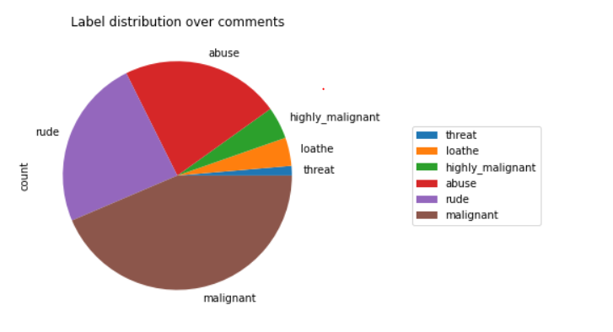
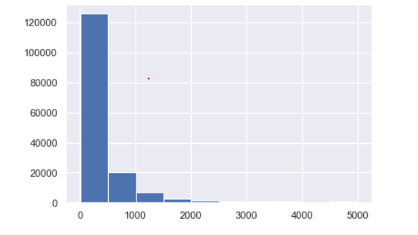
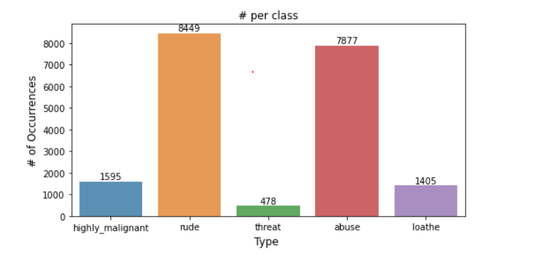

Slide 10
Key Findings and Conclusions of the Study
In this project there are some variables like malignant and rude which are highly correlated it is possible because one comment text may have combination of multiple features.
Removing the column id does not impact the model training.
Using Tree, model can reduce the false negative values
It has future scope in various use cases likewise in election, social media etc, where every day there are multi offensive comments spread.
So, in the future it may use very well to easily classify the comments as bad or good.
Random forest is well suitable for this project as it used tree internally and it used multiple weak learner and generate the strong model and generate low bias and low variance model.

Slide 11
Thanks

