Slide 1
Installations The installation process for this project is a bit more than usual. First we have to download a C++ compiler. We can do this by installing Visual Studios. You can download the community version for free from their website. Once the intaller we will run it and select the ‘Desktop development with C++’. The download and installation will take some time as it is a few Gbs.
After completing and restarting the computer, now we will head on to our Pycharm project. Here we will install the required packages. Below is the list.
1.cmake
2.dlib
3.face_recognition
4.numpy
5.opencv-python

Slide 2
Understanding the problem
Understanding the problem
Although many face recognition algorithms have been developed over the years, their speed and accuracy balance has not been quiet optimal . But some recent advancements have shown promise. A good example is Facebook, where they are able to tag you and your friends with just a few images of training and with accuracy as high as 98%. So how does this work . Today we will try to replicate similar results using a face recognition library developed by Adam Geitge.
Face recognition is a series of several problems:
First, look at a picture and find all the faces in it
Second, focus on each face and be able to understand that even if a face is turned in a weird direction or in bad lighting, it is still the same person.
Third, be able to pick out unique features of the face that you can use to tell it apart from other people— like how big the eyes are, how long the face is, etc.
Finally, compare the unique features of that face to all the people you already know to determine the person’s name.

Slide 3
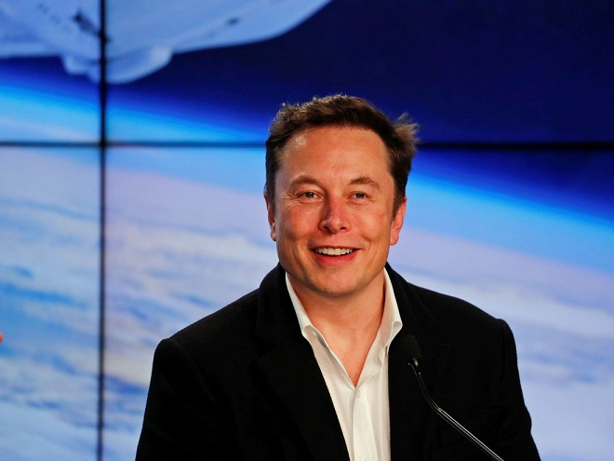
Face Recognition
Importing
First we will import the relevant libraries
import face_recognition import cv2 import numpy as np
The Process of Recognition can be divided into 3 steps.
Step 1
Loading Images and Converting to RGB.
The Face Recognition package consists of a load image function that loads the image. Once imported the image has to be converted to RGB.
imgElon = face_recognition.load_image_file('ImagesBasic/Elon Musk.jpg') imgElon = cv2.cvtColor(imgElon,cv2.COLOR_BGR2RGB) imgTest = face_recognition.load_image_file('ImagesBasic/Elon Test.jpg') imgTest = cv2.cvtColor(imgTest,cv2.COLOR_BGR2RGB)

Slide 4

Find Faces Locations and Encodings
In the second step we will use the true functionality of the face recognition library. First we will find the faces in our images . This is done using HOG (Histogram of Oriented Gradients) at the backend. Once we have the face they are warped to remove unwanted rotations. Then the image is feed to a pretrained neural network that out puts 128 measurements that are unique to that particular face. The parts that the model measures is not known as this is what the model learns by itself when it was trained. Lucky for us all this is done is just 2 lines of code. Once we have the face locations and the encodings we can draw rectangles around our faces.
faceLoc = face_recognition.face_locations(imgElon)[0] encodeElon = face_recognition.face_encodings(imgElon)[0] cv2.rectangle(imgElon,(faceLoc[3],faceLoc[0]),(faceLoc[1],faceLoc[2]),(255,0,255),2) # top, right, bottom, left faceLocTest = face_recognition.face_locations(imgTest)[0] encodeTest = face_recognition.face_encodings(imgTest)[0] cv2.rectangle(imgTest,(faceLocTest[3],faceLocTest[0]),(faceLocTest[1],faceLocTest[2]),(255,0,255),2)

Slide 5
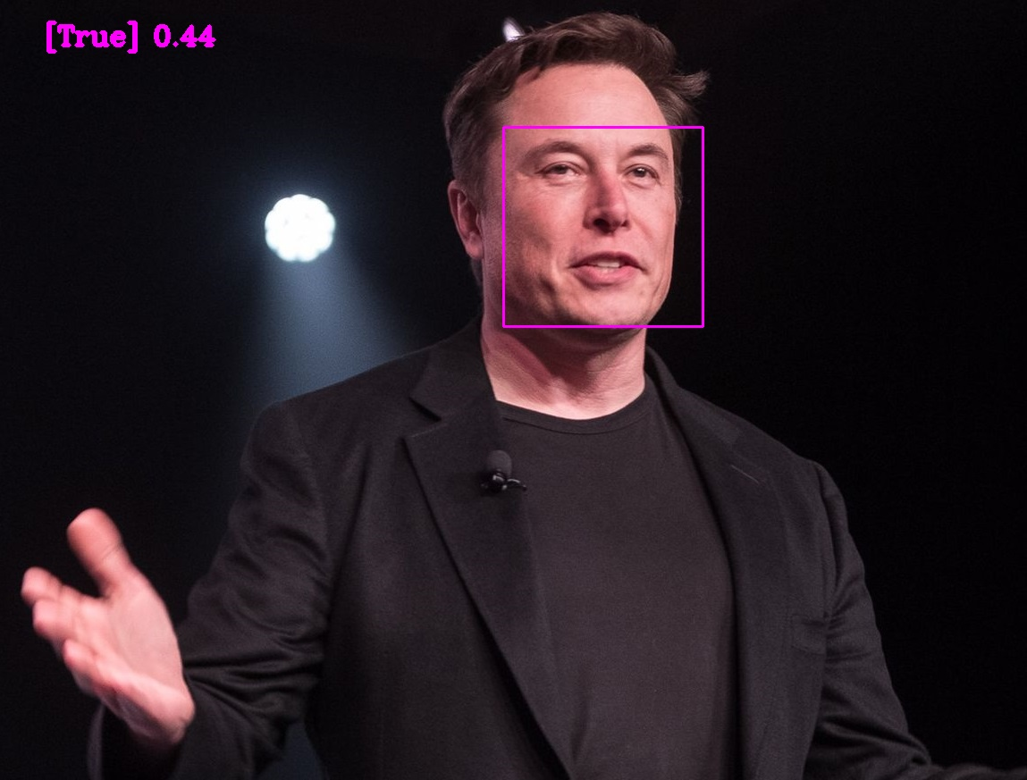
Compare Faces and Find Distance
Once we have the encodings for both faces, then we can compare these 128 measurements of these two faces to find similarities. To compare the package uses one of the most common machine Learning methods linear SVM classifier. We can use the compare_faces function to find if the faces match. This function returns True or False. Similarly we can use the face_distance function to find how likely is the faces match in terms of numbers. This is helpul particularly when there are multiple faces to detect from.
results = face_recognition.compare_faces([encodeElon], encodeTest) faceDis = face_recognition.face_distance([encodeElon], encodeTest) cv2.putText(imgTest,f'{results} {round(faceDis[0],2)} ',(50,50),cv2.FONT_HERSHEY_COMPLEX,1,(255,0,255),3)
If we run this with the test image we get the value True, indicating that the face found is of Elon Musk. The is distance between the faces is 0.44. The lower the distance the better the match.

Slide 6
Attendance Project
As we have imported before we can use the same face_recognition.load_image_file() function to import our images. But when we have multiple images, importing them individually can become messy. Therefore we will write a script to import all images in a given folder at once. For this we will need the os library so we will import that first. We will store all the images in one list and their names in another.
import face_recognition import cv2 import numpy as np import ospath = 'ImagesAttendance' images = [] # LIST CONTAINING ALL THE IMAGES className = [] # LIST CONTAINING ALL THE CORRESPONDING CLASS Names myList = os.listdir(path) print("Total Classes Detected:",len(myList)) for x,cl in enumerate(myList): curImg = cv2.imread(f'{path}/{cl}') images.append(curImg) className.append(os.path.splitext(cl)[0])

Slide 7
Marking Attendance
Lastly we are going to add the automated attendance code. We will start by writing a function that requires only one input which is the name of the user. First we open our Attendance file which is in csv format. Then we read all the lines and iterate through each line using a for loop. Next we can split using comma ‘,’. This will allow us to get the first element which is the name of the user. If the user in the camera already has an entry in the file then nothing will happen. On the other hand if the user is new then the name of the user along with the current time stamp will be stored. We can use the datetime class in the date time package to get the current time.
def markAttendance(name): with open('Attendance.csv','r+') as f: myDataList = f.readlines() nameList =[] for line in myDataList: entry = line.split(',') nameList.append(entry[0]) if name not in line: now = datetime.now() dt_string = now.strftime("%H:%M:%S") f.writelines(f'n{name},{dt_string}')

Slide 8
Labeling Unknown faces as well
Lastly we are going to add the automated attendance code. We will start by writing a function that requires only one input which is the name of the user. First we open our Attendance file which is in csv format. Then we read all the lines and iterate through each line using a for loop. Next we can split using comma ‘,’. This will allow us to get the first element which is the name of the user. If the user in the camera already has an entry in the file then nothing will happen. On the other hand if the user is new then the name of the user along with the current time stamp will be stored. We can use the datetime class in the date time package to get the current time.

