Slide 1
Scrapyard
PROJECT MEMBERS :
1. Swati Sonaje - 210943120102
2. Dhanashri Deora - 210943120027
3. Pratik Varute - 210943120074
4. Mayank Namdev - 210943120051

Slide 2
INTRODUCTIONS
This is an online B2B marketplace connecting buyers with suppliers. The channel focuses on providing a platform to Small & Medium Enterprises (SMEs), Large Enterprises as well as individuals. The project's mission is ‘to make doing business easy’.
ScrapYard for Buyers -
– Convenience of connecting with sellers anytime, anywhere
– Wider marketplace with a range of products and suppliers
– Payment Protection Program
ScrapYard for Suppliers -
– Enhanced business visibility
– Increased credibility for your brand
– Lead Management System

Slide 3
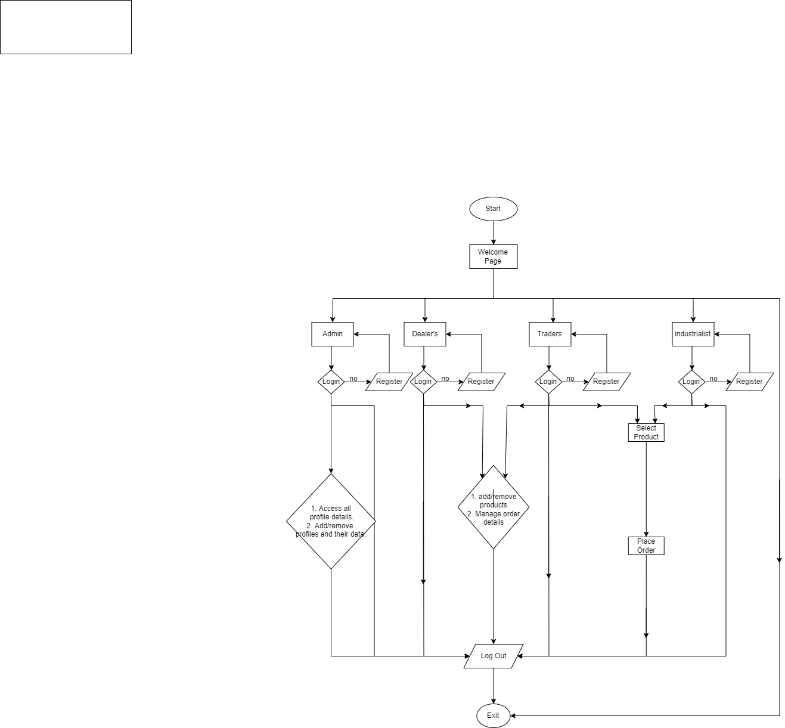
Flow chart

Slide 4
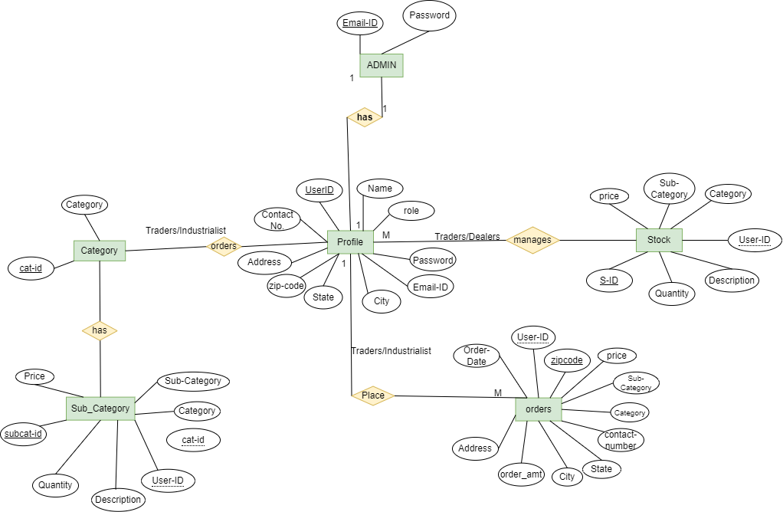
Er-diagram

Slide 5
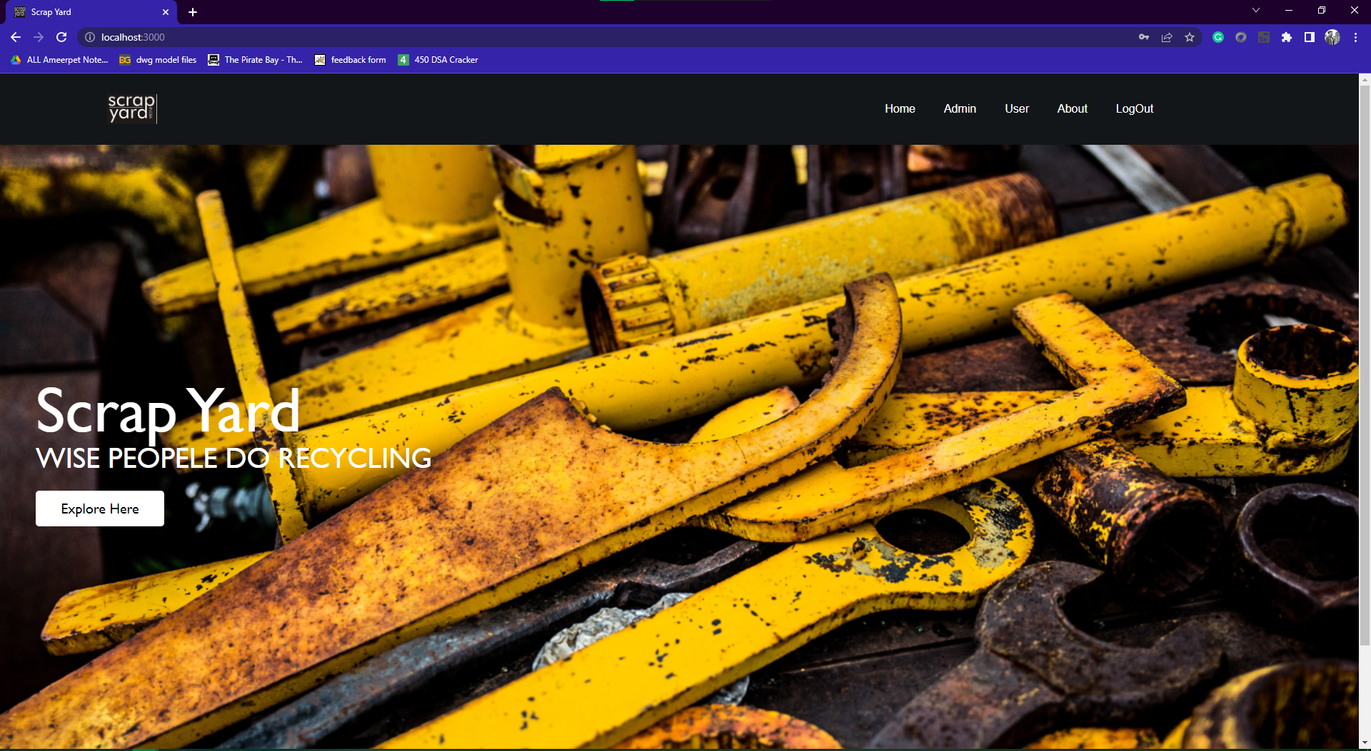
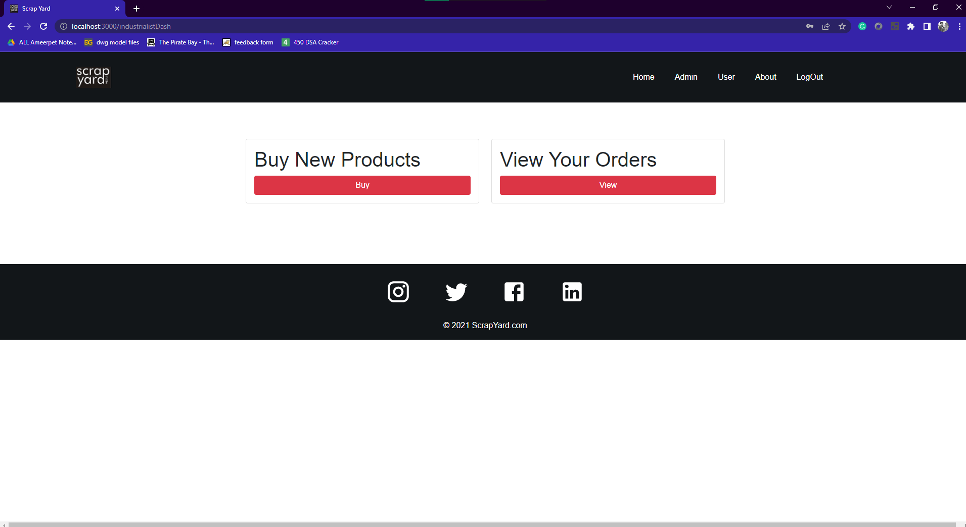
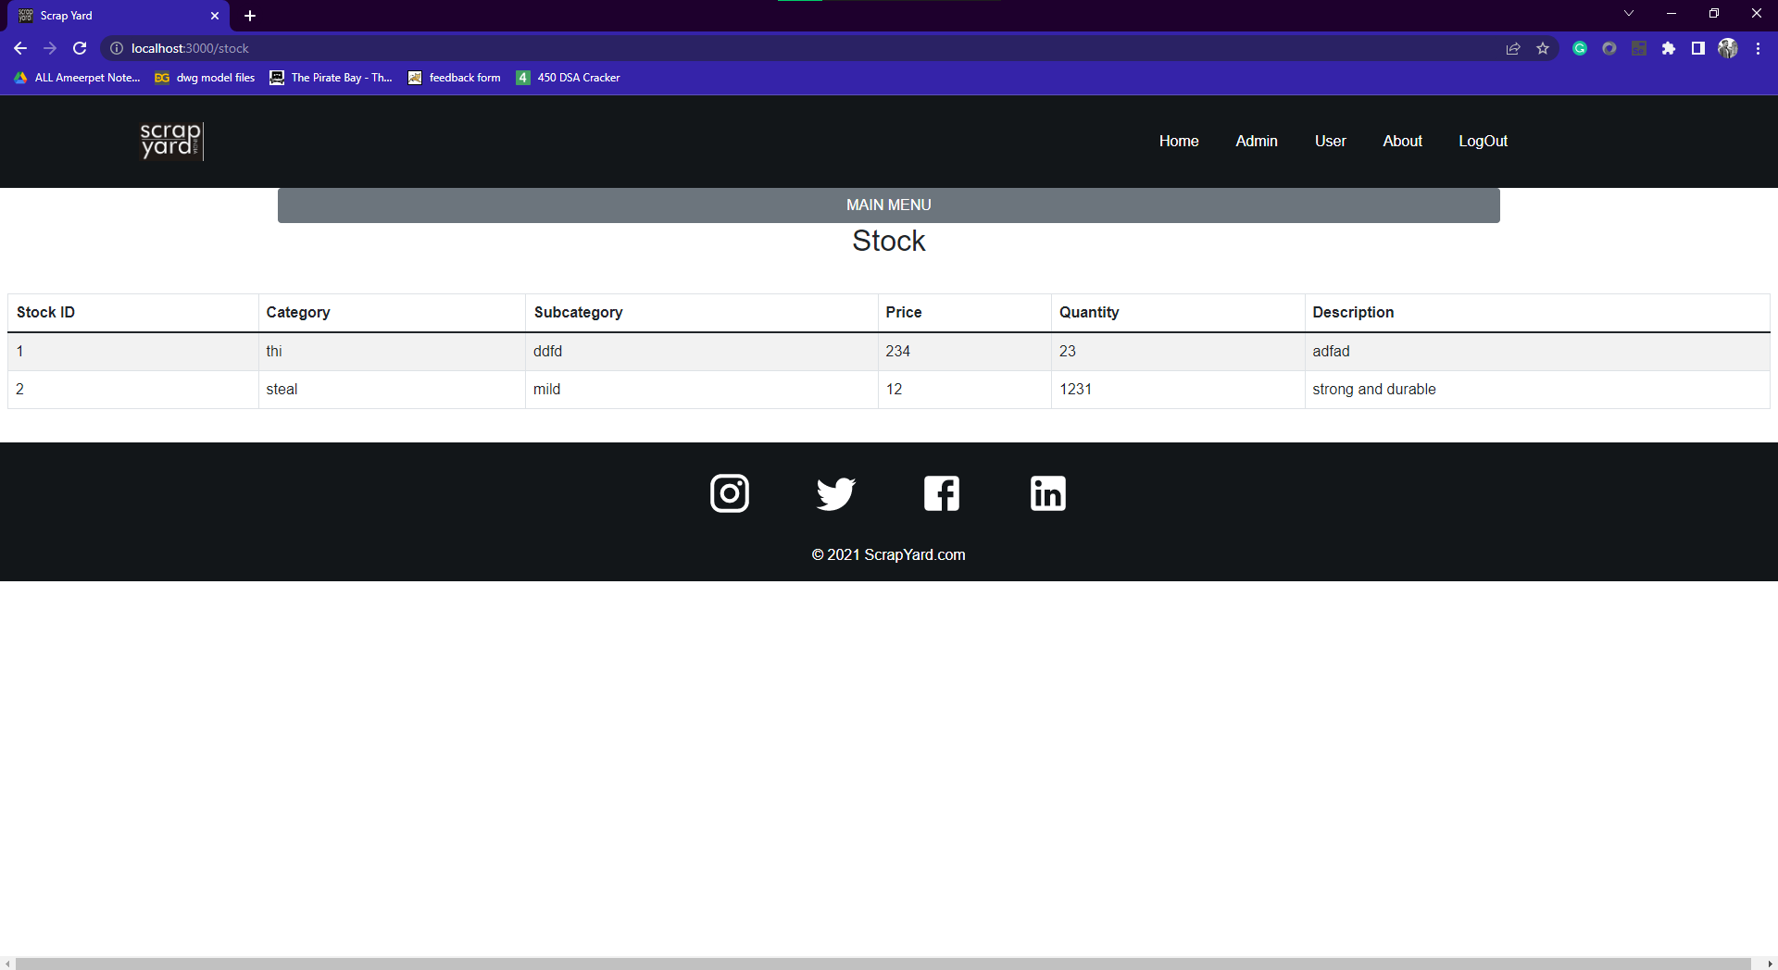
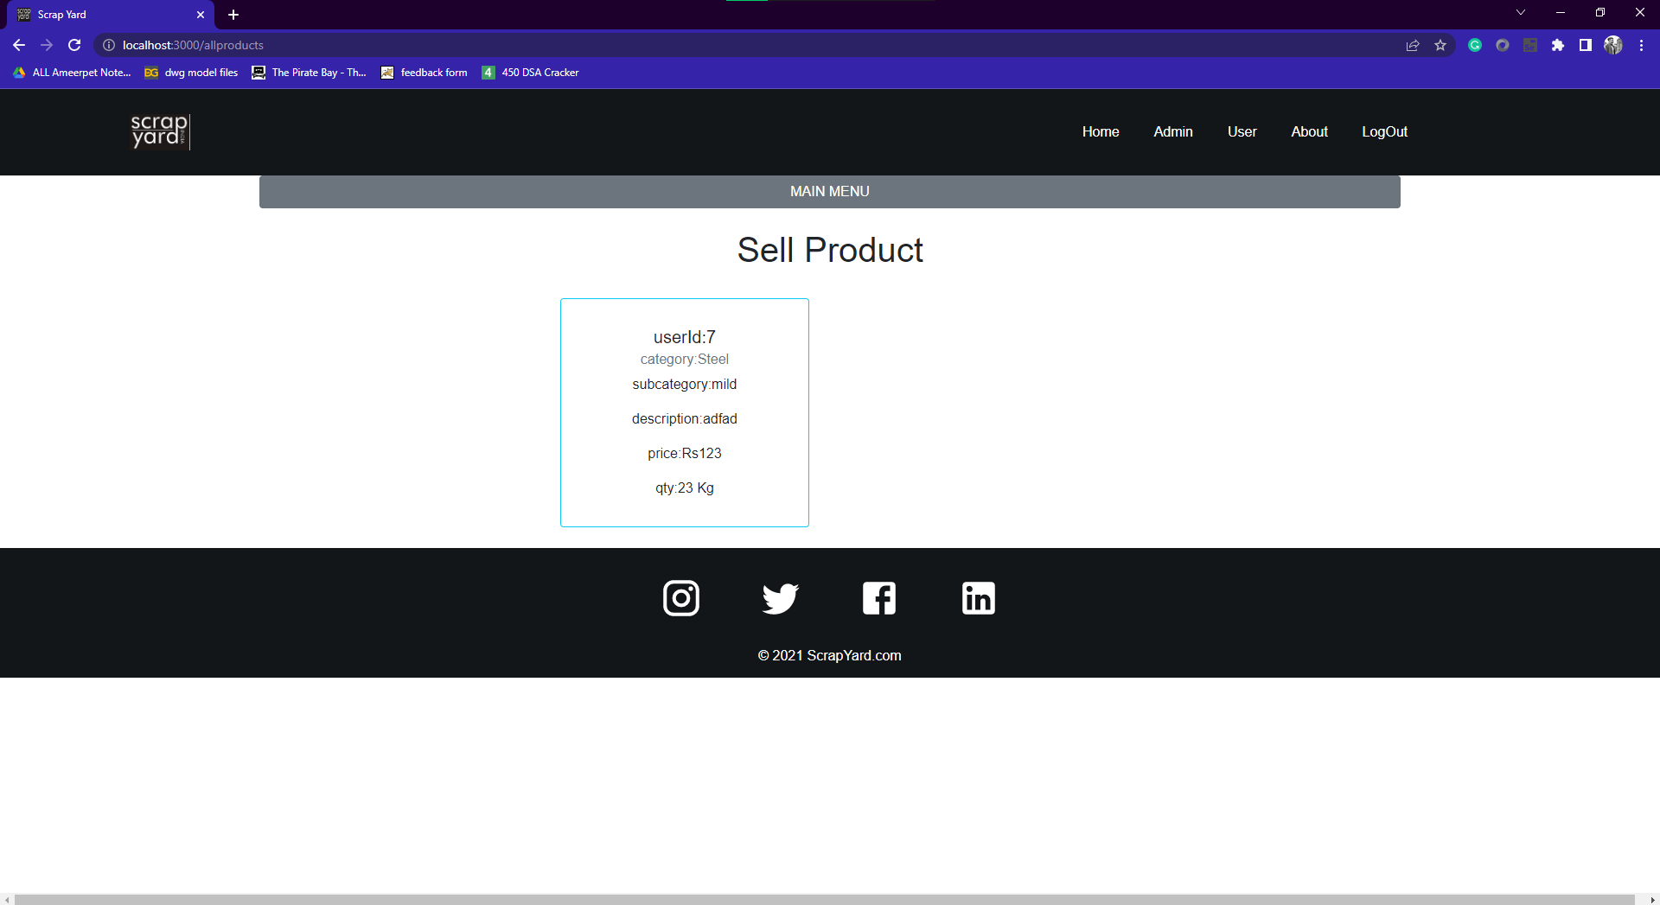

Slide 6
Future scope
We will generate auction system.
We will connect international clients for business expansion.
We will provide tracking and delivery system.
We will provide services that helps for tax benefits.
Industrialist can also sell his raw waste material.
This platform not only sell the scrap but also the used and old factory machineries and parts.

