Slide 1

INTERN
ASSIGNMENT ON
GIT
Presented By :- Mayank singh rajput
Employee ID :- 1642

Slide 2
TASKS
1. Create and collaborate on a new empty repository on GitHub.
2. Each member should make one commit each.
3. This group need to learn and discuss on the following topic – Worktree.
4. You need to push the slides or the doc you create to this
repository

Slide 3
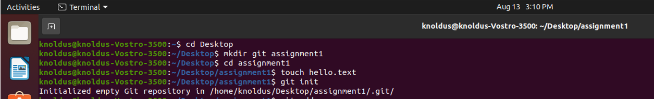
TASK 1
Create and collaborate on a new empty repository on GitHub.
Create a new local repository - git init
Check out a repository/Create a working copy of a local repository:git clone /path/to/repository

Slide 4
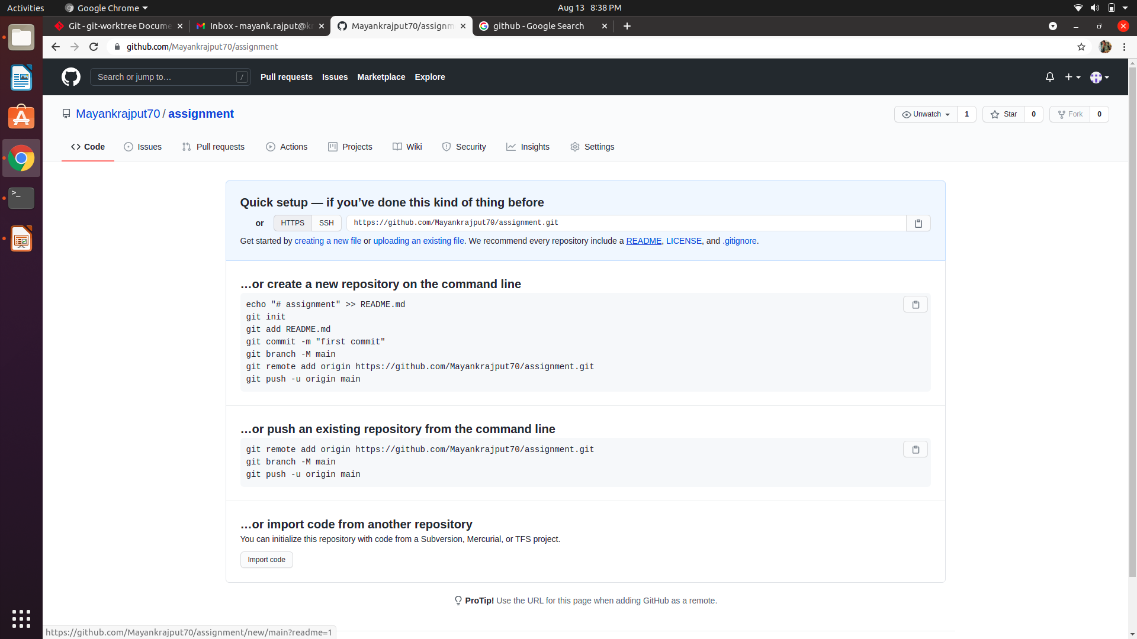
Git repository

Slide 5
TASK 2
Each member should make one commit each.
For a remote server, use: git clone username@host:/path/to/repository
Add files / Add one or more files to staging (index): git add <filename> / git add *
Commit / Commit changes to head : git commit -m "Commit message"
Push Send changes to the master branch of your remote repository: git push origin master
Status / List the files you've changed and those you still need to add or commit: git status

Slide 6
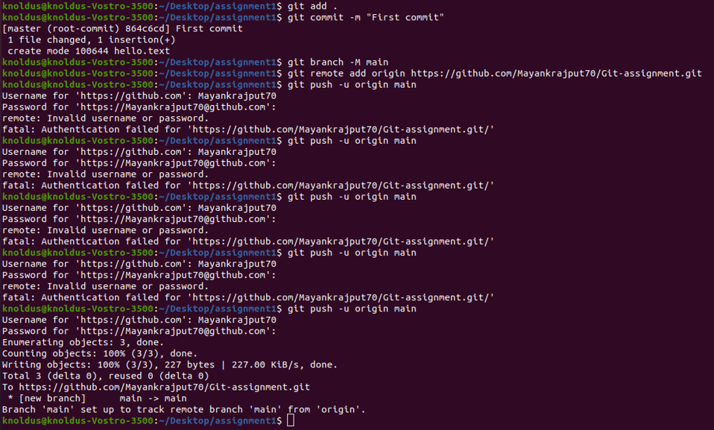
TASK 2

Slide 7
WHAT IS GIT ?
Git is a version control system that you download onto you use Git if you to collaborate with other developers on a coding project or work on your own project.
If you already have Git installed then you will see what version you have you can tpe the command
git –version in the terminal. If you don’t have Git installed you can visit the Git website and easily follow the download instruction to install.

Slide 8
TASK 3
WHAT IS WORKTREE ?
A Git repository can support multiple working tree ,allowing you to check out more than one branch at a time. With git worktree add a new working tree is associated with the repository.
A Git worktree is a linked copy of your Git repository. A worktree has a separate path from your main working copy, but it can be in a different state and on a different branch

Slide 9
Some command
add <path> [<commit-ish>]
List
Lock
Move
Prune working tree information in $GIT_DIR/worktrees.
Remove
repair [<path>…​]
Unlock a working tree, allowing it to be pruned, moved or deleted.

Slide 10
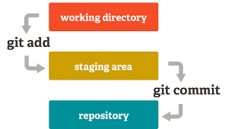

Slide 11
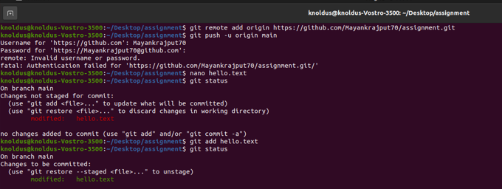

Slide 12
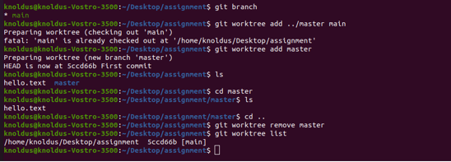

Slide 13
Thank You!
Stay in Touch :-
https://www.facebook.com/KnoldusSoftware
https://twitter.com/Knolspeak?ref_src=twsrc%5
Egoogle%7Ctwcamp%5Eserp%7Ctwgr%5Eauthor

