Slide 1

Prepared By
Amal Ajay
Anand Umak
Mayank Singh
Nilabh Kumar
JOB ANALYTICS PROJECT

Slide 2
Project Overview
Problem Statement
Scrape data from professional networking platform LinkedIn using python library called Beautifulsoup (or similar) and collate information in the given format and make 3 tables using the data.
Objective
The main objective of this project is to analyze the job listings on LinkedIn. The steps involved are as follows-
Web Scraping using Python.
Data cleaning using Python and Excel.
Table generation using Python and Excel.
Generated insights using MSSQL.
Dynamic Dashboard using Excel.

Slide 3
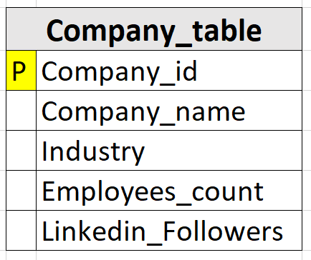
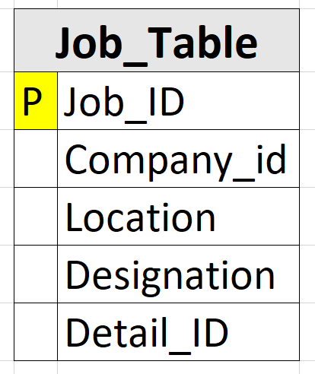
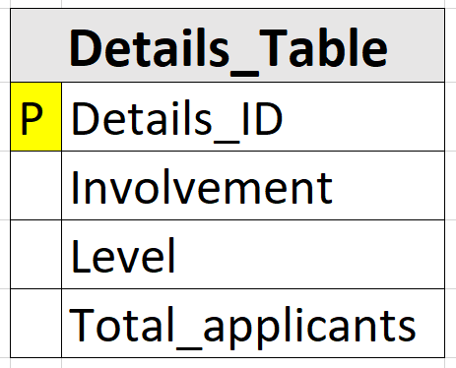
Data Overview

Slide 4
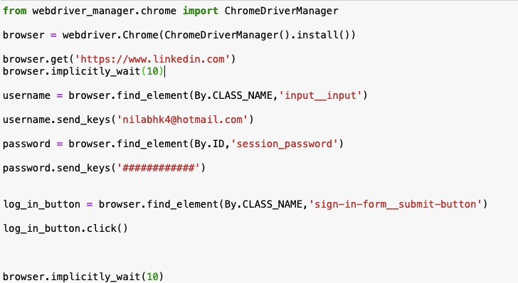
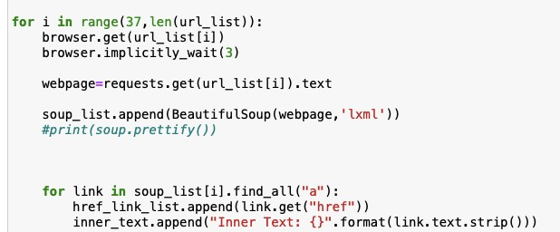
Web Scraping by Python(Beautiful Soup)

Slide 5
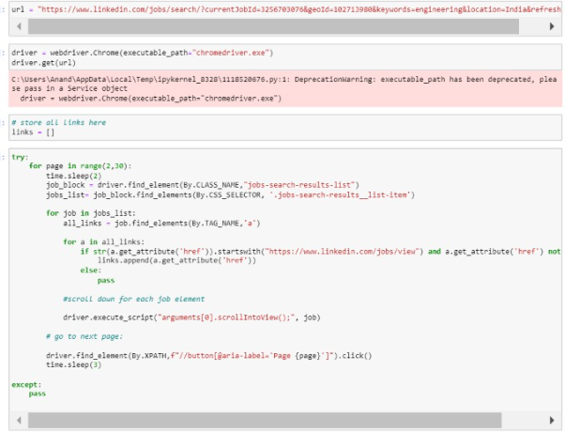
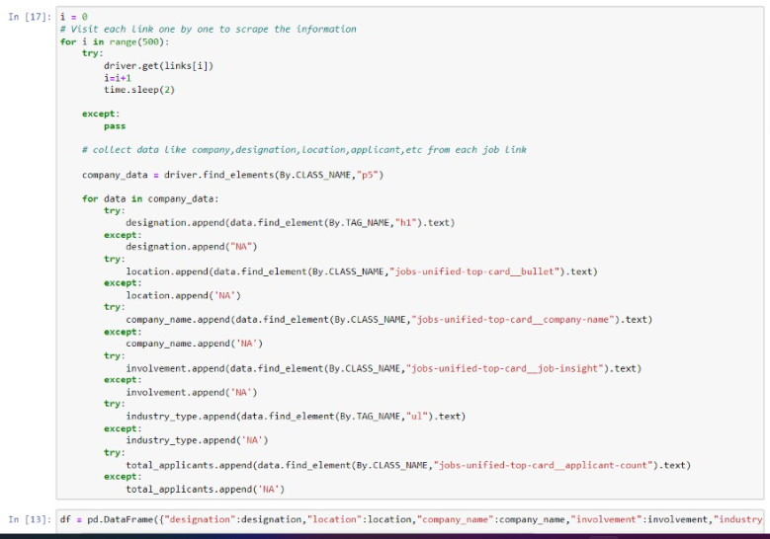
Web Scraping by Python(Selenium)

Slide 6
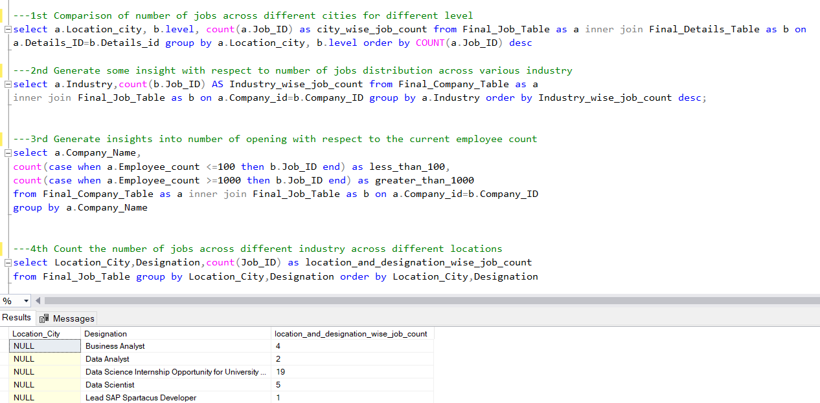
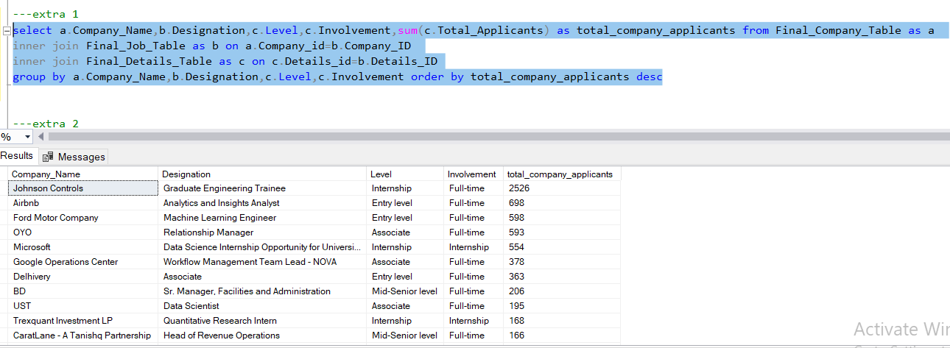
Insights from MSSQL

Slide 7
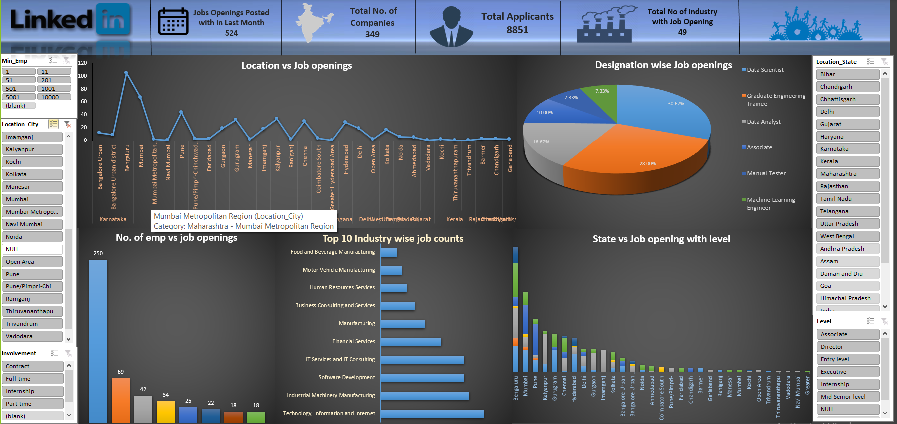
Dynamic Dashboard using Excel

Slide 8
Insights of Job analysis
As per analysis the top 3 locations for Job openings are Bengaluru, Mumbai and Pune.
The top 3 industries which provides the most number of Job openings are Software Development, Technology information and IT services and consultancy.
The Job opportunities are most in companies where the number of employees greater than 10000.
As per the analysis, it clearly seems that the applicants are more inclined towards booming fields like Data Science and Analytics as the combine percentage share is most for these fields.
As per our detailed analysis most number of applicants applied for top MNCs like Johnson Controls, Airbnb, Ford Motor Company, Microsoft etc.

Slide 9


