Slide 1
Public‐key Certification Authority
Aditya Singh Rathore, 2018007
Jaspreet Saka, 2018237

Slide 2
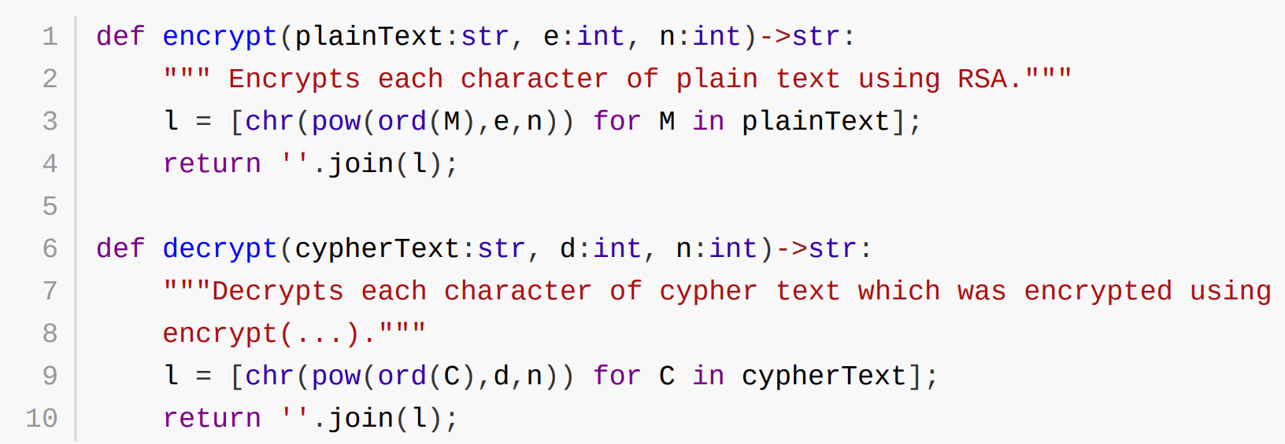
Encryption and Decryption

Slide 3
Client-to-cA
CA-to-client
Client-to-client
Everyone knows the public key of CA
Client encrypts using this public key.
Client registers its keys with CA and gets ID.
For the first time, Client sends its public key along with request to register to CA.
After that, CA can access the public key using ID.
A gets Public Certificate of B from CA.
B gets public certificate of A from CA.
They communicate using Public keys from these certificates.

Slide 4
Issues
Obvious vulnerability is that the statistical nature of text remains. Thus, it can be subjected to character frequency analysis.
Length of plain text is equal to the length of encrypted text.
Why
The reasons were purely implementation based.
Correct way would have been to convert string to a byte array and convert that byte array into a number.
But the size of string in certificate may become too long.
If we were to implement this for a product that was to be used in reality rather than a proof of concept, we would have used Symmetric encryption like AES to encrypt data and use RSA to encrypt AES keys.

Slide 5
Application

Slide 6
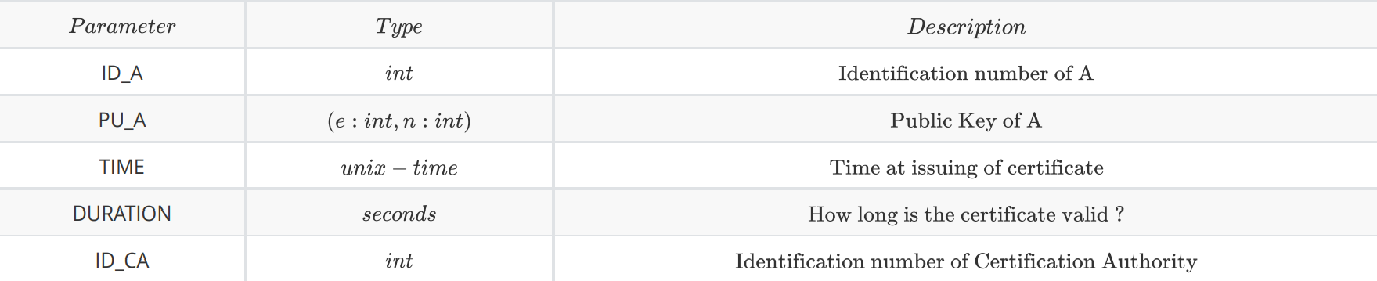
Certificate

Slide 7
Certification authority
Handles three kinds of queries:
getCertificateSelf
getCertificateOther
verifyCertificate

Slide 8
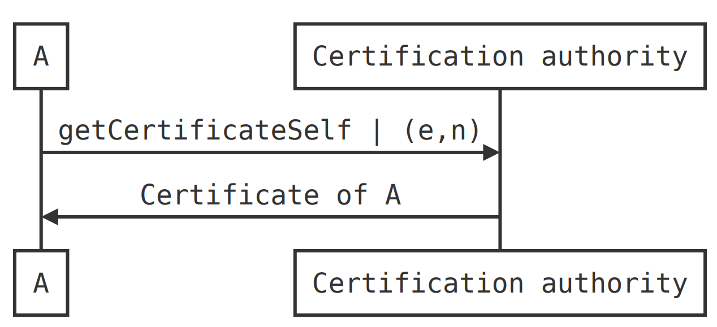
Get-Certificate-Self

Slide 9
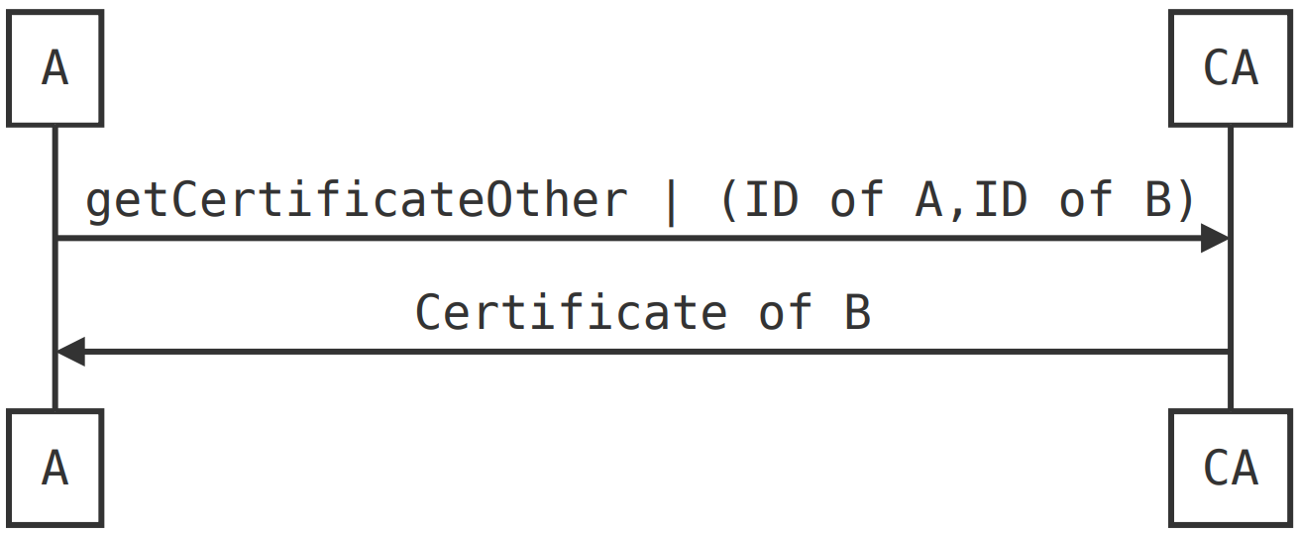
Get-Certificate-Other

Slide 10
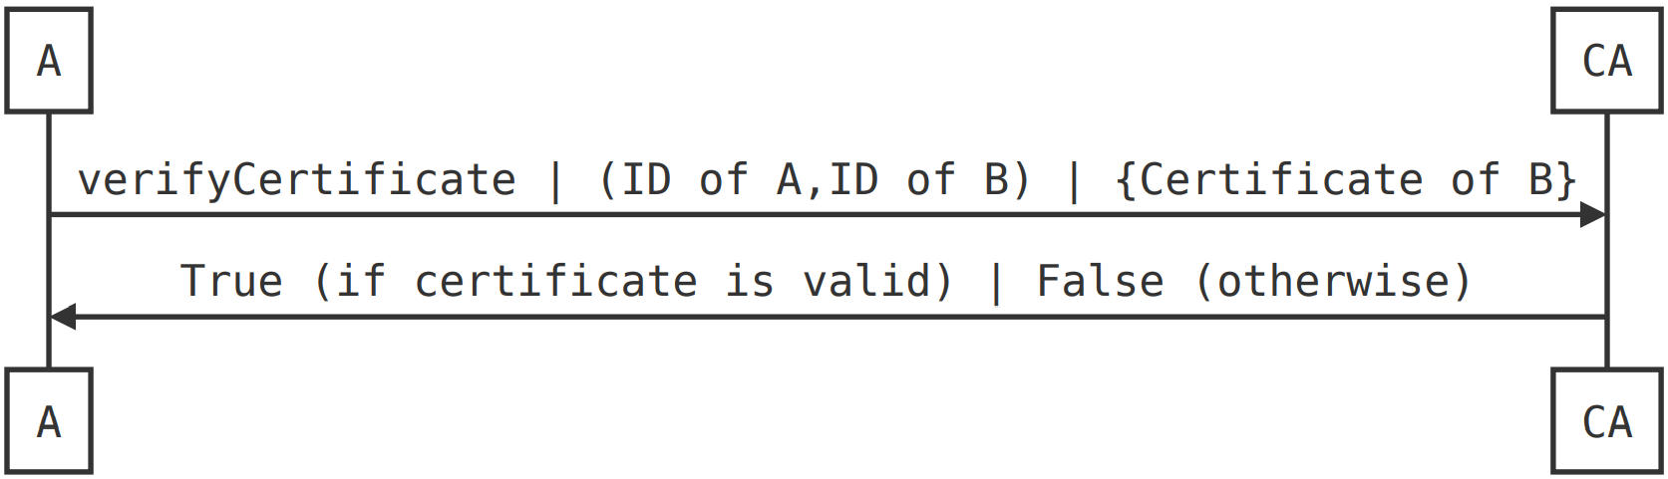
Verify-certificate

Slide 11
Application Flow

Slide 12
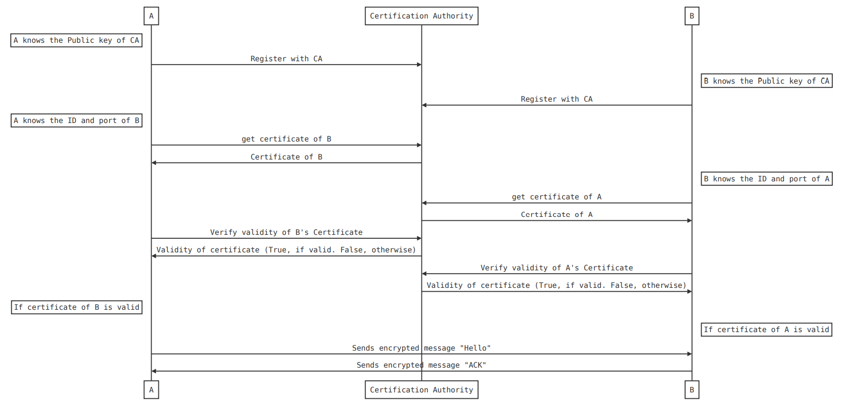

Slide 13
