Slide 1

Customer Churn Analysis
Identifying drivers of customer attrition and revenue loss
PYTHON · SQL · POWER BI

Slide 2

The Business Problem
Challenge
Objective
Telecom company losing customers → reduced revenue & rising acquisition costs
Identify churn drivers, estimate revenue loss, recommend retention actions
Approach
Python EDA → SQL analysis → Power BI dashboarding

Slide 3

DATASET SUMMARY
Dataset at a Glance
7,043 customers
Target: Churn (Yes/No)
21 features per record
12 blank spaces in TotalCharges
5 Feature Categories
Demographics · Account · Services · Billing · Target

Slide 4
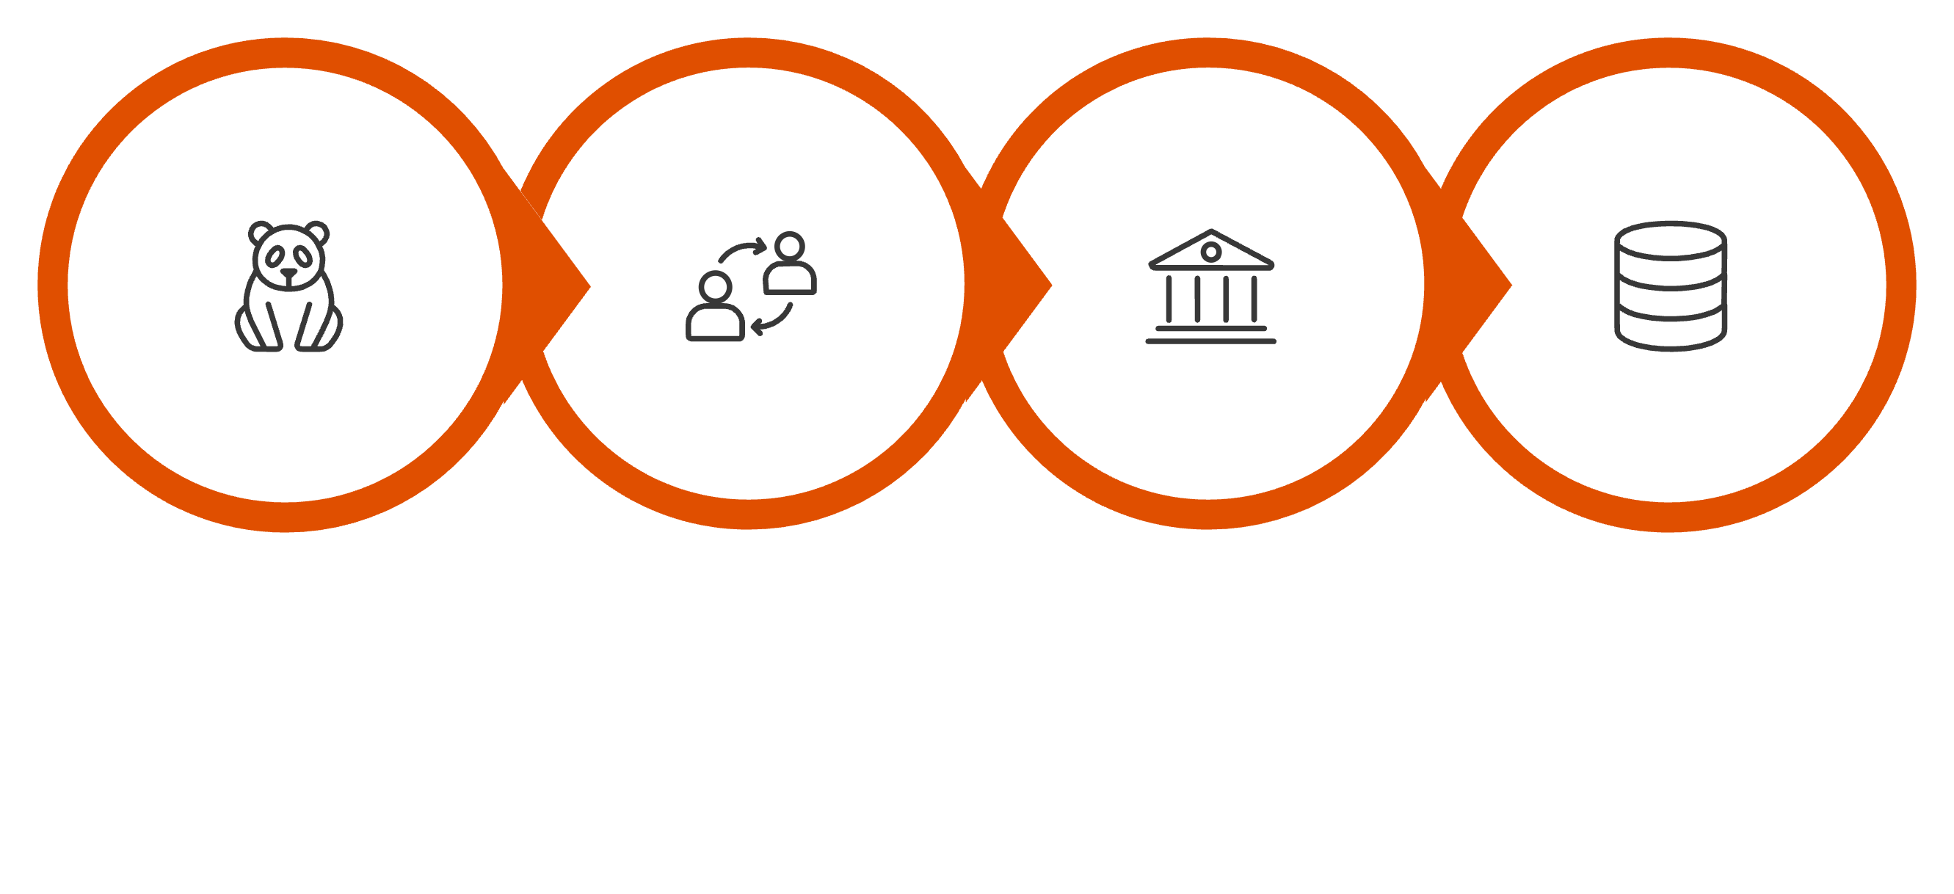
Python Data Preparation
Save to MySQL
Load Data
Clean Blanks
Standardize
Cleaned data was loaded into MySQL for structured business analysis.

Slide 5
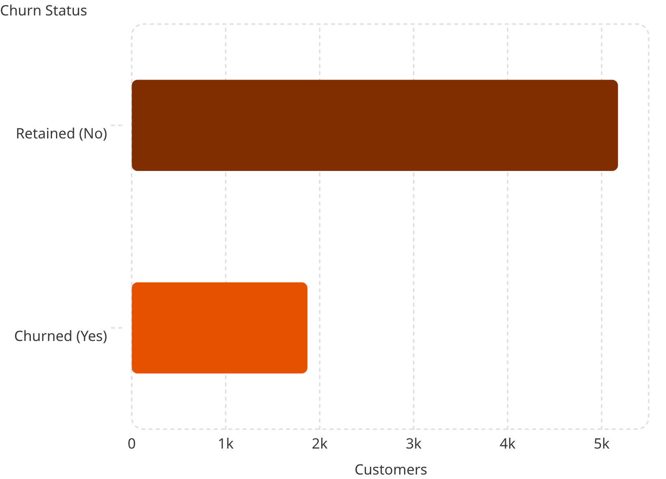
Overall Churn Rate
Key Findings
26.54%
1,869
Overall churn rate
Customers lost

Slide 6
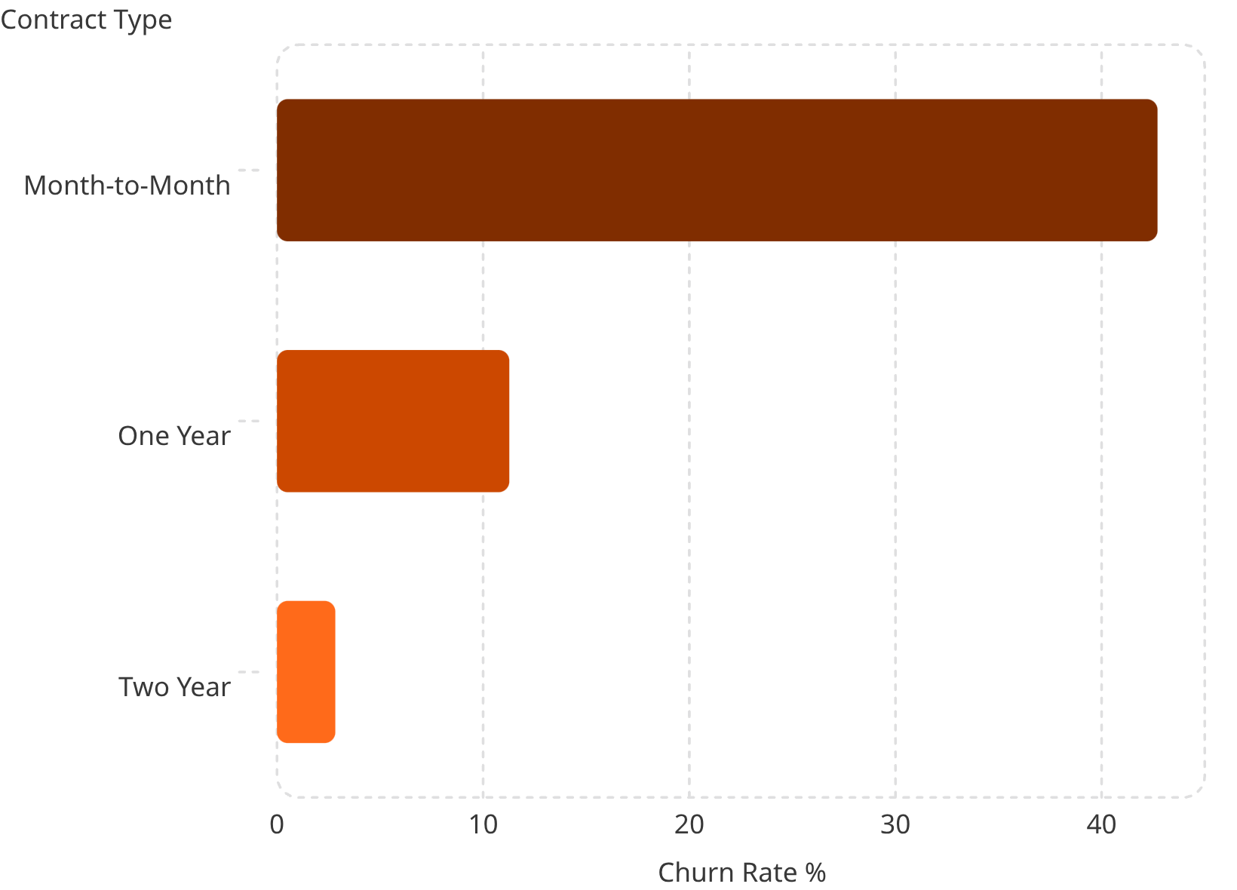
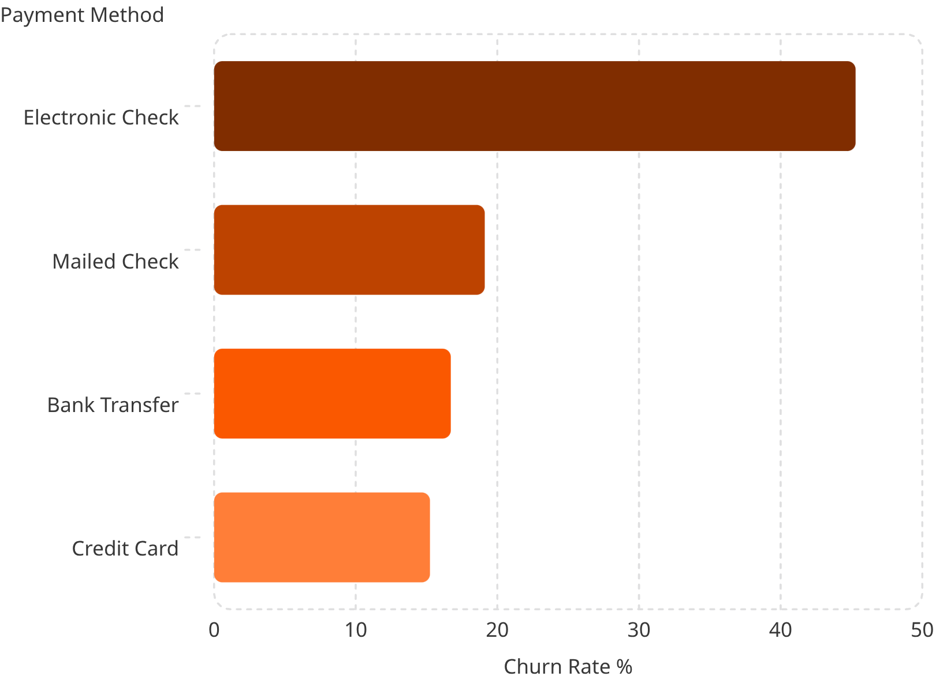
Churn by Contract & Payment

Slide 7


Churn by Tenure, Charges & Services
Tenure Gap
Monthly Charges
Churned avg: 17.98 mo vs Retained: 37.57 mo
Churned avg: $74.44 vs Retained: $61.27
Fiber Optic
No Tech Support
Highest service churn: 41.89%
Churn rate: 41.64% vs 15.17% with support

Slide 8
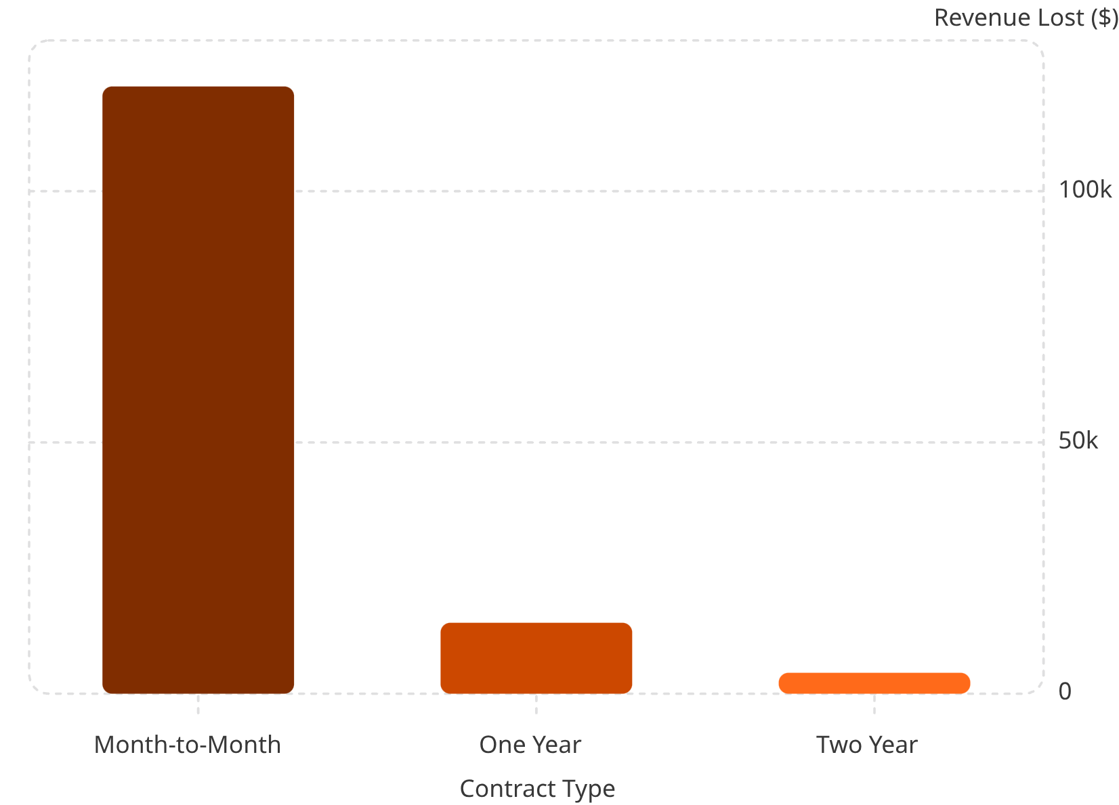
Revenue Loss & Highest-Risk Segments
Highest-Risk Profile
Month-to-Month + Fiber Optic + Electronic Check
Churn rate: 60.37%
Senior Citizens
Churn rate: 41.68% vs 23.61%
Total Revenue Lost
$2,862,927

Slide 9
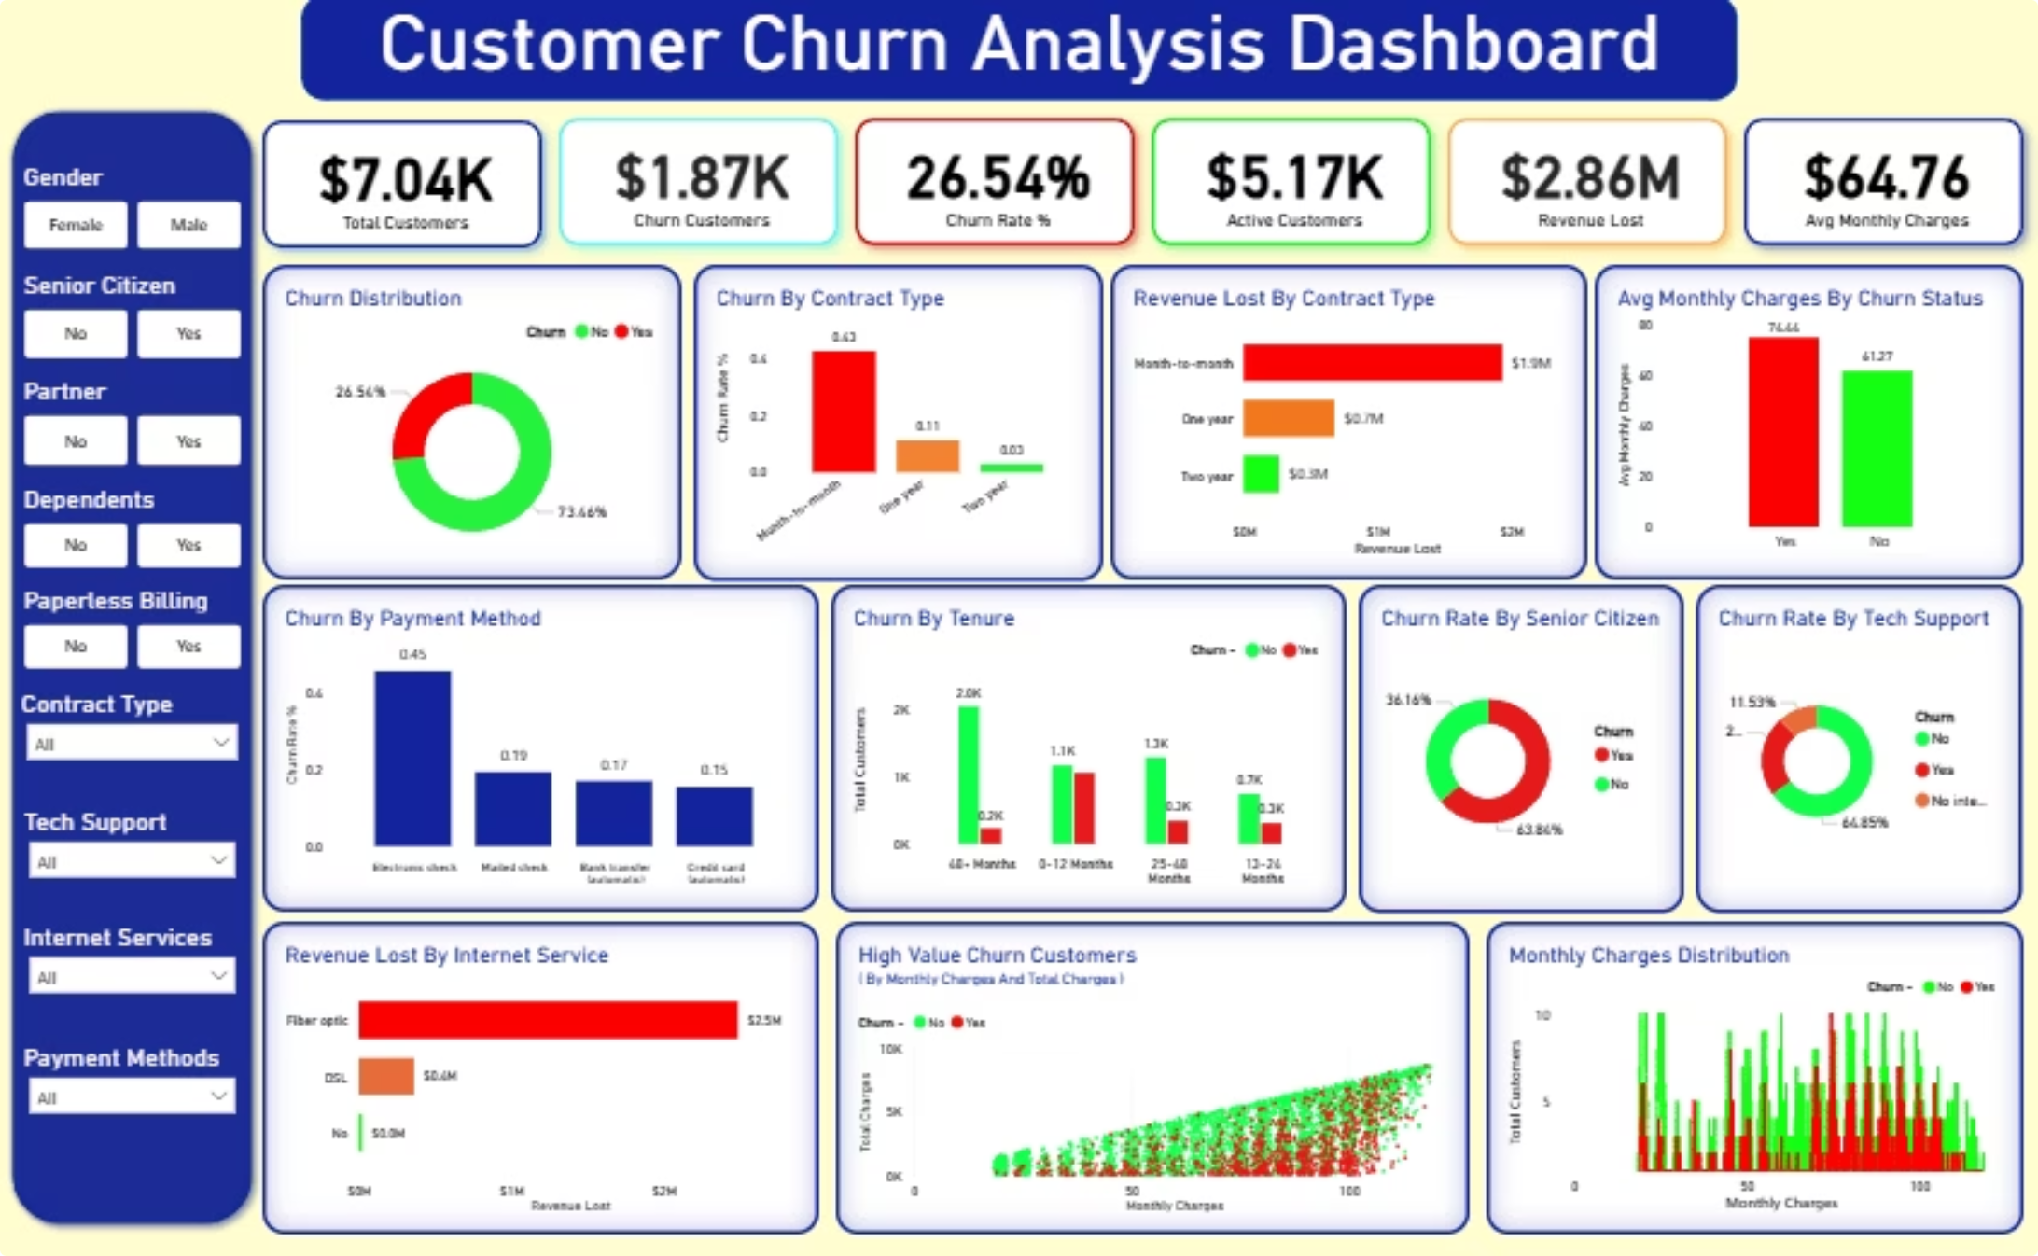
Power BI Dashboard
Turning customer data into actionable insights to reduce churn and maximize revenue growth.

Slide 10

Recommendations & Conclusion
Promote Long-Term Contracts
Discounts & loyalty benefits for annual/two-year plans
Bundle Tech Support
Proactive packages reduce churn by 26+ points
Target High-Risk Segments
Month-to-month + Fiber Optic + Electronic Check users
Improve Payment Experience
Incentivize auto-pay over electronic check

