Slide 1

Customer Shopping Pattern Analysis
Uncovering insights from 3,900 transactions across product categories, demographics, and subscription behavior.

Slide 2
Dataset at a Glance
3,900
18
Purchases
Columns
$59.76
3.75
Avg. Purchase
Avg. Rating
Key features: demographics, purchase details, shipping, discounts, review ratings, and subscription status.

Slide 3

Data Preparation in Python
01
Load & Explore
Imported with pandas; used df.info() and .describe()
02
Clean & Standardize
Imputed 37 missing ratings; renamed columns to snake_case
03
Feature Engineering
Created age_group and purchase_frequency_days columns
04
Load to MySQL
Connected Python to MySQL for SQL analysis

Slide 4
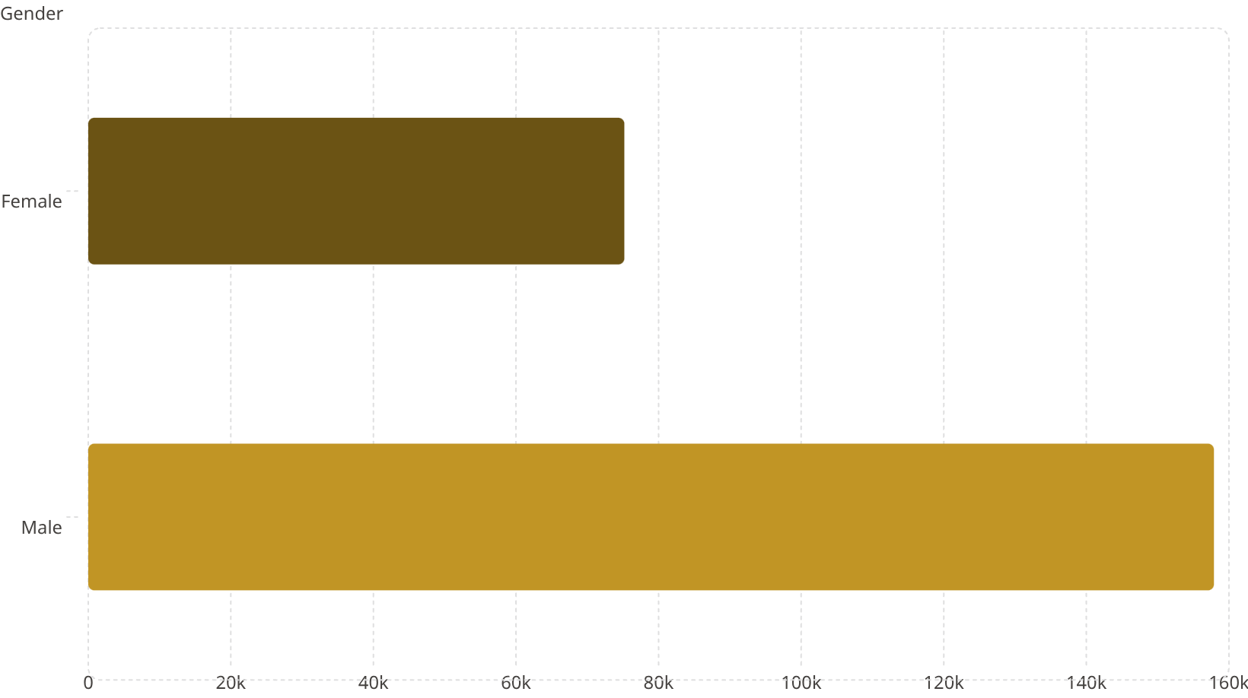
Revenue by Gender & Shipping
Shipping Type vs. Avg. Spend
Shipping
Avg. Amount
Standard
$58.46
Express
$60.48
Male customers generate 2× more revenue than female. Express shipping users spend slightly more.

Slide 5
Top-Rated Products & Discount Leaders
Top 5 by Avg. Rating
Most Discount-Dependent Products
Product
Rating
Product
Discount Rate
Gloves
3.86
Hat
50.00%
Sandals
3.84
Sneakers
49.66%
Boots
3.82
Coat
49.07%
Hat
3.80
Sweater
48.17%
Skirt
3.78
Pants
47.37%

Slide 6
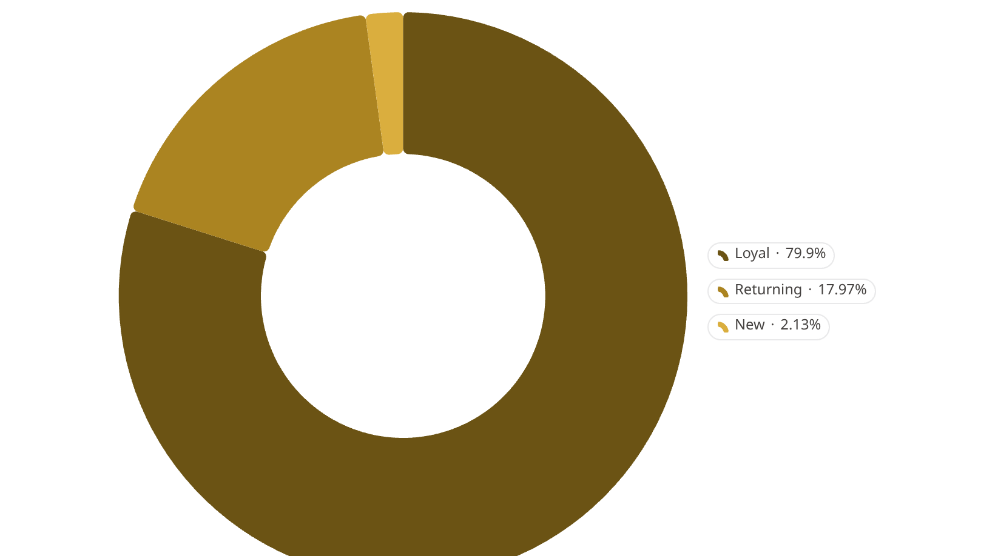
Customer Segmentation
Segment Breakdown
Loyal
Returning
3,116 customers — dominant majority
701 customers
New
83 customers
Customers with >5 purchases: 958 subscribed vs. 2,518 non-subscribed.

Slide 7
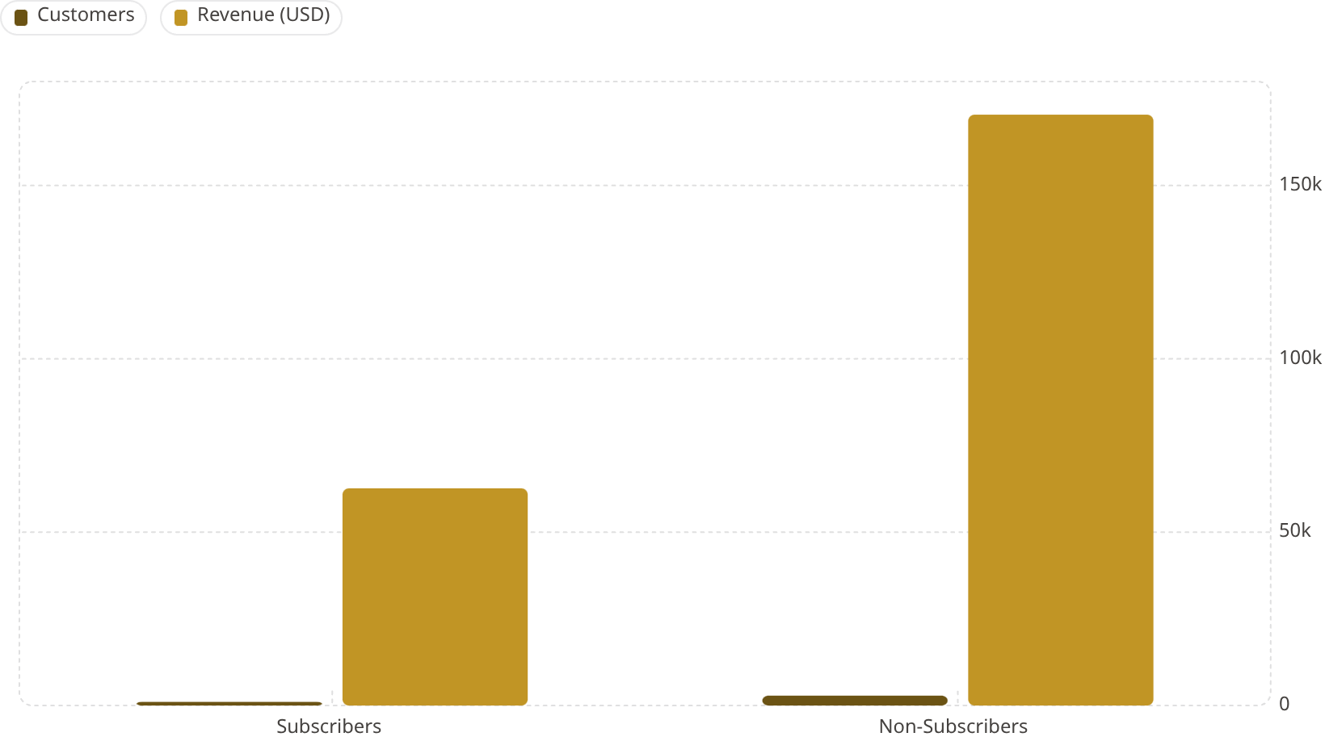
Subscribers vs. Non-Subscribers
Avg. Spend Comparison
Status
Avg. Spend
Subscribers
$59.49
Non-Subscribers
$59.87
Spend per customer is nearly identical — subscription drives volume, not ticket size.

Slide 8
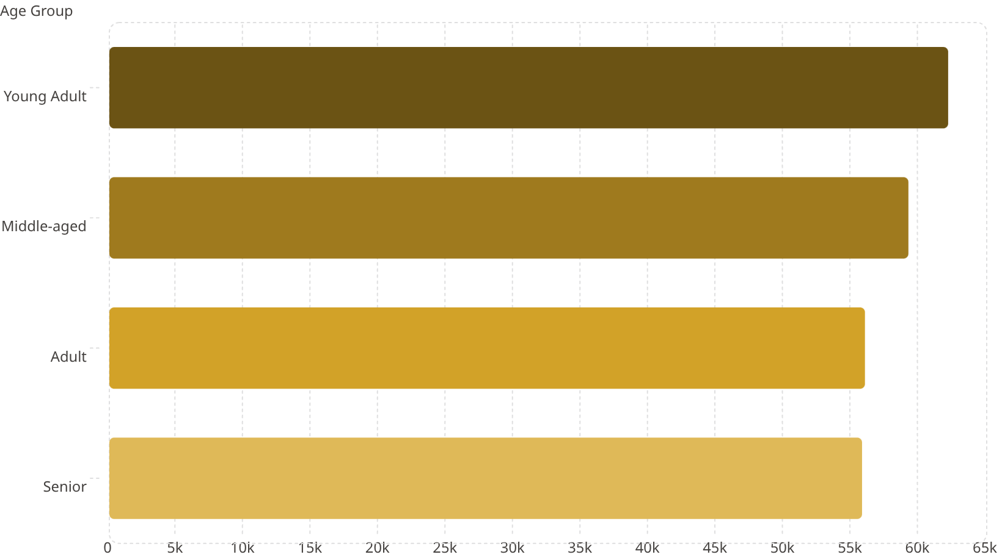
Revenue by Age Group & Top Products per Category
Top Products by Category
Category
#1 Product
Accessories
Jewelry (171)
Clothing
Blouse (171)
Footwear
Sandals (160)
Outerwear
Jacket (163)

Slide 9
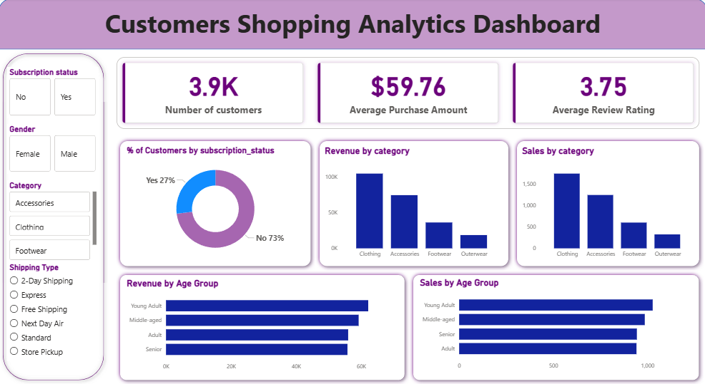
Power BI Dashboard
Interactive dashboard consolidating all key metrics: subscription rates, revenue by category, age group performance, and sales trends.

Slide 10
Business Recommendations
Boost Subscriptions
Loyalty Programs
Review Discount Policy
Promote exclusive subscriber benefits
Reward repeat buyers; move them to "Loyal" segment
Balance sales boosts with margin control
Product Positioning
Targeted Marketing
Highlight top-rated & best-selling items in campaigns
Focus on Young Adults and express-shipping users

