Slide 1

YOLO
you-only-look-once (Real-Time object detection )

Slide 2
Table of topic contents:
Object detection & it’s two types overview .
YOLO-algorithm full description.
R-CNN & Fast-RCNN & Faster-RCNN full description and comparison.
YOLO detector Vs others comparison.
Image classification solution (VIT ) full description & comparison Vs other solutions like CNNs &ResNet.
VIT-YOLO: transformer-based (has a much more enhanced accuracy).

Slide 3
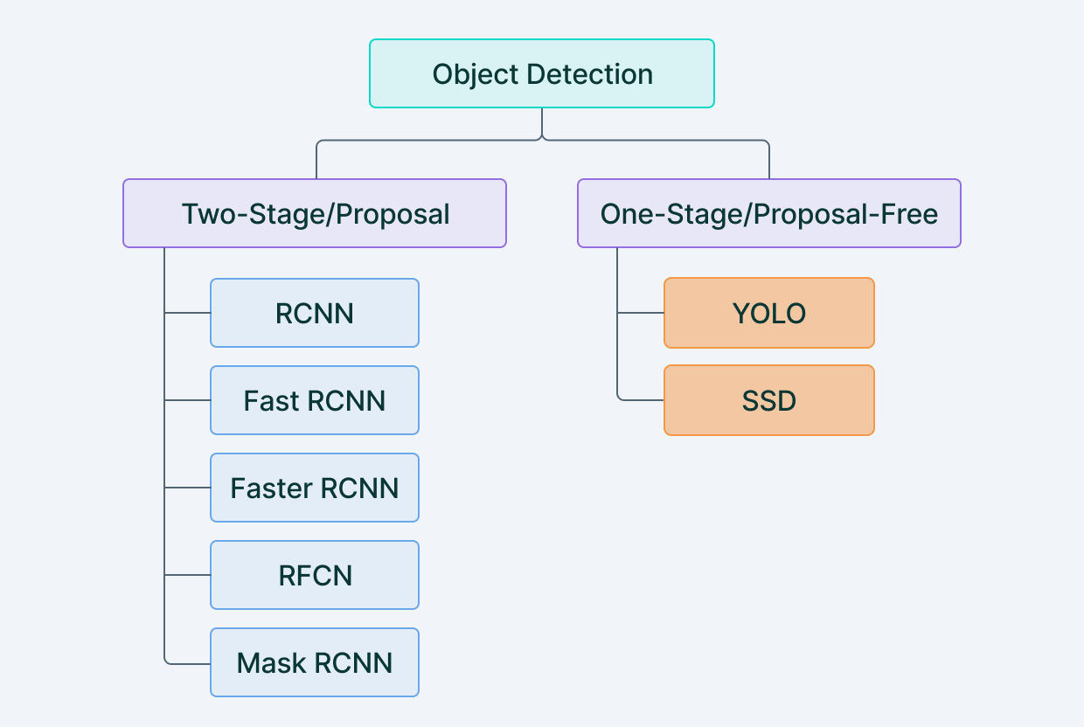
Object-detection (introduction)
Object detection : is an advanced form of image classification where a neural network predicts objects in an image and points them out in the form of bounding boxes & refers to detection and localization of objects in an image that belong to a predefined set of classes.
In general, there's two different approaches for this task – we can either make a fixed number of predictions on grid (one stage)
or
leverage a proposal network to find objects and then use a second network to fine-tune these proposals and output a final prediction (two stage).

Slide 4
One stage .vs. two stage object detection
One stage object detection
Two stage object detection
a one-stage detector predicts bounding boxes in a single-step without using region proposals.
It leverages the help of a grid box and anchors to localize the region of detection in the image and constraint the shape of the object.
One-stage detectors have high inference speeds, but the two-stage object detection have high localization and recognition accuracy.
Two-stage object detection refers to the use of algorithms that break down the object detection problem statement into the following two-stages:
Detecting possible object regions.
Classifying the image in those regions into object classes.
Popular two-step algorithms like Fast-RCNN and Faster-RCNN typically use a Region Proposal Network that proposes regions of interest that might contain objects.
The output from the RPN is then fed to a classifier that classifies the regions into classes.
While this gives accurate results in object detection with a high mean Average Precision (mAP), it results in multiple iterations taking place in the same image, thus slowing down the detection speed of the algorithm and preventing real-time detection.

Slide 5
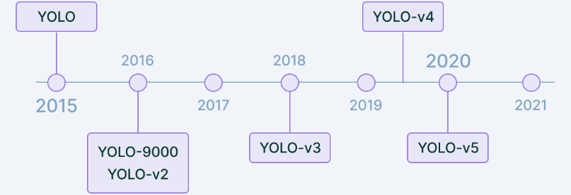
What’s yolo ??
YOLO is an abbreviation for the term ‘You Only Look Once’.
This is an algorithm that detects and recognizes various objects in a picture (in real-time).
Object detection in YOLO is done as a regression problem and provides the class probabilities of the detected images.
YOLO algorithm employs convolutional neural networks (CNN) to detect objects in real-time.
As the name suggests, the algorithm requires only a single forward propagation through a neural network to detect objects.
This means that prediction in the entire image is done in a single algorithm run. The CNN is used to predict various class probabilities and bounding boxes simultaneously.
Note: convolutional neural network (CNN, or ConvNet) is a class of artificial neural network (ANN).
Yolo-Timeline

Slide 6
How yolo works?
The YOLO algorithm works by dividing the image into N grids, each having an equal dimensional region of SxS. Each of these N grids is responsible for the detection and localization of the object it contains.
Correspondingly, these grids predict B bounding box coordinates relative to their cell coordinates, along with the object label and probability of the object being present in the cell.
This process greatly lowers the computation as both detection and recognition are handled by cells from the image, but It brings forth a lot of duplicate predictions due to multiple cells predicting the same object with different bounding box predictions.
YOLO makes use of Non-Maximal Suppression to deal with this issue.

Slide 7
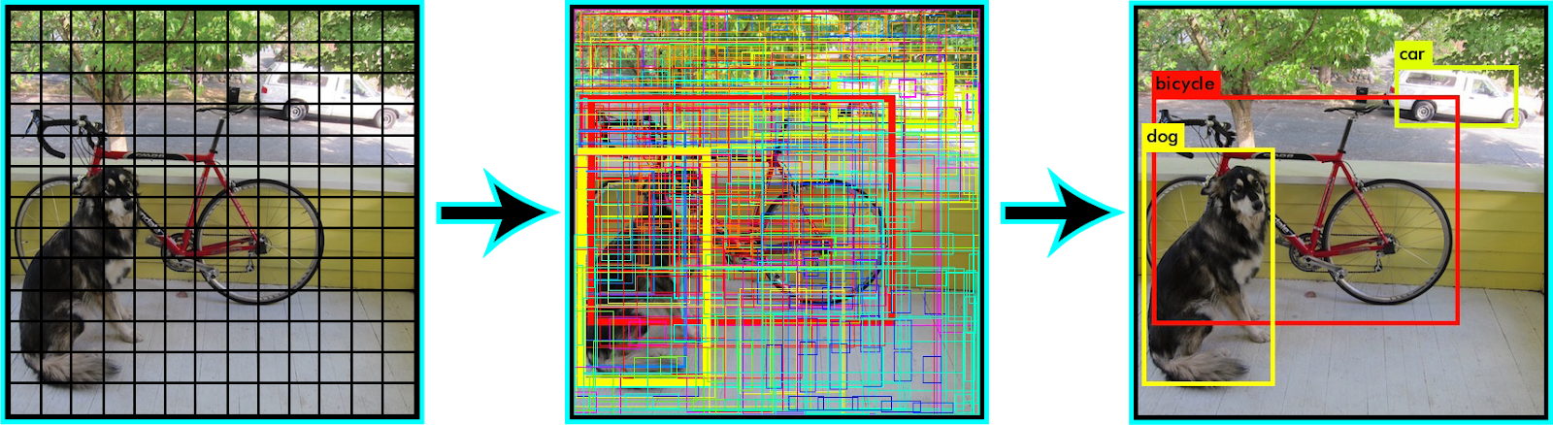
In Non-Maximal Suppression, YOLO suppresses all bounding boxes that have lower probability scores.
YOLO achieves this by first looking at the probability scores associated with each decision and taking the largest one. Following this, it suppresses the bounding boxes having the largest Intersection over Union (iou)with the current high probability bounding box, this depends on your model but in most models is (iou>0.5).
This step is repeated till the final bounding boxes are obtained.

Slide 8
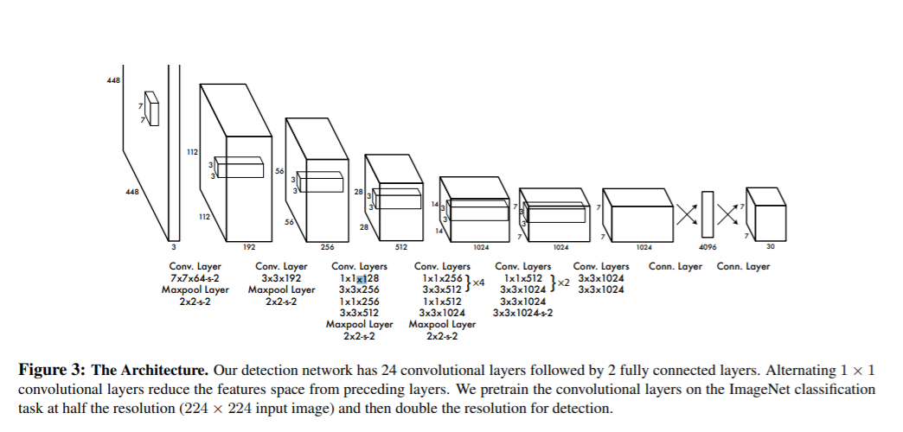
Yolo-architecture
Inspired by the GoogleNet architecture, YOLO’s architecture has a total of 24 convolutional layers with 2 fully connected layers at the end.

Slide 9
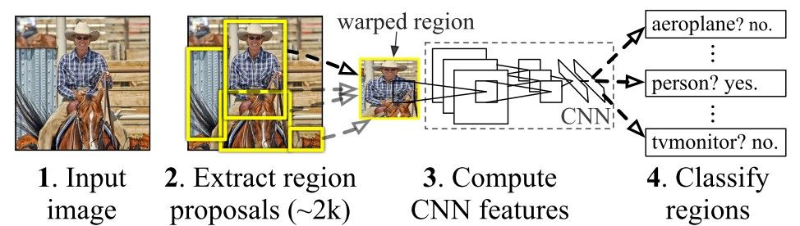
R-cnn vs fast r-cnn vs faster r-cnn
R-CNN:
the main contribution of R-CNN [1][1] is just extracting the features based on a convolutional neural network (CNN). Other than this, everything is similar to the generic object detection pipeline. The next figure shows the working of the R-CNN model.

Slide 10
The R-CNN consists of 3 main modules:
1-The first module generates 2,000 region proposals using the Selective Search algorithm.
2-After being resized to a fixed pre-defined size, the second module extracts a feature vector of length 4,096 from each region proposal.
3-The third module uses a pre-trained SVM algorithm to classify the region proposal to either the background or one of the object classes.
Drawbacks:
1-each stage is independent cannot be be trained end-to-end like YOLO.
2-It caches the extracted features from the pre-trained CNN on the disk to later train the SVMs. This requires hundreds of gigabytes of storage.
3-R-CNN depends on the Selective Search algorithm for generating region proposals, which takes a lot of time.
4-Each region proposal is fed independently to the CNN for feature extraction. This makes it impossible to run R-CNN in real-time unlike YOLO.

Slide 11
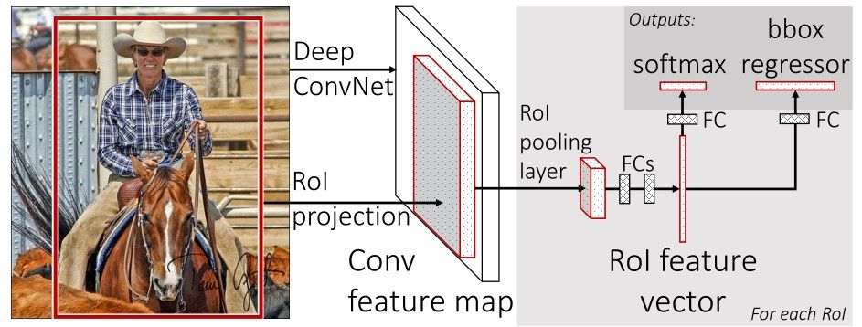
Bit of enhancements is done to R-CNN to increase the speed of the model results in producing new models
Which is (FAST-RCNN) & (FASTER-RCNN).
for Fast-RCNN:(higher speed & more accurate)
a new layer(ROI pooling) is proposed in the arch,
that extracts equal-length feature vectors from all proposals
(i.e. ROIs) in the same image.
The model consists of a single-stage, compared to the 3 stages in R-CNN.
It just accepts an image as an input and returns the class probabilities and bounding boxes of the detected objects.
Fast RCNN uses the ideas from SPP-net and RCNN and fixes the key problem in SPP-net i.e. they made it possible to train end-to-end.
One more thing that Fast RCNN did that they added the bounding box regression to the neural network training itself.
These two changes reduce the overall training time and increase the accuracy in comparison to SPP net because of the end-to-end learning of CNN.

Slide 12
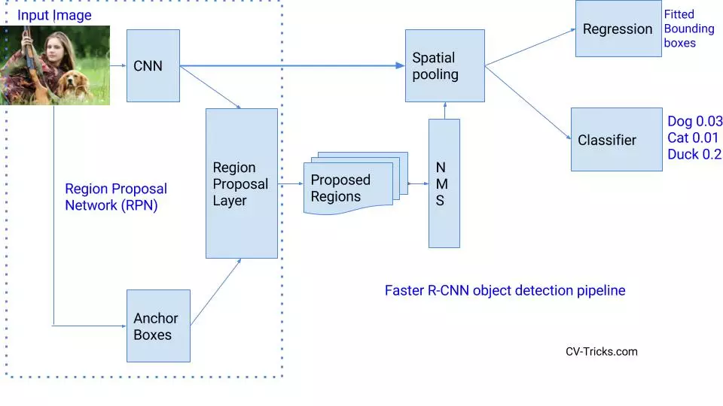
Faster R-CNN: ( is an enhanced version of Fast-R-CNN)
It’s faster than Fast-RCNN by doing an improving replacement, which is:
The slowest part in Fast RCNN was Selective Search or Edge boxes.
Faster RCNN replaces selective search with a very small convolutional network called Region Proposal Network to generate regions of Interests.

Slide 13
YOLO VS OTHER DETECTORS(FAST &FASTER RCNN)
YOLO
FASTER RCNN
In addition to increased accuracy in predictions and a better Intersection over Union in bounding boxes (compared to real-time object detectors), YOLO has the inherent advantage of speed.
YOLO is a much faster algorithm than its counterparts, running at as high as 45 FPS.
But lower in accuracy compared to FASTER-RCNN.
YOLO struggles to detect and segregate small objects in images that appear in groups, as each grid is constrained to detect only a single object. Small objects that naturally come in groups, such as a line of ants, are therefore hard for YOLO to detect and localize.
Is much slower than Yolo as: it works by detecting possible regions of interest using the Region Proposal Network and then perform recognition on those regions separately, YOLO performs all of its predictions with the help of a single fully connected layer,it performs multiple iterations for the same image, while YOLO gets away with a single iteration.
Higher in accuracy than yolo a lot among various object’s sizes
Deals better with higher accuracy than yolo in small object detection

Slide 14
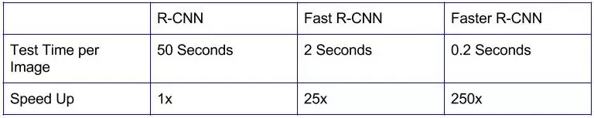
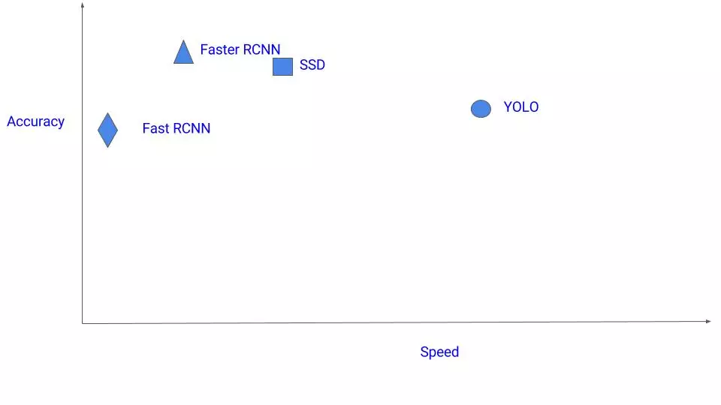
Helping graphs in comparison
Fig(1)
RCNN Vs. Fast RCNN Vs. Faster RCNN in speed.
Fig(2):
Accuracy Vs Speed
From fig(2): we can conclude that there’s a tradeoff between accuracy & model speed.
So, which is better depends on your own project target.

Slide 15
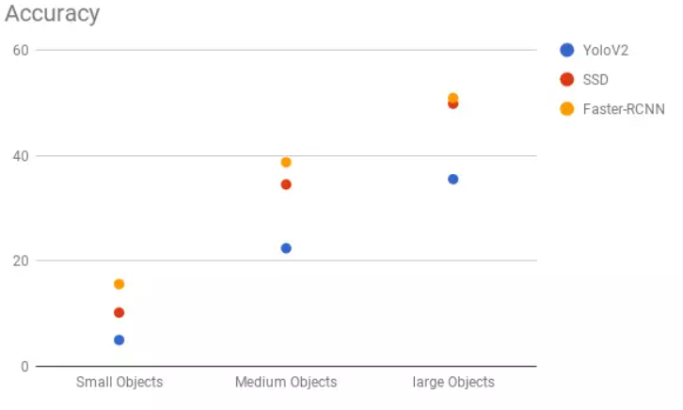
Fig(3)
Accuracy of (YOLO vs SSD vs Faster-RCNN for various sizes).
Conclusion: from fig(3) we can conclude that,
1- Yolo has a very bad accuracy while dealing with small objects, any else model is better.
2-the accuracy of the model has a direct relation with the size of the detected object.

Slide 16
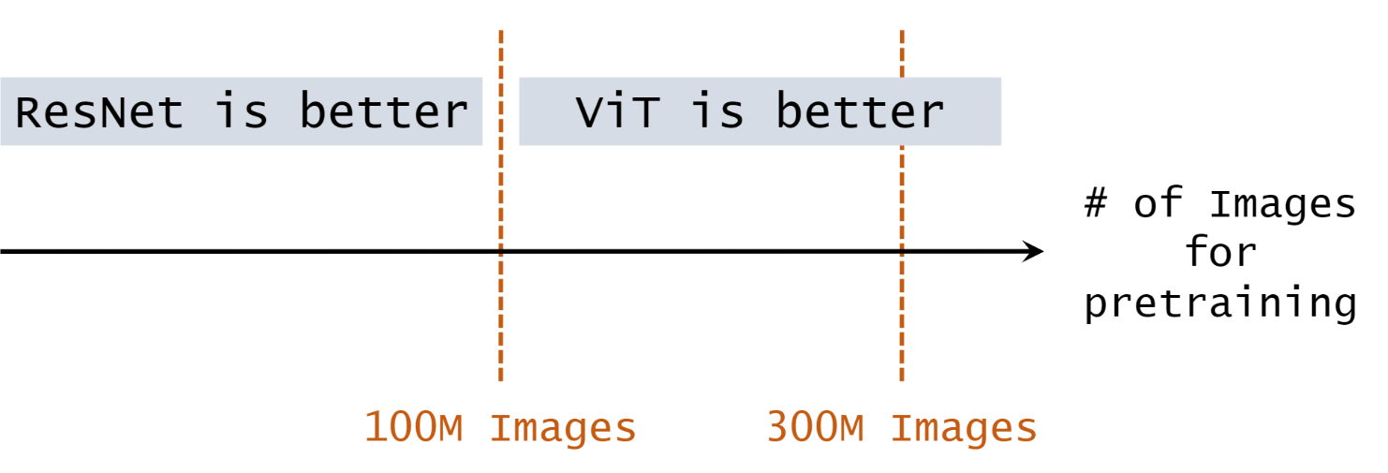
Vision transformers (vit)
Vit is a solution for image classification , which beats the accuracy of CNNS & ResNet if the pretrained dataset is sufficiently large.
it might reach 4 times better accuracy than CNN, if the pretrained dataset is enormously large.
As we can figure ,in the upper figure that vit is a very powerful solution for image classification with high accuracy totally depends on the size of pretrained dataset & has a direct relationship if you want more accuracy increase the pretrained dataset size, till it becomes unbeatable!!!!!!!!

Slide 17
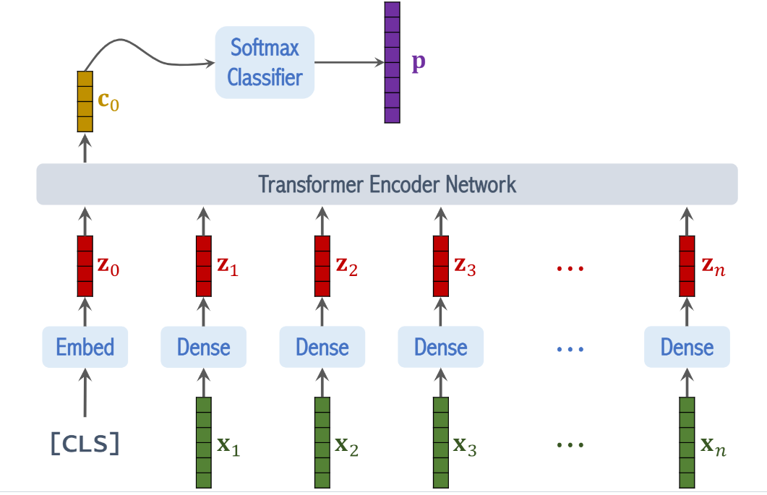
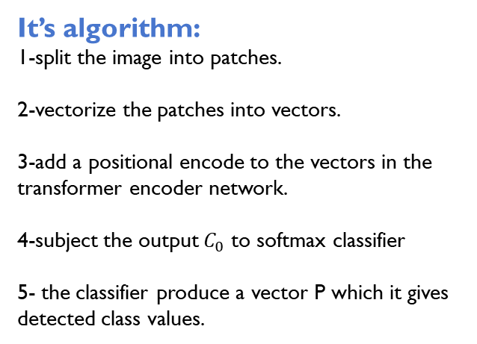
It’s algorithm:
1-split the image into patches.
2-vectorize the patches into vectors.
3-add a positional encode to the vectors in the transformer encoder network.
4-subject the output $C_{0}$ to softmax classifier
5- the classifier produce a vector P which it gives detected class values.
As to enhance our YOLO-algorithm :
The scientist did VIT-YOLO: transformer-based
Yolo for object detection.
Using the VIT solution rather than th CNNs for better accuracy & higher speed detection.

Slide 18

Thank You

