Slide 1
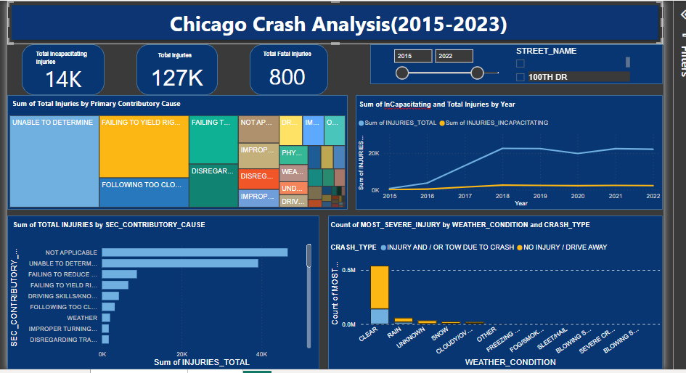

Slide 2
Analysis and Recommendations:
Total injuries: The total number of injuries reported during the period from 2015 to 2023 was 150,000, out of which 16,000 were incapacitating injuries and 948 were fatal injuries.
Weather conditions: The majority of injuries occurred during clear weather conditions, indicating that weather may not have been a significant contributing factor to the accidents.
Crash types: The number of accidents categorized as "drive away" was higher compared to accidents resulting in injury or requiring a tow due to a crash. This suggests that a significant portion of accidents had relatively minor consequences.
Rain: The second most common weather condition during accidents was rain, which indicates a potential correlation between rain and increased accident rates.
Primary contributing cause: Failing to yield the right of way was identified as the primary contributing cause of accidents. This highlights the importance of improving awareness and adherence to traffic regulations regarding right of way.
Secondary contributing cause: Failing to decrease speed was identified as the secondary contributing cause. This emphasizes the need for promoting responsible driving behavior and maintaining appropriate speeds to prevent accidents.
Injury trends: Incapacitating injuries were more prevalent in 2018, suggesting a potential need for further investigation into the factors contributing to this specific year's higher injury rate.
Based on these findings, the following recommendations can be made:
Increase awareness and education: Launch campaigns to educate drivers about the importance of yielding the right of way and the consequences of failing to do so. This can include public service announcements, targeted educational programs, and driver training initiatives.
Enforce speed limits: Strengthen law enforcement efforts to ensure drivers comply with posted speed limits, particularly in areas prone to accidents.
Improve weather-related driving skills: Develop programs that provide education and training on safe driving practices during adverse weather conditions, such as rain, to reduce accident rates during inclement weather.
Continuous monitoring: Establish a system for ongoing monitoring and analysis of accident data to identify emerging trends, evaluate the effectiveness of implemented interventions, and make data-driven decisions for future road safety initiatives.

