Slide 1

Information Technology Institute
Operating System Fundamentals
© Copyright Information Technology Institute - 2016

Slide 2
Chapter Four
PROCESSES

Slide 3
Table of Content
Process Concept
Process Scheduling
Operations on Processes
Cooperating Processes
Inter-process Communication

Slide 4
PROCESS CONCEPT

Slide 5
Process Concept
Process – a program in execution; process execution must progress in sequential fashion.
An operating system executes a variety of programs:
Batch system
Time-shared systems
* Textbook uses the terms job and process almost interchangeably

Slide 6
Process Contents
Text section
Program instructions
Program counter
Next instruction
Stack
Local variables
Return addresses
Method parameters
Data section
Global variables

Slide 7
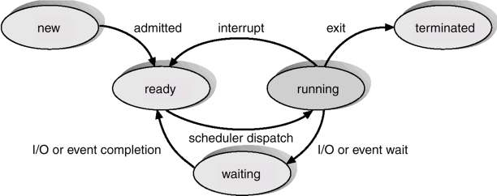
Process State

Slide 8
Process State Cont’d
As a process executes, it changes state
new: The process is being created.
running: Instructions are being executed.
waiting: The process is waiting for some event to occur.
ready: The process is waiting to be assigned to a processor.
terminated: The process has finished execution.

Slide 9
Process Control Block (PCB)
Information associated with each process.
Process state
Program counter
CPU registers
CPU scheduling information
Memory-management information
Accounting information
I/O status information

Slide 10
Process Control Block (PCB) Cont’d
Pointer Process state
Process number Program counter
CPU registers
Memory management info
I/O status information
Accounting Information

Slide 11
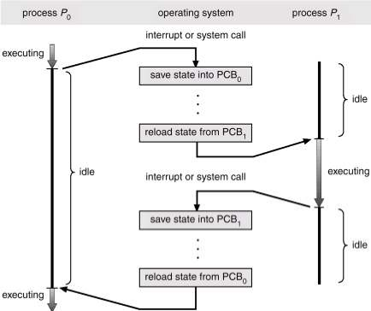
CPU Switch From Process to Process

Slide 12
PROCESS SCHEDULING

Slide 13
Process Scheduling
Multi-Programming systems
Some processes executing at all times
Maximize CPU utilization
Time-Sharing systems
Switch the CPU among processes frequently
Users can interact with a program while it’s executing
Virtually run processes at the same time

Slide 14
Process Scheduling Queues
Job queue
set of all processes in the system.
Ready queue
set of all processes residing in main memory which is ready and waiting to execute.
Device queues
set of processes waiting for an I/O device.
* Process migration between the various queues

Slide 15
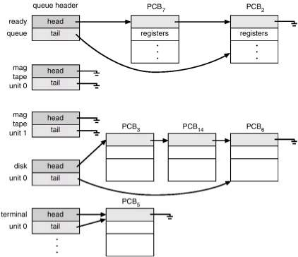
Ready Queue And Various I/O Device Queues

Slide 16
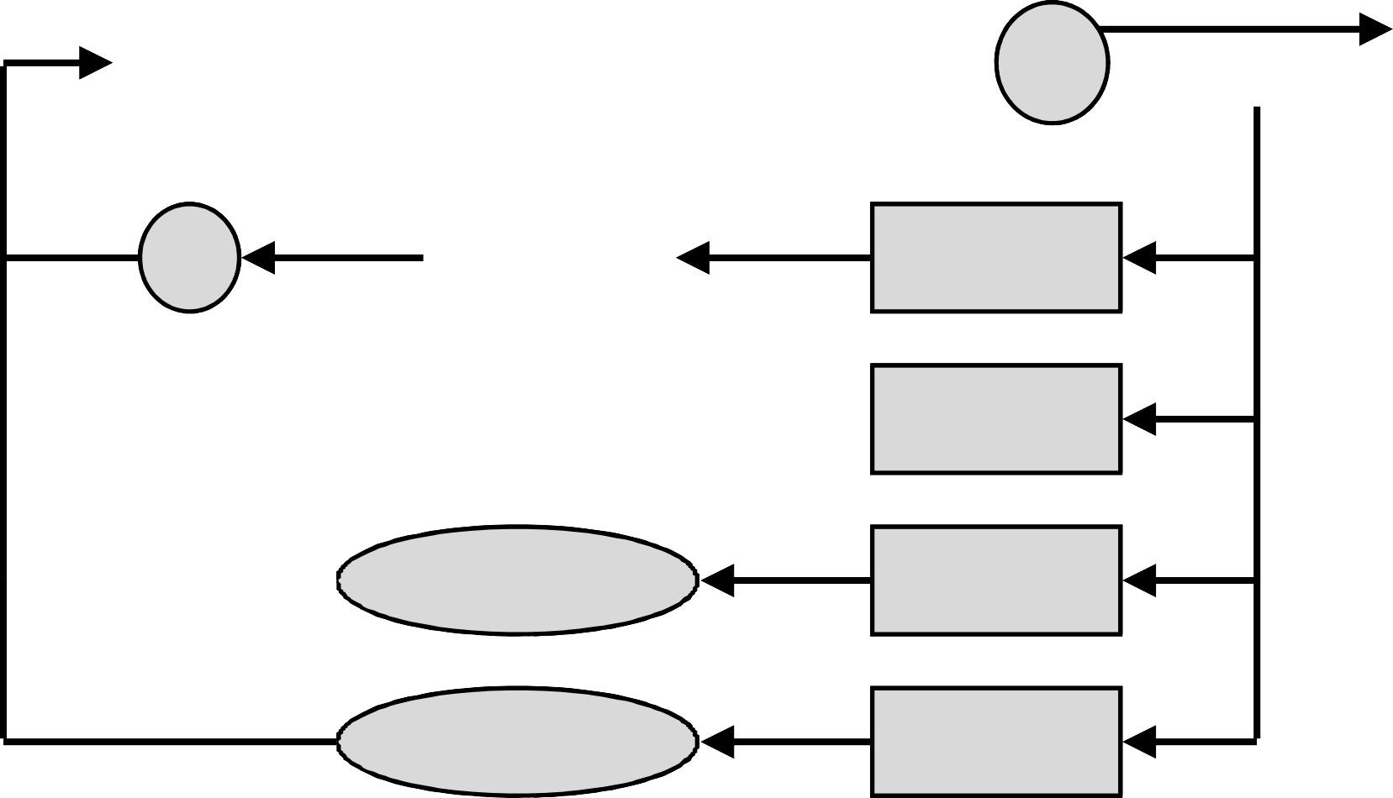
Representation of Process Scheduling
in
out
Ready queue
CPU
I/O
I/O queue
I/O request
time slice expired
child executes
fork a child
wait for an interrupt
interrupt occurs

Slide 17
Schedulers
Long-term scheduler (or job scheduler)
Selects which processes should be brought into the ready queue.
Executes infrequently
May be absent in some O/S
Short-term scheduler (or CPU scheduler)
Selects which process should be executed next and allocates CPU.
Executes frequently

Slide 18
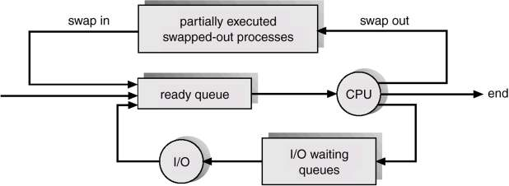
Addition of Medium Term Scheduling

Slide 19
Schedulers Cont’d
Processes can be described as either:
I/O-bound process
spends more time doing I/O than computations, many short CPU bursts.
CPU-bound process
spends more time doing computations; few very long CPU bursts.
Proper System performance
Mix of CPU & I/O bound processes
Improper system performance
All processes are I/O bound
All processes are CPU bound
© Copyright Information Technology Institute - 2016
19

Slide 20
Context Switch
When CPU switches to another process, the system must save the state of the old process and load the saved state for the new process.
Context-switch time is overhead; the system does no useful work while switching.
Time dependent on hardware support.
20

Slide 21
OPERATIONS ON PROCESSES
21

Slide 22
Operations on Processes
Process Creation
Process Termination
Process resources
CPU time
Memory
Files
I/O devices
22

Slide 23
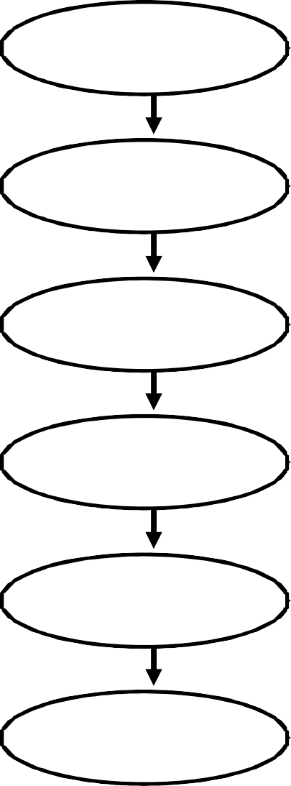
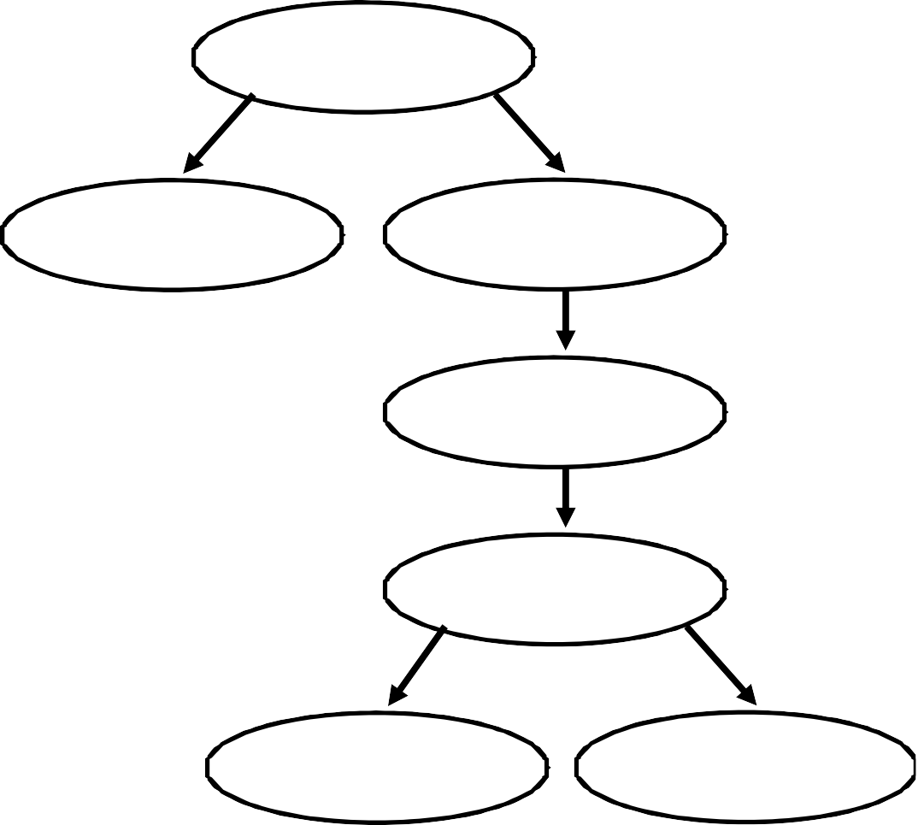
Process Creation
Process n
Process n
Process n+1
Process n+1
Process n+2
Process n+2
Process n+3
Process n+3
Process n+4
Process n+4
Process n+5
Process n+6
Process n+5
23

Slide 24
Process Creation Cont’d
Parent process create children processes, which, in turn create other processes, forming a tree of processes.
Resource sharing
Parent and children share all resources.
Children share subset of parent’s resources.
Execution
Parent and children execute concurrently.
Parent waits until children terminate.
24

Slide 25
Process Creation Cont’d
Address space
Child duplicate of parent.
Child has a program loaded into it.
UNIX examples
fork system call creates new process
exec system call used after a fork to replace the process’ memory space with a new program.
25

Slide 26
Process Termination
Process executes last statement and asks the operating system to decide it (exit).
Output data from child to parent.
Process’ resources are de-allocated by operating system.
Parent may terminate execution of children processes (abort).
Child has exceeded allocated resources.
Task assigned to child is no longer required.
Parent is exiting.
Operating system does not allow child to continue if its parent terminates.
Cascading termination.
26

Slide 27
Cooperating Processes
Independent process cannot affect or be affected by the execution of another process.
Cooperating process can affect or be affected by the execution of another process
Advantages of process cooperation
Information sharing
Computation speed-up
Modularity
Convenience
27

Slide 28
INTER-PROCESS COMMUNICATION
28

Slide 29
Inter-process Communication
Message Passing
Shared Memory
* Synchronization
29

Slide 30
Message Passing
Messages
Fixed size
Variable size
Communication
Direct:
send(P2, message), receive(P1, message)
Indirect:
send(ID, message), receive(ID, messages)
30

Slide 31
Synchronization
Message passing may be either blocking or non-blocking.
Blocking is considered synchronous
Non-blocking is considered asynchronous
send and receive primitives may be either blocking or non-blocking.
31

Slide 32

32

