Slide 1

Information Technology Institute
Operating System Fundamentals

Slide 2
Chapter Seven
Memory Management

Slide 3
Table of Content
Logical versus Physical Address Space.
Swapping.
Contiguous Allocation.
Paging.
Segmentation.
Segmentation with Paging.

Slide 4
LOGICAL VS PHYSICAL ADDRESS
SPACE

Slide 5
Logical vs. Physical Address Space
The concept of a logical address space that is bound to a separate physical address space is central to proper memory management.
Logical address – generated by the CPU; also referred to as virtual address.
Physical address – address seen by the memory unit.
Logical and physical addresses are the same in compile-time and load-time address-binding schemes; logical (virtual) and physical addresses differ in execution-time address-binding scheme.

Slide 6
Memory-Management Unit (MMU)
Hardware device that maps logical (virtual) to physical address.
In MMU scheme, the value in the relocation register (base register) is added to every address generated by a user process at the time it is sent to memory.
The user program deals with logical addresses; it never sees the real physical addresses.

Slide 7
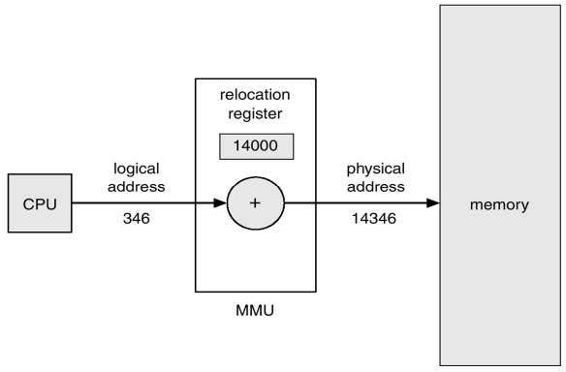
Dynamic relocation using a relocation register

Slide 8
SWAPPING

Slide 9
Swapping
A process can be swapped temporarily out of memory to a backing store, and then brought back into memory for continued execution.
Backing store – fast disk large enough to accommodate copies of all memory images for all users; must provide direct access to these memory images.
Roll out, roll in – swapping variant used for priority-based scheduling algorithms; lower-priority process is swapped out so higher-priority process can be loaded and executed.
Major part of swap time is transfer time; total transfer time is directly proportional to the amount of memory swapped.
Modified versions of swapping are found on many systems, i.e., UNIX, Linux, and Windows.

Slide 10
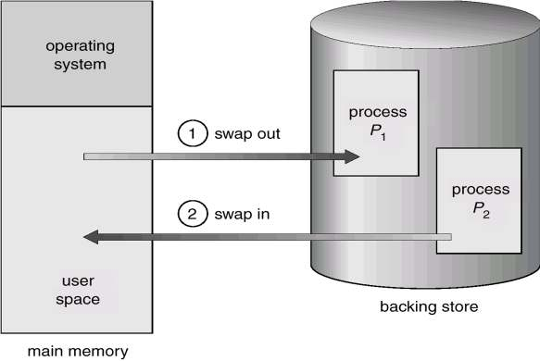
Schematic View of Swapping

Slide 11
CONTIGUOUS ALLOCATION

Slide 12
Contiguous Allocation
Main memory usually into two partitions:
Resident operating system, usually held in low memory with interrupt vector.
User processes then held in high memory.
Single-partition allocation
Relocation-register scheme used to protect user processes from each other, and from changing operating-system code and data.
Relocation register contains value of smallest physical address; limit register contains range of logical addresses.

Slide 13
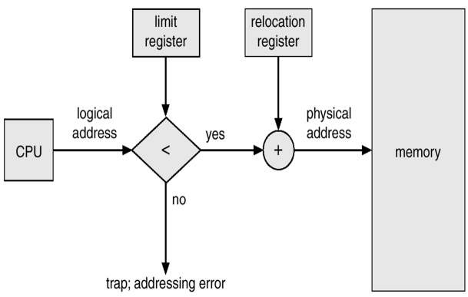
Hardware Support for Relocation and Limit Registers

Slide 14
Contiguous Allocation (Cont.)
Multiple-partition allocation
Hole – block of available memory; holes of various size are scattered throughout memory.
When a process arrives, it is allocated memory from a hole large enough to accommodate it.
Operating system maintains information about:
allocated partitions b) free partitions (hole)
OS OS OS OS
process 5 process 5 process 5 process 5
process 9 process 9
process 8
process 10
process 2
process 2
process 2
process 2

Slide 15
Dynamic Storage-Allocation Problem
How to satisfy a request of size n from a list of free holes.
First-fit: Allocate the first hole that is big enough.
Best-fit: Allocate the smallest hole that is big enough; must search entire list, unless ordered by size. Produces the smallest leftover hole.
Worst-fit: Allocate the largest hole; must also search entire list. Produces the largest leftover hole.
First-fit and best-fit better than worst-fit in terms of speed and storage utilization.

Slide 16
Fragmentation
External Fragmentation – total memory space exists to satisfy a request, but it is not contiguous.
Internal Fragmentation – allocated memory may be slightly larger than requested memory; this size difference is memory internal to a partition, but not being used.
Reduce external fragmentation by compaction

Slide 17
PAGING

Slide 18
Paging
Logical address space of a process can be noncontiguous; process is allocated physical memory whenever the latter is available.
Divide physical memory into fixed-sized blocks called frames (size is power of 2, between 512 bytes and 8192 bytes).
Divide logical memory into blocks of same size called pages.
Keep track of all free frames.
To run a program of size n pages, need to find n free frames and load program.
Set up a page table to translate logical to physical addresses.
Internal fragmentation.

Slide 19
Address Translation Scheme
Address generated by CPU is divided into:
Page number (p) – used as an index into a page table which contains base address of each page in physical memory.
Page offset (d) – combined with base address to define the physical memory address that is sent to the memory unit.

Slide 20
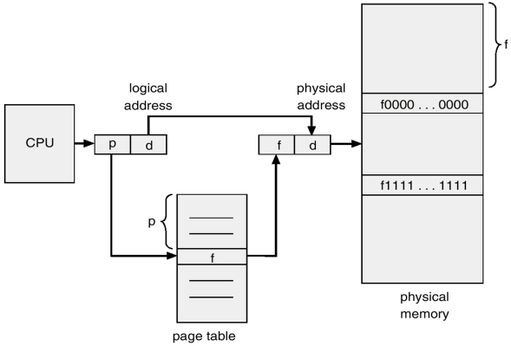
Address Translation Architecture

Slide 21
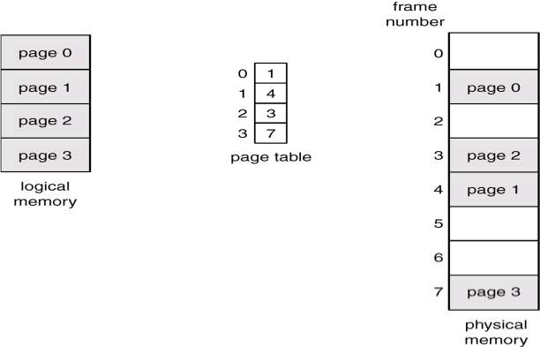
Paging Example

Slide 22
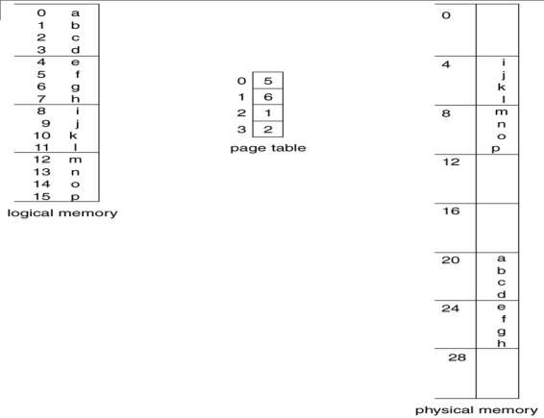
Paging Example

Slide 23
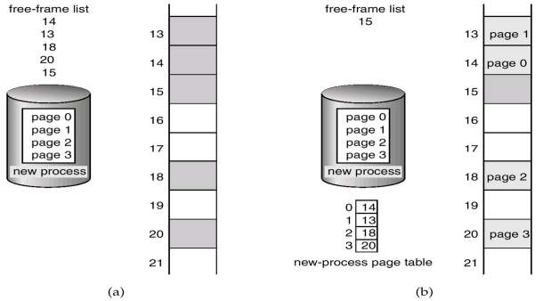
Free Frames
Before allocation
After allocation

Slide 24
Shared Pages
Shared code
One copy of read-only (reentrant) code shared among processes (i.e., text editors, compilers, window systems).
Shared code must appear in same location in the logical address space of all processes.

Slide 25
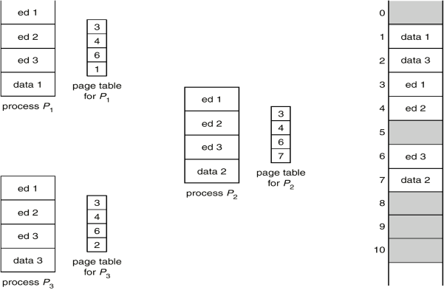
Shared Pages Example

Slide 26
SEGMENTATION

Slide 27
Segmentation
Memory-management scheme that supports user view of memory.
A program is a collection of segments. A segment is a logical unit such as:
main program, procedure,
function,
method, common block, stack,
symbol table, arrays

Slide 28
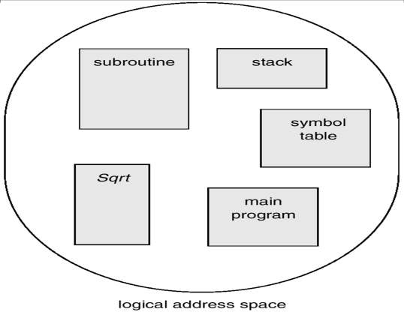
User’s View of a Program

Slide 29
Logical View of Segmentation
1
4
1
2
3
2
4
3
user space
physical memory space

Slide 30
Segmentation Architecture
Logical address consists of a two tuple:
<segment-number, offset>,
Segment table – maps two-dimensional physical addresses; each table entry has:
base – contains the starting physical address where the segments reside in memory.
limit – specifies the length of the segment.

Slide 31
Segmentation Architecture (Cont.)
Relocation.
dynamic
by segment table
Sharing.
shared segments
same segment number
Allocation.
first fit/best fit
external fragmentation

Slide 32
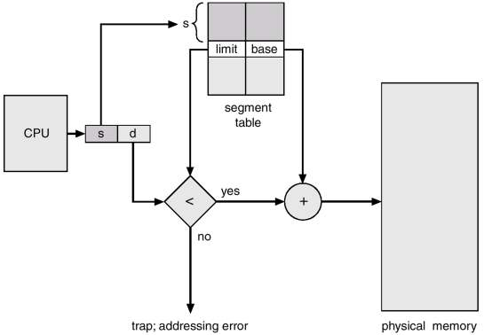
Segmentation Hardware

Slide 33
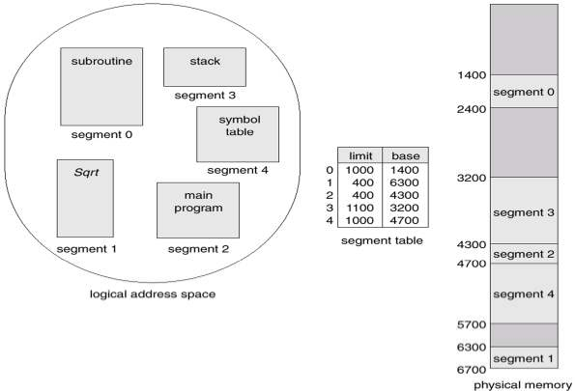
Example of Segmentation

Slide 34
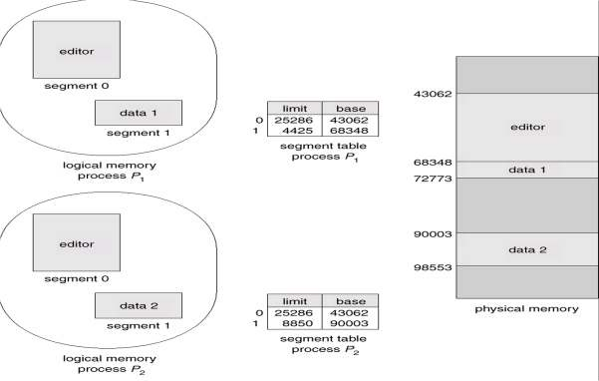
Sharing of Segments

Slide 35
SEGMENTATION WITH PAGING

Slide 36
Segmentation with Paging – MULTICS
The MULTICS system solved problems of external fragmentation and lengthy search times by paging the segments.
Solution differs from pure segmentation in that the segment-table entry contains not the base address of the segment, but rather the base address of a page table for this segment.

Slide 37


