Slide 1
Most Popular Genre of Each Country
The most popular Genre in most countries is Rock.
Argentina has two equally popular genres; Rock and Alternative & Punk.
Only 1 country has Latin as the most popular genre which is Sweden.

Slide 2
Customer with highest purchases in each country
In the graph, the top 10 countries with the most purchases are shown with the first name of user.
Czech Republic has the maximum purchases by Helena.

Slide 3
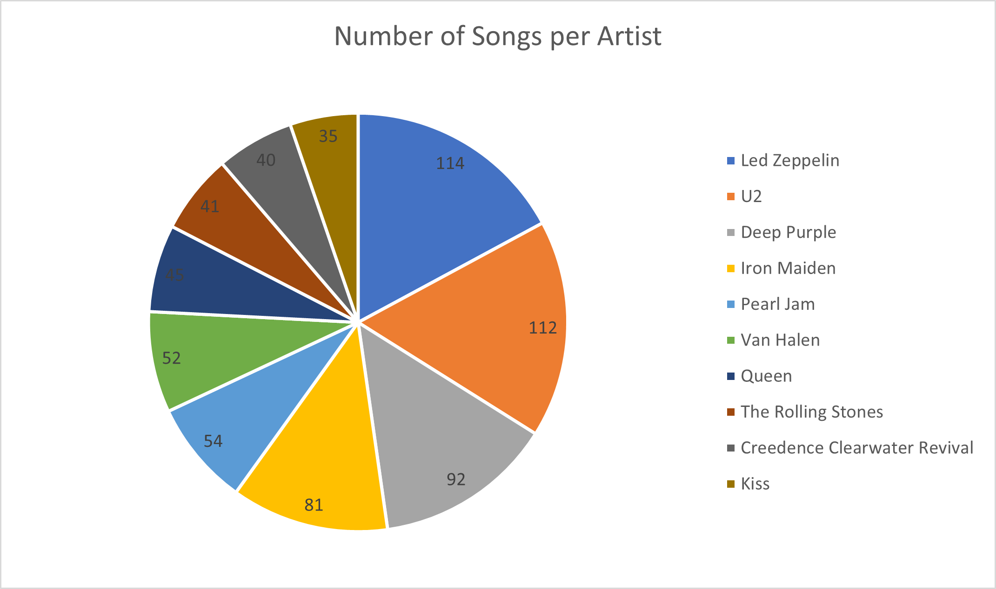
Top 10 Writers of Rock Music
The top 1 artist who wrote the largest number of rock songs is Led Zeppelin, followed by U2 with only 2 songs difference.
<visualization>

Slide 4
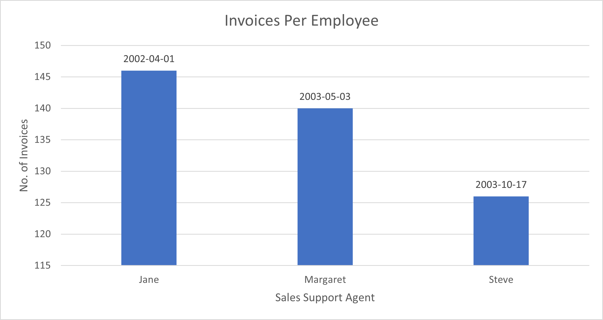
Employees Invoices
<visualization>
Jane sold the most invoices and looking at the hire dates at the top of each bar, the older the employee the more Invoices he/she sold.

