Slide 1
Device New Technique for a Stronger Yet Memorable Textual Password for smartphone
By
Md. Faruk Hossain
Md. Mizanur Rahman
Computer Science & Engineering
University of Dhaka
‹#›
*

Slide 2
Content:
Introduction
Abstraction of Textual Password
Textual Password in Smartphone
Thesis objectives
Research questions
Prospective scheduling
Conclusion
‹#›
*

Slide 3
Introduction
Authentication is a way of ensuring security.
Textual password is a major authentication process.
It is used in websites, banks, offline etc.
It is pretty strong if there is no pattern in text
Attackers do search for patterns in textual passwords.
Our thesis goal is to prevent them.
‹#›
*

Slide 4
Abstraction of Textual Password
Example of a strong password:
“@&A!cd#123 >.”
Statistically need about 99^{P}32 attempts
Difficult to memorize.
Less usability and error prone.
‹#›
*

Slide 5

Abstraction of Textual Password
Slight modification for different websites but memorable.
Use distinct password for different account but hard to remember.
https://docs.google.com/forms/d/1xSfwtaUObuTdr4ec1q8SY6-w0mrHjO1xR7eyFxDnGw/viewanalytics#start=publishanalytics
‹#›
*

Slide 6
Abstraction of Textual Password
How can this memorizing problem be solved?
Use name, pet’s name, song title.
Add birthday.
Change a little bit for new password.
Add a little string.
‹#›
*

Slide 7
Abstraction of Textual Password
“faruk1993”
“1993faruk”
“123hossain123”
“faruk123hossain”
“cse@1993”
“066borkot406”
Question
Sample password
Are these password easy to remember?
Is there any pattern in passwords?
Are these strong?
‹#›
*

Slide 8

Abstraction of Textual Password
Gather personal information.
Formulate password with personal
information.
Cracking attempts reduces than previous
permutation.
‹#›
*

Slide 9
Textual Password in Smartphone
Are the things similar in smartphone?
‹#›
*

Slide 10
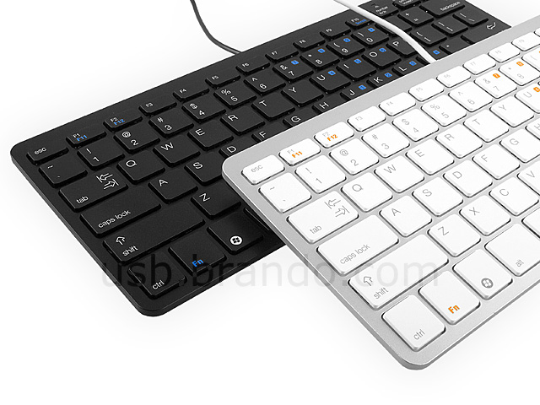
Textual Password in Smartphone
How many of you shall use bottom keyboard?
when bottom keyboard contains only numbers and symbol.
when top keyboard contains only letters.
‹#›
*

Slide 11
Textual Password in Smartphone
Sample password
“Faruk”
“faruk123”
“1993faruk”
“@@faruk123”
‹#›
*

Slide 12
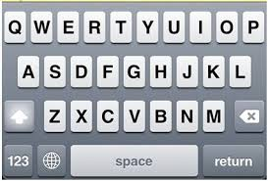
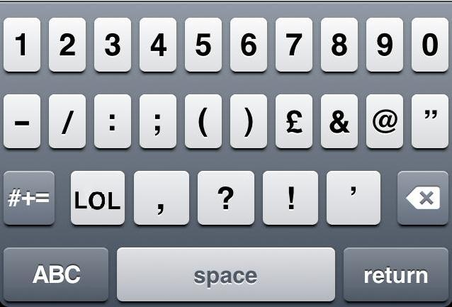
Textual Password in Smartphone
Top layout
Bottom layout
‹#›
*

Slide 13
Textual Password in Smartphone
“Information@23”
Easy to guess for an attacker.
Password starting with letters of basic information.
Half of attempts than previous.
Usability and Security of Text Passwords on Mobile Devices, 2016.
‹#›
*

Slide 14
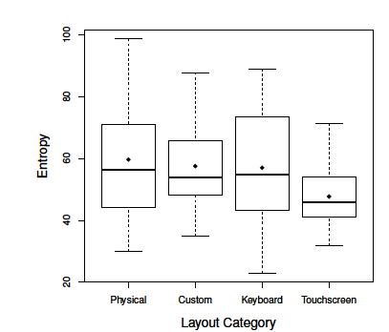
Textual Password in Smart Phone
Passwords and Interfaces: Towards Creating Stronger Passwords by Using Mobile Phone Handsets
Less Entropy.
Less attempts to break.
‹#›
‹#›
*
*

Slide 15
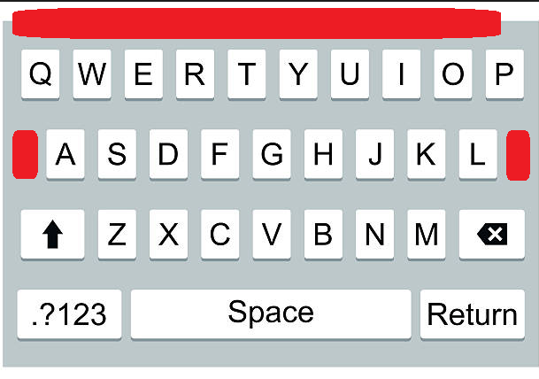
Thesis objectives
Change a smartphone keyboard layout at red position.
Compare current password with
previous one.
Find out if the result is effective or not.
‹#›
*

Slide 16
Research questions
1.Will our layout increase password security?
2.Will it speed up key entry rate?
3.Will it reduce error rate?
4.Will it reduce creation attempts, re-entry attempts and reasons of failure?
5.Will it increase the usability?
‹#›
*

Slide 17
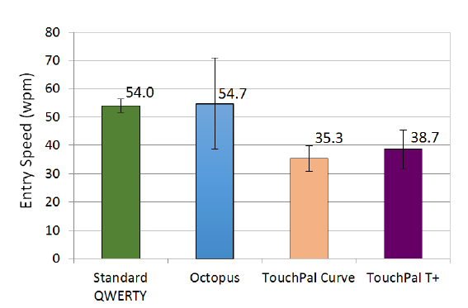
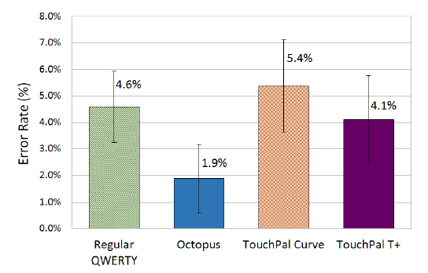
Research questions
Entry speed
Error rate
A Study of Variations of QWERTY Soft Keyboards for Mobile Phones, 2013
‹#›
*

Slide 18
Research questions
Customized Keyboard layout contains:
1.Numbers.
2.Commonly used special symbols.
‹#›
*
Octopus layout
New layout

Slide 19
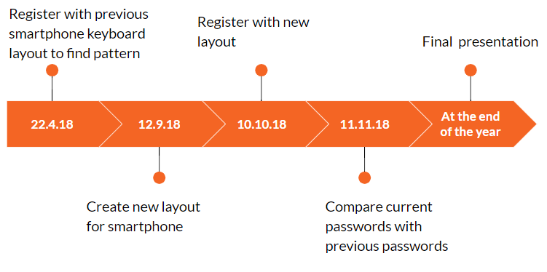
Prospective scheduling
‹#›
*

Slide 20
References
Usability and Security of Text Passwords on Mobile Devices, 2016.
William Melicher, Darya Kurilova,∗ Sean M. Segreti, Pranshu Kalvani, Richard Shay, Blase Ur, Lujo Bauer, Nicolas Christin, Lorrie Faith Cranor, Michelle L. Mazurek,
Passwords and Interfaces: Towards Creating Stronger Passwords by Using Mobile Phone Smartphone.
- S M Taibul Haque ,Matthew Wright, Shannon Scieizo
Study of Variations of QWERTY Soft Keyboards for
Mobile Phones, 2013.
Justin Cuaresma, I. Scott MacKenzie
‹#›
*

Slide 21
Conclusion
By the end, we may have one technique that will help to generate stronger password.
And a keyboard layout that will help to achieve that goal.
‹#›
*

Slide 22
Thank You!
‹#›
*

