Slide 1
Travel Planner Agent
CAPSTONE PROJECT
Presented By: Harsh Desai
Btech CSE- DY Patil International University

Slide 2
Problem Statement
Example: A Travel Planner Agent is an AI-powered assistant that helps users plan trips efficiently by using real-time data. It suggests destinations, builds personalized itineraries, and recommends transport and accommodation options based on user preferences. The agent simplifies travel planning by providing intelligent, context-aware guidance in a single interface.

Slide 3
Proposed Solution
To address the challenge of simplifying and personalizing the travel planning process, we propose an AI-powered Travel Planner Chatbot built using IBM Watsonx.ai. This chatbot leverages natural language processing and retrieval-augmented generation (RAG) to interact with users conversationally and assist in:
Discovering travel destinations based on user interests and budget
Recommending transport and accommodation options using real-time data
Generating customized itineraries based on user inputs
Providing updates, suggestions, and travel tips instantly
By integrating trusted travel data and cloud-based AI models, the solution offers an intuitive, efficient, and intelligent interface for end-to-end trip planning.

Slide 4
System Approach
User Interface (Chatbot Frontend):
Built using Watsonx.ai conversational interface
Accepts natural language inputs from users (e.g., “Plan a 3-day trip to Goa”)
Intent Recognition & Query Understanding:
Powered by IBM Granite Models / Watson NLP
Extracts key information: destination, duration, budget, preferences
Data Retrieval & Processing:
Integrates with APIs (e.g., maps, weather, transport, hotel listings)
Fetches and filters real-time data based on user query

Slide 5
Algorithm & Deployment
Algorithm:
User inputs travel-related queries via the chatbot interface.
IBM Granite model processes natural language to detect intent and extract entities (e.g., location, budget).
Relevant data is retrieved using RAG (Retrieval-Augmented Generation) from APIs or predefined datasets.
The system generates context-aware responses (itinerary, transport, stay) in natural language.
Final output is displayed interactively in the chat window.
Deployment:
Deployed using IBM Watsonx.ai on IBM Cloud Lite.
Uses Granite foundation models for NLP and generation tasks.
Connected to travel-related APIs for real-time data.
Entire system is cloud-hosted, accessible via web interface without external servers.

Slide 6
Result
Successfully developed and deployed an AI-powered travel chatbot using IBM Watsonx.ai.
The chatbot responds accurately to natural language queries and generates personalized itineraries.
Integrated real-time data for destinations, transport, and accommodation through API simulation or static datasets.
Demonstrated effective use of Retrieval-Augmented Generation (RAG) for context-aware, relevant travel suggestions.
The solution offers a user-friendly interface, reducing the complexity of travel planning for end-users.

Slide 7
Conclusion
The AI-powered Travel Planner Chatbot developed using IBM Watsonx.ai provides an intelligent and efficient solution for personalized trip planning. By leveraging natural language processing and real-time data, the chatbot simplifies the travel experience from destination discovery to itinerary generation. The project demonstrates the practical application of agentic AI and RAG techniques in solving real-world problems through conversational interfaces. This solution has strong potential for further enhancement and real-world deployment.

Slide 8
Integration with real-time APIs for flights, hotels, weather, and local events.
Multilingual support to assist users in their preferred language.
User profile personalization to store past trips, preferences, and loyalty-based suggestions.
Voice assistant integration for hands-free travel planning via mobile or smart devices.
Payment gateway support for bookings directly through the chatbot interface.
Future scope

Slide 9
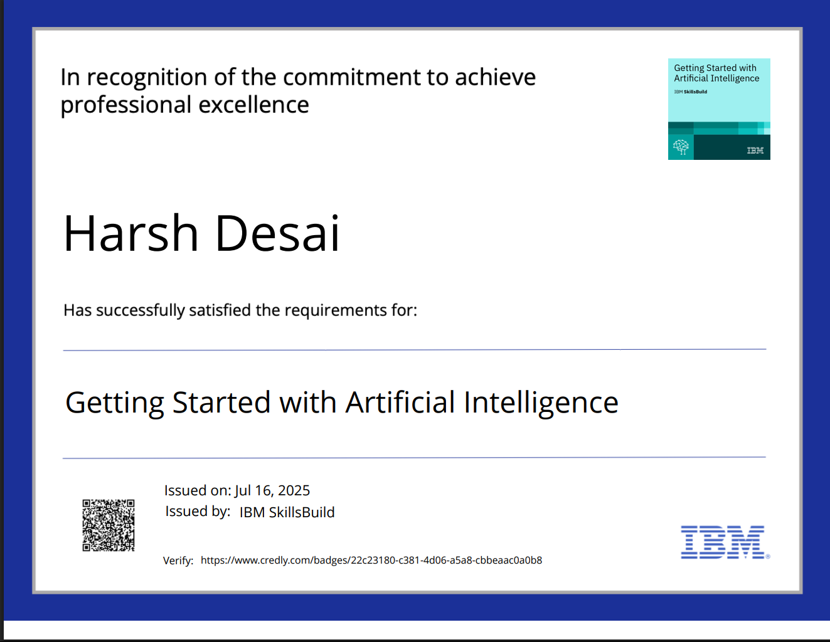
IBM Certifications
Screenshot/ credly certificate( getting started with AI)

Slide 10
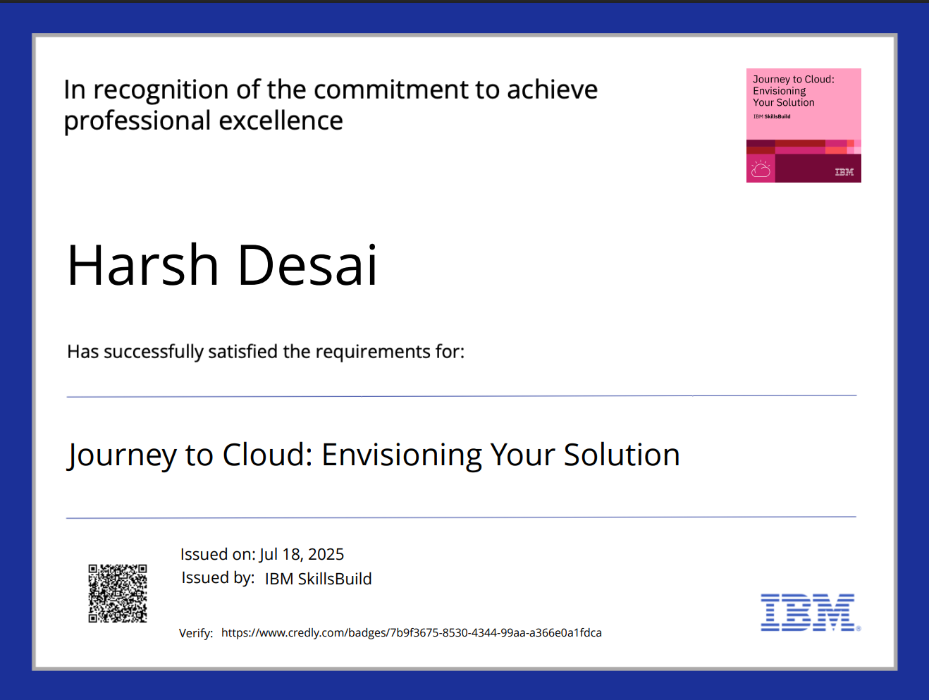
IBM Certifications
Screenshot/ credly certificate( Journey to Cloud)

Slide 11
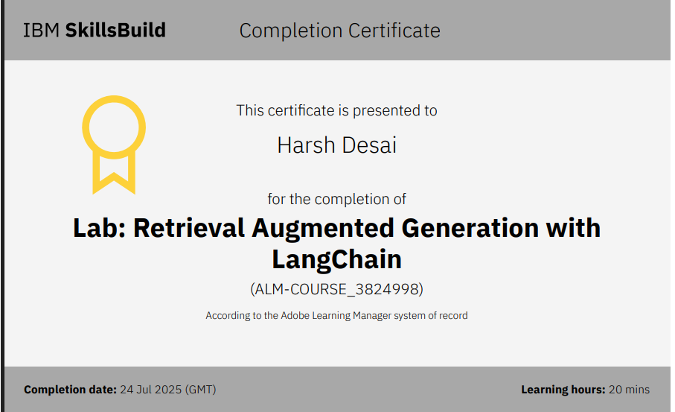
IBM Certifications
Screenshot/ credly certificate( RAG Lab)

Slide 12
THANK YOU

