Slide 1
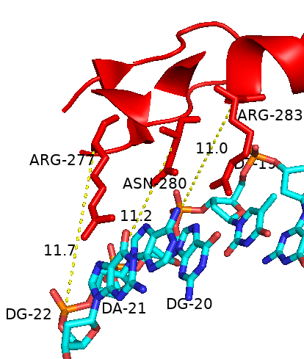
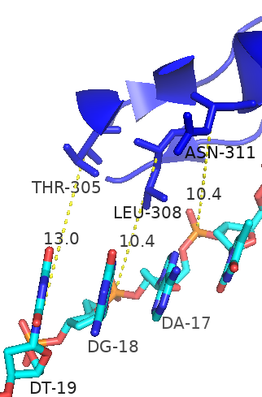
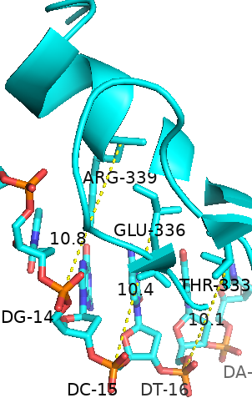
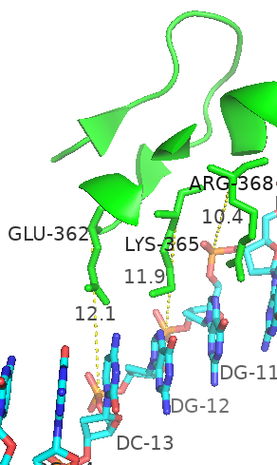
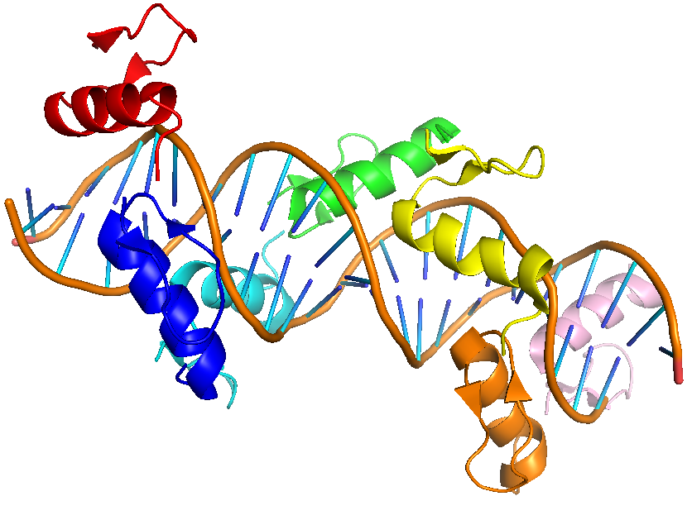
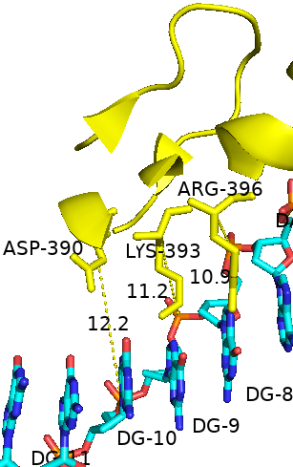
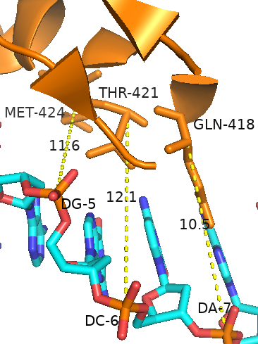
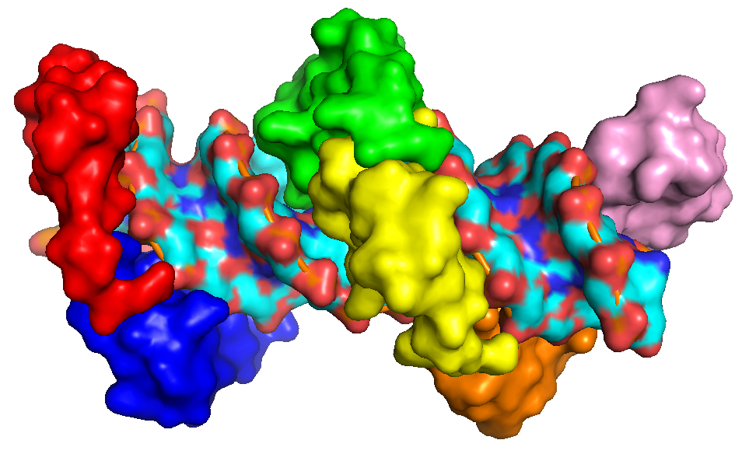
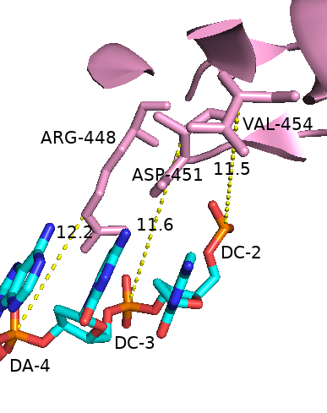
b
c
d
e
a
f
g
h
Figure A: Illustration of the interaction between the seven zinc fingers (ZFs) of CTCF and DNA.
A: Interaction between the seven zinc fingers (ZFs) of CTCF and DNA, with ZF1 in red, ZF2 in blue, ZF3 in cyan, ZF4 in green, ZF5 in yellow, ZF6 in orange, and ZF7 in pink. (B-H): These panels show the specific interactions between each ZF and its corresponding DNA segment, representing ZF1 through ZF7. The DNA base interactions for each triplet involve residues at positions -1, -4, and -7 relative to each ZF.

Slide 2
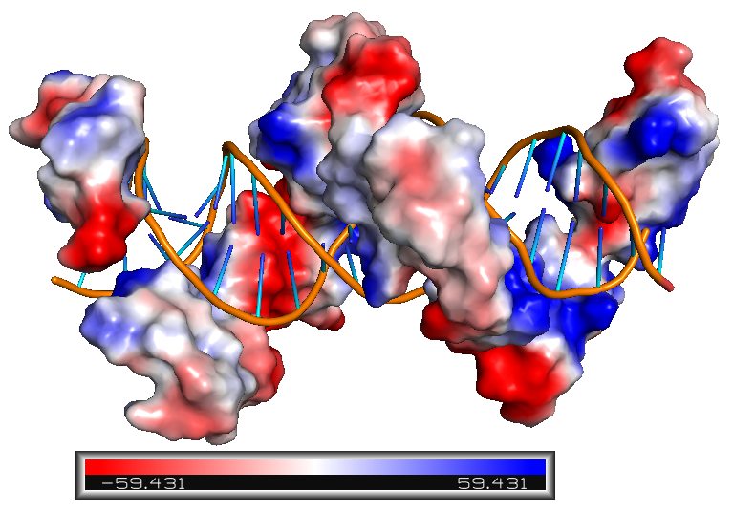
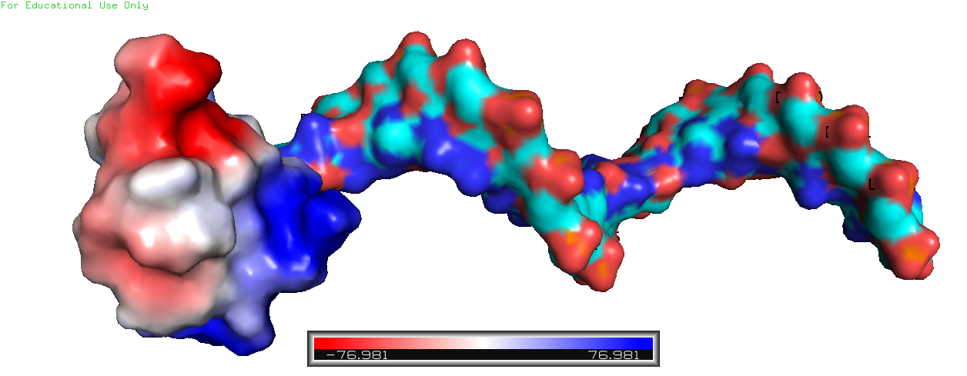
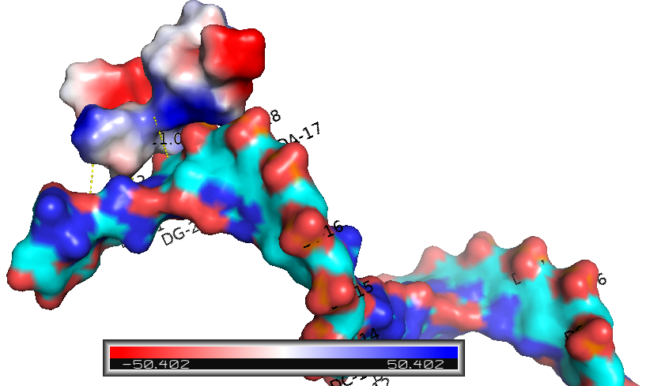
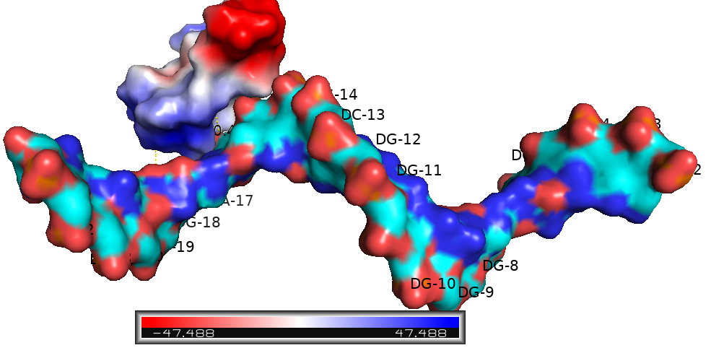
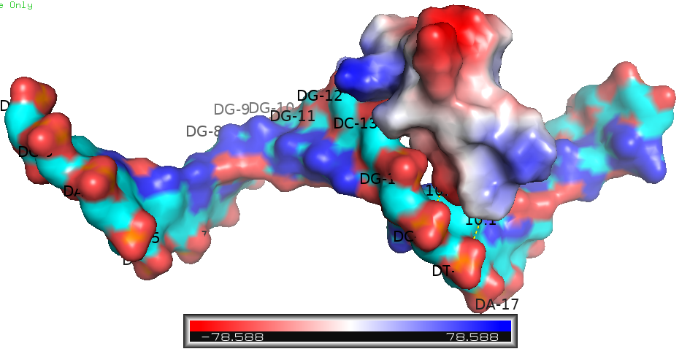
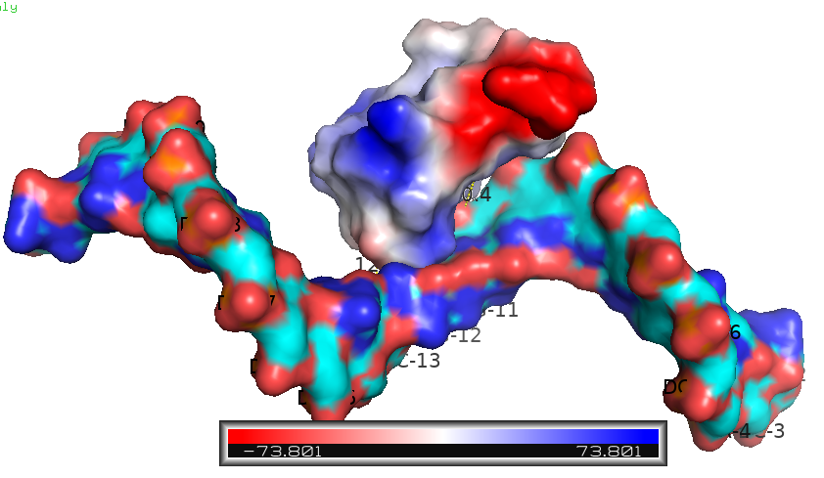
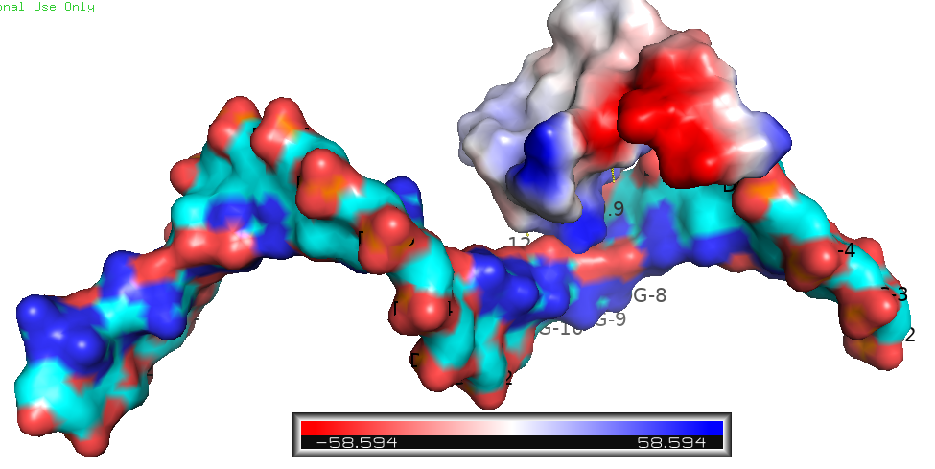
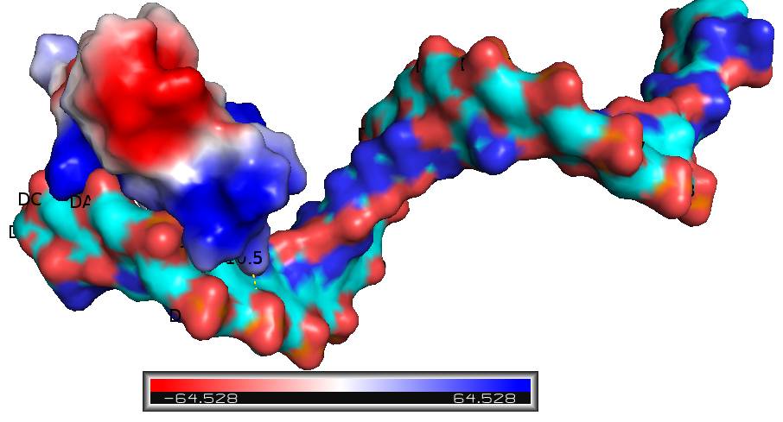
i
p
j
k
l
m
n
o
(I-Q): Electrostatic potential maps depicting the interactions between DNA and the seven ZFs of CTCF, indicating that the DNA interaction motifs primarily align with negatively charged regions, while each ZF of CTCF exhibits a positively charged character.

