Slide 1
Sequence-to-Sequence Translation Using Transformers
CSE 4311 – Neural Networks and Deep Learning
Vassilis Athitsos
Computer Science and Engineering Department
University of Texas at Arlington

Slide 2



Review: Attention Head
Input: queries, keys, and values.
For self-attention, queries = keys = values.
For English-to-Spanish translation, sometimes queries != keys.
Output: the “transformed“ version of the queries.
Attention Head
T(queries)
Attention
$W_{q}×$ queries
$W_{k}×$ keys
$W_{v}×$ values
Dense
Dense
Dense
queries
keys
values

Slide 3












Review: Multi-Head Attention
Multiple attention heads can be used instead of a single one.
Concatenate or Add, followed by another matrix multiplication.
Attention Head
Attention Head
Attention Head
$$T_{1}\left(Q\right)$$
$$T_{2}\left(Q\right)$$
$$T_{3}\left(Q\right)$$
Attention
Attention
Attention
$$W_{q,1}$$
$$W_{k,1}$$
$$W_{v,1}$$
$$W_{q,2}$$
$$W_{k,2}$$
$$W_{v,2}$$
$$W_{q,3}$$
$$W_{k,3}$$
$$W_{v,3}$$
Q
K
V
Q
K
V
Q
K
V

Slide 4
Review: Transformer Encoder
Layer Normalization
Add
The transformer encoder is a neural network module that combines multihead attention with additional dense layers and a normalization layer.
As usual with neural networks, many variations are possible. The version we will use is shown on the right.
Simplified description of this encoder:
We apply multihead attention on the inputs.
On top of that, we apply two fully connected layers, to have more learnable parameters.
Dense (no activation)
Dense (relu activation)
Layer Normalization
Add
Multi-Head Attention
Q, K, V

Slide 5
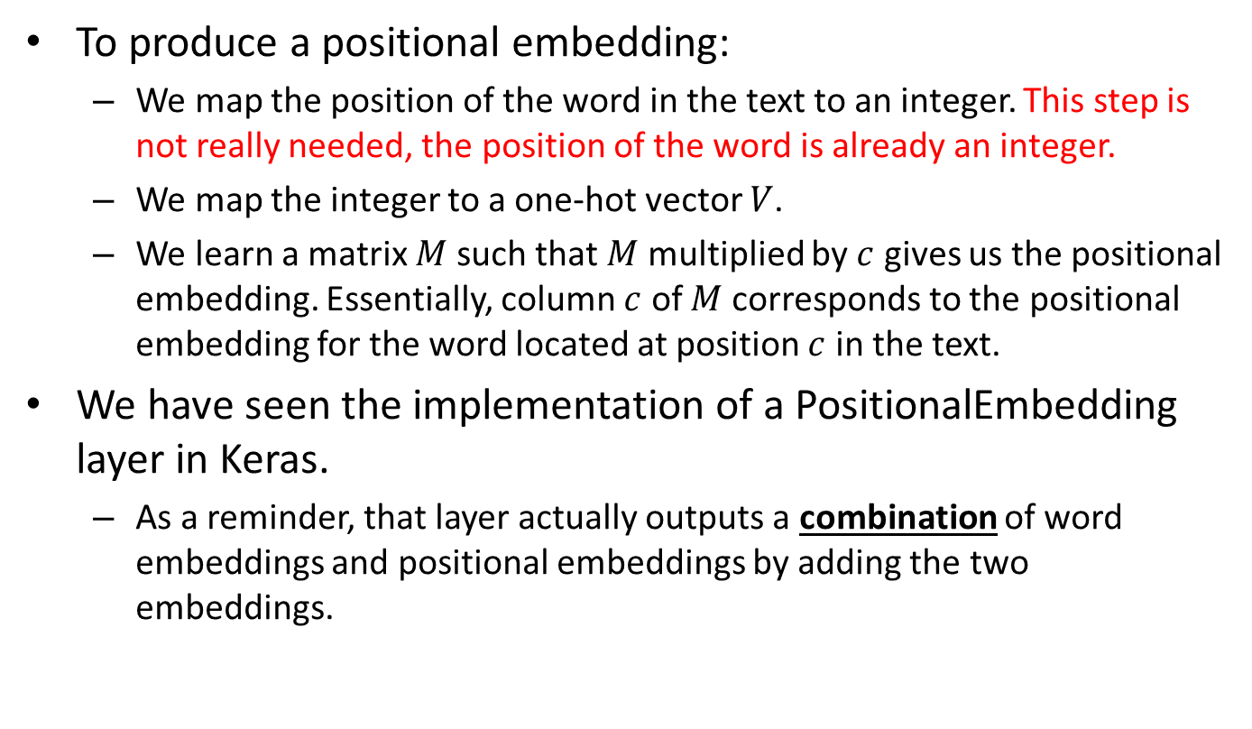
Review: Positional Embeddings
To produce a positional embedding:
We map the position of the word in the text to an integer. This step is not really needed, the position of the word is already an integer.
We map the integer to a one-hot vector $V$.
We learn a matrix $M$ such that $M$ multiplied by $c$ gives us the positional embedding. Essentially, column $c$ of $M$corresponds to the positional embedding for the word located at position $c$ in the text.
We have seen the implementation of a PositionalEmbedding layer in Keras.
As a reminder, that layer actually outputs a combination of word embeddings and positional embeddings by adding the two embeddings.

Slide 6
Review: Encoder-Decoder RNN Model for Translation
This was the Encoder-Decoder RNN model that we used for English-to-Spanish translation.
Decoder
target_next_step
Output Layer
Encoder
x4
encoded_source
Bidirectional(GRU)
decoder_gru + dropout
x1
x2
English word embedding
Spanish word embedding
source
past_target
input layer: English vectors
input layer: Spanish vectors

Slide 7
Review: Encoder-Decoder RNN Model for Translation
This is a simplified version of the previous diagram, highlighting the inputs and outputs of the encoder and decoder modules.
Output: next word in the translation
Encoder RNN
Last output of encoder’s recurrent layer
Decoder
RNN
Input: English text
Input: Partial Spanish translation

Slide 8
Transformer Model for Translation
We can use a pretty similar Encoder-Decoder architecture with Transformers.
We have already seen how to implement the TransfomerEncoder module.
The next slide shows the decoder details.
Output: next word
Dense + softmax
Transformer Encoder
Encoder Output
Transformer Decoder
Input: English text
Input: Partial Spanish translation

Slide 9
Transformer Encoder
Transformer Decoder
Layer Normalization
Layer Normalization
Add
Add
Dense (no activation)
Dense (no activation)
Layer
Normalization
Dense (relu activation)
Dense (relu activation)
Add
Layer Normalization
Layer Normalization
Multi-Head Attention
Add
K,V
T(Q)
Add
Multi-Head Attention
Multi-Head Attention
Q, K, V: English text
Q, K, V: partial Spanish translation

Slide 10
Transformer Decoder
Transformer Decoder
Layer Normalization
Add
The previous slide shows the complete details of the Encoder-Decoder module.
In the next few slides we will go over each of these details.
Dense (no activation)
Layer
Normalization
Dense (relu activation)
Add
Layer Normalization
Multi-Head Attention
T(Q)
Add
K,V (Encoder Output)
Multi-Head Attention
Q, K, V: partial Spanish translation

Slide 11
Inputs
Transformer Decoder
Layer Normalization
Add
Similar to the RNN decoder, the Transformer decoder takes two separate inputs, shown in red:
A partial Spanish translation.
The output of the encoder.
Dense (no activation)
Layer
Normalization
Dense (relu activation)
Add
Layer Normalization
Multi-Head Attention
T(Q)
Add
K,V (Encoder Output)
Multi-Head Attention
Q, K, V: partial Spanish translation

Slide 12
Transformer Decoder
Transformer Decoder
Layer Normalization
Add
The seven blocks on the right side are the same types of blocks that we also used to build the Encoder.
The three layers on the left are the ones that make the difference between the Encoder design and the Decoder design.
Dense (no activation)
Layer
Normalization
Dense (relu activation)
Add
Layer Normalization
Multi-Head Attention
T(Q)
Add
K,V (Encoder Output)
Multi-Head Attention
Q, K, V: partial Spanish translation

Slide 13
Transformer Decoder
Transformer Decoder
Layer Normalization
Add
The decoder starts its computations by applying a Multi-Head Attention layer to the partial Spanish translation.
The output of this operation is added to the original queries.
The next operation is layer normalization. The output is the “transformed” queries.
So far, everything is similar to how an Encoder processes its inputs.
Dense (no activation)
Layer
Normalization
Dense (relu activation)
Add
Layer Normalization
Multi-Head Attention
T(Q)
Add
K,V (Encoder Output)
Multi-Head Attention
Q, K, V: partial Spanish translation

Slide 14
Transformer Decoder
Transformer Decoder
Layer Normalization
Add
This is where the decoder model becomes different from the encoder.
The transformed queries T(Q) are used as queries to the multi-head attention block on the left.
The keys and values for that attention block are equal to each other and to the output of the encoder.
So, this is a case where the queries are different from the keys and values.
Dense (no activation)
Layer
Normalization
Dense (relu activation)
Add
Layer Normalization
Multi-Head Attention
T(Q)
Add
K,V (Encoder Output)
Multi-Head Attention
Q, K, V: partial Spanish translation

Slide 15
Transformer Decoder
Transformer Decoder
Layer Normalization
Add
The output of this attention block is added to the original T(Q).
Then, a layer normalization operation is (again) applied.
Dense (no activation)
Layer
Normalization
Dense (relu activation)
Add
Layer Normalization
Multi-Head Attention
T(Q)
Add
K,V (Encoder Output)
Multi-Head Attention
Q, K, V: partial Spanish translation

Slide 16
Transformer Decoder
Transformer Decoder
Layer Normalization
Add
The last four steps are identical to the last four steps of the Encoder module.
We apply the two dense layers.
We combine via adding the input of the first dense layer with the output of the second dense layer.
We apply a final layer normalization operation.
Dense (no activation)
Layer
Normalization
Dense (relu activation)
Add
Layer Normalization
Multi-Head Attention
T(Q)
Add
K,V (Encoder Output)
Multi-Head Attention
Q, K, V: partial Spanish translation

Slide 17
Final Output
The output of the decoder is NOT the final output of the system.
Instead, we apply an additional Dense output layer to the decoder output.
The argmax of that output gives us the index of the next output word.
Output: next word
Dense + softmax
Transformer Encoder
Encoder Output
Transformer Decoder
Input: English text
Input: Partial Spanish translation

Slide 18
Important: Causal Attention Mask
At training, we provide the same inputs that we provided to the RNN Encoder-Decoder:
English text.
Spanish translation, starting with special token [START].
We need to be careful, because the training input includes the correct output.
If a model simply learns to copy from the input to the output, then the model will not learn anything useful.
With the RNN encoder-decoder, we avoided the problem.
The Spanish translation is processed step-by-step.
At each time step, the computations producing the word from that step cannot access any information about that word from the input.

Slide 19
Important: Causal Attention Mask
A Transformer decoder does NOT process the Spanish translation step-by-step.
Information from all time steps is used at all computations.
So, at training time we need to explicitly make sure that computing a Spanish word as output is done without being able to see that that word is part of the input.
The solution is obtained using what is called a “causal attention mask”.

Slide 20
Important: Causal Attention Mask
The causal attention mask is a square binary matrix, whose size is equal to the number of tokens in the Spanish translation.
The value at Row i column j is:
1 if token j in the Spanish translation should be used in producing the i-th output word.
0 otherwise.
In this matrix, all values above the diagonal are 0. The diagonal and all values below it are one.
These values represent the fact that, in generating the i-th output word, only the first i input words from the Spanish translation should be used.

Slide 21
Causal Attention Mask: Example
Target Spanish translation: [start] no te preocupes [end]
Sequence used as training input: [start] no te preocupes
Sequence used as target output: no te preocupes [end]
Causal attention mask:
 | [start] | no | te | preocupes
no | 1 | 0 | 0 | 0
te | 1 | 1 | 0 | 0
preocupes | 1 | 1 | 1 | 0
[end] | 1 | 1 | 1 | 1

Slide 22
Causal Attention Mask: Example
Intuitive interpretation of the mask:
To produce target output “no”, only the [start] token can be used.
To produce target output “te”, both [start] and “no” can be used.
To produce target output “preocupes”, [start], “no” and “te” can be used.
To produce target output [end], all input tokens can be used.
 | [start] | no | te | preocupes
no | 1 | 0 | 0 | 0
te | 1 | 1 | 0 | 0
preocupes | 1 | 1 | 1 | 0
[end] | 1 | 1 | 1 | 1

Slide 23
Implementation
Code for training a Transformer encoder-decoder model for English-to-Spanish translation is posted in file transformers_translation_train.py.
It took about 9 hours to train a model on my desktop computer.
Code for testing a model that has already been trained is posted in file in file transformers_translation_test.py.

Slide 24
Implementation
Since this is optional material, we will not go into the same level of detail regarding the code.
Still, with the exception of the causal attention mask, the rest of the code should be familiar.
The decoder implementation follows the same steps as the encoder implementation.
There are a few more lines to account for the extra blocks that the decoder has, compared to the encoder.
The creation and use of the causal mask, which appears in the decoder implementation, is the only piece of code that may seem unfamiliar, in terms of the Tensorflow and Keras functions that it uses.
The decode_sentence implementation is almost identical to what we used for the RNN encoder-decoder model.

