Slide 1
Learning Multi-Domain Convolutional Neural Networks for Visual Tracking
CV lab in HYU
Lee Hakjin
Hyeonseob Nam, Bohyung Han:
Learning Multi‐Domain Convolutional Neural Networks for Visual Tracking, CVPR 2016

Slide 2
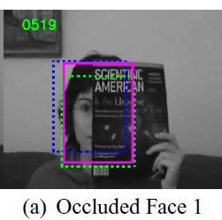



Visual Tracking Problems using hand-crafted features
Motion Blur
Light Condition Change
Deformation

Slide 3
Visual Tracking Problems using CNN
Lack of data for visual tracking
-> Transfer Learning
-> But, low performance
Because domains are different

Slide 4
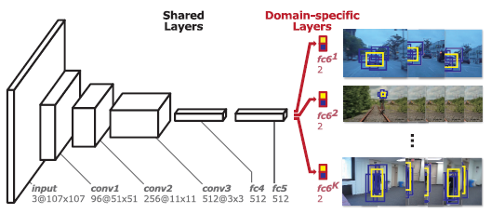
Multi-Domain Network
Shared layers and domain-specific layers
Each domain is trained separately
Region proposal by prior target state

Slide 5
Four reasons using a simple network
1. Simple task - classifying target and background
2. Spatial information is diluted in deeper networks
3. Targets in visual tracking are small
4. Efficient for online tracking

Slide 6
Other tactics of MD Net
Bounding Box Regression
Hard negative mining(Hard minibatch mining)
Consider long-term and short-term change

Slide 7
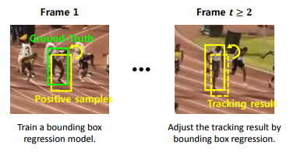
Bounding Box Regression
Ref. http://cvlab.postech.ac.kr/~bhhan/class/cse703r_2016s/csed703r_lecture6.pdf

Slide 8
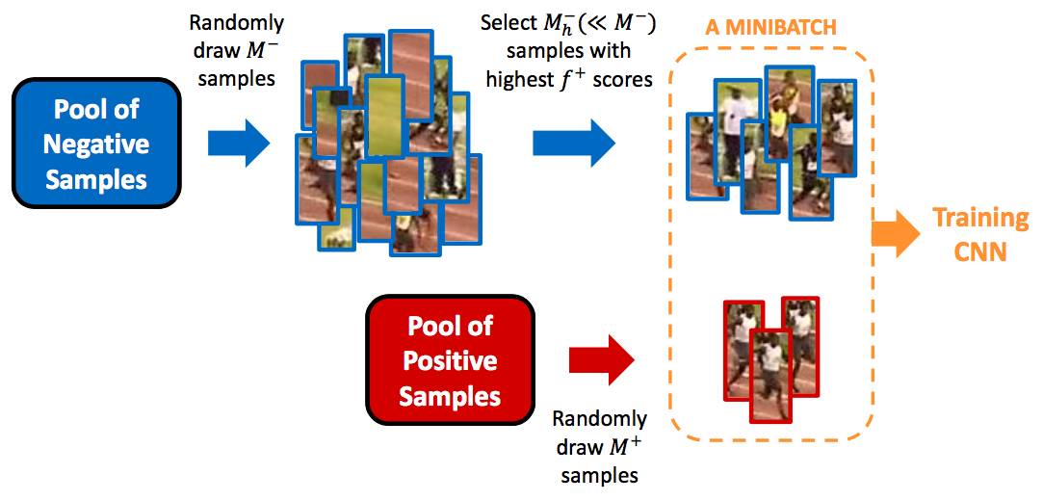
Hard Minibatch Mining
Ref. http://cvlab.postech.ac.kr/~bhhan/class/cse703r_2016s/csed703r_lecture6.pdf

Slide 9
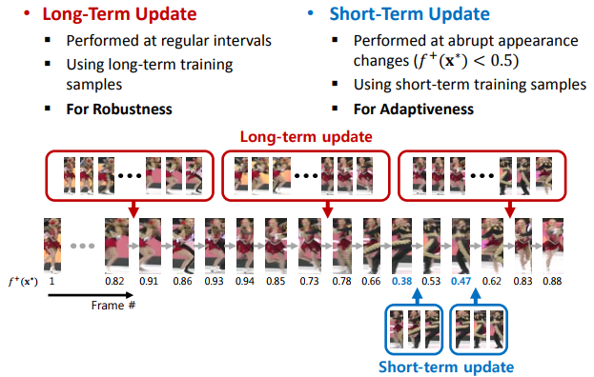
Long-term, Short-term Updates
Ref. http://cvlab.postech.ac.kr/~bhhan/class/cse703r_2016s/csed703r_lecture6.pdf

Slide 10
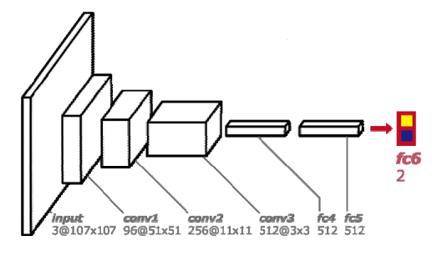
Online Tracking Algorithm
Drop all domain-specific layers
Attach a new randomly initialized layer
Update when the first frame is given

Slide 11
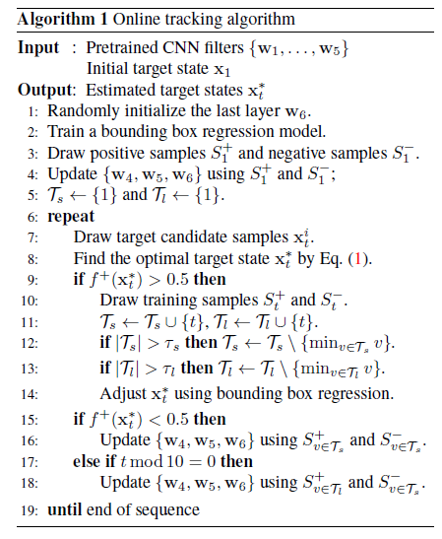
Online Tracking Algorithm

Slide 12
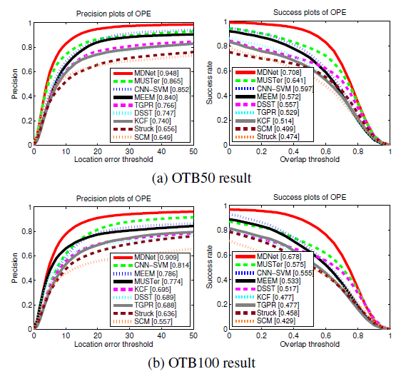
Experiments in OTB

Slide 13
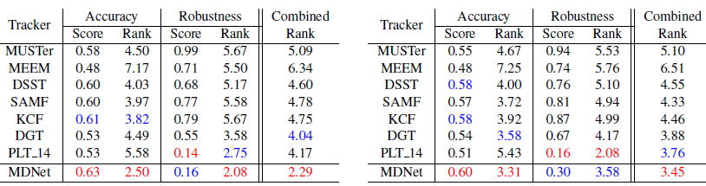
Experiments in VOT2014

Slide 14
Thank You!

