Slide 2
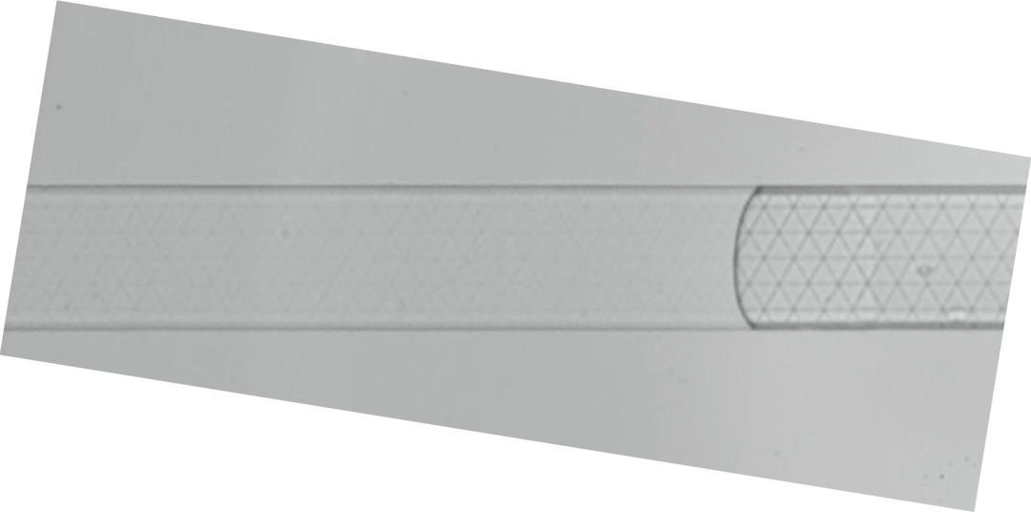
Test 1 after

Slide 3
Test 1 after flip

Slide 4
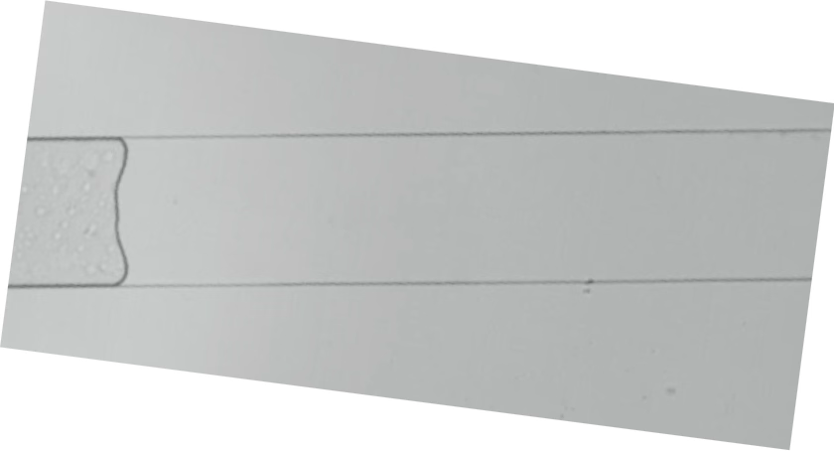
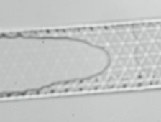
Test 2 after

Slide 5
Test 2 after flip

Slide 6
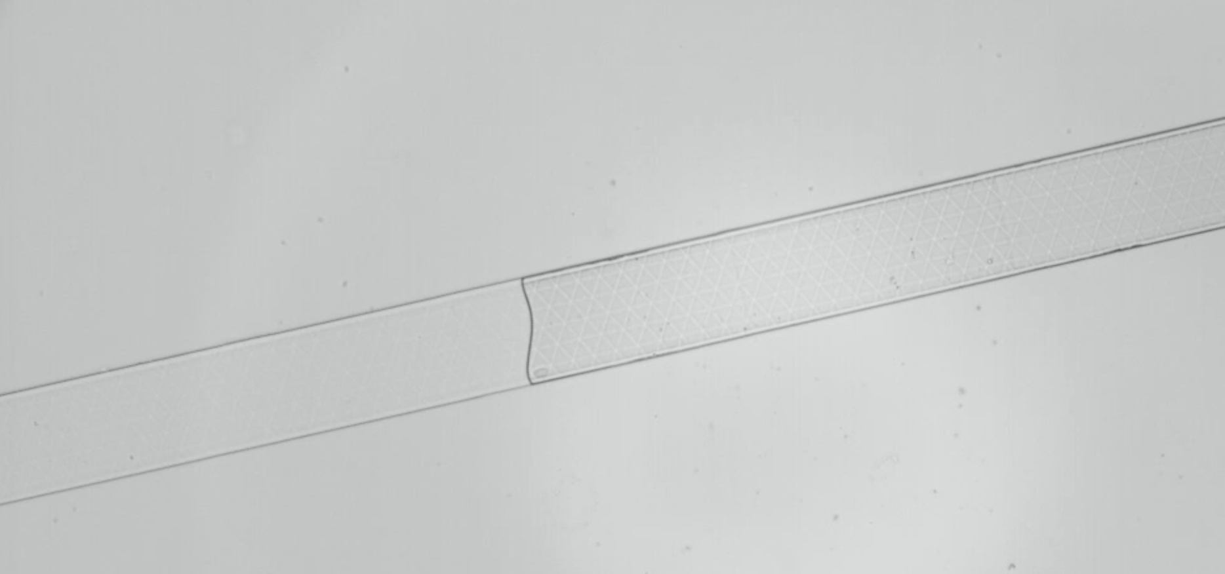
Test 3 after

Slide 7
Test 3 after flip

Slide 8
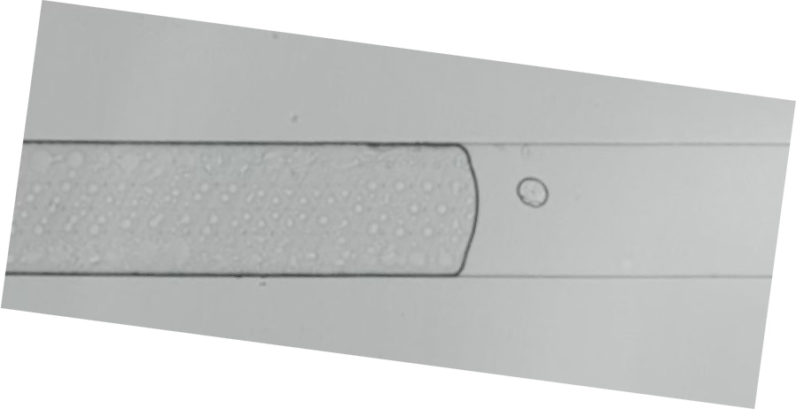
Test 4 before *

Slide 9
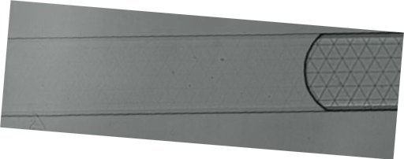
Test 5 after *

Slide 10
Test 5 after * flip

Slide 11
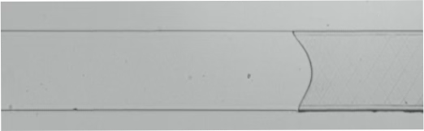
Test 6 after

Slide 12
Test 6 after flip

Slide 13
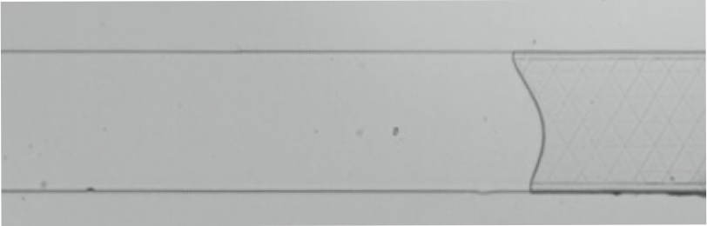
Test 7 after

Slide 14
Test 7 after flip

Slide 15
Test 8 after

Slide 16
Test 8 after flip

Slide 17
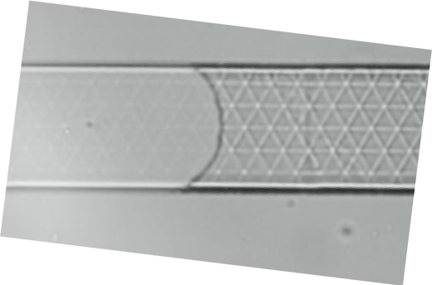
Test 9 before

