Slide 1
EvoGuard Enterprise
E
Live Demo
Agentic AI Cyber Defense Platform
Frontend
https://mayedalshehhi.github.io/EvoGuard-Enterprise/
Backend API
https://evoguard-enterprise-backend.onrender.com
Repository
https://github.com/MayedAlshehhi/EvoGuard-Enterprise
A senior project prototype that simulates, monitors, analyzes, and responds to cyber threats through an AI-powered SOC dashboard.
React Frontend
Flask Backend
AI Engine
Realtime SOC
Demo login
username: mayed
password: mayed123
EvoGuard Enterprise - Agentic AI Cyber Defense Platform
01

Slide 2
PROJECT THESIS
WHY IT MATTERS
EvoGuard turns attack simulation into an explainable AI defense workflow.
The system demonstrates a complete SOC loop: event intake, AI classification, threat intelligence enrichment, response execution, reporting, and live monitoring.
Problem
Approach
Outcome
Dashboards often show alerts without explaining risk, response logic, or attack context.
EvoGuard connects simulations and live-style events to backend AI analysis and response workflows.
The prototype behaves like a command-center platform rather than a static dashboard.
PROJECT TYPE
CORE IDEA
DEPLOYMENT
Enterprise SOC Prototype
Backend as Brain
Public Demo
AI-powered cyber defense platform
Frontend visualizes AI decisions
GitHub Pages + Render
EvoGuard Enterprise - Agentic AI Cyber Defense Platform
02

Slide 3
BACKEND PIPELINE
The backend is the decision layer; the frontend is the SOC command surface.
Flask APIs, SQLite logging, Socket.IO events, AI analysis, IOC enrichment, MITRE mapping, and reports drive the interface.
React Frontend
Flask API
AI Engine
Data + Reports
Dashboard, Simulation,
Map, Reports, Assistant
REST endpoints,
Socket.IO events
Model prediction,
agentic analysis
SQLite logs,
PDF exports
API endpoints: dashboard stats, attack history, event intake, threat intel, AI assistant, reports
Cloud demo: GitHub Pages frontend connected to Render-hosted Flask backend
Backend focus: received attacks, AI analysis, response quality, and evidence storage
EvoGuard Enterprise - Agentic AI Cyber Defense Platform
03

Slide 4
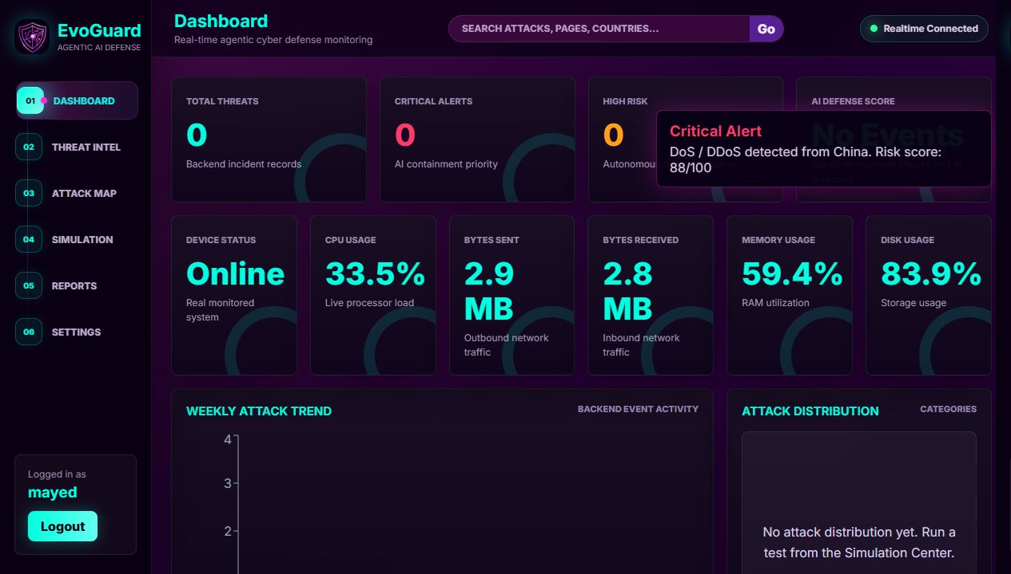
DASHBOARD SCREENSHOT
DASHBOARD SCREENSHOT
The live dashboard presents the real SOC command surface.
This is the instructor's first visual proof: telemetry, AI score, backend status, charts, map, and SOC activity in one interface.
What to point out
Backend-connected status and statistics
Device telemetry and network counters
AI Defense Score and SOC event panels
No simulation controls on the main dashboard
EvoGuard Enterprise - Agentic AI Cyber Defense Platform
04

Slide 5
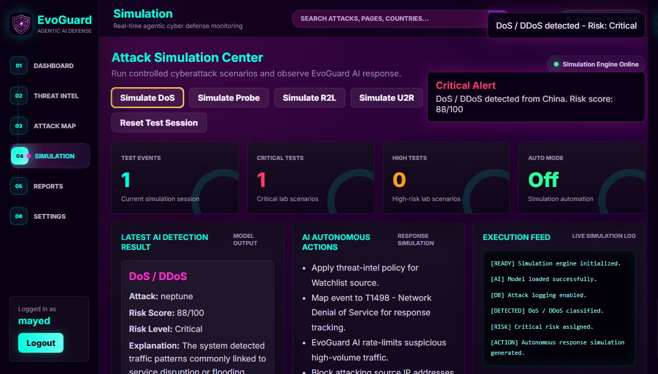
SIMULATION SCREENSHOT
SIMULATION SCREENSHOT
The Simulation Center is the controlled testing environment.
Attack buttons live here so the main dashboard can feel like a real SOC view while testing remains separate and explainable.
What to point out
DoS, Probe, R2L, U2R, and Normal scenarios
Auto simulation and reset test session
Lab counters separated from live dashboard
Generated event feeds into backend AI logic
EvoGuard Enterprise - Agentic AI Cyber Defense Platform
05

Slide 6
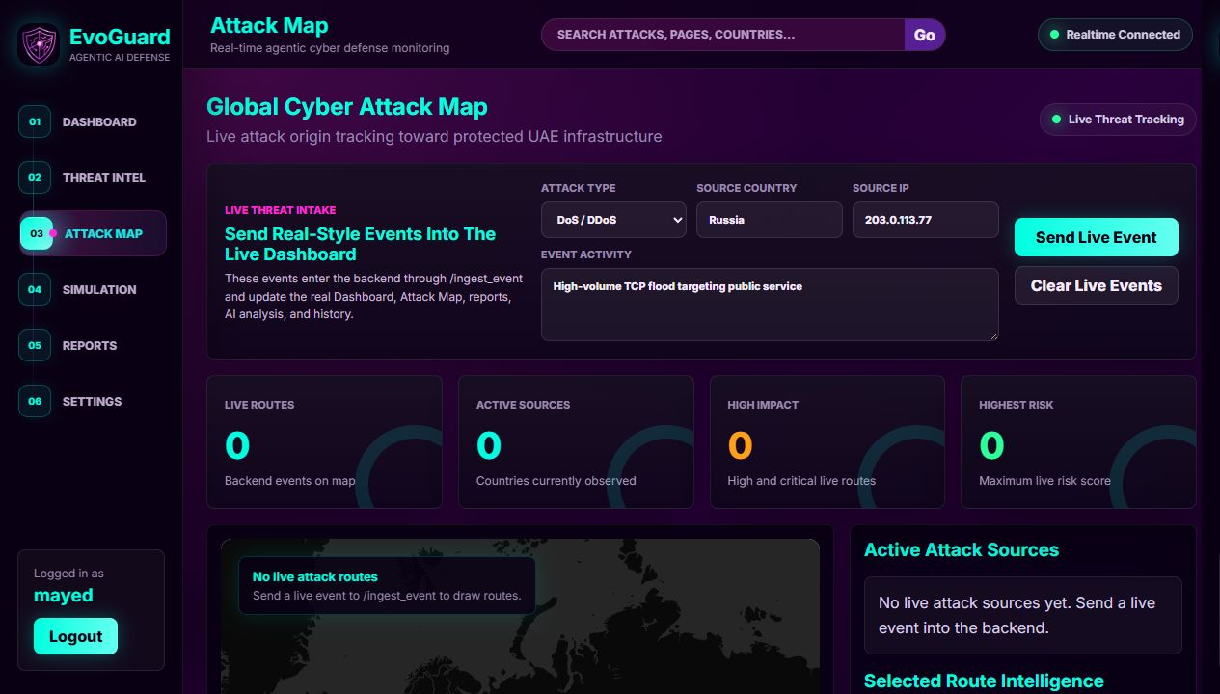
ATTACK MAP SCREENSHOT
ATTACK MAP SCREENSHOT
The attack map visualizes live backend event origins.
Map routes are used for live-style events and source tracking, while simulation-specific activity remains in the testing section.
What to point out
Country-based source intelligence
Risk-colored global attack routes
Protected UAE target visualization
Source counters and active map context
EvoGuard Enterprise - Agentic AI Cyber Defense Platform
06

Slide 7
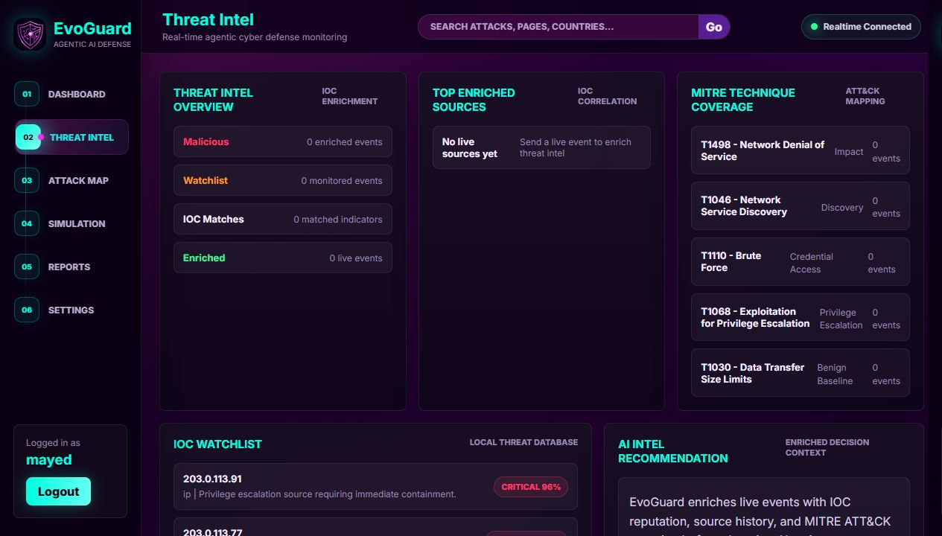
THREAT INTEL SCREENSHOT
THREAT INTEL SCREENSHOT
Threat intelligence explains why an event matters.
The backend enriches events with IOC reputation, confidence, enrichment notes, and MITRE ATT&CK mapping.
What to point out
IOC lookups and reputation signals
MITRE technique and tactic mapping
Real backend data rather than static UI text
Explainability for AI risk decisions
EvoGuard Enterprise - Agentic AI Cyber Defense Platform
07

Slide 8
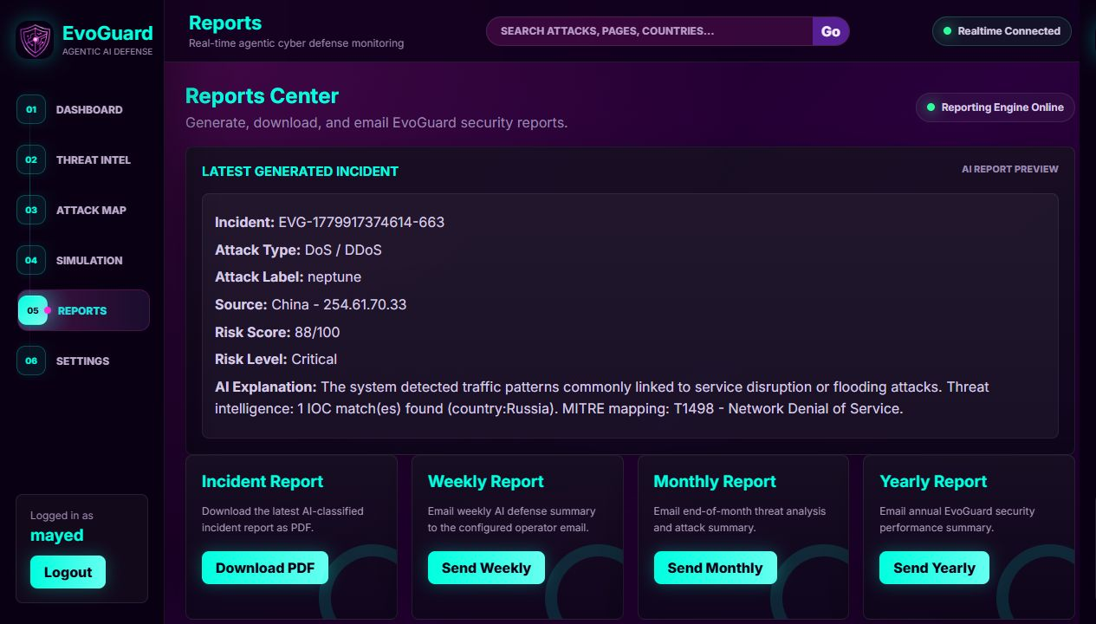
REPORTS SCREENSHOT
REPORTS SCREENSHOT
Reports turn AI decisions into reviewable evidence.
The Reports Center gives the project a complete lifecycle: detection, analysis, response, storage, and export.
What to point out
Incident report preview
Weekly, monthly, and yearly exports
AI analyst summary and recommendations
Evidence path for instructor evaluation
EvoGuard Enterprise - Agentic AI Cyber Defense Platform
08

Slide 9
AI DECISIONING
Agentic logic makes classifications explainable and actionable.
The AI layer combines model output, attack category, risk scoring, IOC context, MITRE mapping, and autonomous response planning.
Input Event
AI Analysis
System Output
Attack type and source IP
Classify attack label
Dashboard alert + logs
Country and activity
Score risk and confidence
Attack map source route
Telemetry or CSV/API input
Enrich with IOC + MITRE
Report and incident history
EvoGuard Enterprise - Agentic AI Cyber Defense Platform
09

Slide 10
COMPLETED ENGINEERING
The implementation has moved beyond UI styling into backend-led cyber workflows.
Completed work includes APIs, realtime updates, event intake, AI response logs, threat intelligence, report generation, and public deployment.
Backend APIs
95% prototype coverage
Realtime updates
90% prototype coverage
AI response logic
88% prototype coverage
Threat intelligence
82% prototype coverage
Public deployment
86% prototype coverage
Completed capabilities: backend login, event intake, CSV intake, Socket.IO realtime events, autonomous AI response logs, AI defense score, IOC enrichment, MITRE mapping, enriched PDF reports, AI assistant endpoints, Docker files, and public deployment.
EvoGuard Enterprise - Agentic AI Cyber Defense Platform
10

Slide 11
DEMO SCRIPT
A five-minute demo can prove the whole system without explaining every file.
The flow should show what the evaluator sees first, then connect each screen to backend behavior and AI reasoning.
1
Open backend
Wake Render and verify API status
Demo links
2
Login
Use mayed / mayed123
Frontend
mayedalshehhi.github.io/EvoGuard-Enterprise
Backend
evoguard-enterprise-backend.onrender.com
Note
Render may take a short time to wake up.
3
Dashboard
Show live stats, device telemetry, SOC terminal
4
Simulation
Run DoS or U2R scenario
5
AI proof
Show risk score, MITRE, IOC, response actions, report
EvoGuard Enterprise - Agentic AI Cyber Defense Platform
11

Slide 12
ROADMAP
The next evolution is a backend-led AI SOC platform.
Future work should deepen the backend: stronger auth, persistent database, real traffic intake, AI evaluation, and production-style deployment.
Short Term
AI Depth
Security Depth
Data Depth
Cloud Depth
Demo polish, README, screenshots, instructor script
Dynamic model accuracy, response success scoring, confidence tracking
Backend auth, hashed passwords, roles, audit logging
PostgreSQL, event retention, real log ingestion, SIEM-style search
Docker, managed secrets, deployment monitoring, stable hosting
Evaluator takeaway
EvoGuard is already an advanced prototype with a real frontend, backend, database, AI analysis logic, realtime events, reports, public deployment, screenshots, and a clear path toward a production-style SOC platform.
EvoGuard Enterprise - Agentic AI Cyber Defense Platform
12

