Slide 1
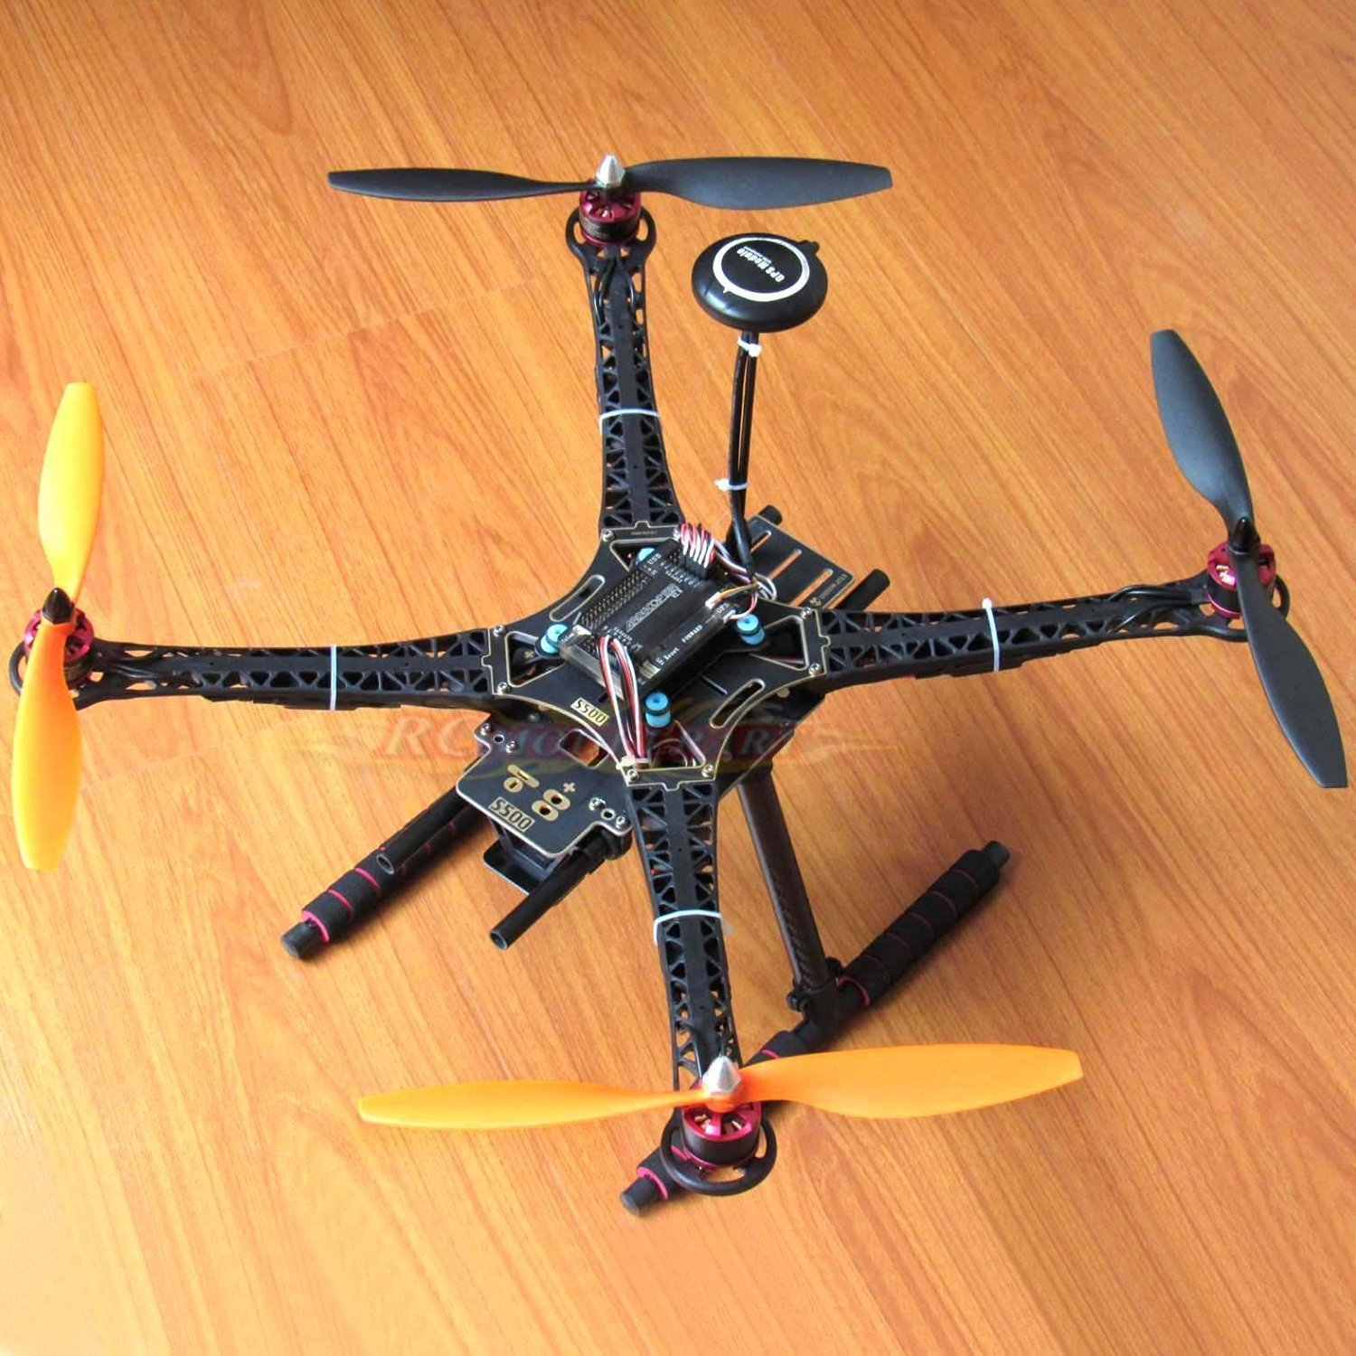
Quadcopter
CSE3216
Microprocessor Based System Lab
Name ID
Mayeesha Humaira 16.02.04.008
Rimon Datta 16.02.04.013
Shimul Paul 16.02.02.014
Ashna Nawar Ahmed 16.02.04.024

Slide 2
Introduction:
A quadcopter, also called a quadrotor helicopter
quadrotor is a multirotor helicopter that is lifted and propelled by four motors
Our aim for this project is to construct something that will have multipurpose usage as well as be beneficial for mankind

Slide 3
Objective:
As the name suggests it will have four propellers that will help it to fly
It will have raspberry pi camera attached to it for live broadcasting
Quadcopter shall contain GPS so that it can be located using mission planner software
It will be able to lift small amount of weight

Slide 4
Purpose:
This quadcopter will be used for security purpose as it can go where humans can’t enter
Users will be able to view unsafe places without even going there
Raspberry pi camera will provide emergency response teams with an ideal solution for identifying victims who are difficult to spot with the naked eye.
In case of natural disaster can carry a small amount of relief at a time to damaged areas

Slide 5
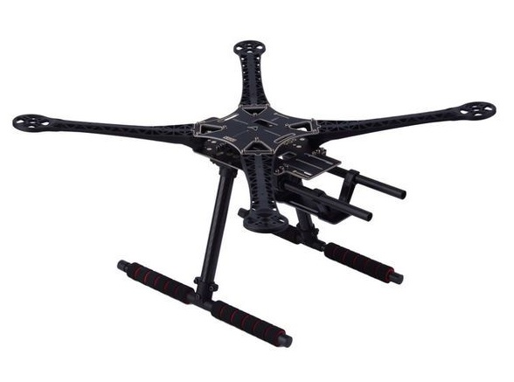
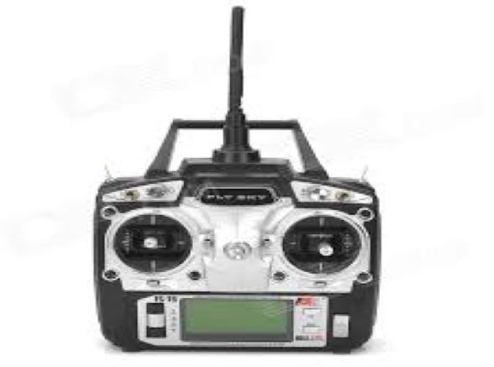
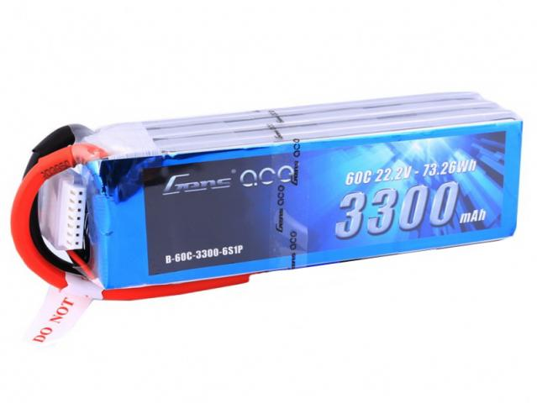
Equipment:
S500 Chassis
Controller-FST6
Lippo 3300
Price-2500/-
Price-4500/-
Price- 3000/-

Slide 6
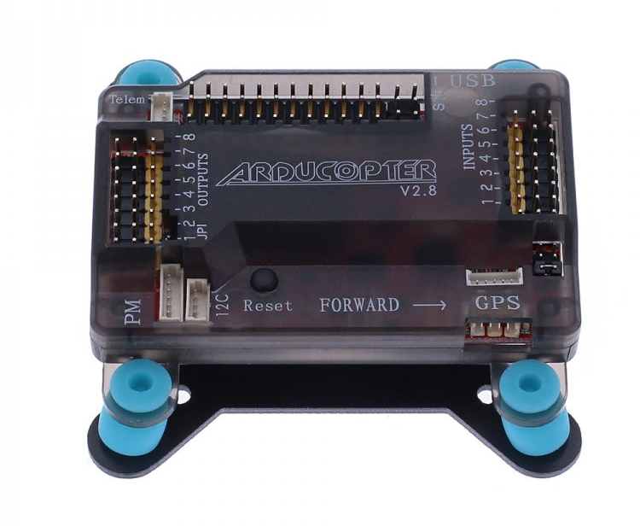
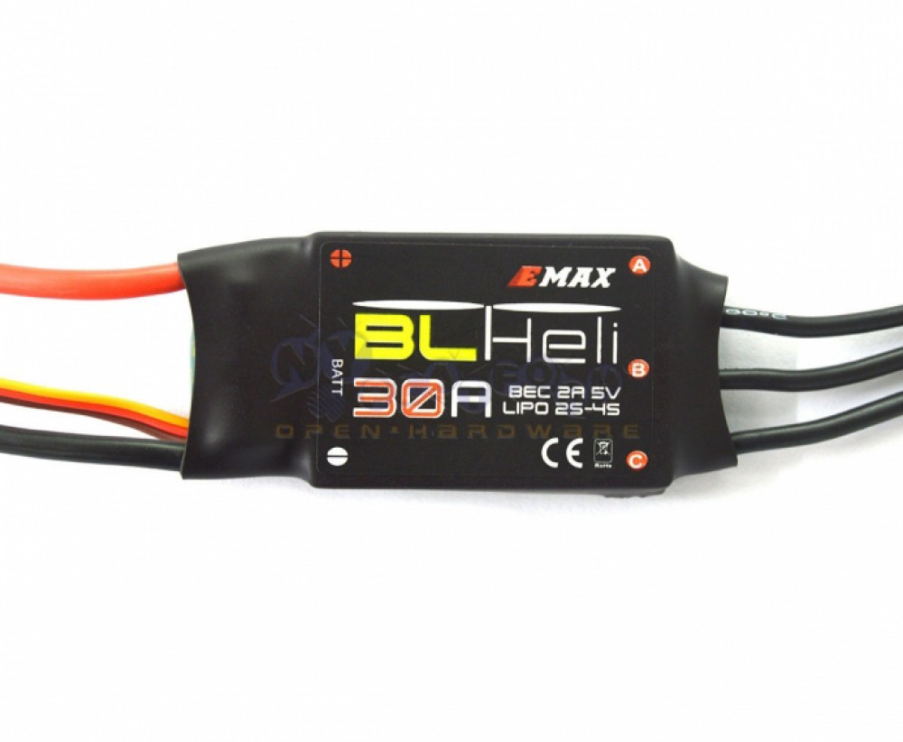
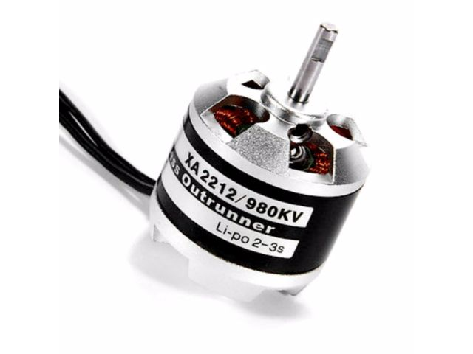
Equipment:
Flight Controller-APM2.8
EMAX 30A ESC
Emax Brushless motors
Price- 8000/-
Price- 3200/-
Price- 4000/-

Slide 7
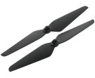
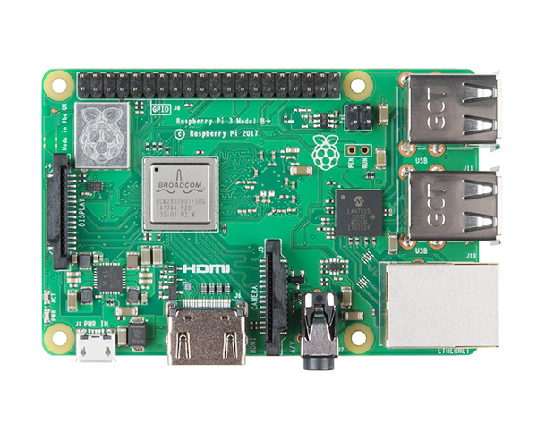
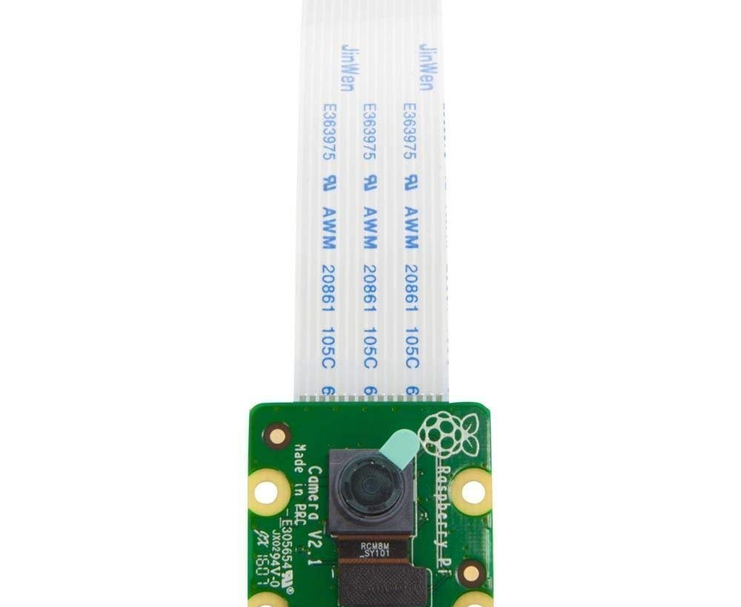
Equipment:
Propeller
Raspberry Pi 3b+
Raspberry Pi Camera
Price- 400/-
Price- 3600/-
Price- 800/-

Slide 8
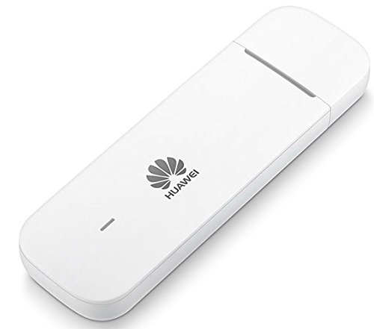
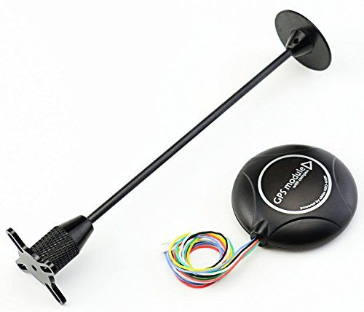
Equipment:
GPS Module
HUAWEI modem
Price- 4500/-
Price- 2000/-

Slide 9
Total Budget:
Main Component Total price = 36500 taka
Extra component price = 2600 taka
________________________________________
Total = 39100 taka

Slide 10
Future Goal:
Our future goal is to help mankind with this quadcopter
It can be used for reaching medicine to remote or unreachable places
Quadcopter can also be used for aerial photography

Slide 11
Contribution of each Member:
16.02.04.008
Mayeesha
Arducopter,
16.02.04.013
Rimon
Telemetry
16.02.04.024
Ashna
GPS and Compass Calibrating
16.02.04.014
Shimul
Live stream
Motor, Esc
Calibration
setup
with Raspberry
pi camera
Overall Structure will be made by all four members

Slide 12
Conclusion
Quadcopter will soon be an essential part of our daily life owing to technology advances. Soon more features could be added due to higher processing power available in small form factors such as the Raspberry Pi. More quadcopter development means lower production cost and more reliable hardware due to competitive market.

Slide 13
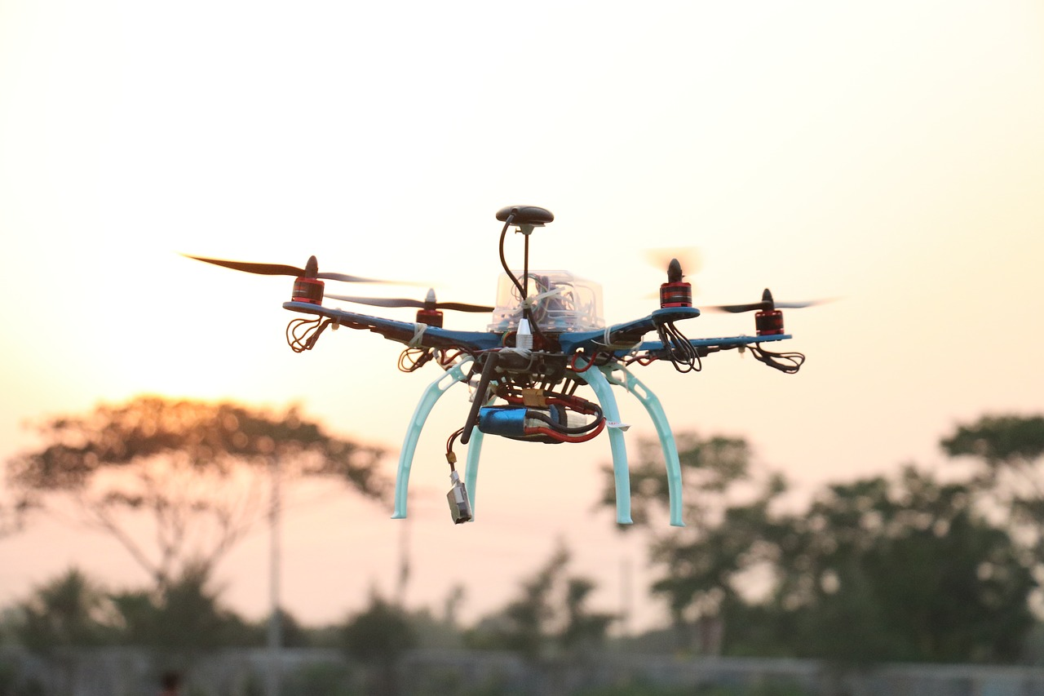
Thank you

