Slide 1
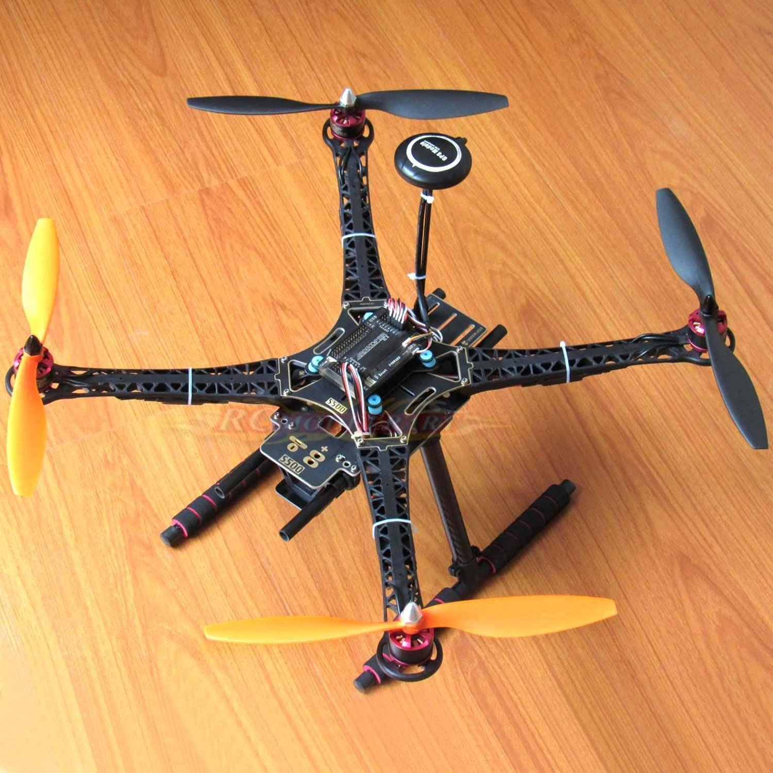
Quadcopter with
Livestreaming
&
Weightlifting
CSE3216
Microprocessor Based System Lab
Name ID
Mayeesha Humaira 16.02.04.008
Rimon Datta 16.02.04.013
Shimul Paul 16.02.02.014
Ashna Nawar Ahmed 16.02.04.024

Slide 2
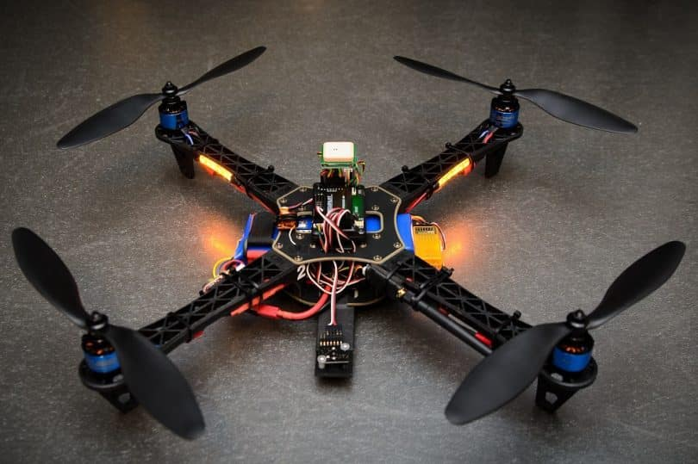
Introduction:
A quadcopter is a quadrotor helicopter
Our aim for this project was to construct something that has multipurpose usage as well as be beneficial for mankind.

Slide 3
O B J E C T I v E
Live Broadcast
Weight Lift
It has a raspberry pi camera attached to it for live broadcasting during flight
Fly
GPS
It is also able to lift a small amount of weight
As the name suggests it has four propellers that help it to fly
Our quadcopter contains a GPS so that it can be located using mission planner software
2
4
1
3

Slide 4
This quadcopter can be used for security purpose as it can go where humans can’t enter
Users will be able to view unsafe places without even going there
Social Benefits
Raspberry pi camera will provide emergency response teams with an ideal solution for identifying victims in case of natural disasters(such as earthquakes, flood etc.) or accidents(such as-building collapse) who are difficult to spot with the naked eye
In case of natural disaster, it can carry a small amount of relief at a time to damaged areas
It can be used for aerial photography

Slide 5
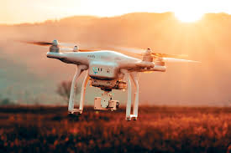
Equipment Details And Price
1
Flight Controller APM 2.8 Price: 8000/-
2
S500 chassis price: 2500/-
3
Controller FS-16X price: 4500/-
4
EMAX Brushless Motor (4 P) price: 4000/-
5
EMAX 30A ESC (4 P) price: 3200/-
6
Propeller (2 pair) Price: 400/-

Slide 6
Equipment Details And Price
7
Raspberry Pi 3B+ price: 3600/-
8
Raspberry Pi Camera price: 800/-
9
Huawei Modem price: 4500/-
10
Lippo price: 3000/-
11
GPS Module price: 2000/-
12
Other Components price: 2600/-

Slide 7
Procedure
STEP 1:
STEP 2:
STEP 3:
STEP 4:
s the name suggests it has four propellers that help it to fly.
MAKING THE FRAME:
used S500 chassis to make the frame.
Made of carbon
CHOOSING AND ATTACHING PROPELLERS, ELECTRONIC SPEED CONTROLLERS, AND MOTORS:
accordance with the size of our drone.
EMAX brushless motors and 10-inch propellers for greater speed and stable flight
ASSEMBLING THE MOTORS:
our motors already came with mountings
We put each motor in its appropriate place and fixed it to the frame using the provided screws and an appropriate screwdriver.
MOUNTING THE ELECTRONIC SPEED CONTROLLERS:
speed controllers on the bottom side will provide less load on upper side
to fix the ESC very well to the frame, we had to use zip ties

Slide 8
Procedure
STEP 5:
STEP 6:
STEP 7:
STEP 8:
s the name suggests it has four propellers that help it to fly.
ADDING THE LANDING GEAR:
reduces the shock when the drone lands on solid ground.
quadcopter landing gear was provided with the Chassis set fixed it with screws provided.
CHOOSING APPROPRIATE FLIGHT CONTROLLER:
allows a drone to be stable in the air while flying and processes all the shifts and changes in direction and the wind.
We used Flight Controller APM 2.8
CHOOSING A RIGHT RC TX-RX (WIRELESS REMOTE CONTROL SYSTEM):
needed to control a drone
used the controller FS-16X
few channels for yaw, pitch, throttle, and roll
MOUNTING THE FLIGHT CONTROLLER:
place it on the top of the frame.
All components fixed before calibrating used zip tie.
4 small pieces of sponge underside APM to absorb and reduce vibration of motors.

Slide 9
Procedure
STEP 9:
STEP 10:
STEP 11:
STEP 12:
s the name suggests it has four propellers that help it to fly.
CONNECTING THE OPEN PILOT TO OUR DRONE:
Step 1 – Installing Mission Planner and Connecting with APM
Step 2 – Calibrating Compass and Accelerometer
Step 3 – Connecting and Calibrating Radio Control
CHECKING OUT AND TESTING YOUR DRONE:
We tested the sensors as well as other components of our drone using OpenPilot GCS
ensured our motors were spinning properly in correct directions and speed
zip ties and cables were connected well
TAKEOFF:
Before taking off, the battery had to be well connected and all the components had to be fixed in place.
Choose place with less people for first flight
Flew well first due to wind crashed broke 2 of the 4 propellers.
ATTACHING RASPBERRY PI CAMERA AND MODEM:
set up the raspberry pi and its camera using Huawei modem and a sim card for live broadcasting.
Done by code in command prompt of Raspberry pi

Slide 10
Contribution of each Member:
Arducopter,
Motor, Esc
Calibration
Telemetry
setup
16.02.04.008
Mayeesha
16.02.04.013
Rimon
16.02.04.014
Shimul
16.02.04.024
Ashna
Live stream
with Raspberry
pi camera
GPS and Compass Calibrating
Overall Structure was made by all four members

Slide 11
Conclusion:
The quadcopter will soon be an essential part of our daily life due to technological advances
Soon more features could be added due to higher processing power available in small form factors such as the Raspberry Pi.

Slide 12
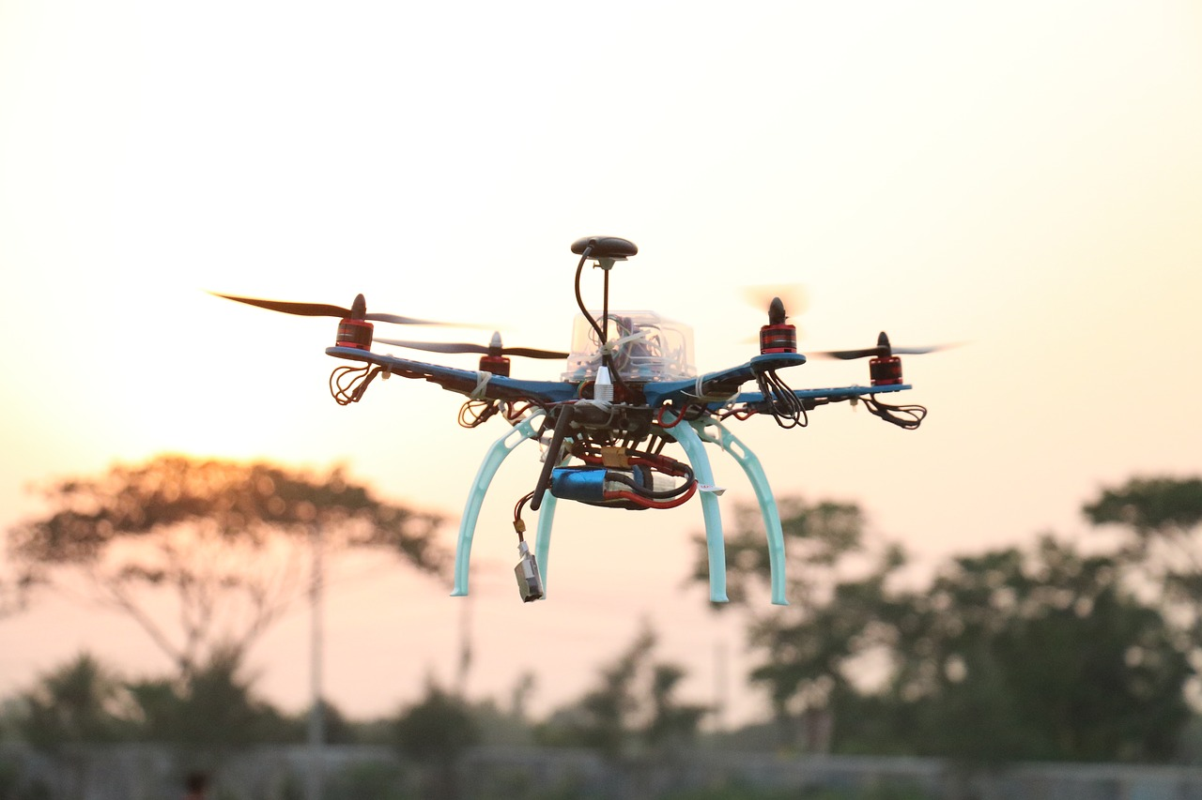
Thank you

