Slide 1

BDA 630: Legal & Ethical Issues Affecting Big Data Section: A20B
Analysis Of Facebook's Privacy Policy
Presented By - Lubna Lnu, Sayuree Vilas Kulkarni & Mayen Udoffia.

Slide 2
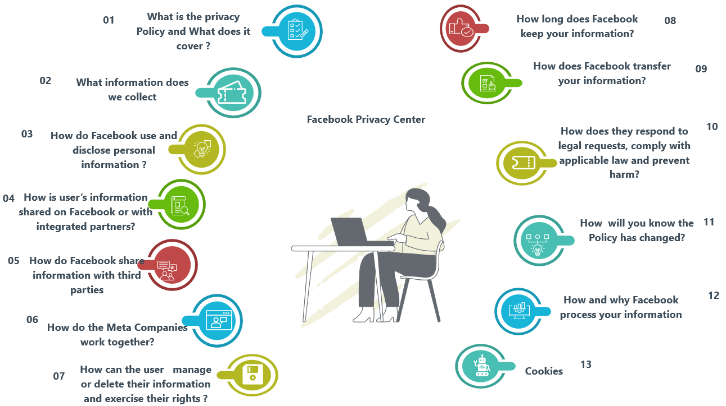
Overview
OVERVIEW

Slide 3
What is Privacy Policy & What Does It Cover ?
The Privacy Policy explains how Meta collects, uses, shares, retains, and transfers data, applies to products like Facebook, Instagram, Messenger, and Meta Quest, and outlines user rights. It emphasizes transparency with examples, simplified language, and resources, helping users manage privacy settings and shape their experiences.
Privacy Policy of Facebook explains:
How they collect, use and share user's information.
How long they keep the information
How securely they transfer it.
"It’s important to us that you know how to control your privacy, so we also show you where you can manage your information in the settings of the Meta Products you use."
Meta emphasizes privacy control but users often find privacy settings difficult to navigate, suggesting the policy could better detail or demonstrate ease-of-use.
"Each section of this Policy includes helpful examples and simpler language to make our practices easier to understand"
While this statement highlights efforts to simplify, the overall length and detail of the policy may still overwhelm users.
"We explain how we collect, use, share, retain, and transfer information."
However, the policy lacks specifics on data-sharing practices. Clearer examples of third-party partners and their roles in the "sharing" and "transfers" sections would enhance transparency.
"We at Meta want you to understand what information we collect, and how we use and share it." However, the policy lacks details on obtaining explicit consent and examples of scenarios involving sensitive data (e.g., health, race). Adding these to the data collection and usage sections would improve clarity.
"This helps you use Meta Products in the way that’s right for you."
By framing data usage in generic, user-centric terms, Meta minimizes privacy concerns and obscures the lack of transparency in its data practices. While they make it sound like they are on our side, their actions are primarily driven by profit motives.
5

Slide 4
What information does Facebook collect?
The information users provide when they sign up for the Products and create a profile, like email address, phone number or age.
What user do on Meta's Products. This includes what user click on or like, their posts, photos and messages they send.
Who are user's friends or followers, and what they do on the Products.
Information from the phone, computer, or tablet users use the Products on, and what version of the app they are using.
Information from partners about things users do both on and off of the Products. This could include other websites they visit, apps they use or online games they play.
5

Slide 5
How do Facebook Use and Disclose Personal Information
The United States Regional Privacy Notice is for people living in the United States and supplements the Meta Privacy policy.
"To provide the products or features offered by Meta , we process information about you, including Personal Information, whether or not you have an account or are logged in". This statement lacks in ensuring to the user that the information will be secured. As it states that the personal information of the user will be processed even if the user don't login the account. It implies that mere interaction with Meta-related platforms or technologies results in data collection. The lack of user control or consent for non-account holders undermines the principles of transparency and informed choice or consent, leaving individuals with limited ability to opt out of such pervasive tracking.
"Subject to the limitations we describe in our privacy policies, we may disclose your Personal Information for business purposes, with strict restrictions on how our partners can use and disclose the data we provide.", "subject" introduces ambiguity, potentially allowing broad interpretations that may not align with user expectations, Without transparency about the nature of the kinds of business purposes or restrictions and how they are upheld, the statement does little to reassure users about the actual protection ,if any ,of their personal information.
"We may also disclose it at your direction or in other ways that are in accordance with applicable U.S. privacy laws. We don’t “share” your Personal Information, as defined in the California Consumer Privacy Act (“CCPA”). We also don’t sell any of your Personal Information, and we never will."
While Meta claims not to "share" or "sell" personal information under the definitions of the California Consumer Privacy Act (CCPA), this language is open to interpretation and may not align with users' broader understanding of data sharing. The phrase "at your direction or in other ways in accordance with U.S. privacy laws" leaves room for significant data handling under legal loopholes or technicalities. This statement also prioritizes legal compliance over clear communication, potentially veiling the extent of third-party data access and raising concerns about transparency and accountability.
4

Slide 6
How is User Information Shared on Facebook and with Integrated Partners?
Integrated partners - Partners that use Meta technologies, like plugins or Facebook login, to connect with users through Meta Products. For example, a game developer using Facebook login is an integrated partner.
"When you share and communicate using our Products, you can sometimes choose the audience for what you share." The use of "sometimes" suggests users lack full control in certain scenarios, but it fails to clarify when or why, undermining trust and highlighting potential privacy gaps.
"People in your audience can view your content and can choose to share it with others outside your audience, on and off our Products." While Facebook allows users to set audience controls, the ability for others to share content beyond the chosen audience undermines these settings, exposing content to broader visibility and weakening privacy protections.
"Some of your information and activity are always public. This includes your: Name, Facebook username, Profile picture, Activity on public groups, Facebook Pages and channels, Avatars etc." This statement limits user control by making certain information, like usernames and group activity, always public, raising privacy concerns and undermining informed consent.
"Sometimes these integrated partners ask you for permission to access certain additional information from your Facebook, Instagram or Messenger account." The statement lacks clarity, as "sometimes" leaves users uncertain about when additional access is requested, and it does not specify what information is accessed or how it will be used, limiting informed decision-making.
4

Slide 7
How do Facebook shar]\e information with third parties?
Who does Facebook shares data with ?
Advertisers, vendors, researchers.
"We provide information to external researchers... When sharing information with external researchers, we ensure the privacy of our users is protected."
This clause focuses on "privacy protection," which is subjective and potentially vague. What mechanisms ensure data privacy, and does anonymization fully prevent re-identification in practice?
“We put this information into aggregate reports so that partners can see how well their content, features, products and services are performing and are able to understand things like users’ experience with such content, products and services”
The phrase lacks specificity and leaves critical terms undefined, making it difficult for users to fully understand the nature, extent, and implications of the data shared in these aggregate reports.
"We don’t sell your information, and we never will"
While this statement provides reassurance, it is complicated by exceptions like sharing with advertisers, vendors, or researchers. The conditional phrasing "unless you" suggests that sharing may occur based on user actions or permissions. Additionally, the lack of a clear definition for "sell" leaves room for interpretation, as selling can occur indirectly—while they may not sell data outright, they can monetize it by sharing it for advertising or marketing purposes. The conditional allowance for explicit user consent.
Apps using Facebook Login or Instagram connections can access nonpublic data unless unused for 90 days. However, third parties may retain previously shared data, with no clear provisions for its deletion post-expiry.
"We don't share information with these advertisers...that by itself can be used to contact or identify you, such as your name or email address, unless you."
The term "by itself" implies that shared information cannot identify users independently but leaves open the possibility that, when combined with other data, users could be identified. (Profiling).
Similarly, the phrase "unless you" suggests there are exceptions to data-sharing limitations but fails to clearly define when and how user consent is explicitly sought, leaving room for interpretation and potential overreach in data usage.
4

Slide 8
How do the Meta Companies work together?
"We share information we collect, infrastructure, systems, and technology with the other Meta Companies."
This highlights a collaborative approach to pooling data and resources for operational efficiency. Notably, the use of "share" rather than terms like "transfer" or "merge" implies collaboration without suggesting ownership changes of the data.
However, the statement lacks clarity regarding the specific types of information being shared, whether personal identifiers, behavioral data, or aggregated insights, leaving its scope open to interpretation and potential ambiguity about the extent of data integration.
The policy does not clearly address how long shared data is retained, either within Meta Companies or by third-party partners. This omission is critical because indefinite retention could create long-term risks for user privacy.
Meta's policy lacks transparency on deleting shared data, particularly with third parties. While users can delete personal data from Meta's platforms, control over data shared externally diminishes, leaving its removal subject to third-party policies.
”We might share your name, email address, who you’re friends with, and other account information within the Meta Companies. "Meta also owns the Meta Companies, which include WhatsApp. Sometimes we share information within these Companies.”
These are clear, specific examples, but the term "other account information" is vague and could include anything from phone numbers to behavioral data.
The use of "sometimes" is vague, implying flexibility in whether or how often data is shared.
Sharing "your name, email address, who you are friends with, and other account information" is very specific and may raise privacy concerns if not limited by strict safeguards. The policy does not explicitly address user consent in such cases.
"The language used in the policy tends to focus on positive outcomes for users, such as: "This helps us keep your accounts safe, "To promote safety, security, and integrity.", "To support innovation."
While these statements sound reassuring, they often obscure the broader implications of data collection and sharing. This selective framing shifts focus away from potential privacy concerns and creates a narrative that justifies invasive practices under the guise of user benefits and innovation.
3

Slide 9
How Can The User Manage or Delete Their Info And Exercise Their Rights ?
"You have rights to view and download the information we have about you." "You can use the settings in this section to manage your privacy." "You also can delete your account or specific account information, if you want to."
The phrase "if you want to" creates a sense of user agency, but it does not provide guarantees about the thoroughness of the deletion process or timelines for data removal.
"We may use your location along with other information from your profile, or activities on and off Facebook, to show you more relevant ads."
The use of "may" introduces flexibility. It does not guarantee that Facebook will use this information in every instance, but it reserves the right to do so. "off-Facebook activities" are open-ended, leaving users unclear about the extent of data collection. By focusing on ad relevance, the statement attempts to position extensive data collection as a user benefit.
While Facebook provides settings to manage location data usage, reports suggest that estimated locations may still be derived from IP addresses, raising concerns about the effectiveness of user controls.
"We may use your location to show you more relevant ads."
The term "relevant ads" positions data collection as beneficial to users, downplaying potential privacy concerns.
Does Data Actually Get Deleted? The policy does not clarify whether data deletion is complete or if backups and shared data remain accessible to Meta or third parties.
"People can see locations you've shared depending on the privacy permissions of your account and posts." "When you share your location on our products, only the people you choose to share it with can see it."
This assures users that shared locations are visible only to intended audiences based on their privacy settings. However, it does not address: How easily users can modify permissions retroactively, Whether shared data is stored indefinitely or deleted after a certain period.
There’s no explicit mention of how long data (e.g., location or third-party activity) is stored, nor clear commitments to minimize retention
While users can "control" certain aspects, it’s unclear whether data shared with third parties can be fully deleted or how third-party compliance is enforced
Komando, K. (n.d.). Facebook tracks locations despite permission settings. Retrieved from https://www.komando.com/news/social-media/facebook-tracks-locations-despite-permission-settings/
4

Slide 10
How Long Do Facebook Keep User's Information ?
"We keep information for as long as we need it to provide a feature or service."
This language leaves retention undefined and entirely at Meta's discretion. Additionally, the statement, "We keep information as long as we need it to provide our Products, comply with legal obligations or protect our or other’s interests," introduces broad categories that justify data retention, without committing to specific timeframes. These open-ended justifications mean users cannot know exactly how long their data will be stored.
Meta’s policy mentions, "We decide how long we need information on a case-by-case basis," and highlights considerations like the necessity to operate products or provide features. For instance, the policy explains, "messages sent using Messenger’s vanish mode are retained for less time than regular messages." Meta's "case-by-case" data retention lacks transparency, leaving users uncertain about timelines. While vanish mode suggests shorter retention, it's unclear duration and discontinuation on Messenger highlight inconsistencies that fail to meet user privacy expectations.
Meta asserts, "We’ll delete that information unless we have to keep it for something else, like for legal reasons." This indicates that while users can request deletion of their data, Meta reserves the right to retain it for purposes such as compliance with laws, governmental investigations, or other obligations. The flexibility in "unless we have to keep it for something else" weakens the assurance of deletion, as the policy does not clearly define or limit these exceptions.
"Your information, including financial transaction data related to purchases or money transfers made on our Products, may be preserved and accessed for a longer time period if it’s related to any of the following: a legal request or obligation, preventing harm, or protecting ourselves."
Meta states that financial data, like transaction information, "may" be retained longer for reasons such as legal requests or harm prevention. This raises concerns about indefinite retention of sensitive data under broad justifications.
No commitment to clear timelines or providing users with insight into how long their information will be kept.
User data deletion requests may be overridden by Meta’s policies or obligations, undermining transparency and user control.
Meta’s policy may not align with stricter regional regulations, such as GDPR, which require stricter data minimization and retention limitations.

Slide 11
How Long Do Facebook Keep User's Information ?
The policy notes, "In some cases, we may preserve your information based on the above reasons even after you request deletion of your account or some of your content." Furthermore, it states, "We may preserve information from accounts that have been disabled and content that has been removed for violations of our terms and policies." This highlights that deletion requests may not lead to a complete removal of data, particularly if Meta determines that the data is needed for legal, investigatory, or policy-related reasons.
Meta clarifies that certain data, including financial transaction information, may be preserved longer. It states, "Your information, including financial transaction data related to purchases or money transfers made on our Products, may be preserved and accessed for a longer time period if it’s related to any of the following: a legal request or obligation, preventing harm, or protecting ourselves." This creates potential risks for users, as sensitive data like financial information could be retained indefinitely under broad justifications.
No commitment to clear timelines or providing users with insight into how long their information will be kept.
user requests for data deletion are not absolute and may be overridden by Meta’s internal policies or external obligations.
4

Slide 12
How Does Facebook Transfer Information?
"We share the information we collect globally, both internally across our offices and data centers, and externally with our partners, measurement vendors, service providers and other third parties. Because Meta is global, with users, partners and employees around the world, transfers are necessary for a variety of reasons"
Personal information about users is obtained from third parties, raising concerns about transparency and consent.
Third parties are authorized to access a user's information, which may not be protected by Meta's safeguards. The company may combine user data with additional data from third-party sources, increasing risks of profiling.
It is unclear whether data shared with third parties can be combined with other data, raising concerns about invasive profiling practices.
"Places we have infrastructure or data centers, including the United States, Ireland, Denmark and Sweden, other countries where our partners, vendors, service providers and other third parties are located outside of the country where you live, for purposes as described in this Policy"
The reference to "partners, vendors, and other third parties" without specifying their locations can create uncertainty about where data is stored or processed, raising concerns about privacy in jurisdictions with weak data protection laws.
The phrase "for purposes as described in this Policy" might be interpreted as overly broad, allowing for unexpected or unclear uses of personal data
Facebook says it tells users about government data requests, but legal restrictions often prevent full disclosure, leaving users unaware.
The extra security measures, like encryption, aren’t explained in detail, making it unclear how well they protect against new risks
Facebook reviews government requests internally, but sometimes, independent oversight is needed to ensure fairness
Facebook says it tells users about government data requests, but legal restrictions often prevent full disclosure, leaving users unaware
Meta outlines GDPR compliance and safeguards like SCCs, but legal challenges, such as Schrems II, question the consistency and adequacy of these measures in practice.
3

Slide 13
Standard Contractual Clauses
Section I: General Provisions This section ensures compliance with GDPR (Regulation (EU) 2016/679) for transferring personal data to third countries, defining the roles of "data exporter" and "data importer" with specifics outlined in Annex I and additional appendices. The clauses guarantee safeguards for data subjects' rights and remedies, which cannot be altered without affecting their essence. Data subjects are granted enforceable rights under these clauses, barring specified exclusions. If conflicts arise, SCCs take precedence over other agreements, ensuring alignment with GDPR definitions and prohibiting contradictory provisions.
Section II: Obligations of the Parties Data importers must process personal data solely per the exporter’s instructions, ensuring data accuracy, security, and proper handling. Security measures, including encryption and pseudonymization, must be implemented, with regular checks and confidentiality obligations for personnel. Onward transfers require compliance with GDPR principles, and importers must assist exporters in handling data subject requests. Sub-processors engaged by importers must adhere to equivalent data protection standards.
Section III: Local Laws and Public Authorities Both parties must ensure that third-country laws do not obstruct SCC obligations, with assessments and documentation to validate compliance. Importers are required to notify exporters of any public authority requests for access to transferred data, challenge unlawful requests, and document their actions, reinforcing accountability and legal adherence.
Section IV: Final Provisions Exporters can suspend or terminate data transfers if importers fail to comply with the SCCs, with the obligation to return or delete data unless local laws prevent it. The clauses are governed by the laws of an EU member state, such as Ireland, with disputes resolved in EU courts to ensure consistency with GDPR enforcement.
6

Slide 14
How do they respond to legal requests, comply with applicable law and prevent harm?
Handling Legal Requests:
Law Enforcement Guidelines: Facebook evaluates requests from governments and law enforcement to ensure they align with international human rights standards, such as due process, privacy, free expression, and the rule of law.
The company safeguards user data from overbroad or arbitrary requests and supports transparency through regular reporting on government data requests.
Compliance with Applicable Laws:
Facebook strives to respect domestic laws in jurisdictions where it operates but prioritizes international human rights principles when conflicts arise. The company collaborates with governments and other stakeholders to promote human rights standards globally.
Preventing Harm:
Community Standards and Privacy Principles: Meta enforces rules on acceptable content and integrates privacy safeguards in its products. This includes conducting privacy reviews and mitigating data risks.
Transparency Reporting: Facebook publishes detailed reports about its enforcement of community standards, responses to legal requests, and steps to protect intellectual property.
Responsible Innovation: The company proactively addresses potential harms in the development of new technologies by involving ethicists, social scientists, and rights experts to ensure fairness and inclusivity.
Protection of Human Rights Defenders:
Facebook implements measures to support high-risk groups such as journalists and activists, defending them against digital security risks, surveillance, and censorship. Encryption, like end-to-end security in WhatsApp, plays a critical role here.

Slide 15
Access and Preserve Information
"If you unlawfully collect and use Facebook user data, we may share your information to defend ourselves against claims or in litigation"
Using may instead of will weakens the potential deterrent effect on those considering unlawful data collection.
By not committing to a clear course of action, the policy may lead to questions about Facebook’s responsibility to safeguard user data, especially given its history of data privacy controversies.
The word may suggest that Facebook retains discretion about whether to act in such cases.
It say that by not making action obligatory (will share instead of may share), Meta appears hesitant to take decisive measures to protect users, potentially putting others at risk.
The policy doesn't specify under what circumstances information will be shared or what thresholds must be met for action to be taken.
The policy doesn’t specify how long data may be preserved, leading to fears of indefinite retention.
Terms like "prevent harm," "safety, security and integrity purposes," and "protect ourselves" are vague and open to interpretation.
Users are not offered a way to manage or opt out of extended data retention.
The policy does not explain how Meta determines whether a situation qualifies for extended retention
"If you post threatening or harmful content, we may share your information across the Meta Companies to protect ourselves and others. This can include blocking your access to certain features or disabling your account across the Meta Companies"
Your information, including financial transaction data related to purchases or money transfers made on our Products, may be preserved and accessed for a longer time period if it’s related to any of the following:
A legal request or obligation, including obligations of Meta Companies or to comply with applicable law
A governmental investigation
An investigation of possible violations of our terms or policies
To prevent harm
For safety, security and integrity purposes
To protect ourselves, including our rights, property or products
If it’s needed in relation to a legal claim, complaint, litigation or regulatory proceedings

Slide 16
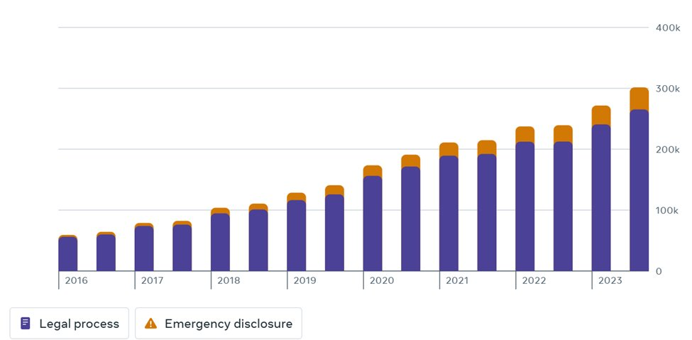
Response to Legal Process / Emergency Disclosure
Legal Process : These represent formal data requests from governments or law enforcement agencies made through official channels, such as subpoenas, court orders, or warrants.
Emergency Disclosure: These refer to urgent data requests made in situations involving immediate danger, such as threats to life or physical safety, where there isn’t enough time for standard legal processes.
The increasing number of legal process and emergency disclosure requests raises significant privacy concerns, as it highlights growing government reliance on Facebook for sensitive user data. Critics argue that this trend reflects potential overreach, lack of transparency, and insufficient safeguards against misuse, particularly for emergency disclosures that bypass standard legal processes. Without clearer oversight and stronger user protections, Facebook risks eroding user trust while appearing to prioritize compliance over privacy.

Slide 17
Response to Legal Process / Emergency Disclosure
Data Privacy and User Rights : Facebook has faced significant challenges in complying with strict data privacy regulations like GDPR, which mandates transparency, user consent, and data protection. Non-compliance has led to hefty fines, such as the €265 million penalty in 2022 for data breaches.
CCPA (California Consumer Privacy Act):
Similar laws in the U.S., like the CCPA, require Facebook to allow users to access, delete, or opt out of their data collection practices.
Ongoing investigations in multiple jurisdictions are testing Facebook’s handling of user data and targeted advertising practices.
Misinformation and Election Interference: Facebook has been accused of enabling the spread of fake news and misinformation during major elections, such as the 2016 U.S. presidential election and Brexit.
Governments, including the U.S. Congress, have held hearings and issued subpoenas to Facebook, demanding explanations for its role in political interference campaigns, often linked to foreign entities like Russia.
Countries like Germany and France have introduced laws that impose penalties on platforms for failing to curb misinformation and hate speech.
Regulatory Pressure Over Child Safety: The U.K.’s Online Safety Bill and similar global initiatives demand platforms take stricter measures to prevent child exploitation and cyberbullying.
Facebook’s plans for products targeting younger audiences (e.g., Instagram Kids) faced global backlash, leading to its suspension.
How will user know the Policy has changed?
"Users are notified prior to any material changes to the policies“
Changes to the policies are effective immediately and continued use of the product indicates consent.
Federal Trade Commission. (2019, July 24). FTC imposes $5 billion penalty and sweeping new privacy restrictions on Facebook. Federal Trade Commission. Retrieved from https://www.ftc.gov/news-events/news/press-releases/2019/07/ftc-imposes-5-billion-penalty-sweeping-new-privacy-restrictions-facebook
Jefferson University. (n.d.). What does the FTC’s antitrust case vs. Facebook mean for social media users? The Nexus. Retrieved from https://nexus.jefferson.edu/business/what-does-the-ftcs-antitrust-case-vs-facebook-mean-for-social-media-users/

Slide 18
How & Why Does Facebook Process Information
"For Your Benefit" ,"provide you personalized experiences"
Meta claims data processing benefits users but often masks its true aim: creating detailed profiles for targeted ads.
The policy frames data processing as user-focused but prioritizes advertising, profiling, and monetization, masking commercial goals in user-centric language.
​Frequent use of "may" gives Meta broad discretion, leaving data processing practices unclear.
​Meta's claim of processing data "to personalize user experiences" is overly generic, failing to explain how specific data (e.g., mouse movements, hashtags) aids personalization. This vagueness often masks the true intent of maximizing ad revenue.
The policy weakens user rights with qualifiers like "subject to applicable law," limiting data access and deletion. Retention terms are vague, allowing indefinite storage under broad justifications, even after account deletion.
The policy permits global data sharing but lacks clarity on compliance with stricter laws like GDPR in less-regulated regions and omits external audits or accountability for international handling.
The policy justifies collecting granular data like mouse movements for "bot detection," raising overreach concerns. Cross-platform sharing, framed as enhancing a "seamless experience," broadens data use beyond user expectations.
​The policy lacks detail on methods, offering no clarity on how AI assesses preferences or safeguards against errors. It also vaguely claim data anonymization without specifying techniques or ensuring irreversibility, raising re-identification concerns.
Reference: Meta. (2023, May 22). Our response to the decision on Facebook’s EU-U.S. data transfers. Retrieved from https://about.fb.com/news/2023/05/our-response-to-the-decision-on-facebooks-eu-us-data-transfers/

Slide 19
Cookies Policy
Why do Facebook use cookies?
Cookies are small pieces of text used to store information on web browsers
"The cookies that we use include session cookies, which are deleted when you close your browser, and persistent cookies, which stay in your browser until they expire, or you delete them." Meta’s policy specifies cookie types but uses technical terms that are unclear to users. It lacks detail on purposes and control, with persistent cookies raising tracking and trust concerns.
How do Facebook use cookies?
Authentication - "We use these cookies to authenticate you and keep you logged in as you navigate between Facebook Pages." Keeping the users logged in while navigating the pages, results in giving access of profile information to owners of those pages. Thus, authentication may also invade privacy, though it is used for security and convenience.
Analytics and research - "We use cookies to better understand how people use the Meta Products so that we can improve them." The statement simplifies cookie use, omitting their role in tracking for ads and monetization, lacking transparency on data collection and privacy impacts, which undermines trust.
Third party websites and apps - "Our business partners may also choose to share information with Meta from cookies set in their own websites' domains. Specifically, cookies named _fbc or _fbp may be set on the domain of the business partner whose site you're visiting." Meta's use of third-party cookies like _fbc and _fbp extends tracking beyond its platforms, lacking clarity on data usage and control, undermining transparency and user autonomy.
Site feature and Services - "Cookies help us store preferences, know when you’ve seen or interacted with Meta Products’ content and provide you with customized content and experiences." While cookies are framed as enhancing convenience, some users may prioritize privacy and feel uncomfortable with Facebook storing their interaction data, raising concerns about transparency and trust.

Slide 20
Where Are cookies Used
Cookies as a core mechanism for data collection
Passive Tracking
Meta's policy allows cookies to track activity on third-party sites regardless of login status or account ownership, effectively bypassing explicit user consent and raising privacy concerns.
Meta claims cookies improve user experience by personalizing content and ads, analyzing behavior for optimization, enhancing security, and building profiles for targeted advertising, but these purposes largely serve Meta’s business interests.
'Third Party Platforms'
Meta's cookies on third-party platforms, including "like" buttons, Facebook pixel, and embedded ads, track even non-users without their consent. This broad surveillance raises ethical concerns about transparency and privacy.
Meta offers limited control over cookies, with deletion via browsers failing to remove already collected data. Vague terms like "retains data as necessary" suggest full data deletion is unlikely, raising privacy concerns.
Meta’s policy, “We may place cookies on your computer or device and receive information stored in cookies when you use or visit,” grants broad control over user data without explicit consent, raising concerns about transparency and user privacy.
Meta’s cookies on Facebook, Instagram, and WhatsApp extensively track user activities, prioritizing ad-driven profits over transparency and user privacy.
"Data Collection Through Cookies"
Cookies allow Meta to collect various forms of data:
Behavioral Data: ( clicks, searches, purchases).
Device Information: Includes IP address, operating system, browser type,
Identifiers: cookie identifiers that allow Meta to associate activity across devices and platforms.
Facebook’s cookie policy minimizes user apprehension while enabling extensive data tracking and monetization. User control is limited, as deleting cookies or "opting out" doesn’t erase stored data, underscoring the need for stronger regulations and transparency. Meta deflects responsibility by advising users to review third-party policies, shifting the burden and exposing users to inconsistent privacy practices.

Slide 21
The Hidden Cost of "Free Services"
If there is no product, you are the product"
"Is anything really free" ? Your Data is the Real Currency
The hidden cost of "free services" is clear in Meta's data practices, which track even non-users through tools like the Facebook Pixel. Despite offering ad management tools, Meta often ignores user preferences, prioritizing ad revenue over privacy and informed consent.
Facebook provides limited tools for parental oversight, which could enhance protection for underage users while balancing their autonomy. Despite protective policies, concerns persist about Facebook's potential to monetize minors’ data, as highlighted by FTC scrutiny. This raises ethical questions about prioritizing profit over protecting vulnerable users.
There is no conclusive evidence that Facebook actively listens to conversations through device microphones for targeted advertising. While many users suspect this due to the uncanny relevance of ads, Facebook has repeatedly denied these claims, and investigations have not proven such practices. However, Facebook does collect extensive user data through other means, such as online behavior, location tracking, and browsing history, which may create the perception of "listening."
Facebook’s lack of transparency and proactive measures in its policy leaves significant gaps in ensuring that its algorithms do not inadvertently contribute to biases or discrimination. Addressing these issues requires clear accountability mechanisms, transparency in algorithmic processes, and robust safeguards against biased outcomes.
Is data really deleted? Does the internet really forget? critical questions about the permanence of online data are raised. While Facebook and other platforms claim to delete user data upon request, retention policies often allow for extended storage due to legal obligations, backups, or operational needs. Additionally, once data is shared or accessed by third parties, its deletion is beyond the platform's control. These realities highlight that the internet rarely truly "forgets," challenging user trust and the effectiveness of privacy safeguards.
While Facebook has made public commitments to improving privacy, past actions, such as data-sharing partnerships with companies like Amazon, Apple, and Netflix, reveal gaps in prioritizing user consent and safeguarding data.
Reference
Privacy International. (2020, November 5). Facebook's response to advertising failure: Failure to acknowledge responsibility. Retrieved from https://privacyinternational.org/news-analysis/4171/facebook-response-advertising-failure-acknowledge-responsibility
New York Post. (2024, September 3). Marketing firm admits using your phone to listen in on your conversations. Retrieved from https://nypost.com/2024/09/03/business/marketing-firm-spies-on-you-through-your-phones-microphone-report/

Slide 22
What can Users do to Safeguard Their Privacy ?
Avoid using Facebook Login for third-party apps or websites to limit cross-platform data sharing.
Regularly update privacy settings to control who can view posts and access personal information.
Opt-out of targeted ads through Facebook’s ad preferences to restrict data use for advertising.
Disable location services for the Facebook app to minimize location tracking.
Clear browser cookies and adjust cookie preferences to limit tracking by cookies.
Avoid sharing sensitive information, such as phone numbers or financial details, on your profile.
Use end-to-end encrypted chats in Messenger for more secure communication.
Audit and remove unnecessary permissions from third-party apps linked to your Facebook account.
Enable two-factor authentication (2FA) and use strong, unique passwords to secure your account.
Monitor and manage data shared with third parties using tools like "Off-Facebook Activity."

Slide 23


