Slide 1

Analyzing Credit card churning for enhanced risk management
Presenters: Sayuree Vilas Kulkarni, Mayen Udoffia, Devika Bandela & Santosh Sai Kadudula

Slide 2
Introduction.
In In the dynamic landscape of the financial industry, the phenomenon of credit card churning has emerged as a multifaceted challenge for risk management professionals and financial institutions. Credit card churning, characterized by the repeated opening and closing of credit card accounts to exploit introductory offers and rewards, poses intricate risks that demand a nuanced and comprehensive approach. As financial institutions strive to navigate through this complex terrain, understanding the patterns, behaviors, and potential consequences associated with credit card churning becomes imperative for effective risk mitigation. This analysis aims to delve into the intricacies of credit card churning, offering insights into the identification of churners, assessing associated credit risks, and proposing strategies for enhanced risk management.

Slide 3

Business Problem
What are the patterns of Credit card churning?
For Financial Institutions, Regulatory Bodies and Business Managers to mitigate risks and refine customer acquisition.
Offering insights into the identification of churners, assessing associated credit risks, and proposing strategies for enhanced risk management.

Slide 4
Data cleaning
Acquired a 2021 bank dataset from Kaggle, encompassing information on 10,000 customers with 20 variables, including Age, Salary, Marital status, Credit card limit, and Credit card category.
Encoded categorical variables using dummy or indicator variables to prepare the data for analysis..
Identified and removed outliers in the dataset to enhance the robustness of the analysis..
Conducted correlation matrix exploration and regression modeling, to discern relationships among variables, ultimately selecting pertinent variables based on statistical significance and practical relevance.
Created a new CSV file to store the cleaned and finalized dataset

Slide 5
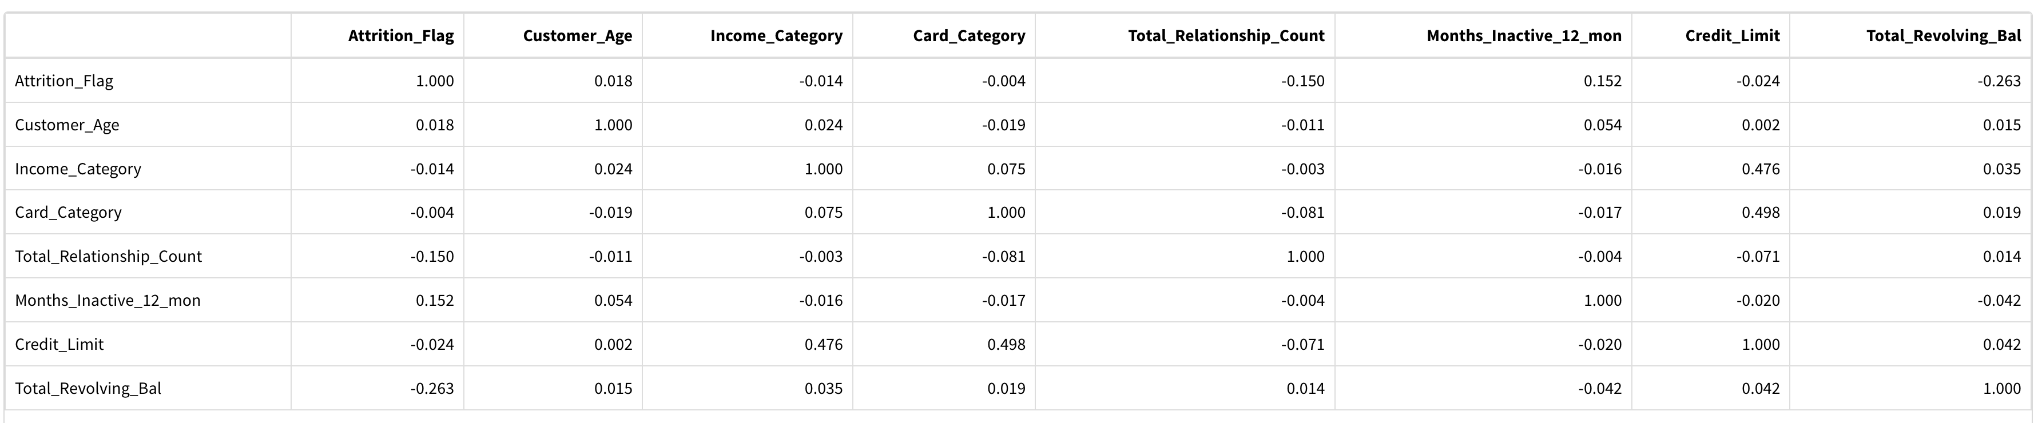
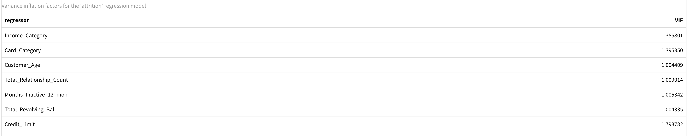
Correlation Matrix
VIF

Slide 6
Why these variables?
Income Category: Monitoring income trends helps a credit card company stay competitive in the market by adjusting interest rates, rewards, and fees to attract and retain customers with varying income levels.
CARD CATEGORY: Investigated "card category" to determine if specific card types exhibited a higher likelihood of customer attrition.
CUSTOMER AGE: We prioritize Customer Age as it unveils distinct spending patterns tied to different age groups.
TOTAL RELATIONSHIP COUNT: With intuition, we know that Total relationship count significantly influences attrition. More connections usually mean lower attrition. Conversely, fewer relationships may indicate higher attrition.
NUMBER OF MONTHS INACTIVE: customer activity, especially in the context of card usage, is crucial for identifying potential issues and preventing customer attrition.
TOTAL REVOLVING BALANCE: More connections usually mean lower attrition, while fewer relationships may indicate higher attrition risk.
CREDIT LIMIT: More connections usually mean lower attrition, while fewer relationships may indicate higher attrition risk due to diminished commitment.
.

Slide 7
Logistic regression
Attrition Flag = Qualitative Response
churn = 1
existing = 0
Logistic Regression helps in modelling the probability of y variable to a particular category rather than modeling y variable directly.
In our case, the logistic regression will model the probability of attrition flag variable with the change in the given independent variables.
probability of response variable stay between 0 and 1 and helps in deriving more accurate analytical results.

Slide 8

Logistic regression
Total number of Rows In Attrition Flag (y) = 10,000
Training (0.80) Testing (0.20)
8102 2025

Slide 9
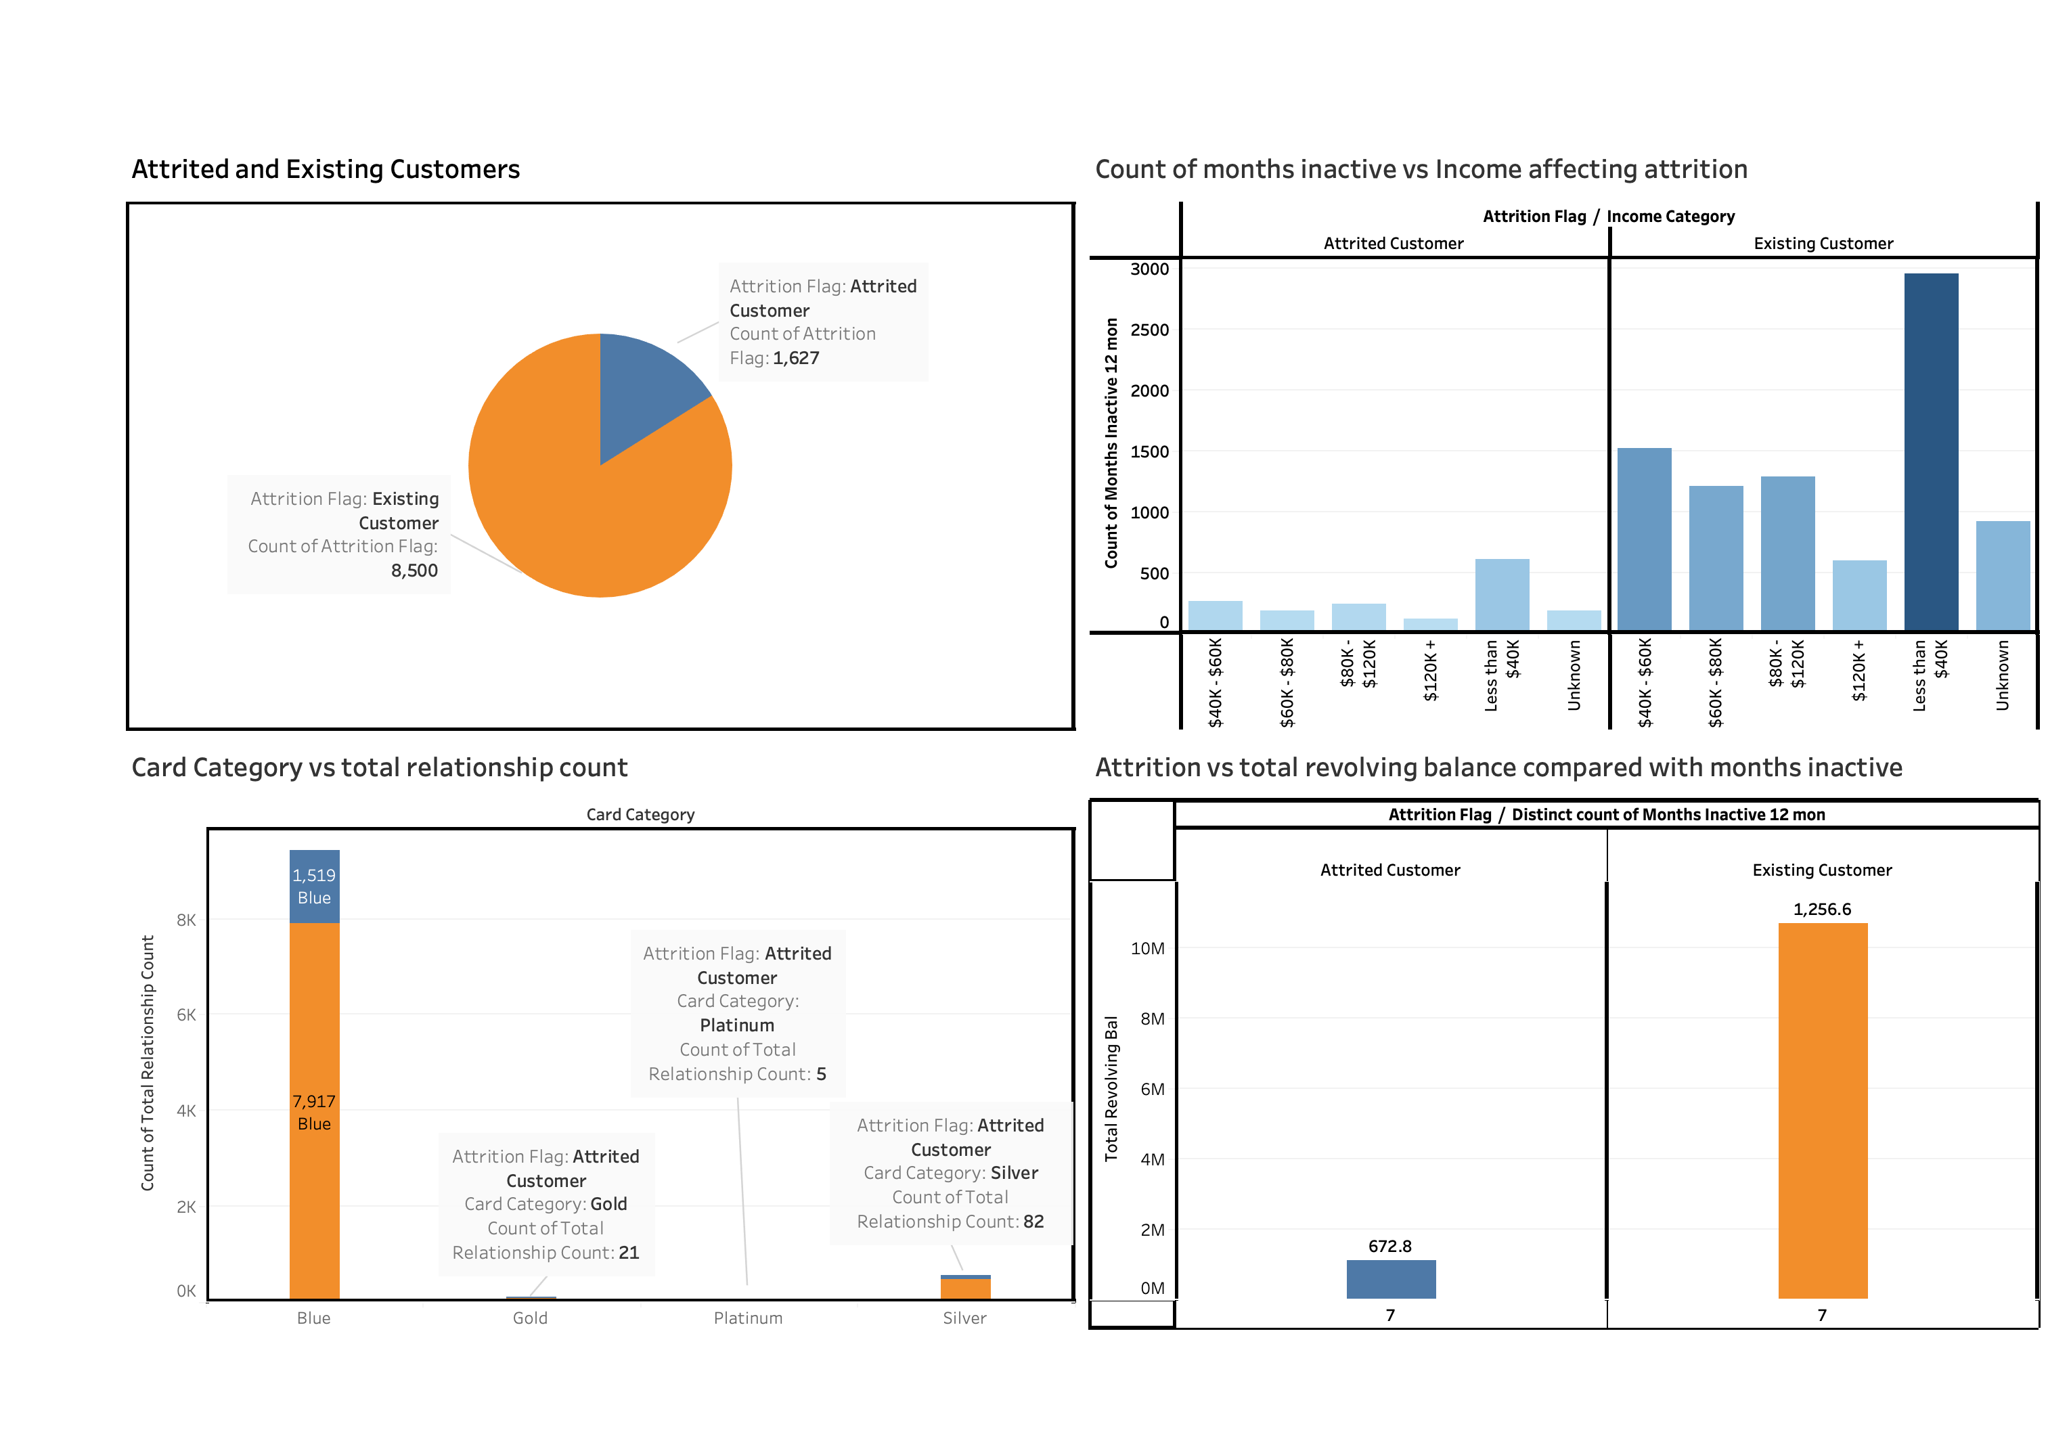
GRAPHICAL REPRESENTATION

Slide 10
CONCLUSIONS AND RECOMMENDATIONs
We suggest that the company offers educational resources to assist customers with lower incomes in effectively navigating the system. for example, introducing a credit management tool or lowcost banking products.
Provide personalized offers and rewards based on card usage patterns. offering exclusive benefits tied to the card category can enhance customer satisfaction and loyalty.
Design loyalty programs that cater to the life stages of customers.
Implement loyalty programs for existing customers, offering exclusive perks and rewards to show appreciation for their loyalty.
Send personalized messages to inquire about the reasons for inactivity. use customer feedback to tailor solutions
Regularly reassess and adjust credit limits based on customer behavior, financial stability, and creditworthiness.
Introduce proactive debt relief programs for customers with high revolving balances like introducing balance transfer credit cards and so on.
Regularly assess the market to ensure your pricing and offers remain competitive.
Implement regular surveys and feedback mechanisms to understand customer sentiments.

Slide 11
Thank you!

