Slide 1
Evaluating Foundation Models Trained with Earth Observation Data
Lillianne Thomas
Wei Ji Leong
Daniel Wiesmann
Soumya Ranjan

Slide 2
Evaluating Foundation Models Trained with Earth Observation Data
Topics Covered
What are Earth Observation Foundation Models?
Hands-on with Prithvi and Clay
Flood detection case study: 2022 Pakistan floods

Slide 3
Learning Objectives
By the end of this chapter, you will be able to:
Explain what foundation models are and how they work
Use pre-trained EOFMs (Prithvi, Clay) to generate embeddings
Analyze embeddings using PCA and t-SNE
Train a classifier on top of foundation model embeddings
Compare different foundation models for the same task

Slide 4
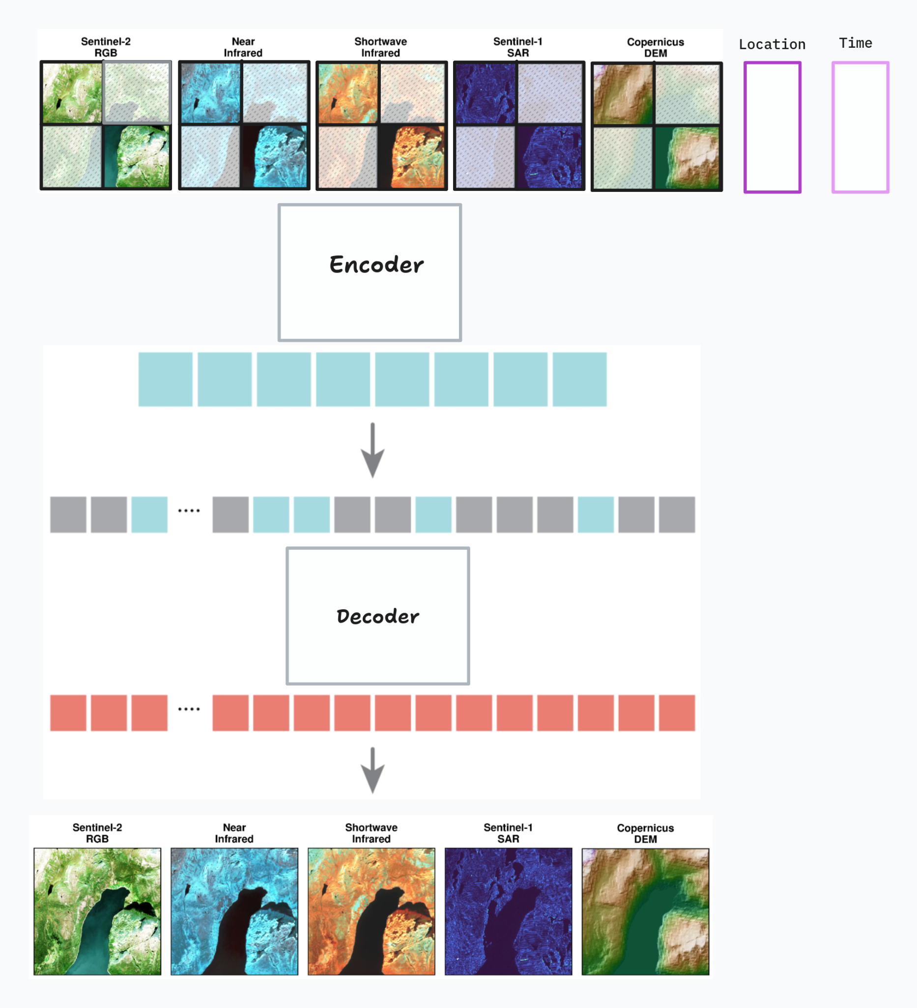
What is a Foundation Model?
Definition: Large-scale ML models pre-trained on vast amounts of remote sensing data to learn general-purpose representations
Key Characteristics:
Pre-trained on diverse satellite imagery (optical, radar) or location attributes (elevation)
Learn without human-annotated labels (self-supervised)
Can be adapted to many downstream tasks
Reduce time and cost of developing specialized applications
Examples: Prithvi, Clay, DOFA, Presto

Slide 5
How Foundation Models Learn
Common Approaches:
Masked Reconstruction — Hide parts of image, predict missing content
Contrastive Learning — Distinguish similar vs. dissimilar pairs
Generative Methods — Learn to synthesize input distributions
Key Insight: No labeled data required for pre-training!
Unlabeled Satellite Imagery
Pretext Task (e.g., masked reconstruction)
Learned Representations

Slide 6
How Foundation Models Learn
How it works:
Divide image into fixed-size patches (e.g., 16×16 pixels)
Treat patches as a sequence of tokens
Apply self-attention to model relationships
Output: embeddings that capture representative features
Note: Vision Transformers (ViTs) are the backbone, not the foundation model itself
Images
Patch Tokens
Transformer Encoder
Output Embeddings

Slide 7
Why Foundation Models Matter
Benefit | Description
Reduced Training Costs | Fine-tune instead of training from scratch
Faster Development | Ready-to-use features and embeddings
Better with Limited Data | Robust even with small labeled datasets
Scalability | One model → many applications
Democratizing Access | Open-source, no expensive infrastructure
Better Backbones | Trained on EO data, not just RGB
90% with 10% Effort | Competitive results, fraction of the work

Slide 8
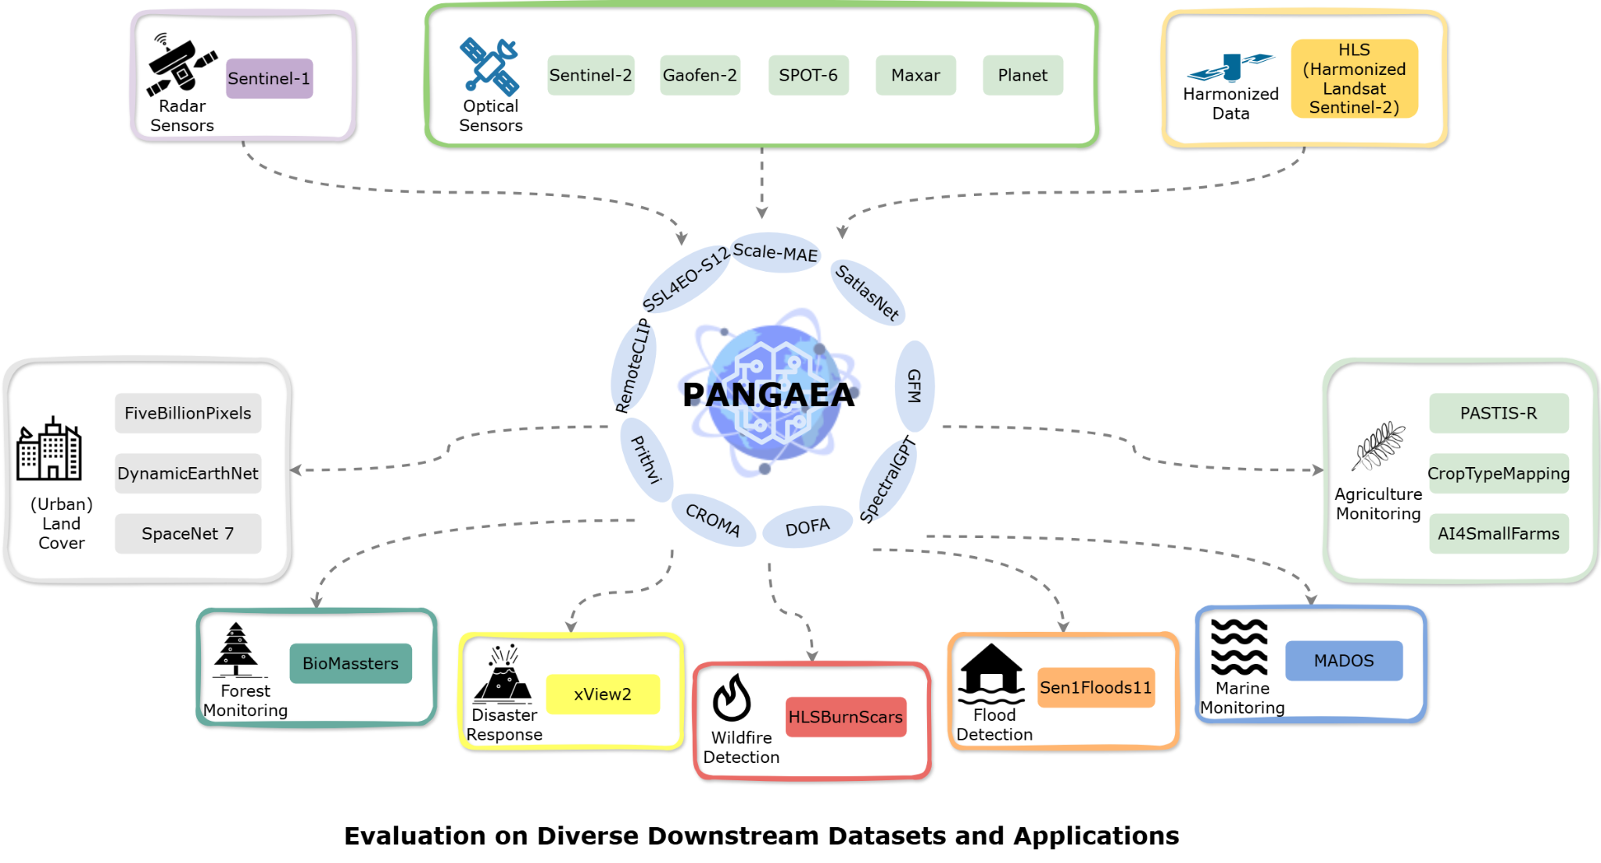
Limitations & Challenges
Current Limitations
Validation Gaps:
Still relatively new in EO domain
Need more validation across diverse applications
Domain-Specific Challenges:
May struggle with under-represented conditions
Rapidly changing environments (urban areas)
Unique spectral signatures (polar regions)
EO-Specific Complexity:
Diverse sensors, resolutions, wavelengths
Temporal dynamics
Metadata variations (CRS, view angles, providers)
Marsocci, V., Jia, Y., Bellier, G. L., Kerekes, D., Zeng, L., Hafner, S., Gerard, S., Brune, E., Yadav, R., Shibli, A., Fang, H., Ban, Y., Vergauwen, M., Audebert, N., & Nascetti, A. (2024). PANGAEA: A Global and Inclusive Benchmark for Geospatial Foundation Models (Version 1). arXiv. https://doi.org/10.48550/ARXIV.2412.04204

Slide 9
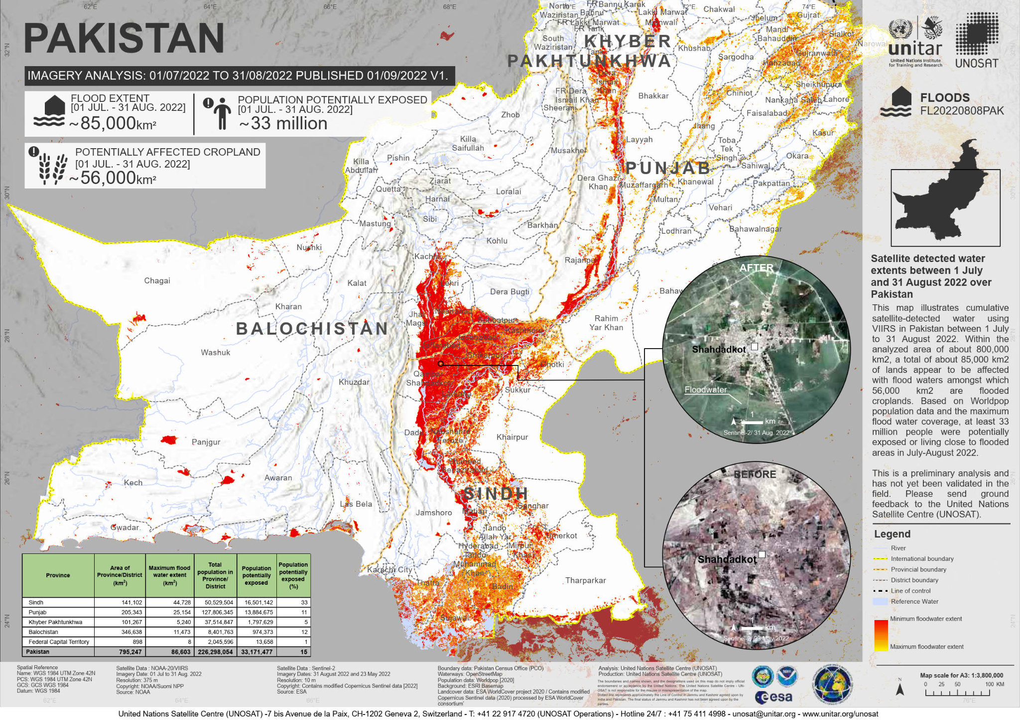
Case Study Introduction
2022 Pakistan Floods
The Disaster:
Unprecedented monsoon rainfall from July-August 2022
~33 million people affected
Vast agricultural lands submerged
$30+ billion in damages
Our Study Area:
Padidan, Sindh Province, Pakistan
One of the most severely impacted regions
Indus River overflow
Our Goal:
Use foundation models to detect and analyze flood conditions from satellite imagery
Satellite-detected water extent from UNOSAT (https://unosat.org/products/3346)

Slide 10
The Two Models
Feature | Prithvi-EO-2.0 | Clay
Developers | NASA + IBM | Clay Foundation
Architecture | ViT + MAE | ViT-based
Training Data | HLS (Harmonised Landsat-Sentinel-2) | Multi-sensor
Input Format | Quadruplets (4 timesteps) | Single Images
Temporal | Built-in temporal modeling | Per-image
Flexibility | HLS-optimized | Variable resolution/sensors

Slide 11
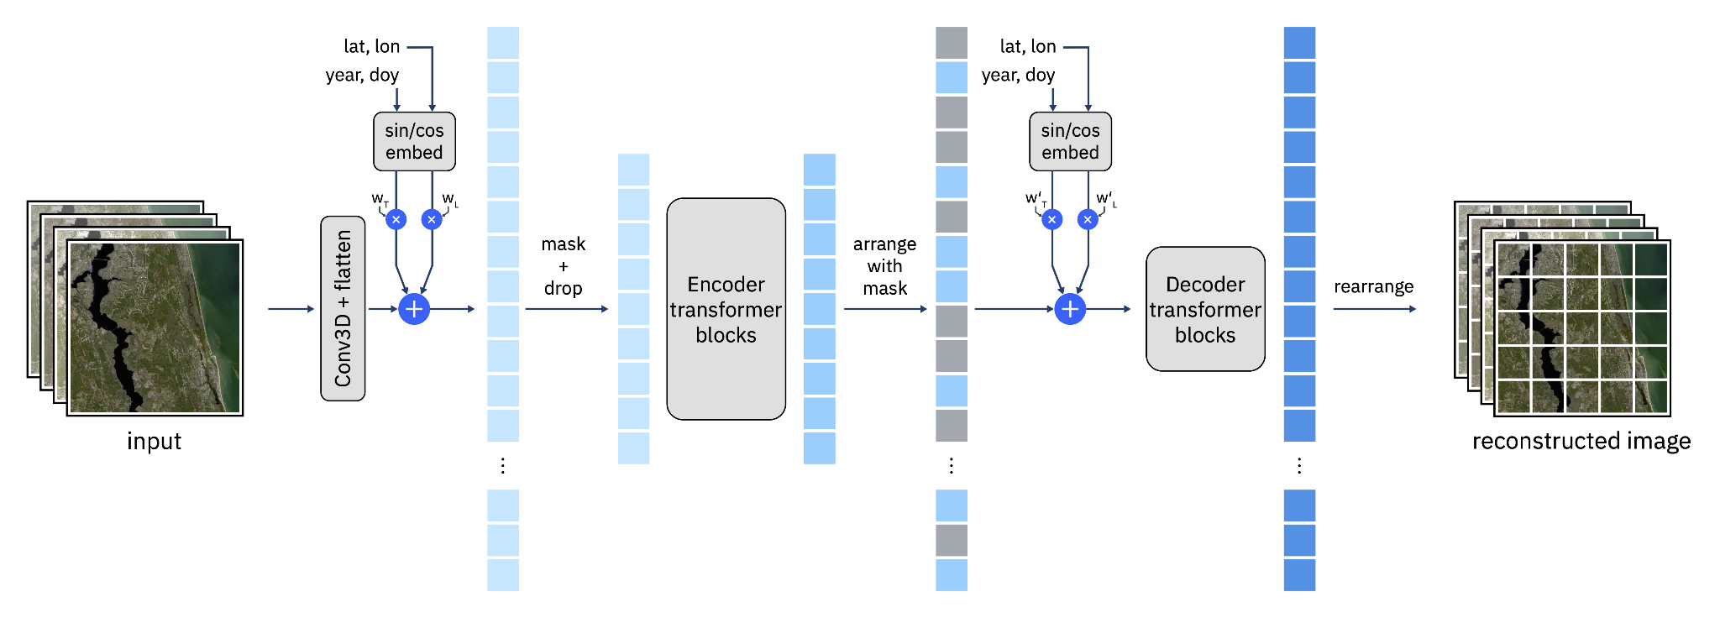
Prithvi Architecture
Input: B, C, T, H, W (Bands, Channels, Time, Height, Width)
Key Features:
Masked Autoencoder (MAE) self-supervised learning
3D patch embeddings for spatiotemporal features
Temporal + spatial embeddings
6 spectral bands: Blue, Green, Red, NIR, SWIR1, SWIR2
Prithvi Architecture (https://huggingface.co/ibm-nasa-geospatial/Prithvi-EO-2.0-300M)
4 Images (T=4)
3D Patch Embedding
Transformer Encoder
CLS Token

Slide 12
Data Pipeline
Define Location & Dates → Padidan, Pakistan | June-October 2022
Query STAC Catalog → NASA CMR → HLS S30 Collection
Download Imagery → 22 images, 6 bands, 256×256 pixels
Format for Model → Create quadruplets (overlapping sequences of 4)
Generate Embeddings → 1024-dimensional vectors per quadruplet

Slide 13
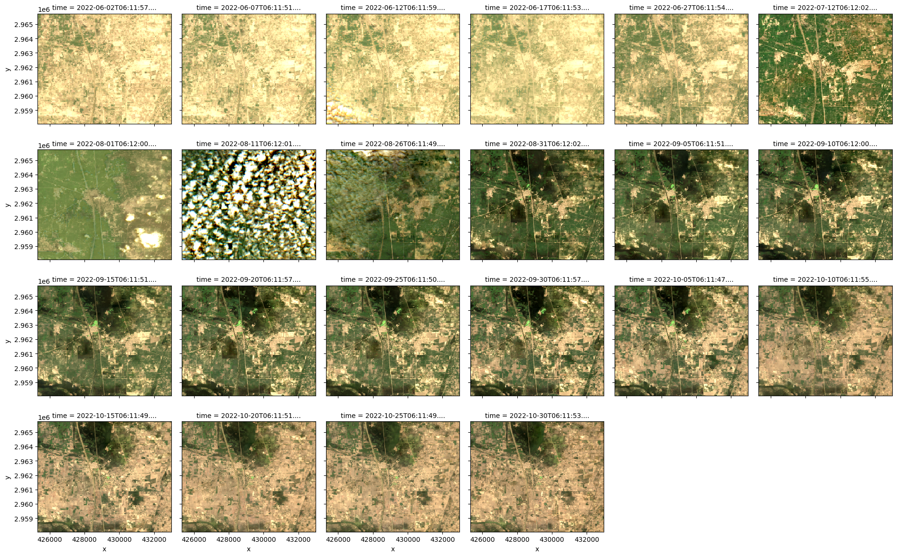
Visualizing the Flood Progression
What we see:
Pre-flood: Agricultural fields, dry land
During flood: Dark pixels (likely water inundation)
Post-flood: Gradual recovery, some standing water
June 2022: Pre-Flood (Normal), 5 images
July-late August 2022: FLOOD, 4 images
Late August - October 2022: Post-Flood (Recovery), 13 images

Slide 14
Dimensionality Reduction with PCA
Why PCA?
Embeddings are 1024-dimensional
PCA extracts directions of maximum variance
Project to 1-2 dimensions for visualization
What we expect:
Similar conditions → cluster together
Different conditions → separate in PCA space

Slide 15
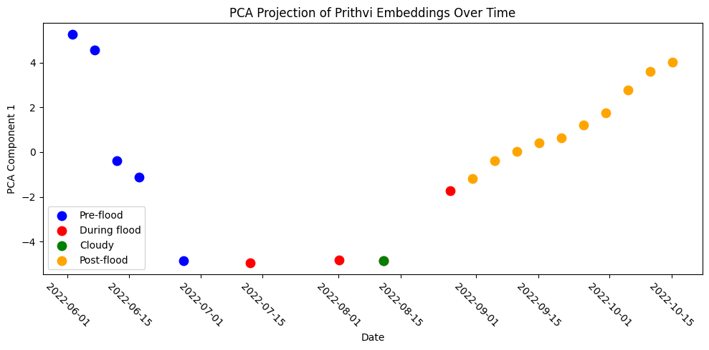
Quadruplet Embeddings
First Approach: CLS Token per Quadruplet
What we do:
Pass each quadruplet through Prithvi
Extract CLS token (summarizes all 4 timesteps)
Get 19 embeddings (one per quadruplet)
Result:
Some separation between flood phases
But... there's a an issue with how are using these embeddings here…it is hard to cluster temporally when a given time step can exist in multiple quadruplets

Slide 16
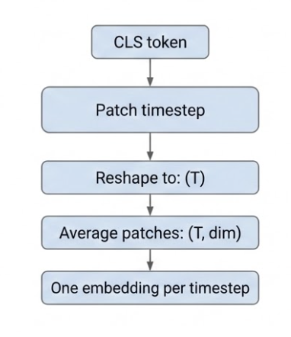
Per-timestep Embeddings
Cleaner Analysis with Individual Timesteps
Prithvi outputs:
CLS token (whole sequence summary)
Patch tokens for each timestep ← We want to use these
Extraction:
Embedding shape: (1, num_tokens, dim) → Reshape to: (T, patches_per_timestep, dim) → Average patches: (T, dim) → One embedding per timestep
Result: 22 embeddings, one per image, no mixing!

Slide 17
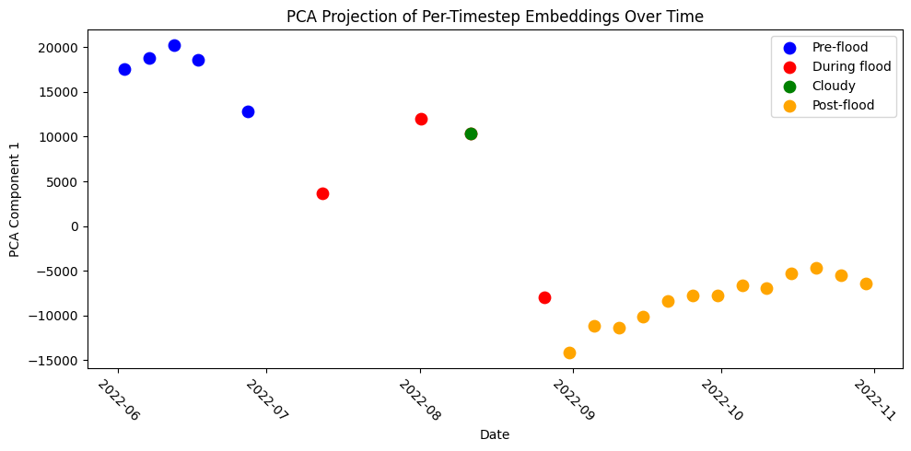
PCA Results (Per-Timestep)
Fairly Clear Separation of Flood Phases
PCA Component 1 vs Time
Key Insight:
The model distinguishes flood phases without any labels!

Slide 18
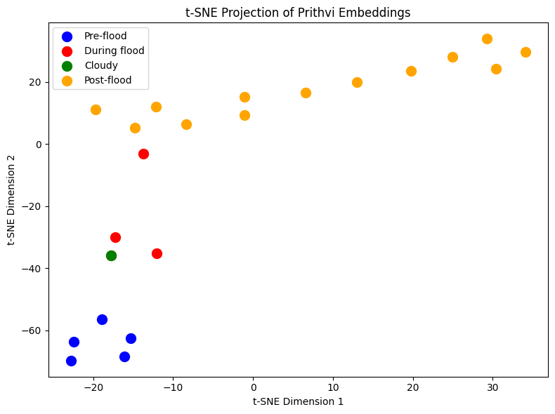
t-SNE Analysis
Preserving Local Structure
t-SNE vs PCA:
PCA: Linear projection, preserves global variance
t-SNE: Non-linear, preserves local neighborhoods
Results:
Confirms PCA findings
Fairly distinct clusters for each flood phase

Slide 19
Training a Classifier
From Embeddings to Predictions
1. Use per-timestep embeddings as features
2. Assign labels: 0=cloudy, 1=pre-flood, 2=flood, 3=post-flood
3. Partition timesteps into training and testing sets
4. Train simple SVM classifier
Result: Strong classification performance with minimal data!

Slide 20
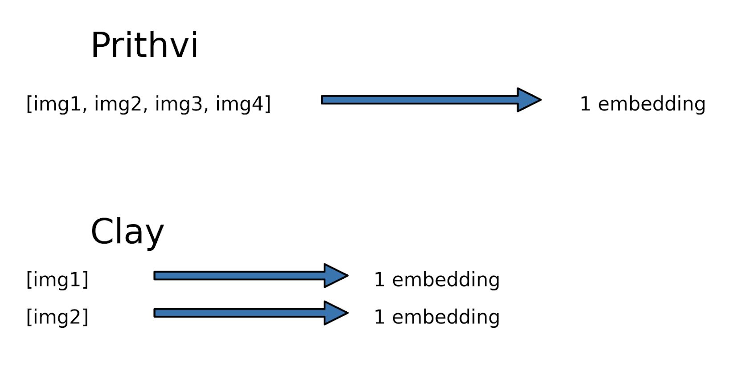
Clay Model
Key Difference:
Clay processes individual images (not quadruplets)
One image in → one embedding out
No temporal mixing
For clay, embeddings are directly per-timestep

Slide 21
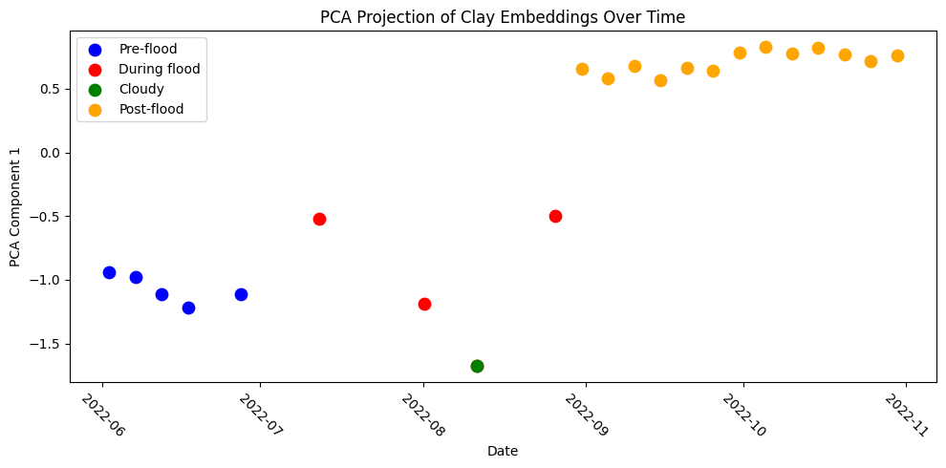
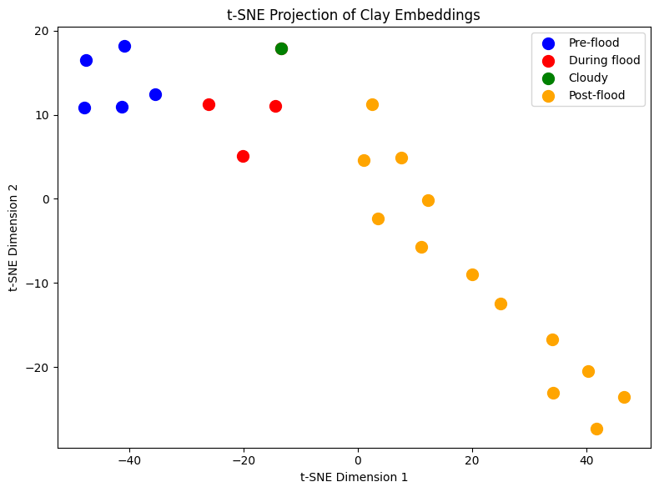
Clay Results
Comparing the Models
PCA on Clay Embeddings:
Also shows clear flood phase separation
Slightly different clustering pattern
Emphasizes different aspects of the data
Key Insight:
Both models capture flood dynamics, but with different learned representations
Practical Implication:
Ensemble multiple models for more robust predictions

Slide 22
Model Comparison Summary
Aspect | Prithvi-EO-2.0 | Clay
Input | Quadruplets | Single images
Temporal Context | 4 timesteps | Per-image
Embedding Extraction | Need to extract per-timestep | Direct
Clustering Quality | Excellent | Excellent
Possibly best for | Temporal analysis | Flexible applications

Slide 23
Key Takeaways
What We Learned
Foundation models learn general representations without labels
Self-supervised learning enables training on vast unlabeled data
Embeddings capture meaningful patterns — flood phases cluster naturally
Different models, different strengths
Simple classifiers on top of embeddings achieve strong results
Practical applications are accessible with just a few lines of code

Slide 24
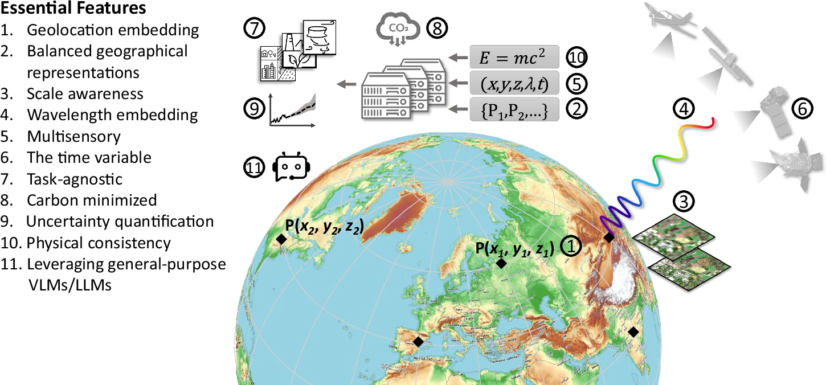
Limitations & Future Work
What to Keep in Mind
Current Limitations:
Models may struggle with under-represented conditions
Need validation across diverse geographies
Computational requirements for inference
Future Directions:
Multi-sensor fusion models
Better temporal modeling
Smaller, more efficient architectures
Domain-specific fine-tuning
Zhu, X. X., Xiong, Z., Wang, Y., Stewart, A. J., Heidler, K., Wang, Y., Yuan, Z., Dujardin, T., Xu, Q., & Shi, Y. (2026). On the foundations of Earth foundation models. Communications Earth & Environment, 7(1), 103. https://doi.org/10.1038/s43247-025-03127-x

Slide 25
Resources
Learn More
Models:
Prithvi: https://github.com/NASA-IMPACT/Prithvi-EO-2.0
Clay: https://clay-foundation.github.io/model
Data:
HLS: https://hls.gsfc.nasa.gov/
Earth Data Login: https://urs.earthdata.nasa.gov/

Slide 26
Try It Yourself
Hands-On Exercise
The notebook includes:
Complete code for both Prithvi and Clay
Data download and preprocessing
Embedding generation and visualization
Classifier training
Experiment with:
Different locations (your own AOI)
Different time periods
Different disaster types (fires, droughts)
Other foundation models

Slide 27
Discussion
Key Questions to Consider:
How would you adapt this workflow for a different disaster type?
What are the trade-offs between Prithvi's temporal modeling and Clay's flexibility?
How might you validate these results with ground truth data?
What other downstream tasks could benefit from these embeddings?

