Slide 1

Skin Cancer Risk Intelligence &
Patient Diagnosis Optimization
Healthcare Data Analytics SQL Capstone
Dermalife Oncology & Research Institute (DORI)
SQL-driven analysis to identify high-risk patients, diagnosis patterns, environmental exposure, lifestyle risk and opportunities for early detection.
Prepared for capstone analysis presentation

Slide 2

PROJECT CONTEXT
DORI’s analytics challenge
The institute needed a structured SQL analysis to investigate rising skin cancer cases, delayed diagnoses, high-risk patient groups and uneven risk patterns across regions.
Health problem: late-stage skin cancer diagnoses, high-risk lesion progression and recurring patient complications, especially among elderly and underserved populations.
Analytical goal
Identify high-risk patients
Reveal diagnosis trends
Evaluate environmental and lifestyle risk
Recommend preventive actions
Healthcare SQL Capstone | DORI
SQL • Healthcare analytics • Skin cancer risk intelligence

Slide 3
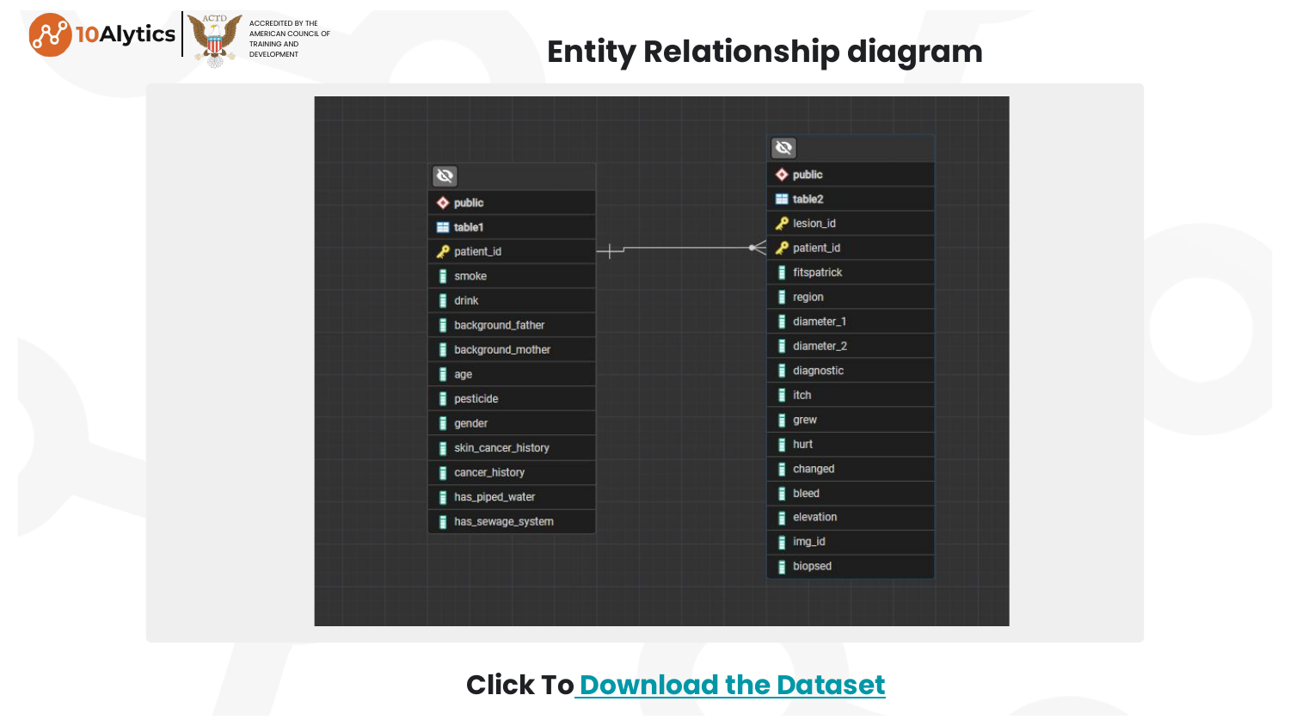
Methodology: SQL workflow and database structure
A repeatable analysis process from database restore to healthcare recommendations
1
Restore DB
Entity Relationship Diagram
PostgreSQL backup imported for SQL analysis
patient_id links patient-level and lesion-level tables
2
Explore data
Patient demographics, lesion fields and diagnosis categories
3
Analyse risk
CASE, JOIN, FILTER, aggregation and ranked queries
4
Interpret results
Translate query outputs into clinical insights
5
Recommend action
Screening, triage and preventive strategies
Healthcare SQL Capstone | DORI
SQL • Healthcare analytics • Skin cancer risk intelligence

Slide 4
Dataset at a glance
1,088 patient records joined to 1,088 lesion records
1,088
1,088
14
6
Patient records
Lesion records
Body regions
Diagnosis categories
Diagnosis category frequency
Diagnosis grouping used in this analysis
Malignant / severe
MEL • SCC • BCC
Precancerous
ACK
Benign
NEV • SEK
All findings are descriptive associations within the dataset. They should not be presented as proof of clinical causation.
Healthcare SQL Capstone | DORI
SQL • Healthcare analytics • Skin cancer risk intelligence

Slide 5
Diagnosis abbreviation guide
Full meanings used throughout the SQL capstone analysis
Severe / malignant diagnoses
Precancerous and benign diagnoses
MEL
Melanoma
ACK
Actinic Keratosis
Rare in this dataset; highest average lesion diameter
Precancerous category; most frequent diagnosis overall
SCC
Squamous Cell Carcinoma
SEK
Seborrheic Keratosis
Classed as malignant/severe in the analysis
Benign diagnosis category
BCC
Basal Cell Carcinoma
NEV
Melanocytic Nevus
Most common malignant diagnosis among smokers
Benign diagnosis category, commonly a mole
Analysis rule: severe diagnosis = MEL + SCC + BCC. ACK is treated as precancerous, while SEK and NEV are treated as benign. Other abbreviations: DORI = Dermalife Oncology & Research Institute; SQL = Structured Query Language; DB = Database.
Healthcare SQL Capstone | DORI
SQL • Healthcare analytics • Skin cancer risk intelligence

Slide 6
Patient demographic risk analysis
Malignant diagnoses concentrated among older adults, male patients and facial lesions
Skin cancer diagnoses by age group
Gender distribution of diagnoses
Top malignant body regions
66.73% male
60–79
224
Face
Insight: screening and early assessment should prioritise older adults and visible high-risk regions such as the face, chest and nose.
highest age group
previous skin cancer history
top malignant region
Healthcare SQL Capstone | DORI
SQL • Healthcare analytics • Skin cancer risk intelligence

Slide 7
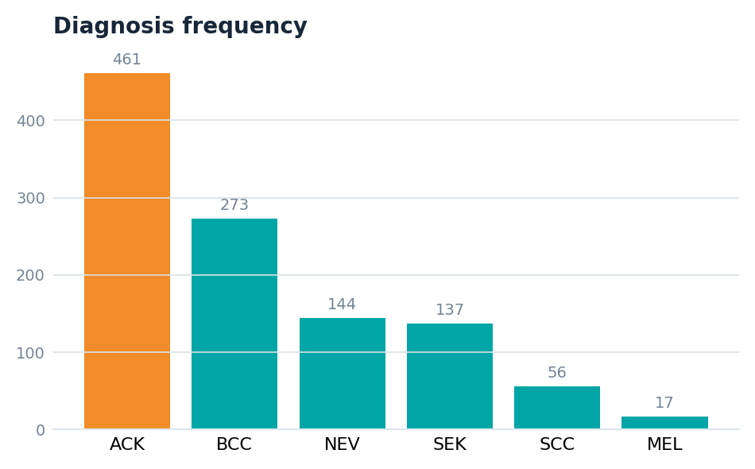
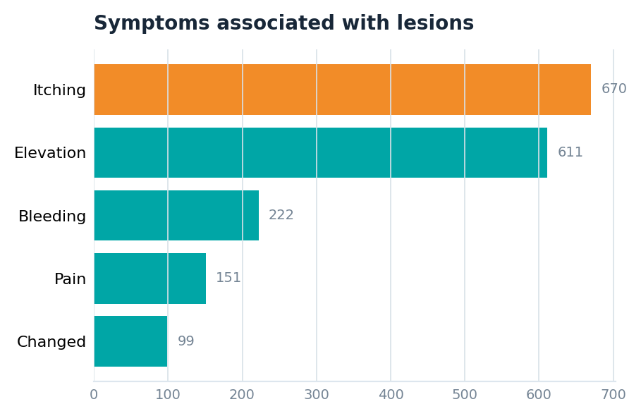
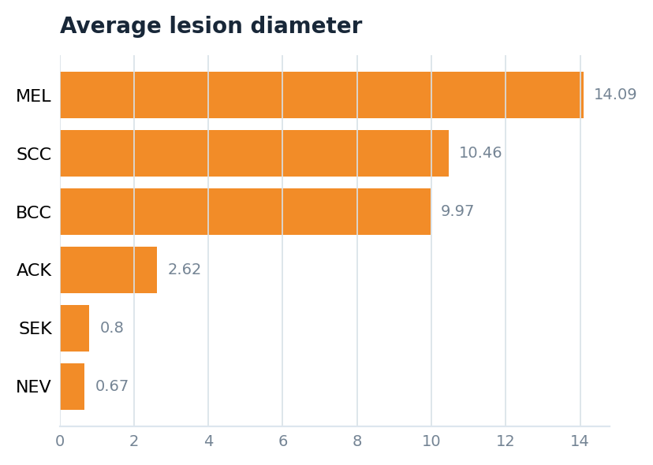
Lesion growth and diagnosis analysis
ACK was most frequent, itching was the leading symptom, and MEL had the highest average lesion diameter
510
46.88%
458
42.10%
Key finding
MEL had the largest average diameter despite being the rarest malignant diagnosis.
growing lesions
growth rate
biopsied lesions
biopsy rate
Presentation note: a lesion may have multiple symptoms, so symptom counts should not be added together as patient totals.
Healthcare SQL Capstone | DORI
SQL • Healthcare analytics • Skin cancer risk intelligence

Slide 8
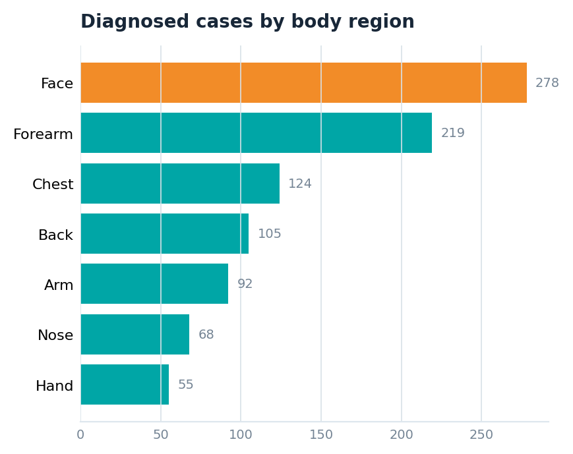
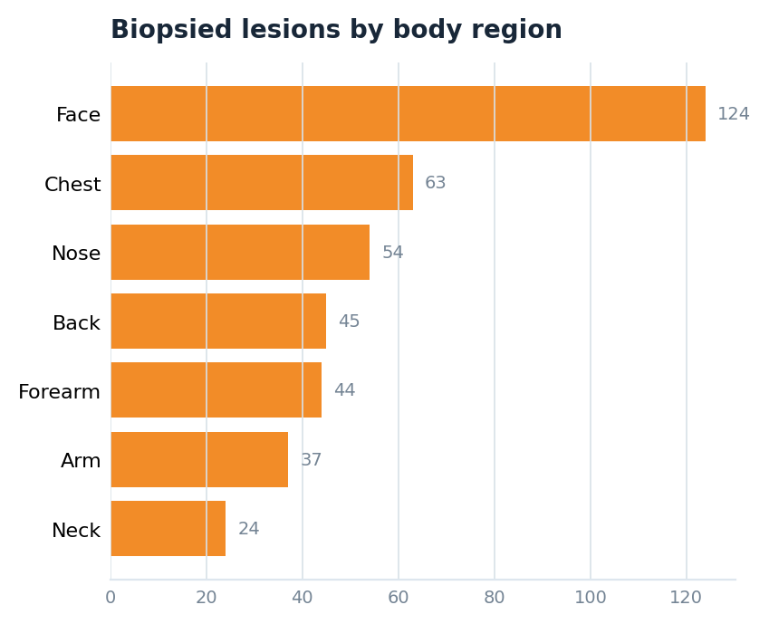
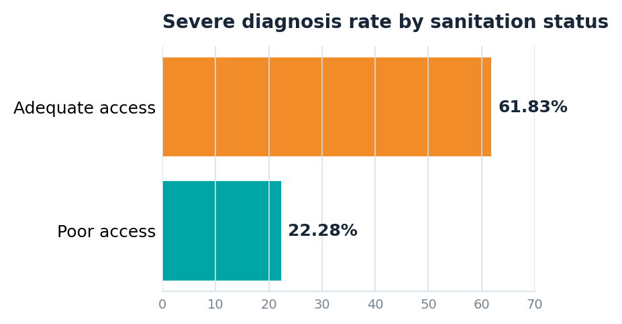
Environmental healthcare analysis
The face dominated diagnosis and biopsy counts; poor sanitation did not show a higher severe rate in this dataset
782
815
Face
Face
without piped water
without sewage system
top diagnosis region
top biopsy region
Finding: poor sanitation was common, but severe diagnoses were proportionally higher among patients with adequate sanitation access in this dataset. Interpret cautiously because this shows association only.
Healthcare SQL Capstone | DORI
SQL • Healthcare analytics • Skin cancer risk intelligence

Slide 9
Lifestyle and behavioural risk analysis
Combined smoking and alcohol exposure recorded the highest severe-diagnosis percentage
62
138
45.16%
Most common smoker diagnosis
smokers
alcohol consumers
smokers who drink
BCC (Basal Cell Carcinoma): 30 cases
Diagnosis among smokers
Malignant rate by lifestyle group
Insight: patients who both smoked and consumed alcohol had the highest malignant diagnosis rate at 82.14%; smoking was the strongest individual factor.
Healthcare SQL Capstone | DORI
SQL • Healthcare analytics • Skin cancer risk intelligence

Slide 10
Key insights
01
Older adults at risk
The 60–79 age group recorded the highest malignant diagnosis count.
02
Visible regions dominate
The face had the highest overall, malignant and biopsied lesion counts.
03
Symptoms support triage
Itching and elevation were the leading symptom indicators.
04
Melanoma deserves attention
Melanoma (MEL) was rare but had the highest average lesion diameter.
05
Lifestyle signal is strong
Smoking plus alcohol produced the highest malignant-diagnosis percentage.

Slide 11
Healthcare recommendations
Turn SQL insights into early-detection and preventive-care actions
1
Targeted screening
4
Biopsy prioritisation
Prioritise older adults, especially patients aged 60–79, for routine lesion reviews and early referral.
Use lesion diameter and suspicious symptom combinations to support biopsy decisions.
2
Region-focused assessment
5
Lifestyle prevention
Give careful attention to the face, chest and nose because they recorded the highest malignant counts.
Integrate smoking and alcohol counselling into skin-cancer risk education and follow-up.
3
Symptom-led triage
6
Data monitoring
Fast-track lesions that are growing, itchy, elevated, bleeding or painful for closer review.
Maintain a dashboard tracking diagnosis category, region, symptoms, biopsy rate and severe diagnosis rate.
These recommendations are based on descriptive patterns in the available dataset and should be combined with clinical judgement.
Healthcare SQL Capstone | DORI
SQL • Healthcare analytics • Skin cancer risk intelligence

Slide 12
Limitations and next steps
How the analysis should be interpreted before clinical decision-making
Limitations
Recommended next steps
Results show associations, not proof of causation
No time dimension to analyse diagnosis delay or progression speed
No control variables such as UV exposure, occupation or treatment pathway
Poor sanitation pattern may be affected by confounding or data imbalance
Diagnosis codes need clinical validation before operational use
Turn the SQL outputs into a live monitoring dashboard for screening, biopsy prioritisation and preventive-care planning.
Add date fields for trend and time-to-diagnosis analysis
Compare malignant rates with age, sex and body-region controls
Use regression or risk scoring to test which factors remain significant
Create clinical thresholds for diameter, symptoms and biopsy escalation
Best message for presentation: the SQL analysis supports targeted early detection, but final clinical decisions require validation and expert review.
Healthcare SQL Capstone | DORI
SQL • Healthcare analytics • Skin cancer risk intelligence

Slide 13
Final conclusion
The analysis identified older adults, facial lesions, suspicious symptoms, larger melanoma lesions and combined smoking/alcohol exposure as the strongest areas for clinical attention in the dataset.
Ready for questions
SQL capstone analysis
DORI skin cancer risk intelligence
Clinical value
Thank you
The SQL findings can support targeted screening, symptom-led triage, biopsy prioritisation and preventive health education.

