Slide 1
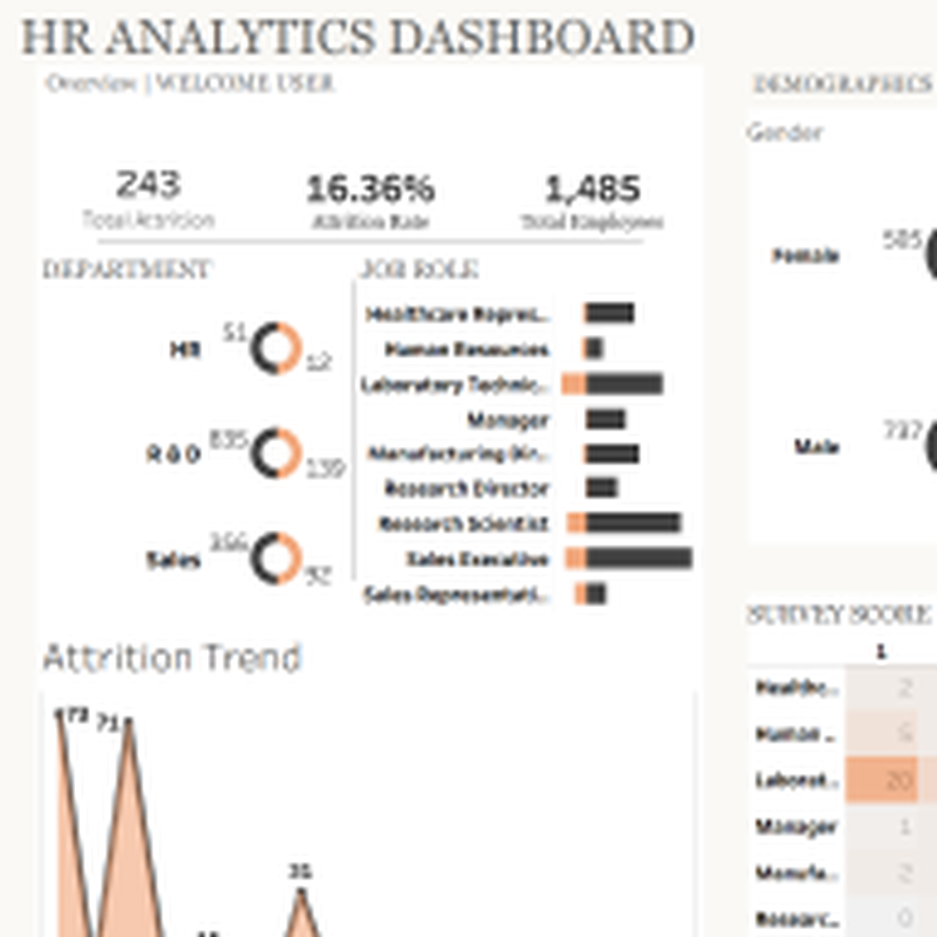
Talent-Pulse Solutions Inc.
Workforce Attrition & Performance Analysis
Tableau / Excel portfolio presentation: from workforce demographics to HR retention recommendations.
1,485
243
16.4%
Employees analysed
Employees left
Overall attrition rate
Presented by Mariam Adetoyi
Data Analyst | Power BI | SQL | Excel | Tableau

Slide 2
Executive summary
Attrition is concentrated in specific groups - not evenly distributed across the workforce
16.4%
20.5%
39.8%
31.0%
Overall attrition
Highest department rate: Sales
Highest role rate: Sales Rep
Attrition among overtime staff
•
R&D has the largest number of leavers, but Sales has the higher attrition rate - so volume and risk should be interpreted separately.
•
Early-tenure employees are the clearest retention risk: 0 years and 1-2 years at company show the highest attrition rates.
•
Overtime is a major warning signal: employees doing overtime leave at roughly three times the rate of non-overtime employees.
•
Employees who left had lower average satisfaction and lower average monthly income than those who stayed.
Key message for HR leaders
Retention action should be targeted by department, role, tenure, overtime exposure and employee experience - not treated as a single organisation-wide issue.
Talent-Pulse Workforce Analysis | 2

Slide 3
Business problem and project aim
Talent-Pulse needed a clearer view of workforce risk and retention drivers
PROBLEM
AIM
•
High attrition may reduce productivity, continuity and organisational performance.
•
Identify key factors associated with attrition.
•
Attrition trends were not clearly understood across department, role, demographics and tenure.
•
Analyse workforce demographics and current employees.
•
Survey scores and employee experience needed to be connected to turnover patterns.
•
Compare attrition patterns across job role, gender, age, education and tenure.
•
HR needed a dashboard story to support evidence-based decisions.
•
Convert findings into HR recommendations using Tableau storytelling.
Analytical lens
The analysis separates attrition count from attrition rate. This is important because a large group can produce more leavers simply because it has more employees, while a smaller group may carry a higher proportional risk.
Talent-Pulse Workforce Analysis | 3

Slide 4
Workforce overview
Understanding the employee base before interpreting attrition
Workforce snapshot
1,242
Current employees
243
Leavers
Interpretation
R&D is the largest department, so it naturally contributes the highest number of leavers. Rate-based analysis is needed before treating it as the highest retention-risk area.
Talent-Pulse Workforce Analysis | 4

Slide 5
Department attrition: count vs rate
The largest number of leavers is not the same as the highest risk
Insight
R&D recorded the largest attrition count (139 leavers), but Sales has the highest attrition rate at 20.5%. This means HR should prioritise Sales for proportional retention risk while still monitoring R&D because of its workforce size.
Talent-Pulse Workforce Analysis | 5

Slide 6
Role and education risk areas
Some job roles and education fields show materially higher turnover
•
Sales Representative has the highest role attrition rate (39.8%), despite being a smaller population than Sales Executive or Laboratory Technician.
•
Laboratory Technician contributes the highest number of leavers (65), making it important from a workforce planning perspective.
•
Technical Degree, Human Resources and Marketing education fields show higher attrition rates than Life Sciences, Medical and Other fields.
Talent-Pulse Workforce Analysis | 6

Slide 7
Tenure risk: attrition is highest early in the employee journey
The strongest retention opportunity is within onboarding and early-role support
Interpretation
Employees with 0 years at company have an attrition rate of 36.4%, while those with 1-2 years are at 29.6%. This suggests the first stage of employment is a critical retention period.
Talent-Pulse Workforce Analysis | 7

Slide 8
Demographic and workload signals
Younger employees and overtime workers show elevated attrition risk
•
Employees under 25 have a high attrition rate of 39.2%; the 25-34 group is also above average at 20.2%.
•
Overtime workers show 31.0% attrition compared with 10.6% among non-overtime workers.
•
Frequent travellers show higher attrition (24.9%) than rare or non-travellers.
Talent-Pulse Workforce Analysis | 8

Slide 9
Employee experience: satisfaction and pay signals
Leavers score lower on key satisfaction measures and have lower average income
£4,757
£6,872
Avg. monthly income - leavers
Avg. monthly income - stayed
10.5
8.9
Avg. distance from home - leavers
Avg. distance from home - stayed
8.3
11.9
Avg. total working years - leavers
Avg. total working years - stayed
Interpretation: Lower satisfaction, lower income and shorter career tenure are associated with attrition in this dataset. These should be treated as risk signals, not proof of direct causation.
Talent-Pulse Workforce Analysis | 9

Slide 10
Tableau Story: how to present the analysis
Move from workforce context to attrition risk, then recommendations
RECOMMENDED STORY FLOW
•
1. Workforce overview and KPIs
•
2. Department count vs rate
•
3. Job-role and education risk
•
4. Tenure, age, overtime and travel signals
•
5. Survey score comparison
•
6. HR recommendations and next steps
PRESENTATION TIP
Avoid saying only “R&D has the highest attrition.” Say: “R&D has the highest count, but Sales has the highest rate.” This sounds more analytical and shows you understand denominator effects.
Talent-Pulse Workforce Analysis | 10

Slide 11
Recommendations for Talent-Pulse HR leadership
Turn insight into targeted retention action
1
Prioritise Sales retention
Sales has the highest departmental attrition rate. Review sales targets, workload, management support, incentives and progression.
2
Strengthen early-tenure support
High attrition within 0-2 years suggests onboarding, role expectation and manager check-in improvements could reduce early exits.
3
Investigate overtime pressure
Overtime workers show a much higher attrition rate. Monitor overtime frequency and workload distribution by team and role.
4
Create role-specific interventions
Sales Representatives and Laboratory Technicians need different retention responses because one carries higher rate risk and the other higher volume impact.
5
Use survey scores as warning indicators
Track satisfaction and work-life balance by team, role and tenure to identify risk before employees leave.
Success measures
Track attrition rate, early-tenure exits, overtime exposure, survey score movement and role-level leaver count monthly.
Talent-Pulse Workforce Analysis | 11

Slide 12
How I would present this project
A concise talk track for interview or portfolio presentation
Start with the problem
Talent-Pulse had high attrition but needed to know where the risk was concentrated and which factors were linked with leavers.
Explain the method
I used the employee dataset to calculate attrition counts, attrition rates, employee demographics, tenure patterns and survey-score comparisons.
Share the key insight
The important finding is that attrition should not be judged by count alone. Sales has the highest department rate, while R&D has the largest number of leavers.
Move to action
The recommendations focus on early-tenure support, overtime monitoring, role-specific retention and survey-score tracking.
Closing line: “This project shows my ability to move from raw workforce data to clear HR insight and practical recommendations.”

